Slide 1
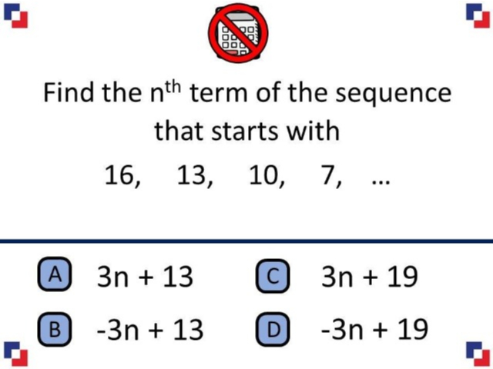
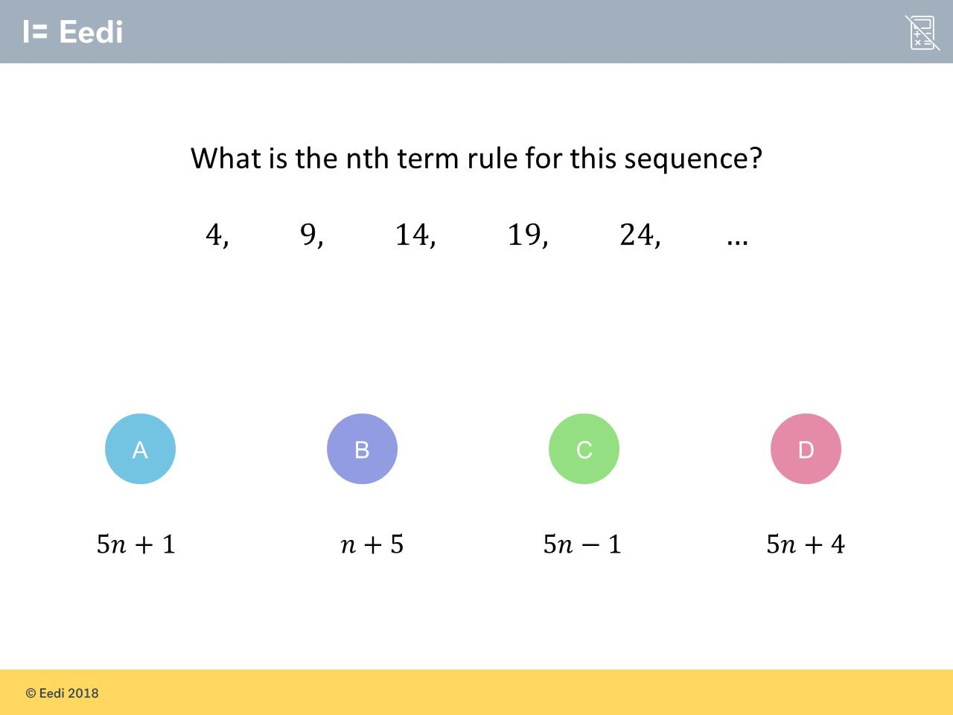
Worst answered question?
Most common wrong answer?

Slide 2
ANSWERS

Slide 3
Worst answered question?

Slide 4
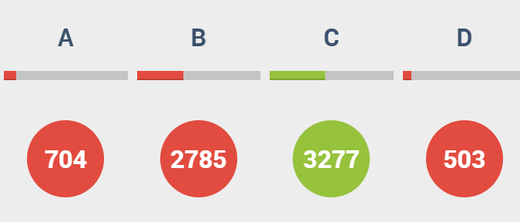
B
They found the term to term rule.

Slide 5
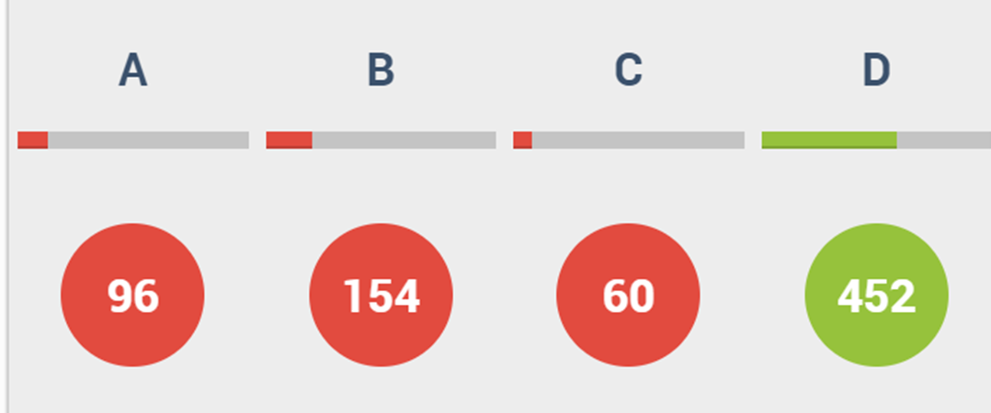
B
They found the
correct multiplier
but they found the difference between
3 and 16 for the adjusted value.

