Slide 1
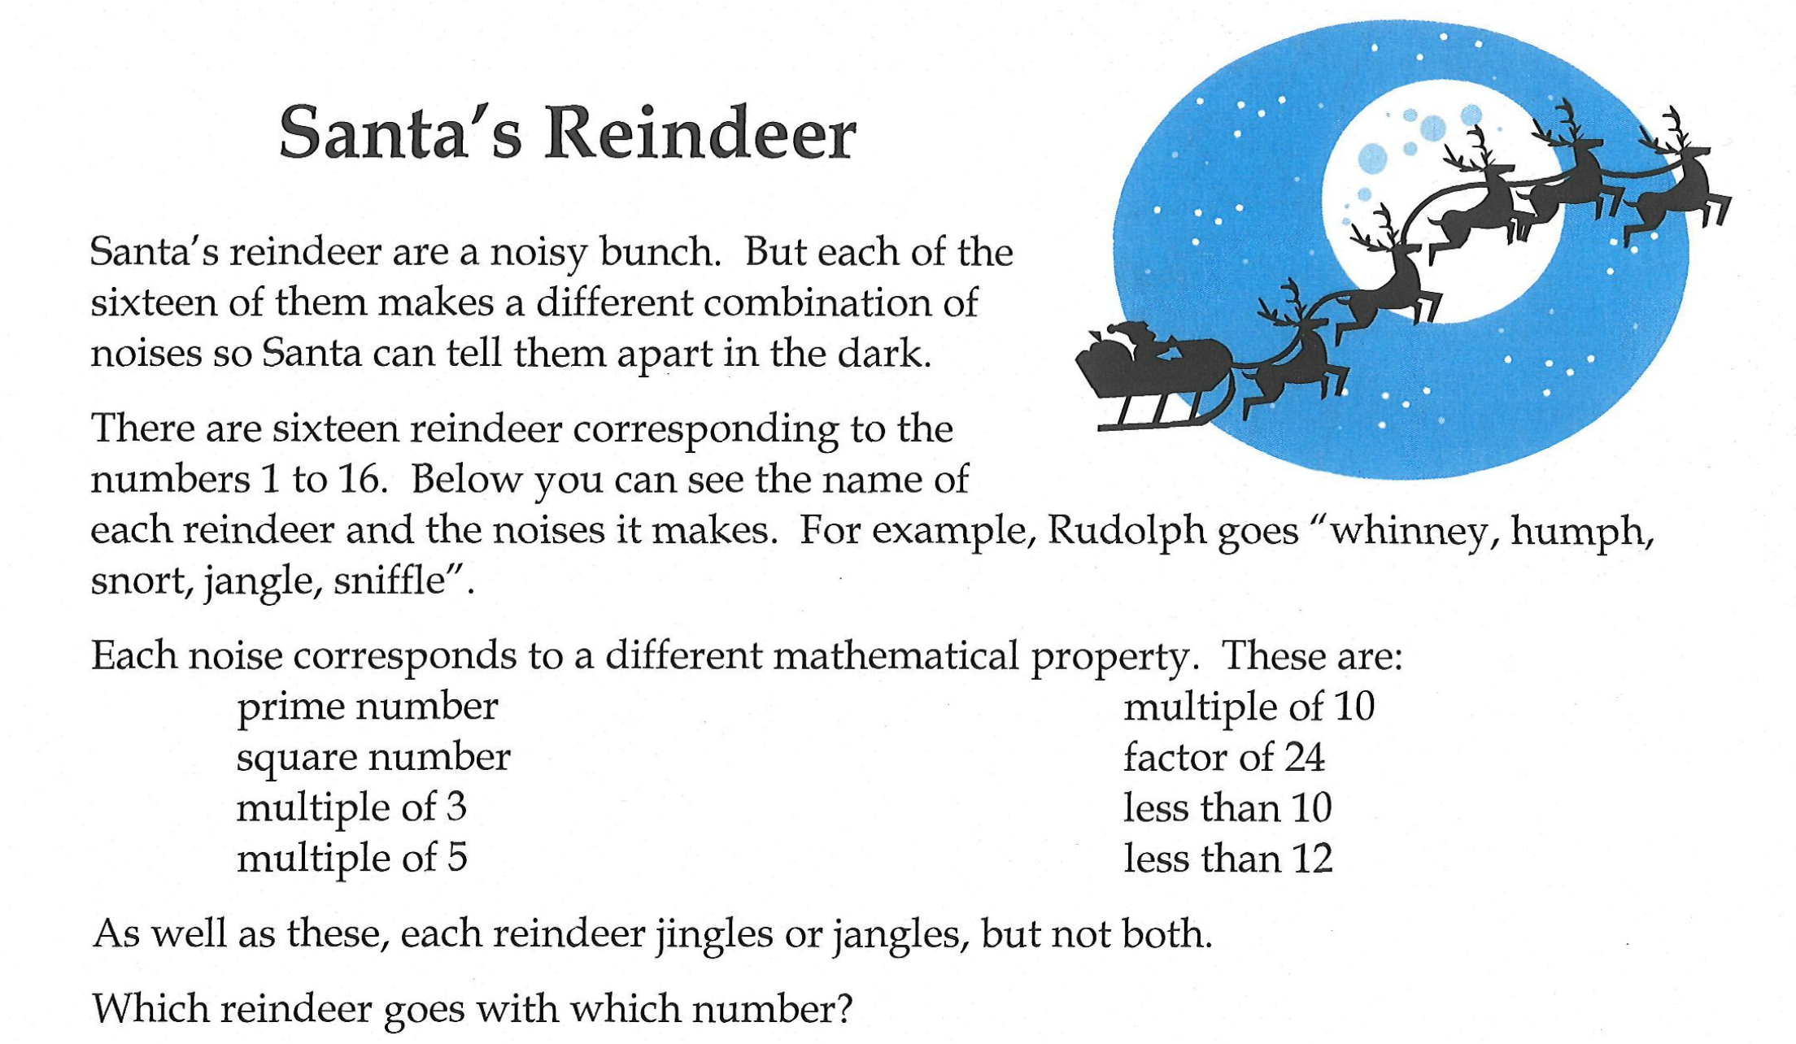

Slide 2
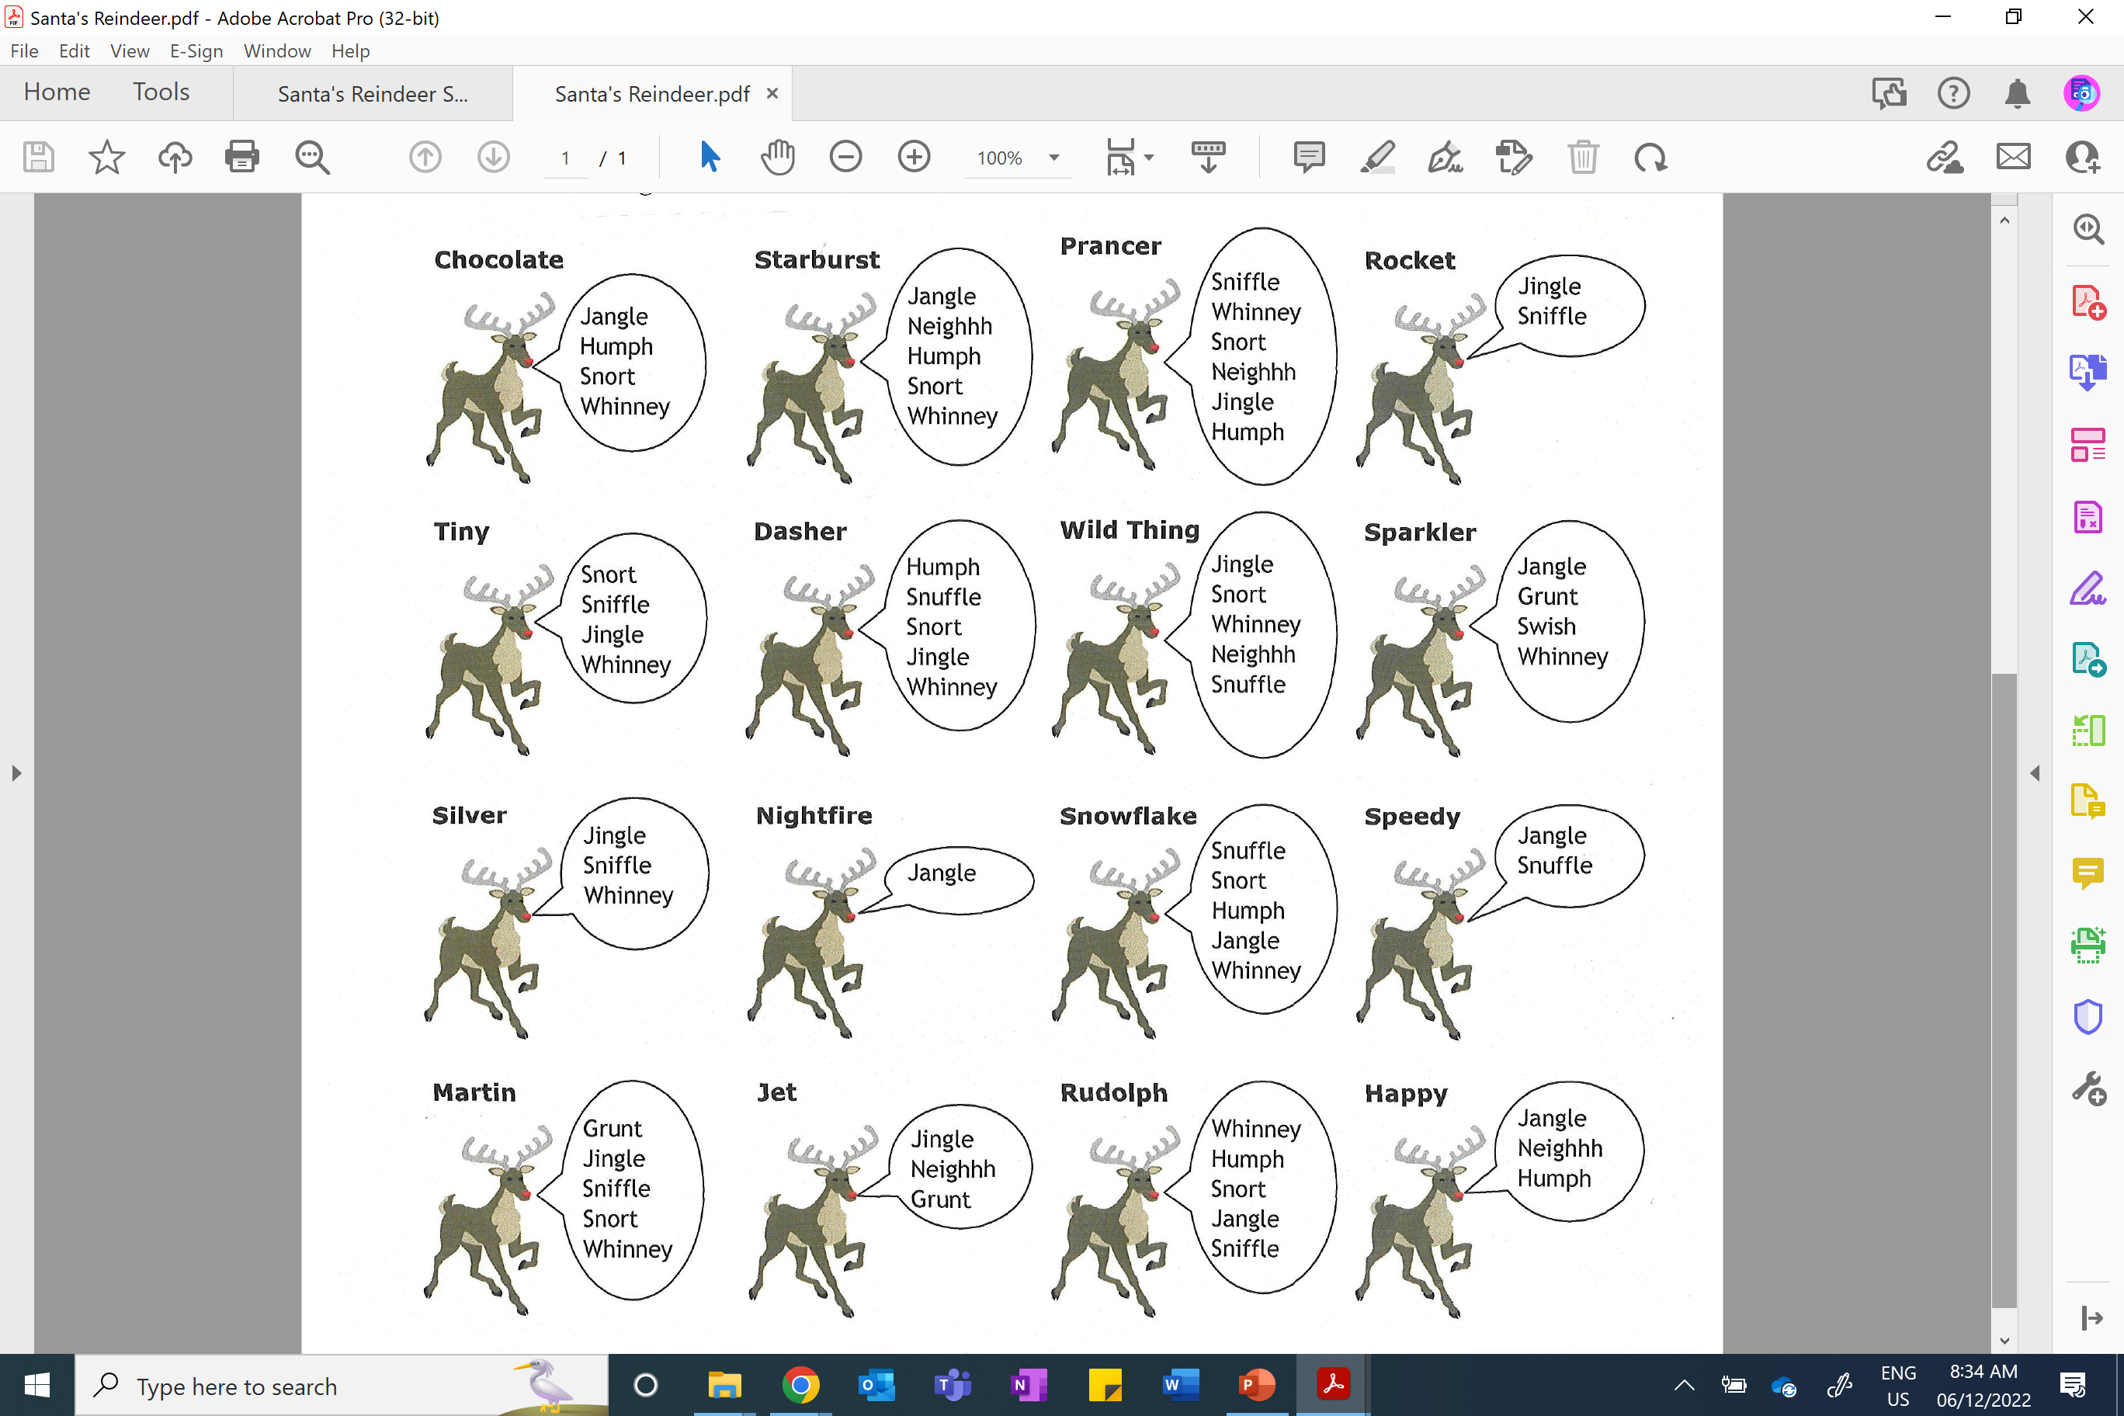

Slide 3
ANSWERS

Slide 4
