Slide 1
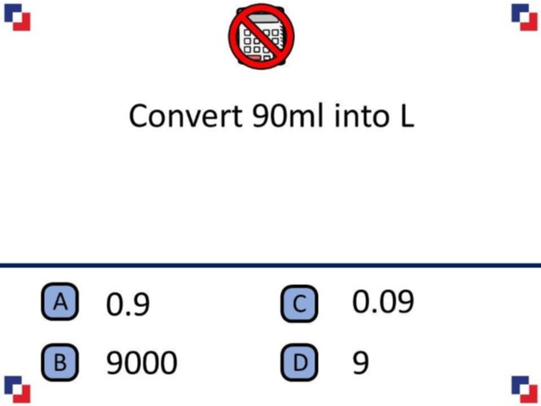
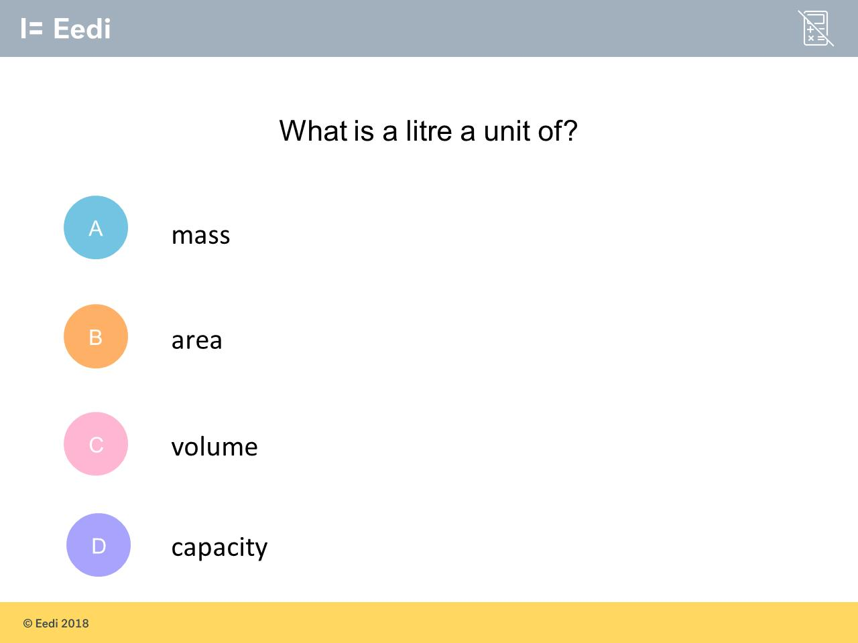
Worst answered question?
Most common wrong answer?

Slide 2
ANSWERS

Slide 3
Worst answered question?

Slide 4
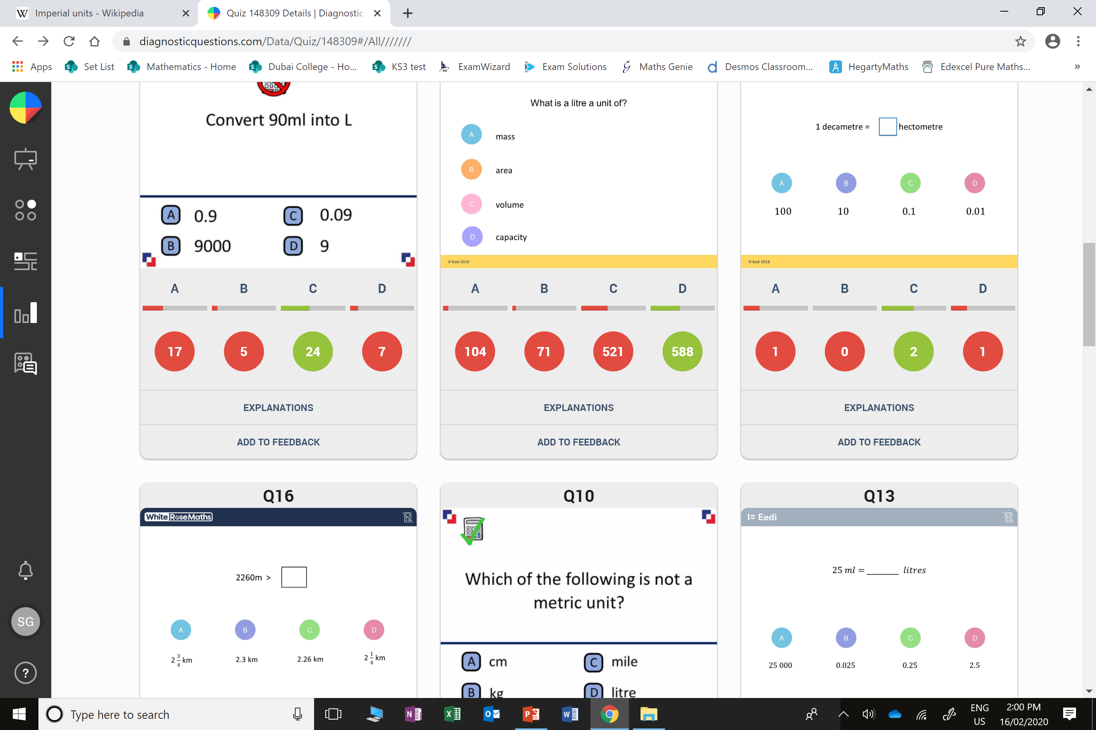
A
They thought 100ml = 1 litre
Instead of
1000ml = 1 litre

Slide 5
C
Capacity is a measure of liquid.

