Slide 1
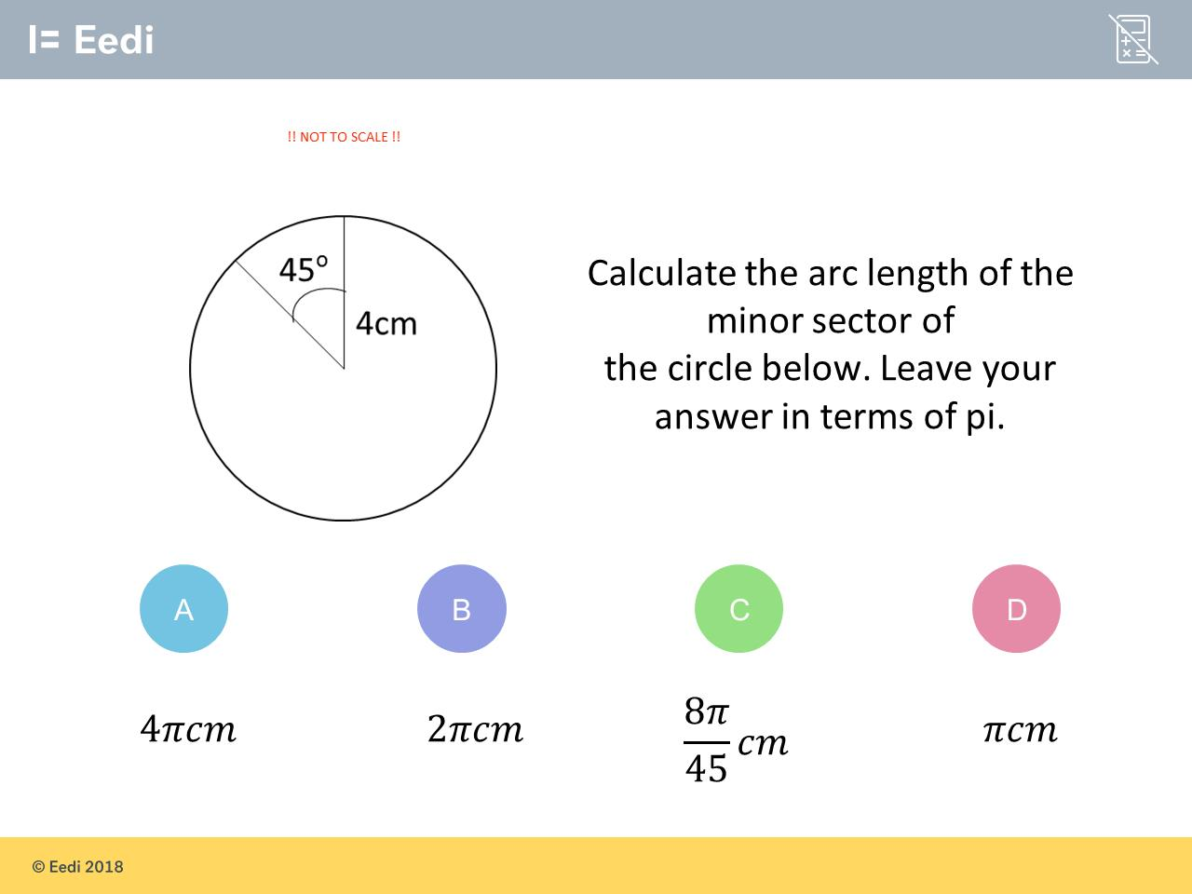
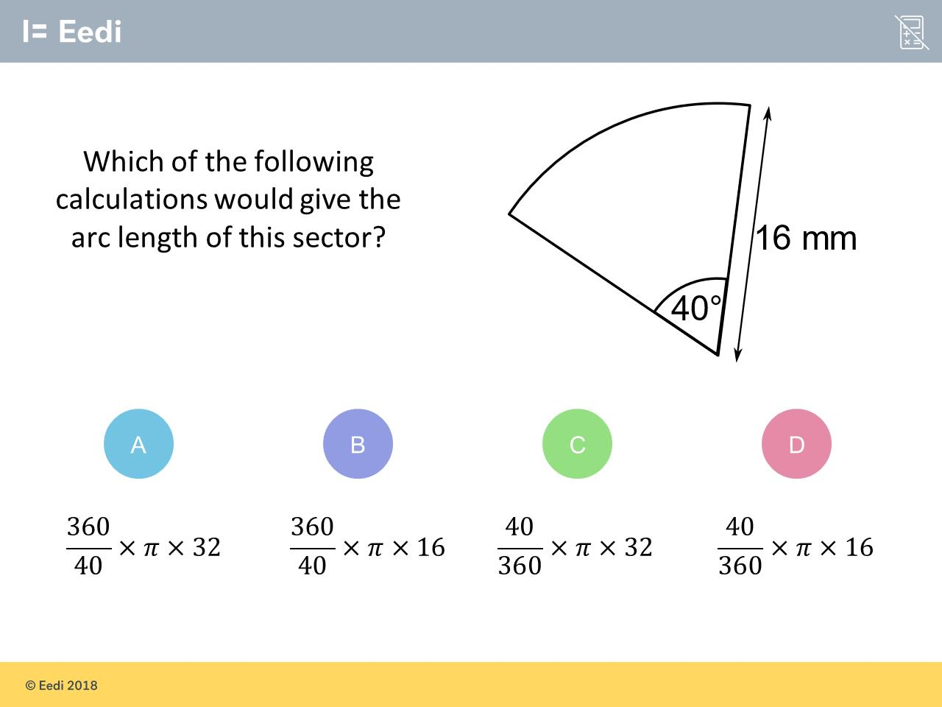
Worst answered question?
Most common wrong answer?

Slide 2
ANSWERS

Slide 3
Worst answered question?

Slide 4
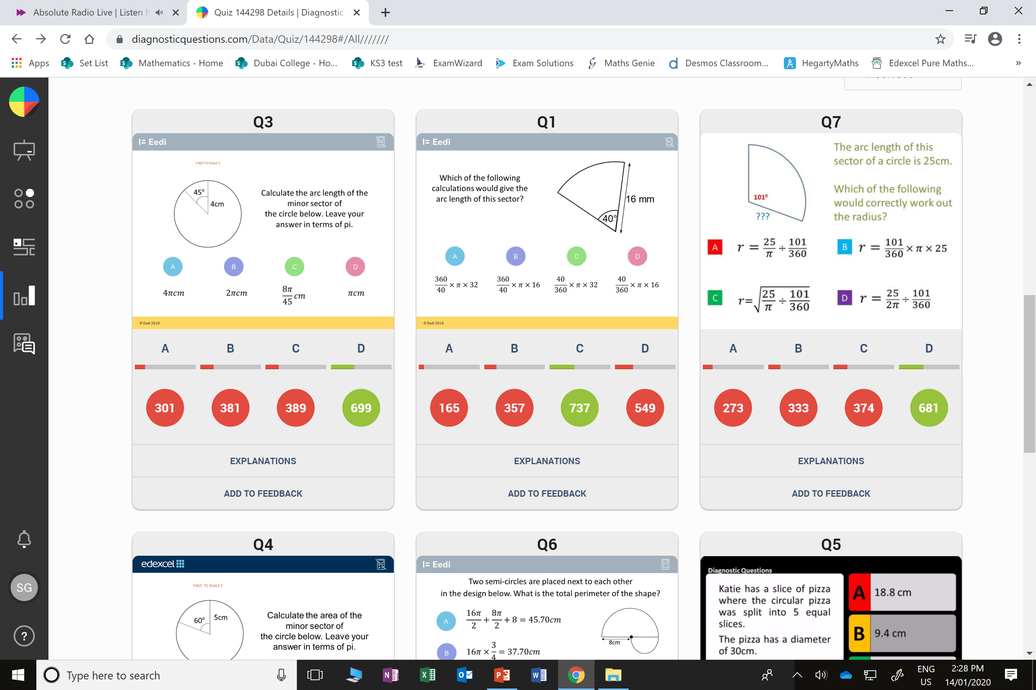
C
They should have divided by 8
as 45˚ is an eight of 360˚.

Slide 5
D
They used radius instead of diameter.

