Slide 1
LO: Circles
(Geometry Problems)

Slide 2

Skill Check List:
ם Find gradient between two co-ordinates
ם Find gradient of a perpendicular line
ם Find the equation of a line
ם Find missing co-ordinates values
ם Find length of a line using Pythagoras
ם Find the area of a triangle
ם Find the exact values in surd form

Slide 3
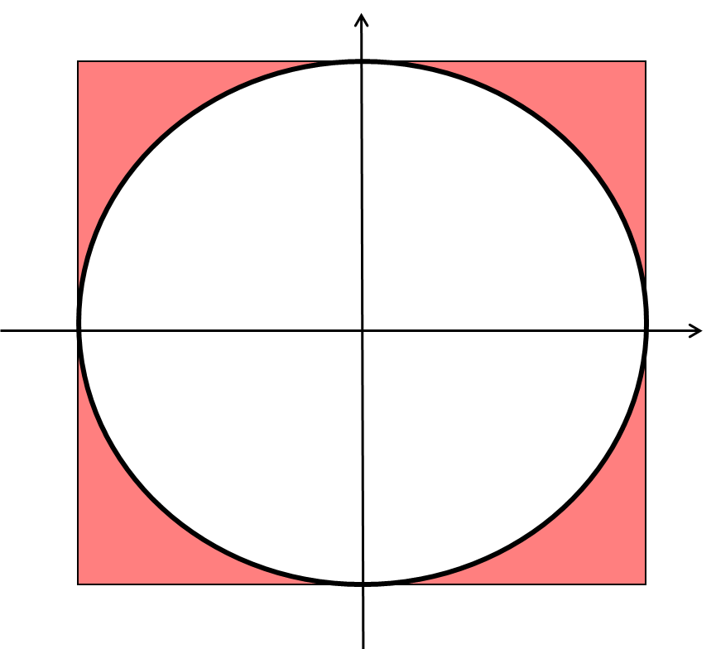
What is the method that would enable you to find the area of the shading?
Area of Shading =
Area Square – Area Circle

Slide 4

What lengths do you need to know to find the area of the triangle OAB?
A
B
0
Area of Triangle = $\frac{1}{2}$ x OA x AB

Slide 5
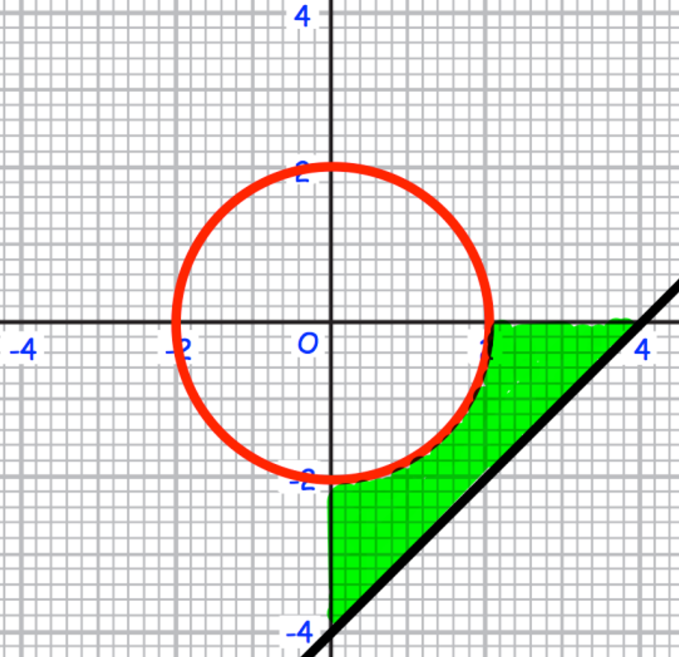
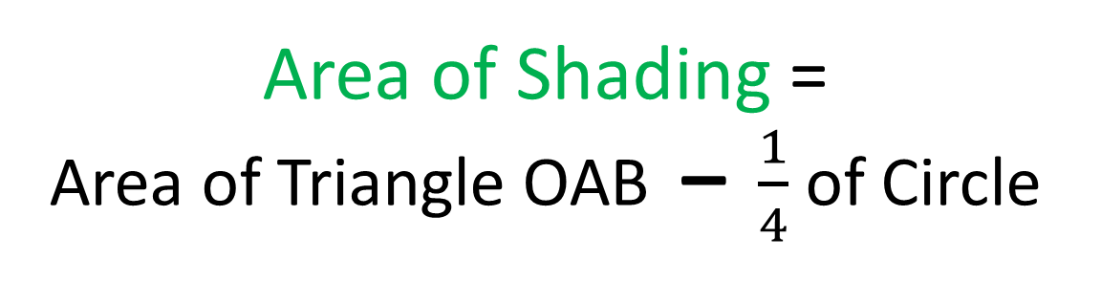
What is the method that would enable you to find the area of the shading?
Area of Shading =
Area of Triangle OAB – $\frac{1}{4}$ of Circle
O
A
B

Slide 6
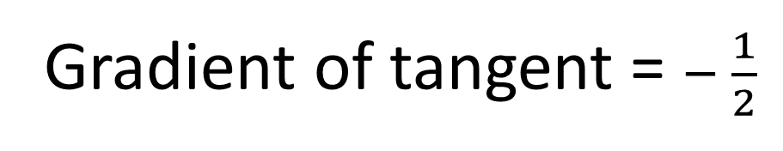
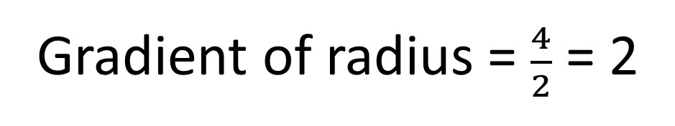
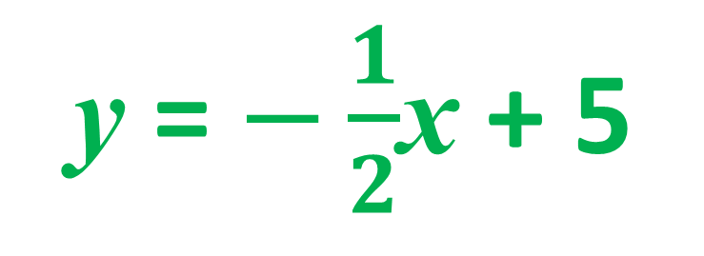
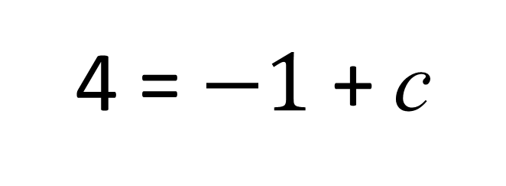
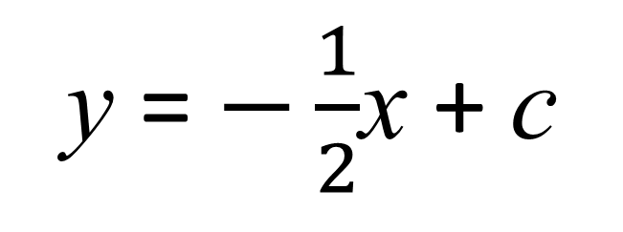
What is the equation of the tangent?
Gradient of radius = $\frac{4}{2}$ = 2
Gradient of tangent = $− \frac{1}{2}$
A(2,4)
y = $−\frac{1}{2}$x + c
B(?, 0)
4 = $−1$ + c
y = $−\frac{1}{2}$x + 5

Slide 7
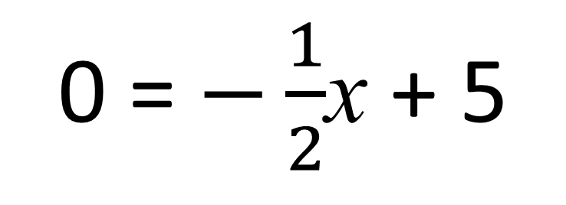
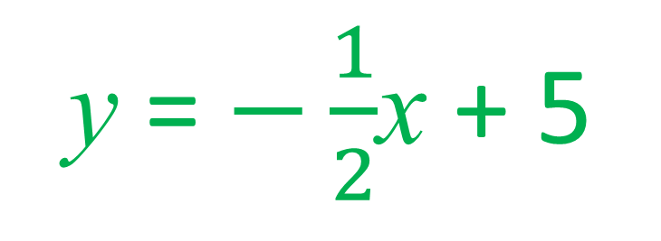
What is the missing value of the B co-ordinate?
y = $−\frac{1}{2}$x + 5
A(2,4)
B(?, 0)
0 = $−\frac{1}{2}$x + 5
x = 10

Slide 8

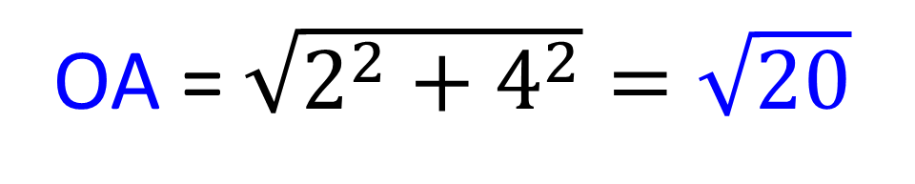
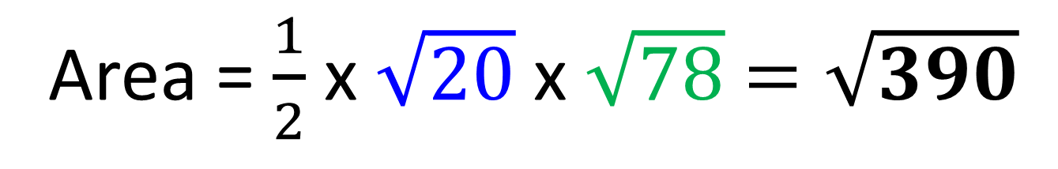
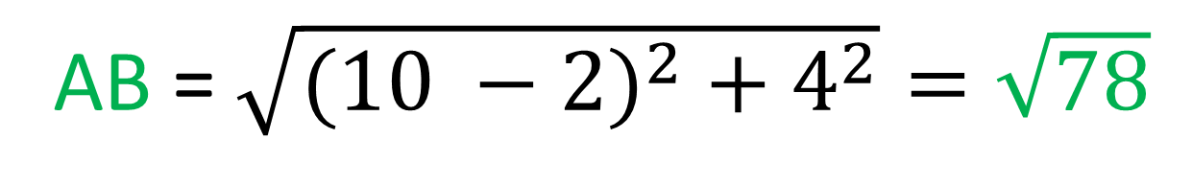
What is exact area of triangle OAB?
Area = $\frac{1}{2}$ x OA x AB
A(2,4)
B(10, 0)
OA = $\sqrt{2^{2}+4^{2}}=\sqrt{20}$
0
AB = $\sqrt{{(10 −2)}^{2} + 4^{2}}=\sqrt{78}$
Area = $\frac{1}{2}$ x $\sqrt{20}$ x $\sqrt{78}$ $=\sqrt{390}$

