Slide 1
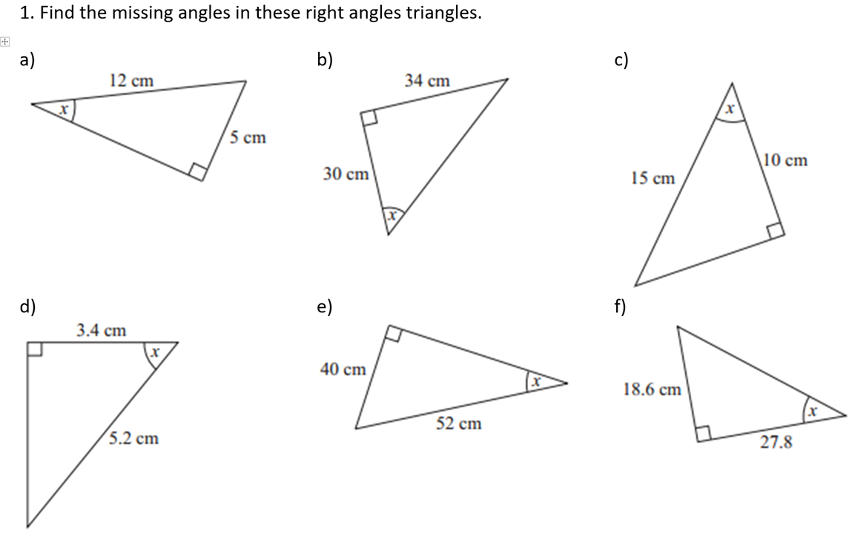

Slide 2
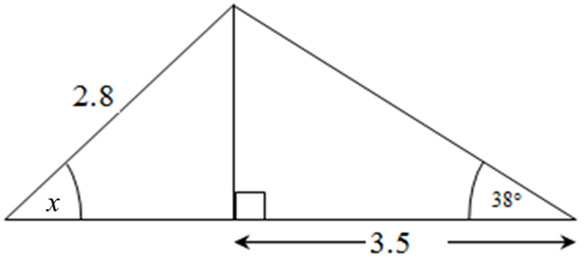
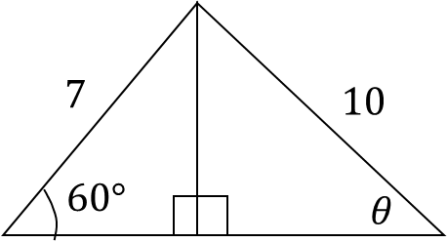
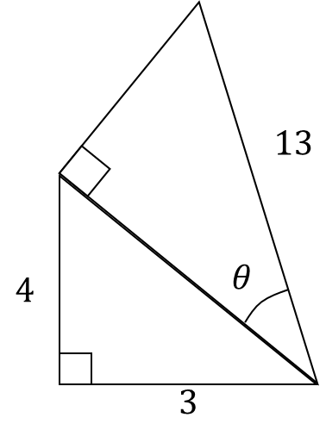
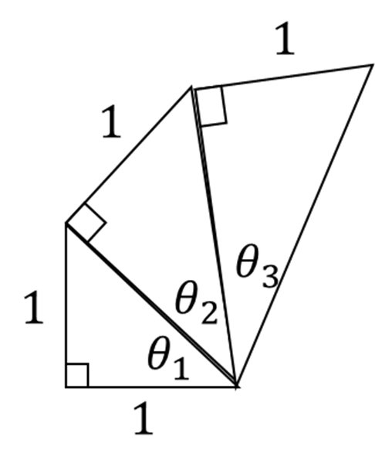
1) Find the angle x
2) Find the angle ϴ
3) Find the angle ϴ
4) Find the all three angles

Slide 3
ANSWERS

Slide 4

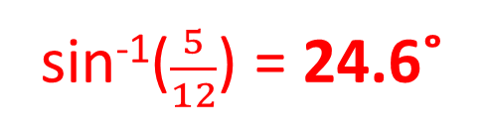
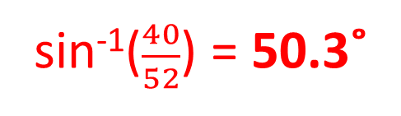



cos⁻¹($\frac{10}{15}$) = 48.2˚
sin⁻¹($\frac{5}{12}$) = 24.6˚
tan⁻¹($\frac{34}{30}$) = 48.6˚
cos⁻¹($\frac{3.4}{5.2}$) = 49.2˚
sin⁻¹($\frac{40}{52}$) = 50.3˚
tan⁻¹($\frac{18.6}{27.8}$) = 33.8˚

Slide 5




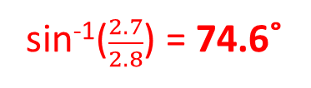

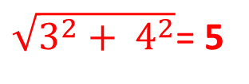
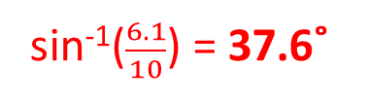

1) Find the angle x
2) Find the angle ϴ
3.5 tan($38$) = 2.7
sin⁻¹($\frac{2.7}{2.8}$) = 74.6˚
7 sin($60$) = 6.1
sin⁻¹($\frac{6.1}{10}$) = 37.6˚
3) Find the angle ϴ
4) Find the all three angles
tan⁻¹($\frac{1}{1.4}$) = 35.3˚
cos⁻¹($\frac{5}{13}$) = 67.4˚
tan⁻¹($\frac{1}{1.7}$) = 30.5˚
$\sqrt{3^{2}+ 4^{2}}$= 5
tan⁻¹($\frac{1}{1}$) = 45˚

