Slide 1
LO: Cubic Graphs

Slide 2
x = 2
Find the value of the expression.
x³
= (2)³
= 2 x 2 x 2
= 8

Slide 3
x = 2
Find the value of the expression.
4x³
= 4(2)³
= 4(2 x 2 x 2)
= 32

Slide 4
x = -2
Find the value of the expression.
x³
= (–2)³
= –2 x –2 x –2
= –8

Slide 5
x = –2
Find the value of the expression.
4x³
= 4(– 2)³
= 4(– 2 x –2 x –2)
= –32

Slide 6
x = – 3
Find the value of the expression.
2x³ – 3x – 2
= 2(– 3)³ – 3(– 3) – 2
= 2(– 27) + 9 – 2
= – 47

Slide 7
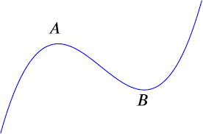

What does a
cubic graph look like?

Slide 8
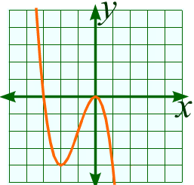
Cubic graph or Not?
Yes

Slide 9
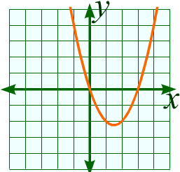
Cubic graph or Not?
Not

Slide 10
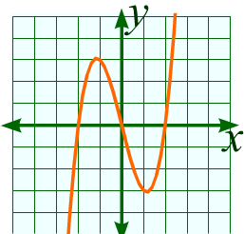
Cubic graph or Not?
Yes

Slide 11
Cubic graph or Not?
Yes

Slide 12
What makes a cubic graph
a cubic graph?
A cubic graph can have up to two turning points.
A cubic graph has no lines of symmetry.
A cubic graph can cross the x axis once, twice or three times.

Slide 13
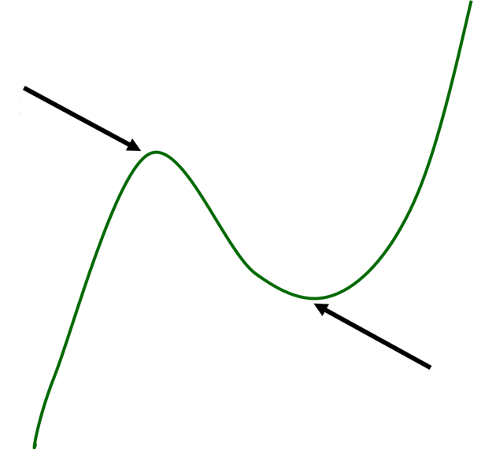
Why do you think they are called
local points?
Local
maximum point
Local
Minimum Point

Slide 14
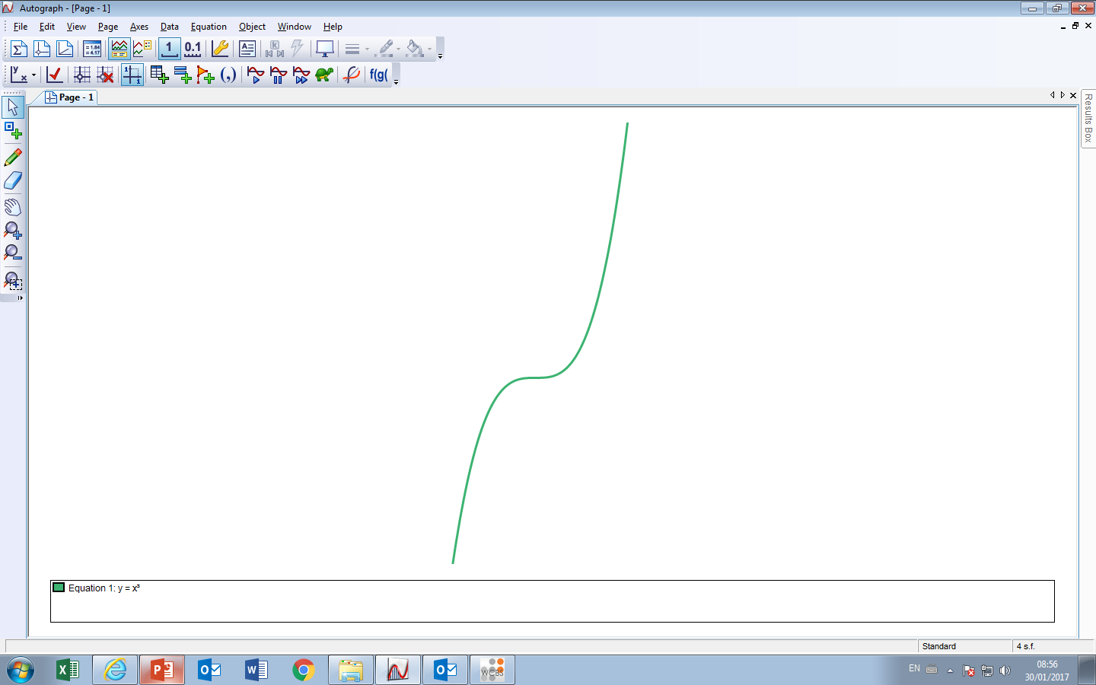
Cubic graphs can have inflection points.
How would you describe an inflection point?
Inflection point
It fattens but does not change direction

Slide 15
What makes a cubic equation a cubic equation?

Slide 16
Cubic Equation or Not?
y = x – 3
Not

Slide 17
Cubic Equation or Not?
y = x² – 3
Not

Slide 18
Cubic Equation or Not?
y = x³ – 3
Yes

Slide 19
Cubic Equation or Not?
y = x³ – 3x² + 6
Yes

Slide 20
Cubic Equation or Not?
y = x⁴ – x³ + 6
Not

Slide 21
Cubic Equation or Not?
y = x²(x – 3)
Yes

Slide 22
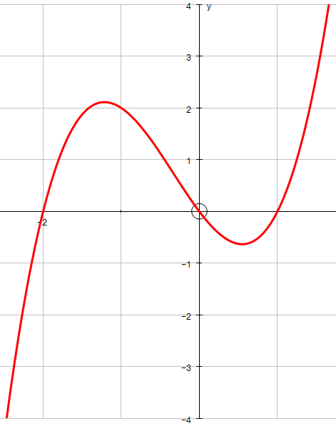
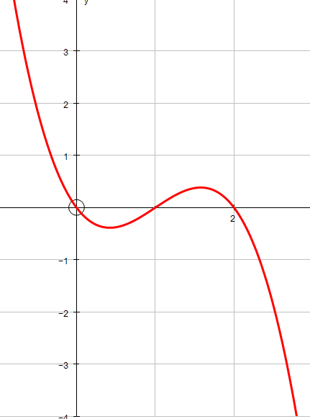
What is different about these graphs?

Slide 23
Positive gradient x³
Negative gradient -x³

Slide 24
Positive or Negative Gradient?
Negative

Slide 25
Positive or Negative Gradient?
Postive

Slide 26
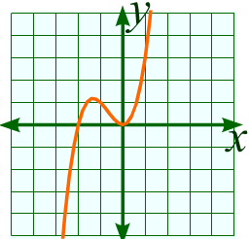
Positive or Negative Gradient?
Positive

Slide 27
Positive or Negative Gradient?
Negative

Slide 28
Positive or Negative Gradient?
y = x³ – 3
Positive

Slide 29
Positive or Negative Gradient?
y = x² – x³
Negative

Slide 30
Positive or Negative Gradient?
y = 3x² – x³ + 6
Negative

Slide 31
Positive or Negative Gradient?
y = x³ – x²
Positive

Slide 32
Positive or Negative Gradient?
y = x – 3x³
Negative

