Slide 1
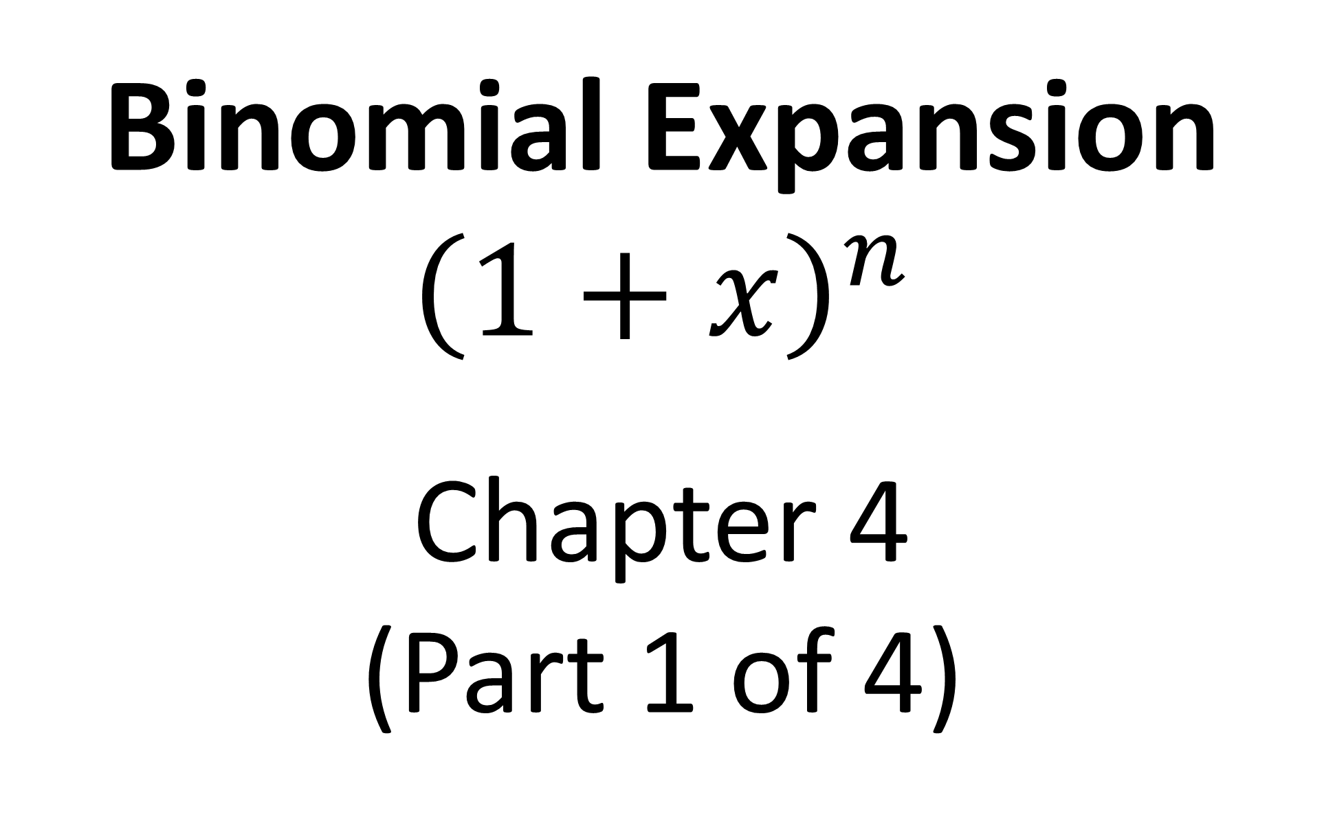
Binomial Expansion
$${\left(1+x\right)}^{n}$$
Chapter 4
(Part 1 of 4)

Slide 2
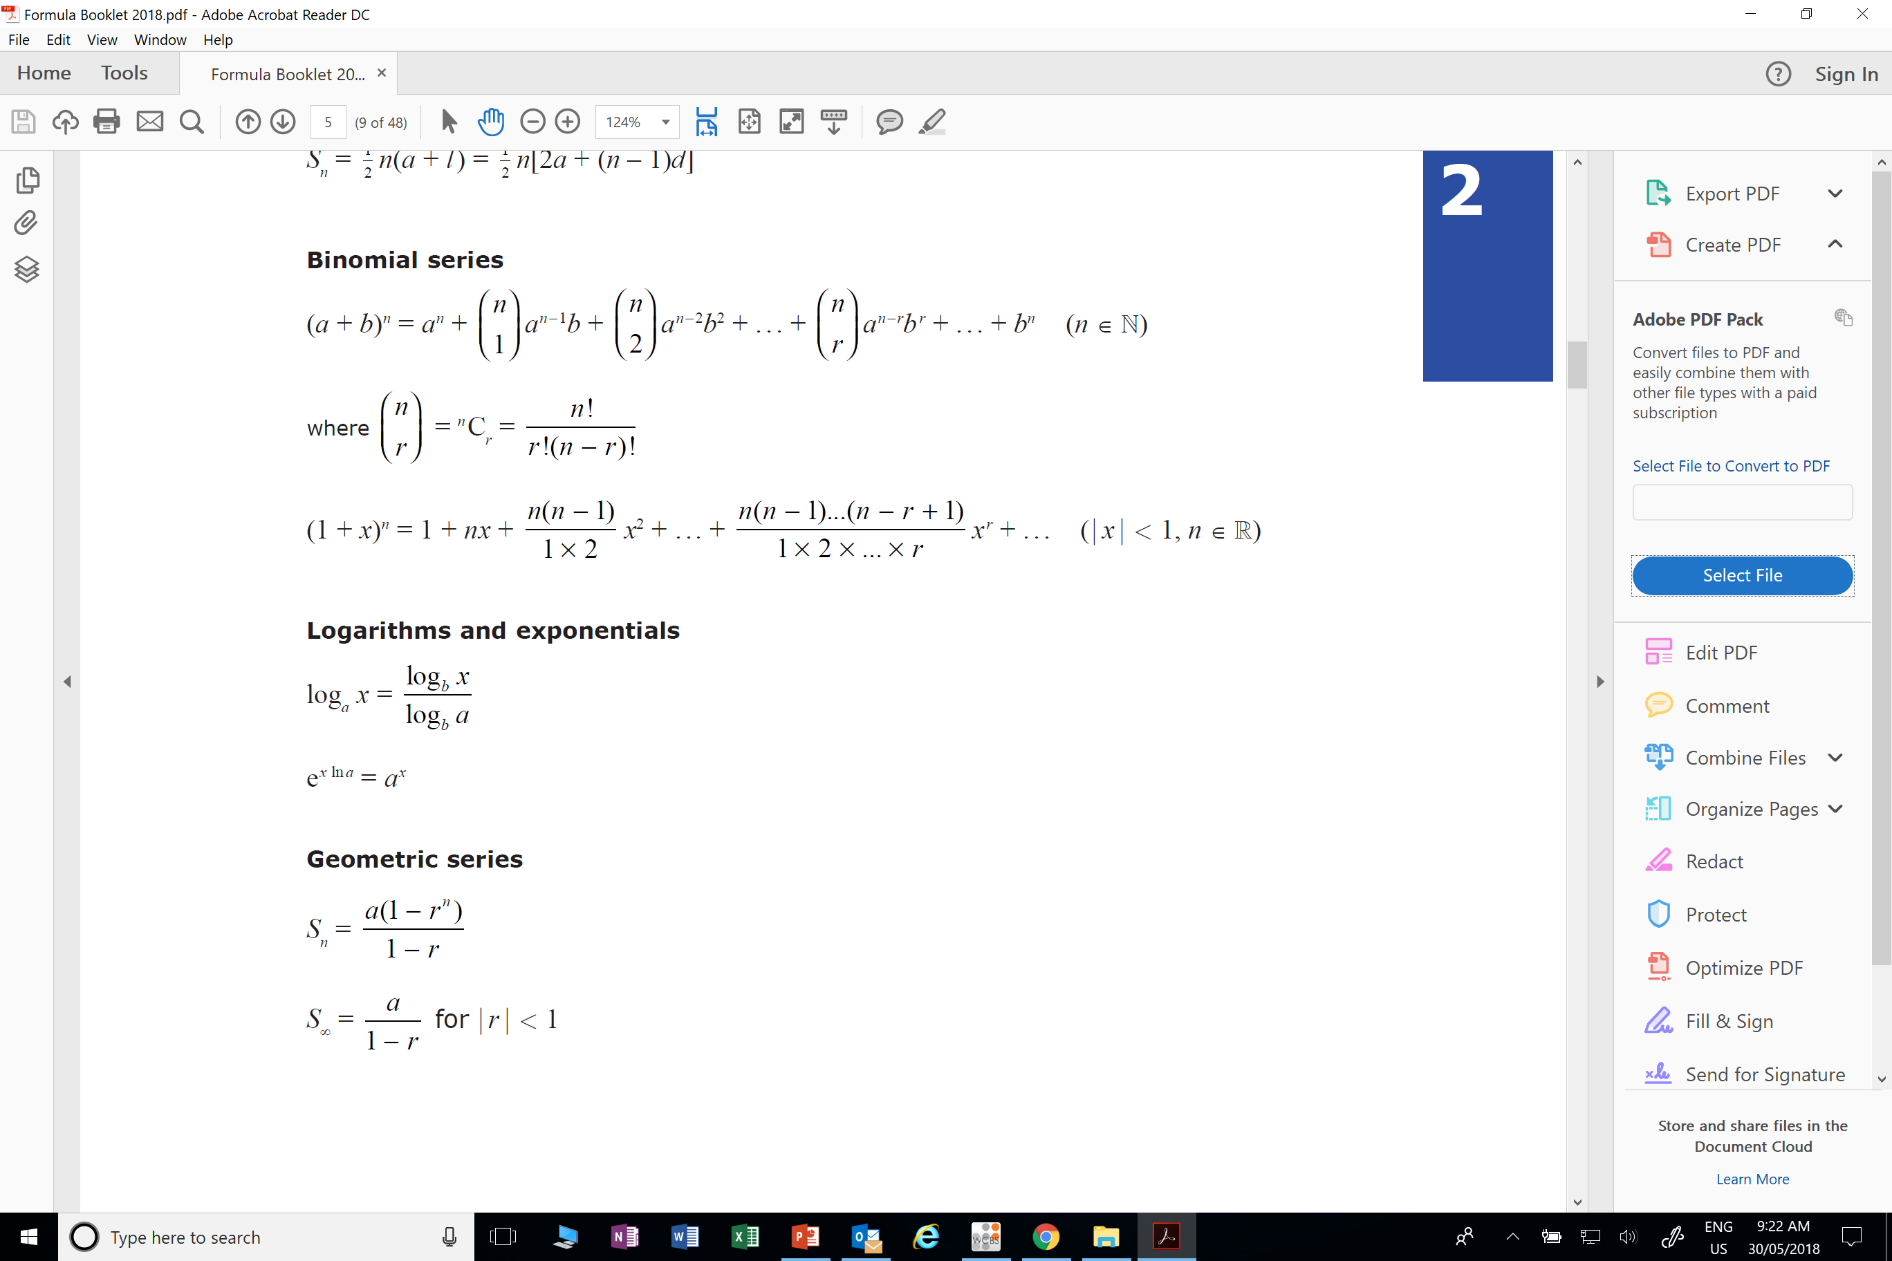
In the formula booklet there two different expansions you could choice from.

Slide 3
When would use each expansion?

Slide 4
n is a
positive integer
n is a
positive, negative or
a fractions

Slide 5
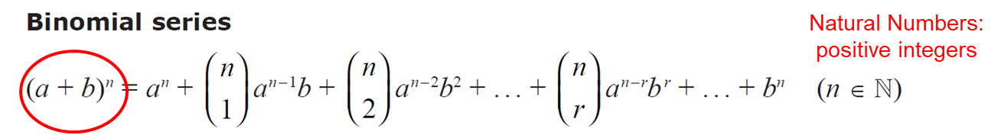

Which expansion would you use for (2 + x)⁵ ?
(a + b)^{n}

Slide 6
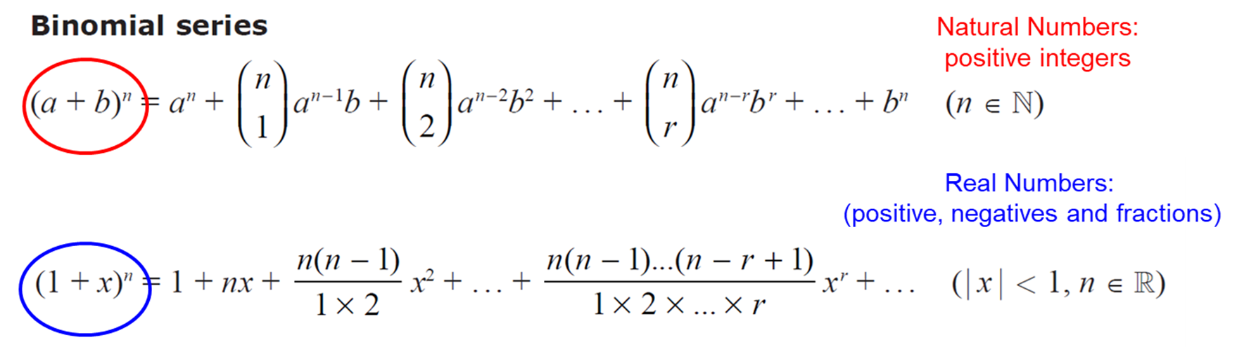
Which expansion would you use for (1 + 3x)^{–2} ?
(1 + x)^{n}

Slide 7
Which expansion would you use for (1 + x)^{1/2} ?
(1 + x)^{n}

Slide 8
Which expansion would you use for (2 + 3x)⁴ ?
(a + b)^{n}

Slide 9
Which expansion would you use for (1 – 2x)⁵ ?
(a + b)^{n}

Slide 10
Which expansion would you use for (3 – 2x)^{–1/2} ?
(1 + x)^{n}

Slide 11
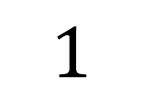
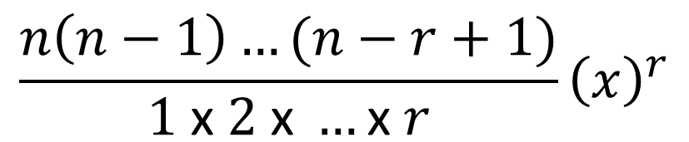
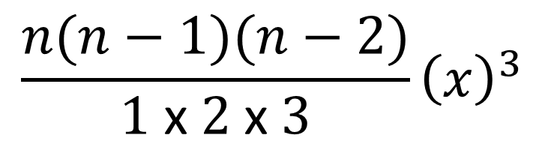
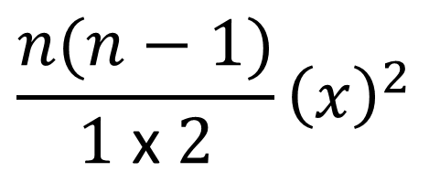
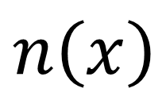
1st term
2nd term
3rd term
Last term
$${\left(1+x\right)}^{n}=1+n\left(x\right)+\frac{n(n−1)}{1 \text{x} 2}{\left(x\right)}^{2}+\frac{n\left(n−1\right)…(n−r+1)}{1 \text{x} 2 \text{x} …\text{x} r}{\left(x\right)}^{r}$$
$$\frac{n(n−1)(n−2)}{1 \text{x} 2 \text{x} 3}{\left(x\right)}^{3}$$
1st term
$$1$$
4th term
2nd term
$$n\left(x\right)$$
x
$$\frac{n\left(n−1\right)…(n−r+1)}{1 \text{x} 2 \text{x} …\text{x} r}{\left(x\right)}^{r}$$
Last term
$$\frac{n(n−1)}{1 \text{x} 2}{\left(x\right)}^{2}$$
3rd term

Slide 12
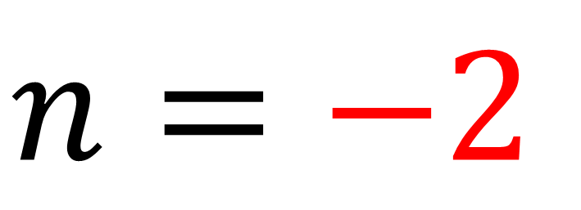

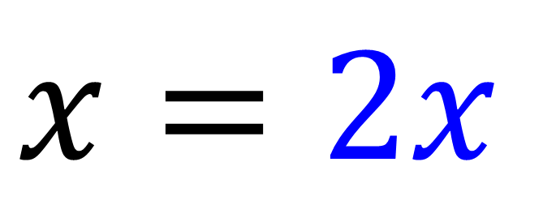
What is the value of n and x for the expansion of ${\left(1+2x\right)}^{−2}$?
$$n=−2$$
$$x=2x$$

Slide 13
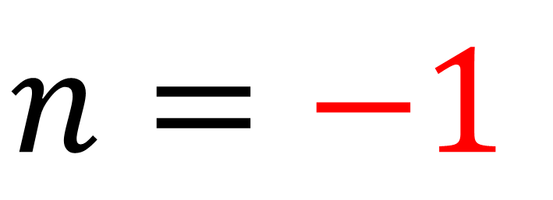

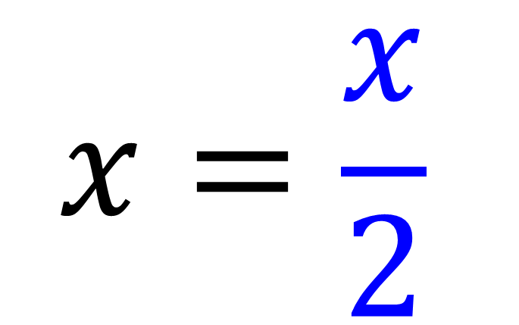
What is the value of n and x for the expansion of ${(1+\frac{x}{2})}^{−1}$?
$$n=−1$$
$$x=\frac{x}{2}$$

Slide 14
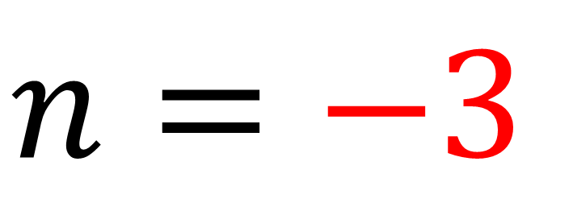

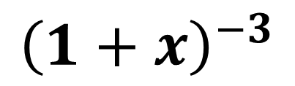
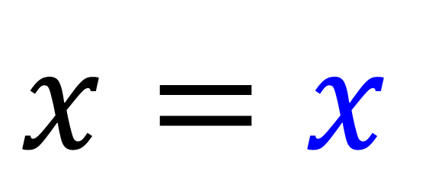
What is the value of n and x for the expansion of $\frac{1}{\left(1+x\right)3}$?
$${\left(1+x\right)}^{−3}$$
$$n=−3$$
$$x=x$$

Slide 15
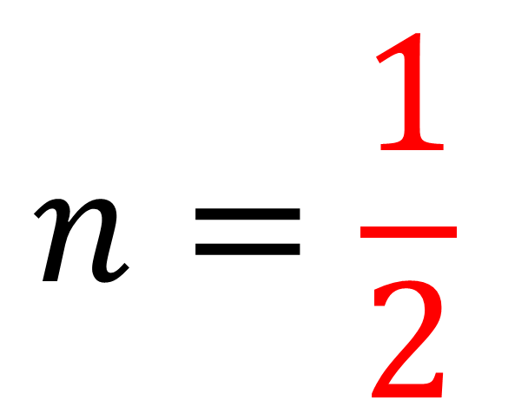



What is the value of n and x for the expansion of $\sqrt{x+1}$?
$${\left(1+x\right)}^{\frac{1}{2}}$$
$$n=\frac{1}{2}$$
$$x=x$$

Slide 16
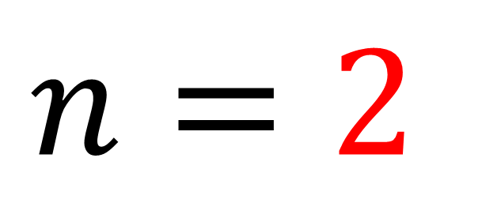

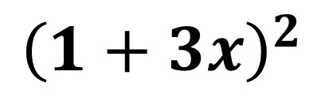
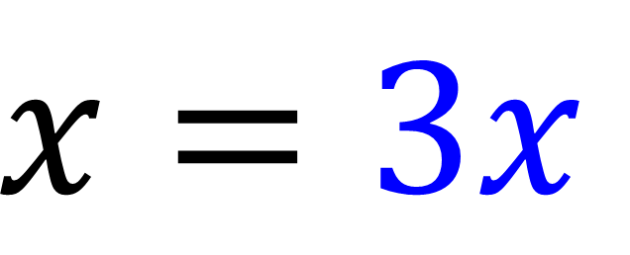
What is the value of n and x for the expansion of $\frac{\left(1 + 3x\right)5}{\left(1 + 3x\right)3}$ ?
$${\left(1+3x\right)}^{2}$$
$$n=2$$
$$x=3x$$

Slide 17
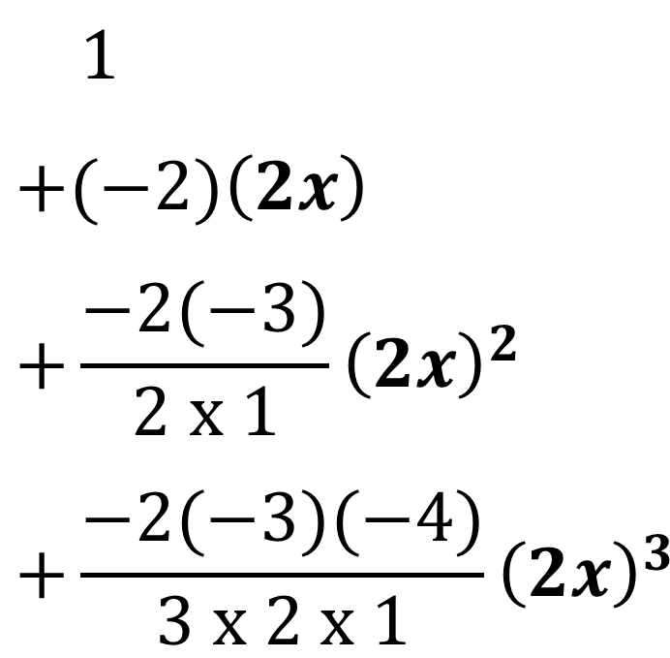
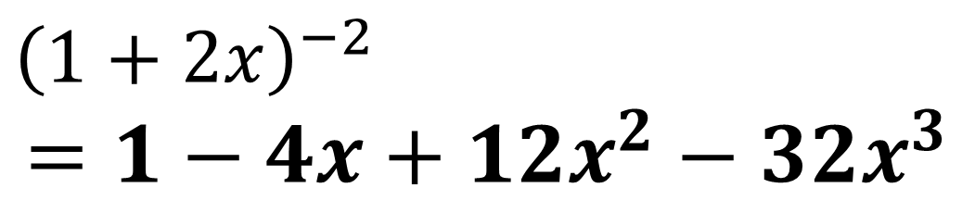
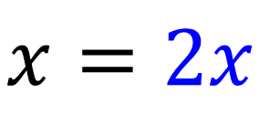
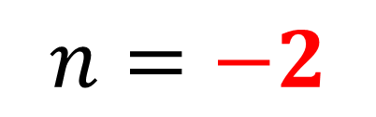
Expand and find the first four terms of${\left(1+2x\right)}^{−2}$
$n=−2$
$$x=2x$$
$${\left(1+x\right)}^{n}=1+n\left(x\right)+\frac{n(n−1)}{1 \text{x} 2}{\left(x\right)}^{2}+\frac{n\left(n−1\right)…(n−r+1)}{1 \text{x} 2 \text{x} …\text{x} r}{\left(x\right)}^{r}$$
$$1$$
$$+(−2)\left(2x\right)$$
$$+\frac{−2(−3)}{2 x 1}{\left(2x\right)}^{2}$$
$$+\frac{−2(−3)(−4)}{3 x 2 x 1}{\left(2x\right)}^{3}$$
$${\left(1+2x\right)}^{−2}$$
$$=1−4x+12x^{2}−32x^{3}$$

Slide 18
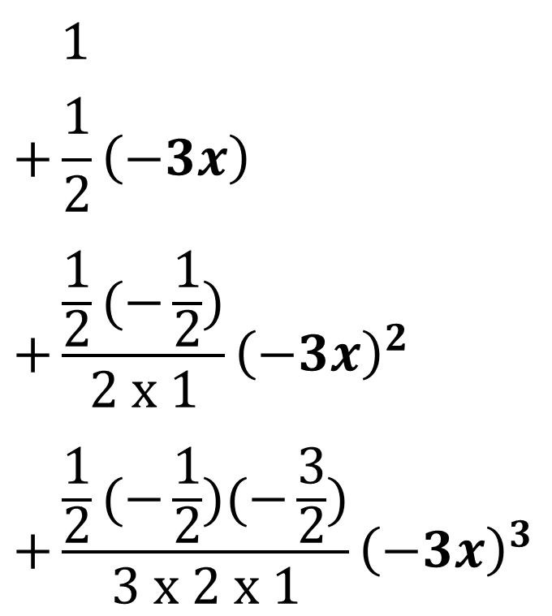
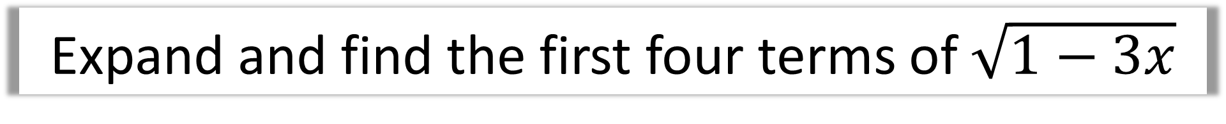
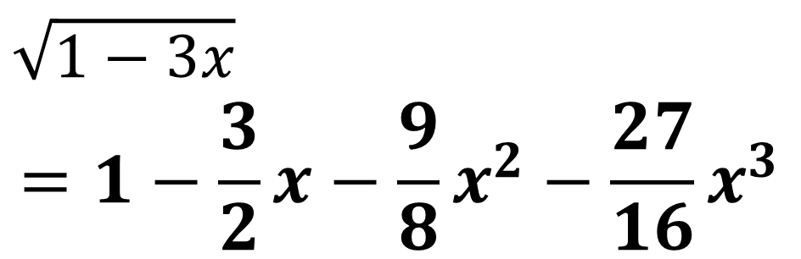
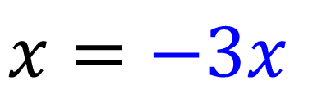
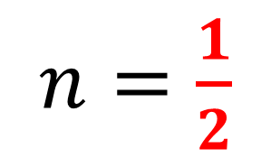
Expand and find the first four terms of $\sqrt{1−3x}$
$n=\frac{1}{2}$
$$x=−3x$$
$${\left(1+x\right)}^{n}=1+n\left(x\right)+\frac{n(n−1)}{1 \text{x} 2}{\left(x\right)}^{2}+\frac{n\left(n−1\right)…(n−r+1)}{1 \text{x} 2 \text{x} …\text{x} r}{\left(x\right)}^{r}$$
$$1$$
$$+\frac{1}{2}\left(−3x\right)$$
$$+\frac{\frac{1}{2}(−\frac{1}{2})}{2 x 1}{\left(−3x\right)}^{2}$$
$$+\frac{\frac{1}{2}(−\frac{1}{2})(−\frac{3}{2})}{3 x 2 x 1}{\left(−3x\right)}^{3}$$
$$\sqrt{1−3x}$$
$$=1−\frac{3}{2}x−\frac{9}{8}x^{2}−\frac{27}{16}x^{3}$$

Slide 19
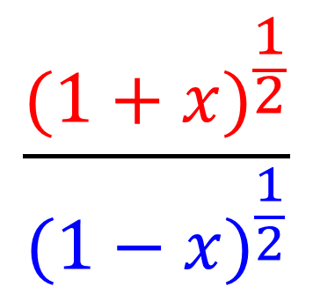
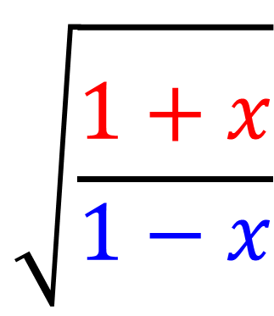
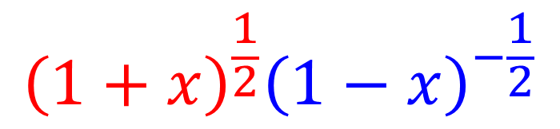
Binomial Expansion – Multiplying Expansions
Question
Expansion Required
$$\sqrt{\frac{1+x}{1−x}}$$
$$\frac{{(1+x)}^{\frac{1}{2}}}{{(1−x)}^{\frac{1}{2}}}$$
$${\left(1+x\right)}^{\frac{1}{2}}{\left(1−x\right)}^{−\frac{1}{2}}$$

Slide 20
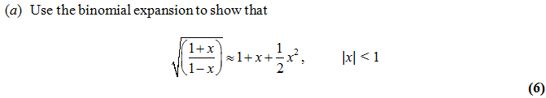
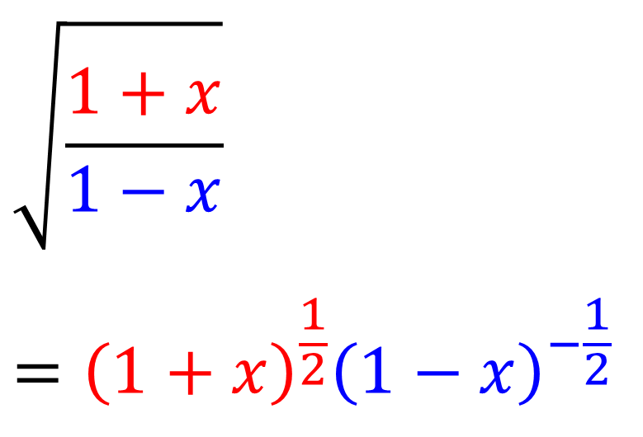
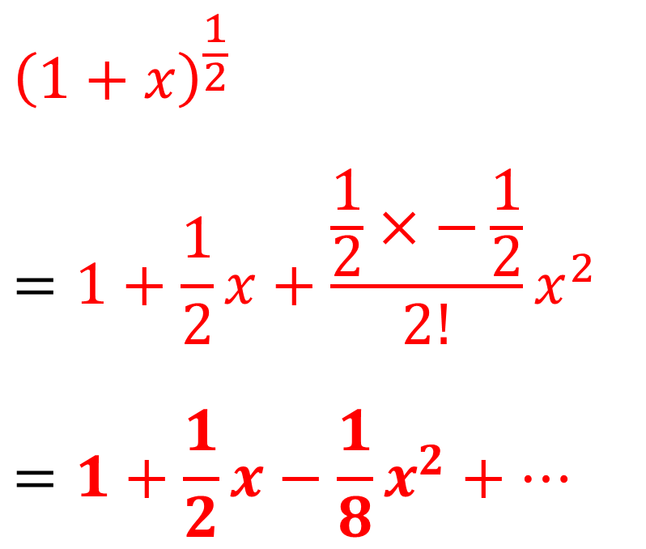
$${\left(1+x\right)}^{n}=1+n\left(x\right)+\frac{n(n−1)}{1 \text{x} 2}{\left(x\right)}^{2}+\frac{n\left(n−1\right)…(n−r+1)}{1 \text{x} 2 \text{x} …\text{x} r}{\left(x\right)}^{r}$$
$${\left(1+x\right)}^{\frac{1}{2}}$$
$$=1+\frac{1}{2}x+\frac{\frac{1}{2}×−\frac{1}{2}}{2!}x^{2}$$
$$=1+\frac{1}{2}x−\frac{1}{8}x^{2}+…$$
$$\sqrt{\frac{1+x}{1−x}}$$
$$={\left(1+x\right)}^{\frac{1}{2}}{\left(1−x\right)}^{−\frac{1}{2}}$$

Slide 21

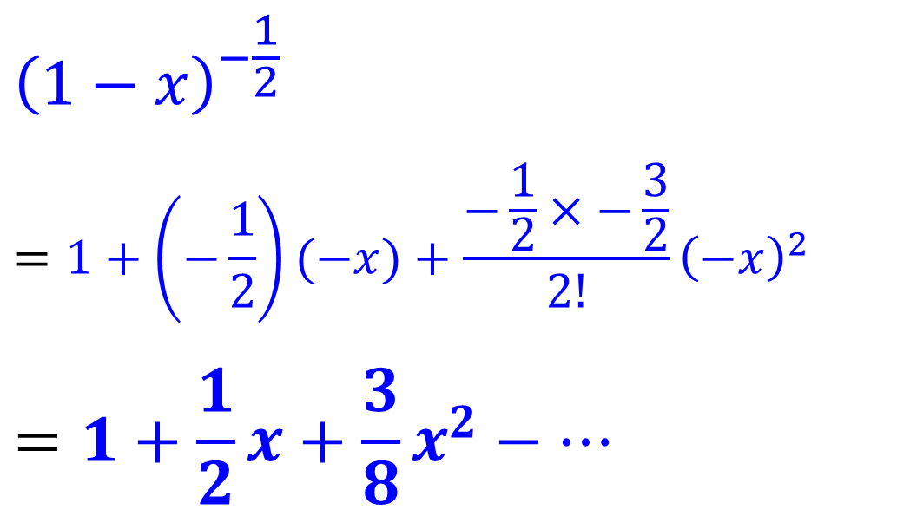
$$\sqrt{\frac{1+x}{1−x}}$$
$$={\left(1+x\right)}^{\frac{1}{2}}{\left(1−x\right)}^{−\frac{1}{2}}$$
$${\left(1−x\right)}^{−\frac{1}{2}}$$
$$=1+\left(−\frac{1}{2}\right)(−x)+\frac{−\frac{1}{2}×−\frac{3}{2}}{2!}{\left(−x\right)}^{2}$$
$$=1+\frac{1}{2}x+\frac{3}{8}x^{2}−…$$

Slide 22
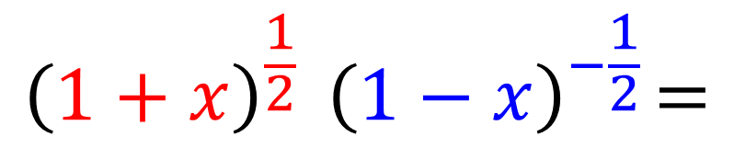
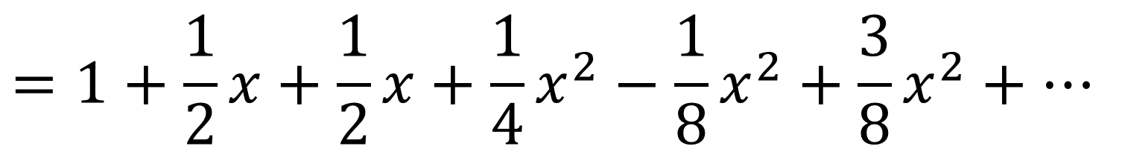
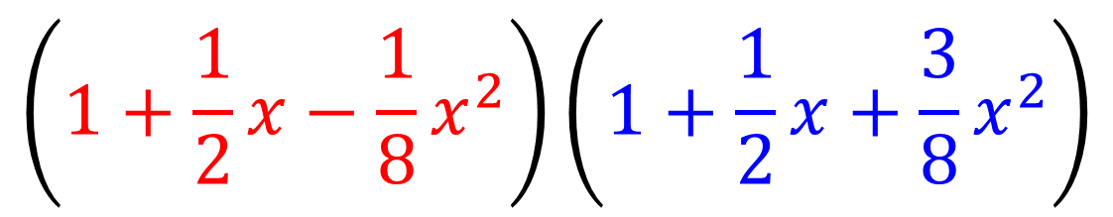
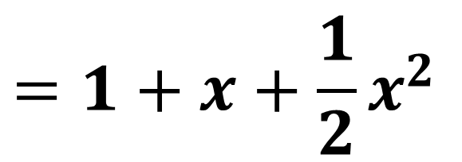
$${\left(1+x\right)}^{\frac{1}{2}}{ \left(1−x\right)}^{−\frac{1}{2}}=$$
$$\left(1+\frac{1}{2}x−\frac{1}{8}x^{2}\right)\left(1+\frac{1}{2}x+\frac{3}{8}x^{2}\right)$$
$$=1+\frac{1}{2}x+\frac{1}{2}x+\frac{1}{4}x^{2}−\frac{1}{8}x^{2}+\frac{3}{8}x^{2}+…$$
$$=1+x+\frac{1}{2}x^{2}$$

Slide 23
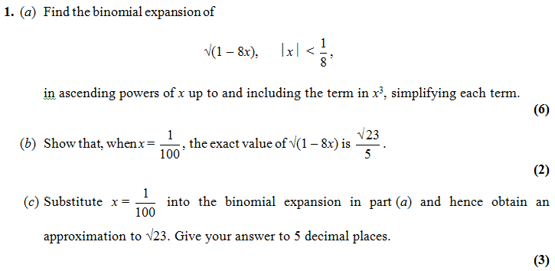
$${\left(1+x\right)}^{n}=1+n\left(x\right)+\frac{n(n−1)}{1 \text{x} 2}{\left(x\right)}^{2}+\frac{n\left(n−1\right)…(n−r+1)}{1 \text{x} 2 \text{x} …\text{x} r}{\left(x\right)}^{r}$$

Slide 24

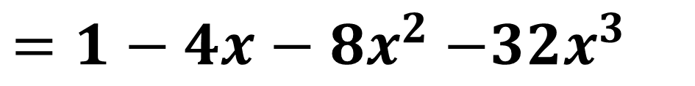
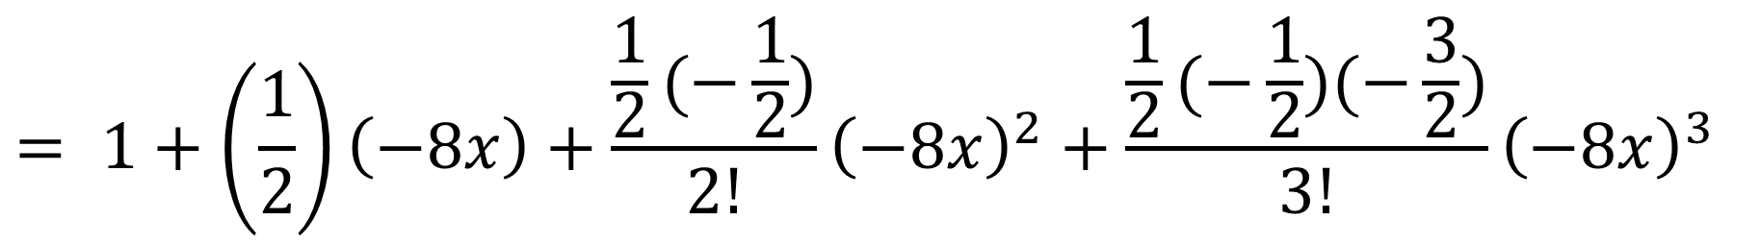
$${\left(1+x\right)}^{n}=1+n\left(x\right)+\frac{n(n−1)}{1 \text{x} 2}{\left(x\right)}^{2}+\frac{n\left(n−1\right)…(n−r+1)}{1 \text{x} 2 \text{x} …\text{x} r}{\left(x\right)}^{r}$$
$${\left(1−8x\right)}^{\frac{1}{2}}$$
a)
$$= 1+\left(\frac{1}{2}\right)\left(−8x\right)+\frac{\frac{1}{2}(−\frac{1}{2})}{2!}{\left(−8x\right)}^{2}+\frac{\frac{1}{2}(−\frac{1}{2})(−\frac{3}{2})}{3!}{\left(−8x\right)}^{3}$$
$=1−4x−8x^{2}$ $−32x^{3}$

Slide 25
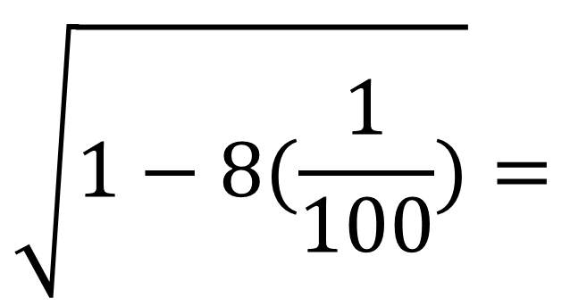
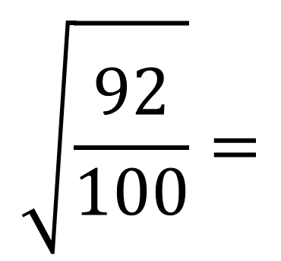
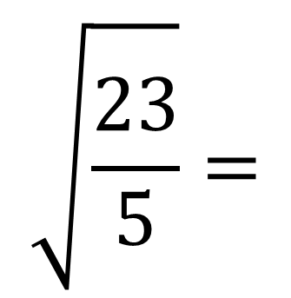
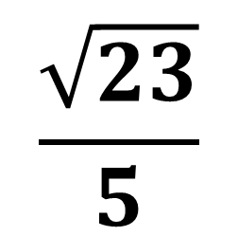
b)
$$\sqrt{1−8(\frac{1}{100})}=$$
$$\sqrt{\frac{92}{100}}=$$
$$\sqrt{\frac{23}{5}}=$$
$$\frac{\sqrt{23}}{5}$$

Slide 26
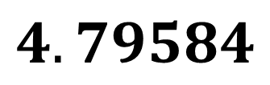



c)
$1−4(0.01)−8(0.01)x^{2}$ $−32{\left(0.01\right)}^{2}=$
$$0.959168$$
$$\sqrt{23}=$$
$0.959168$ x $5=$
$$4.79584$$

