Slide 1
Prove the following statements
are true using algebra.
EVEN + EVEN =
ODD + ODD =
EVEN + ODD =
EVEN
EVEN x EVEN =
EVEN x ODD =
ODD x ODD =
EVEN
EVEN
EVEN
ODD
ODD

Slide 2
ANSWERS

Slide 3
EVEN + EVEN = EVEN
2n + 2n = 4n
= 2(2n)
multiple of 2 hence always even

Slide 4
ODD + ODD = EVEN
2n + 1 + 2n + 1 = 4n + 2
= 2(2n + 1)
multiple of 2 hence always even

Slide 5
EVEN + ODD = ODD
2n + 2n + 1 = 4n + 1
= 2(2n) + 1
Even + 1 = Odd

Slide 6
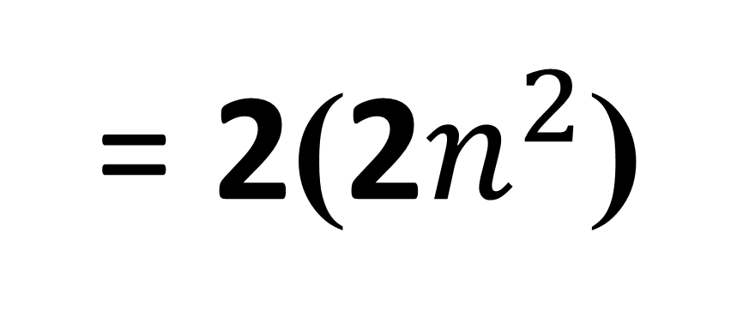
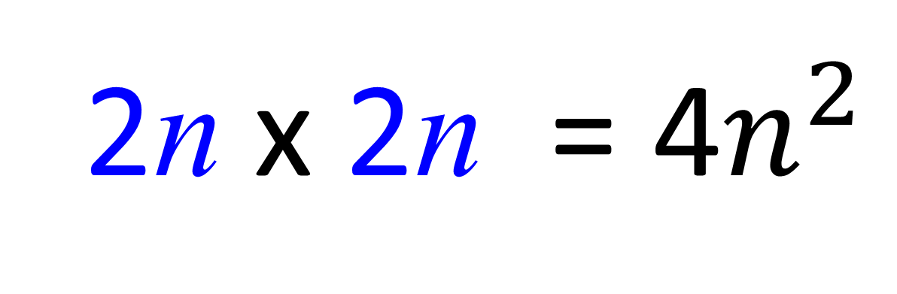
EVEN x EVEN = EVEN
2n x 2n = 4$n^{2}$
= 2(2$n^{2}$)
Multiple of 2 hence even

Slide 7
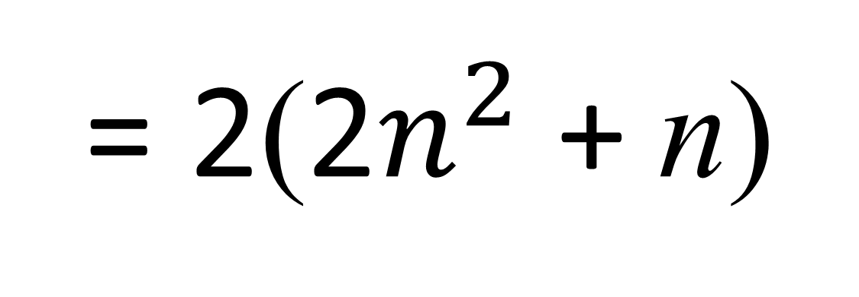
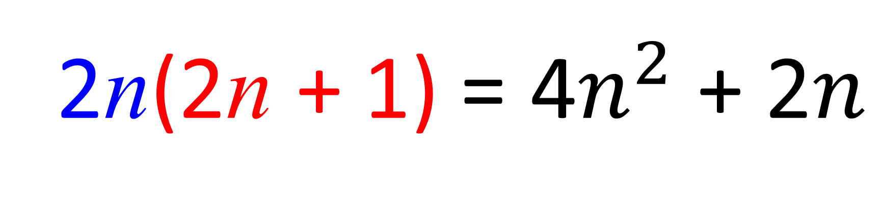
EVEN x ODD = EVEN
2n(2n + 1) = 4$n^{2}$ + 2$n$
= 2(2$n^{2}$ + n)
Multiple of 2
hence even

Slide 8
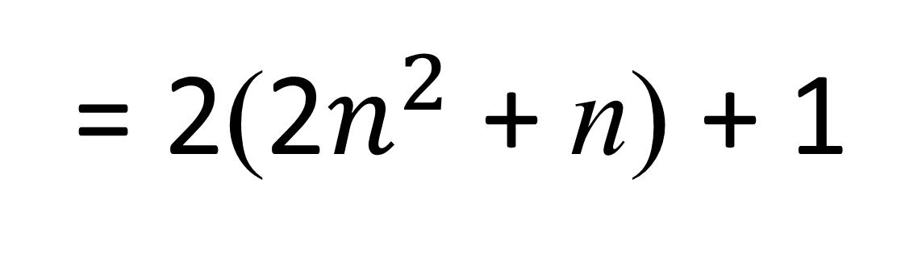
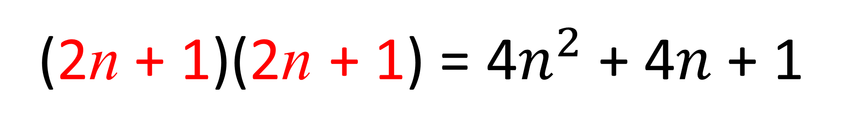
ODD x ODD = ODD
(2n + 1)(2n + 1) = 4$n^{2}$ + 4$n$ + 1
= 2(2$n^{2}$ + n) + 1
Even + 1 = Odd

