Slide 1
FM: Functions

Slide 2
A function is when you take an input,
perform a calculation and get an output.
Input
Output
x 3
+ 5

Slide 3
Notation
Input
Output
x 3
+ 5
y = 3x + 5
x → 3x + 5

Slide 4
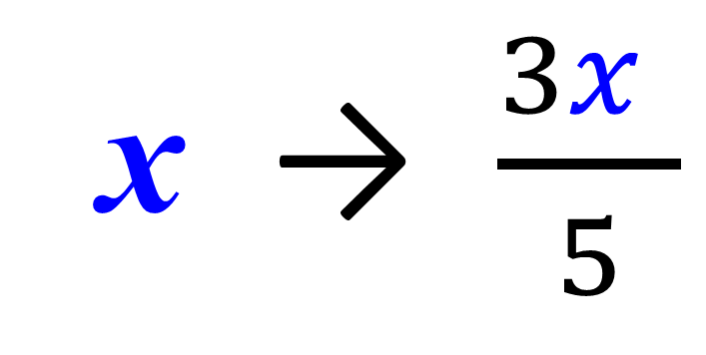
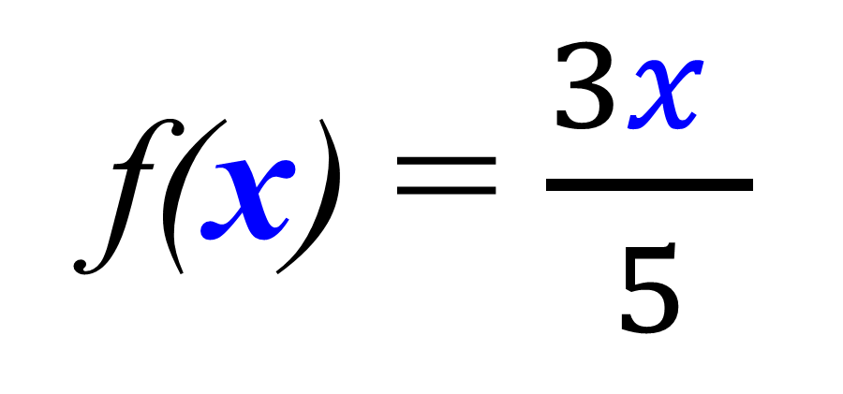
Write the following using function notion.
Input
Output
x 3
÷ 5
f(x) = $\frac{3x }{5}$
x → $\frac{3x }{5}$

Slide 5
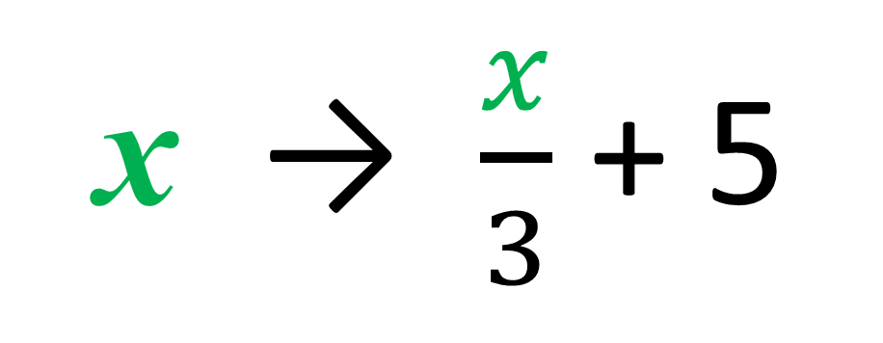
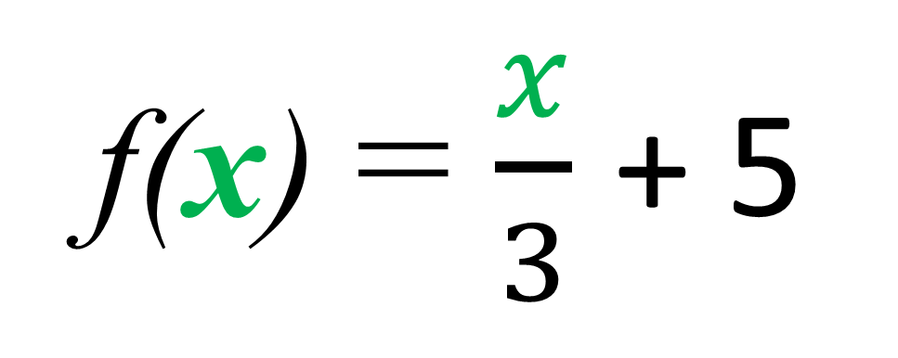
Write the following using function notion.
Input
Output
÷ 3
+ 5
f(x) = $\frac{x}{3}$ + 5
x → $\frac{x}{3}$ + 5

Slide 6
Value of a Function
f (x) = 3x + 5
f (3) =
3(3) + 5
f (3) = 14

Slide 7
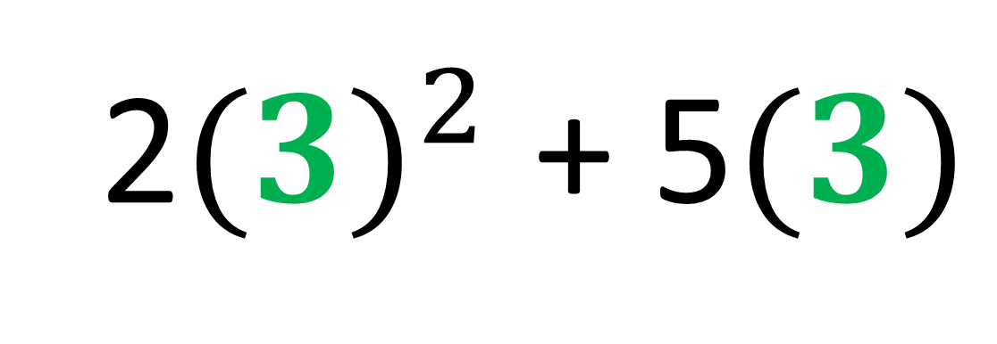
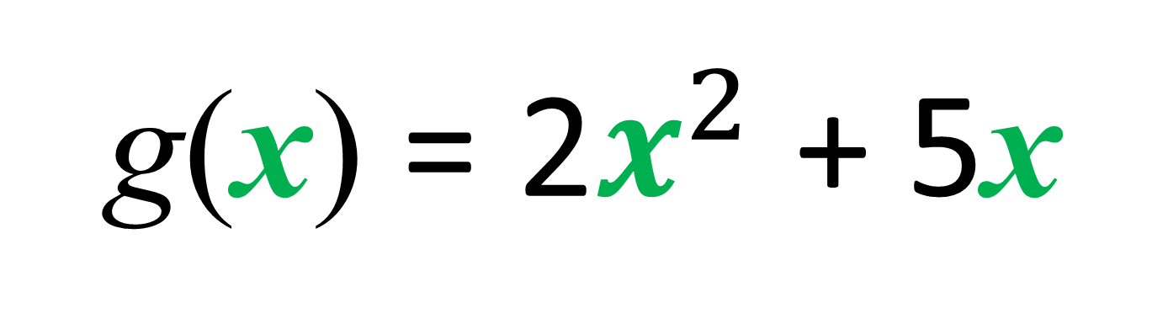
g(x) = 2$x^{2}$ + 5x
g(3) =
2${(3)}^{2}$ + 5$(3)$
g(3) = 33

Slide 8
f (x) = 2x
g(x) = x² + 4
Work out f (3) + g(3)
f (3) + g(3) =
6 + 13 = 19

Slide 9
f (x) = x + x²
Work out 5f (3)
f (3) =
12
5f (3) =
5 x 12 = 60

Slide 10
g(x) = x + x²
Write an expression for g(2x)
g(2x) =
(2x) + (2x)²
g(2x) =
2x + 4x²

Slide 11
g(x) = 2x + x²
Write an expression for g(x + 1)
g(x + 1) =
2(x + 1) + (x + 1)²
g(x + 1) =
2x + 2 + x² + 2x + 1
g(x + 1) =
x² + 4x + 3

Slide 12
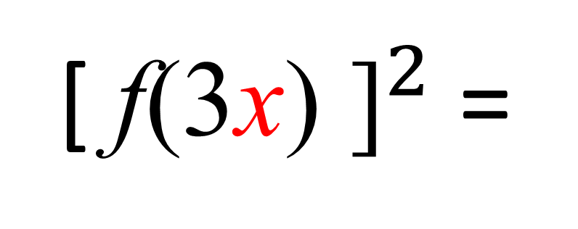
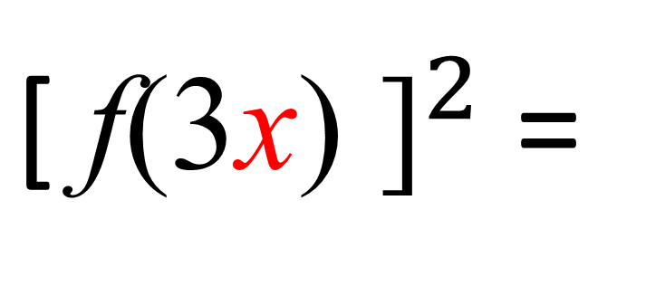
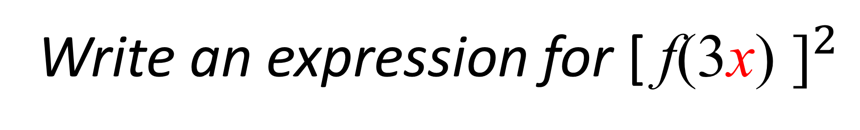
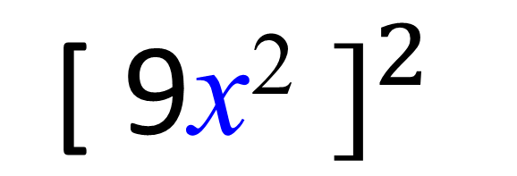
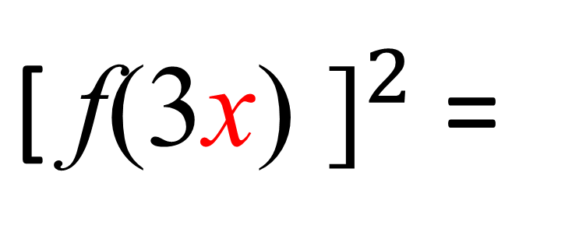
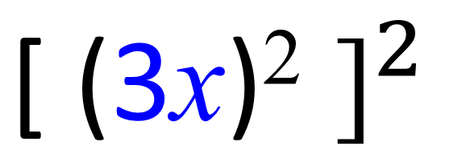
f(x) = x²
Write an expression for ${\text{[} \text{f}\text{(3}\text{x}\text{)} \text{]}}^{2}$
${\text{[} \text{f}\text{(3}\text{x}\text{)} \text{]}}^{2}$=
$${\text{[} \text{(}\text{3}\text{x}\text{)}\text{2} \text{]}}^{2}$$
${\text{[} \text{f}\text{(3}\text{x}\text{)} \text{]}}^{2}$=
$${\text{[} \text{9}\text{x}\text{2} \text{]}}^{2}$$
${\text{[} \text{f}\text{(3}\text{x}\text{)} \text{]}}^{2}$=
81x⁴

Slide 13
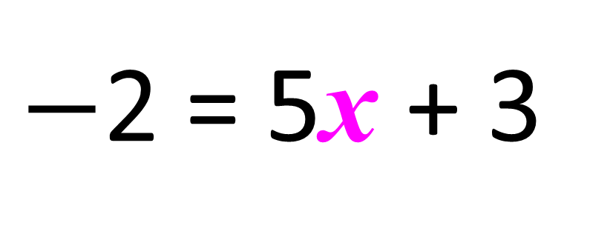
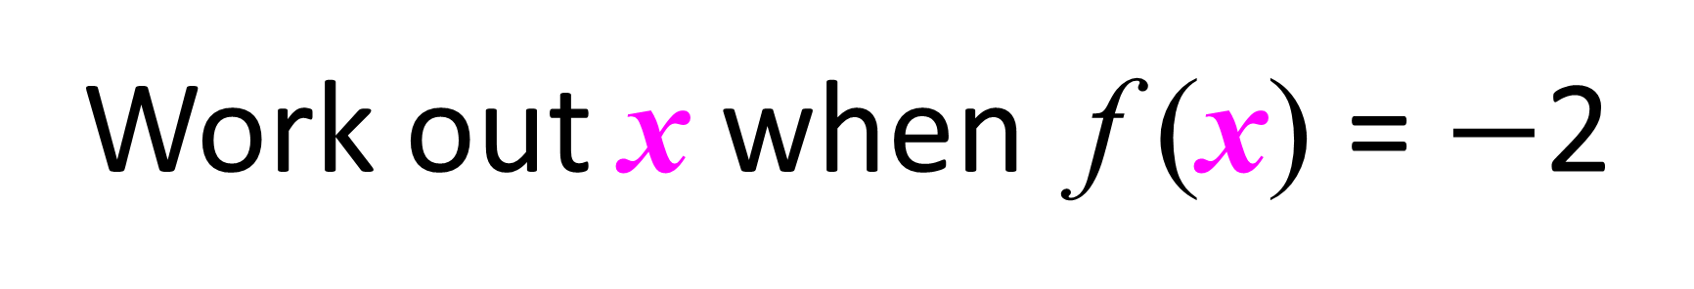
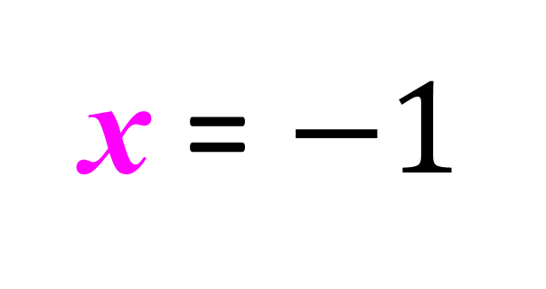
Solving a Function
f (x) = 5x + 3
Work out x when f (x) = $−$2
$−$2 = 5x + 3
x = $−1$

Slide 14
f (x) = 4x – 3
Work out x when f (x) = 0
0 = 4x – 3
x = 0.75

