Slide 1
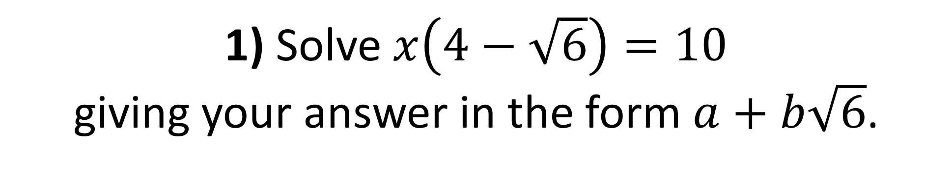
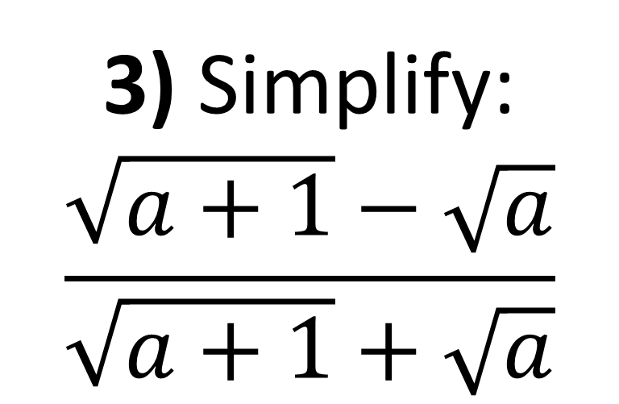
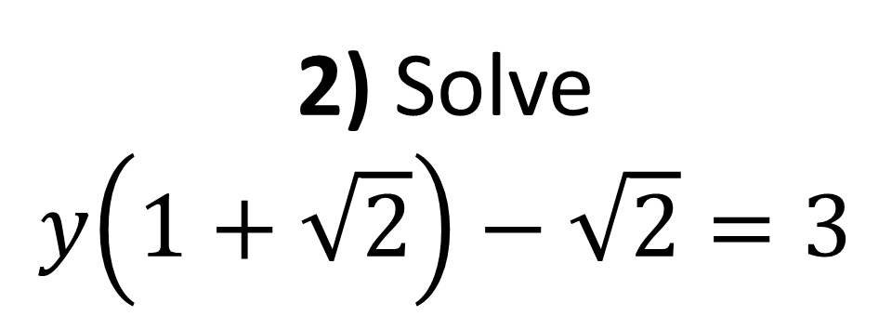
1) Solve $x\left(4−\sqrt{6}\right)=10$
giving your answer in the form $a+b\sqrt{6}$.
3) Simplify:
$$\frac{\sqrt{a+1}−\sqrt{a}}{\sqrt{a+1}+\sqrt{a}}$$
2) Solve
$$y\left(1+\sqrt{2}\right)−\sqrt{2}=3$$

Slide 2
ANSWERS

Slide 3
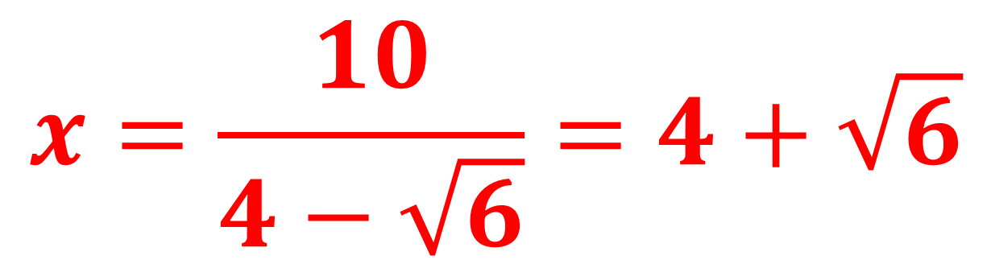
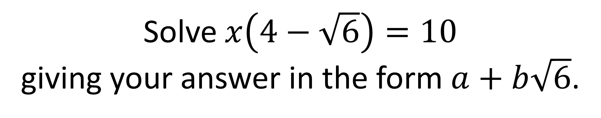
Solve $x\left(4−\sqrt{6}\right)=10$
giving your answer in the form $a+b\sqrt{6}$.
$$x=\frac{10}{4−\sqrt{6}}=4+\sqrt{6}$$

Slide 4
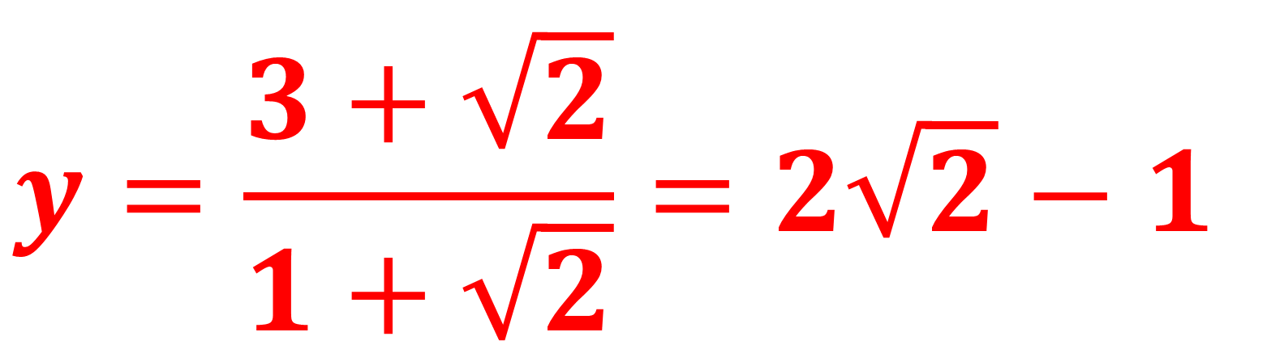
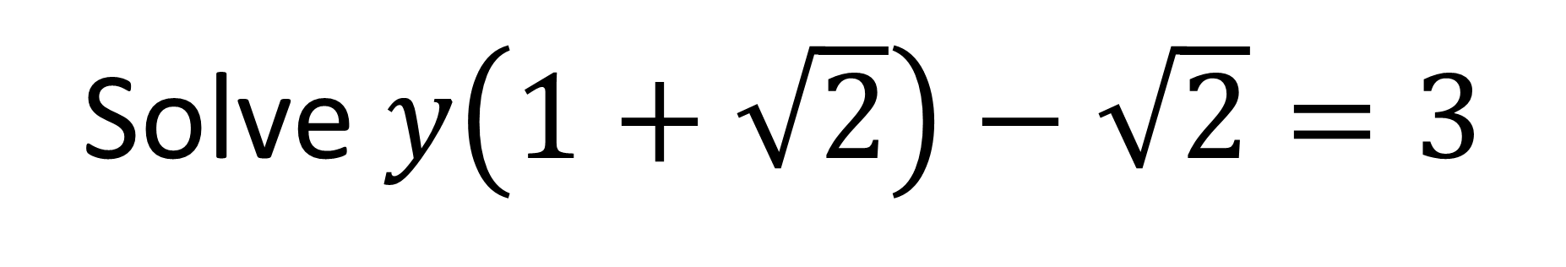
Solve $y\left(1+\sqrt{2}\right)−\sqrt{2}=3$
$$y=\frac{3+\sqrt{2}}{1+\sqrt{2}}=2\sqrt{2}−1$$

Slide 5
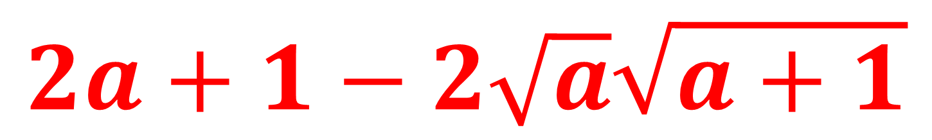
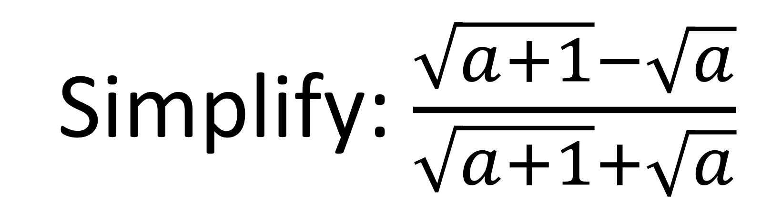
Simplify: $\frac{\sqrt{a+1}−\sqrt{a}}{\sqrt{a+1}+\sqrt{a}}$
$$2a+1−2\sqrt{a}\sqrt{a+1}$$

