Slide 1
LO: Set Notation

Slide 2
A set is a collection of numbers/items.
ξ = The universal set
{ } = List numbers of a set
∩ = Intersection (AND)
∪ = Union (OR)
∈ = an element of a set

Slide 3
If you have more than one set of numbers
you may want to use a Venn Diagram to organise them.
A = { 1, 3, 4, 5, 6, 7}
B = {2, 4, 7, 8, 9}
A
B
1
8
6
4
5
9
3
7
2

Slide 4
A set is a collection of numbers.
A = {1, 2, 4, 5, 8}
Set A contains the numbers 1, 2, 4, 5 and 8.

Slide 5

ξ is the notation for the universal set.
A
B
1
8
6
4
5
9
3
7
2
10
=
{ 1, 2, 3, 4, 5, 6, 7, 8, 9, 10}

Slide 6
∩ = Intersection
An intersection refers to A and B.
A
B
1
8
6
4
5
9
3
7
2
10

Slide 7
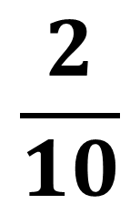
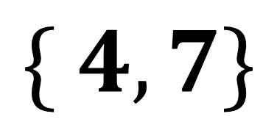
A
B
1
8
4
6
9
5
7
3
2
10
A ∩ B =
$$\{ 4, 7\}$$
$$\frac{2}{10}$$
P(A ∩ B) =

Slide 8
∪ = Union
A union refers to A or B.
A
B
1
8
6
4
5
9
3
7
2
10

Slide 9
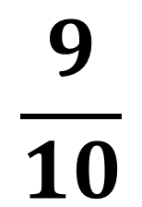
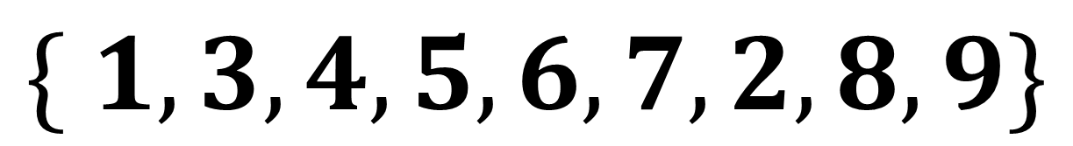
A
B
1
8
4
6
9
5
7
3
2
10
A ∪ B =
$$\{ 1,3,4, 5,6, 7,2,8,9\}$$
$$\frac{9}{10}$$
P(A ∪ B) =

Slide 10


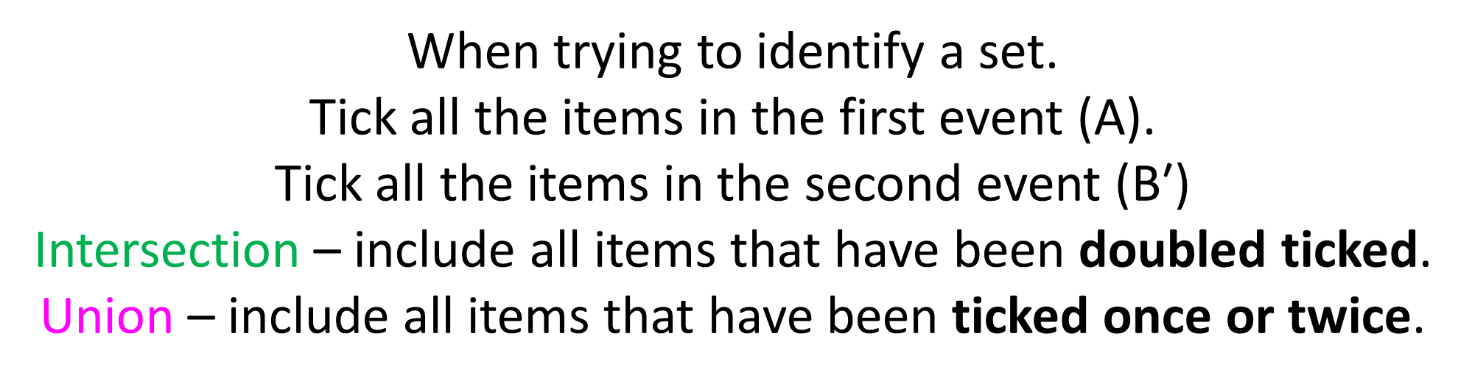
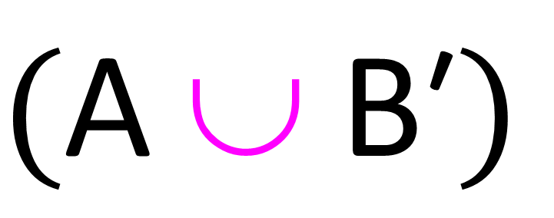
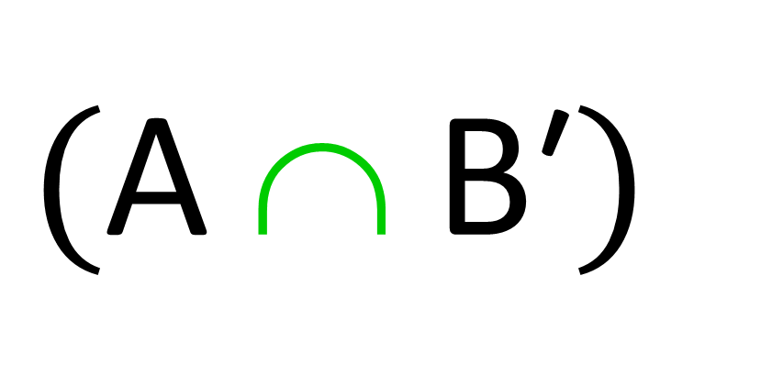
$(\text{A} \text{∩} \text{B}\text{′}$)
$$(\text{A} \text{∪} \text{B}\text{′}\text{)}$$
When trying to identify a set.
Tick all the items in the first event (A).
Tick all the items in the second event ($\text{B}\text{′}$)
Intersection – include all items that have been doubled ticked.
Union – include all items that have been ticked once or twice.

Slide 11
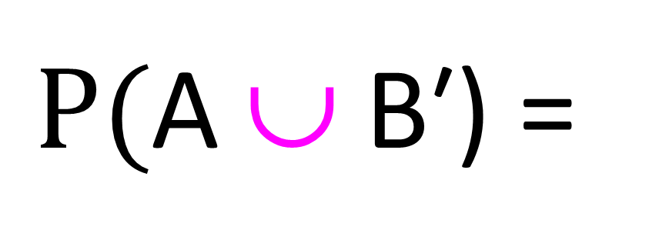
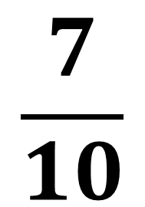
A
B
7
8
1
6
9
3
4
5
2
10
$$\frac{7}{10}$$
$P(\text{A} \text{∪} \text{B}\text{′}$) =

Slide 12
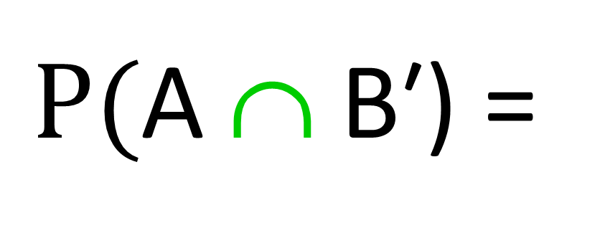
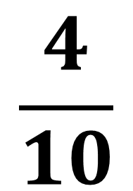
A
B
7
8
1
6
9
3
4
5
2
10
$$\frac{4}{10}$$
$P(\text{A} \text{∩} \text{B}\text{′}$) =

Slide 13
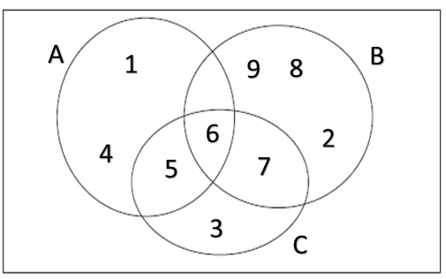
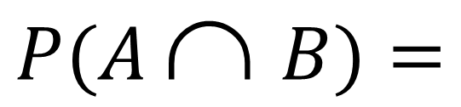
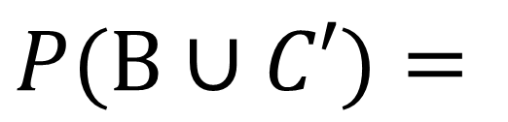
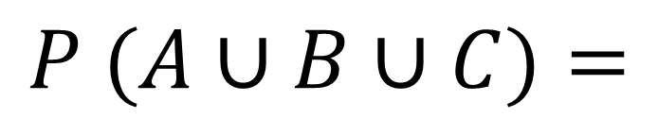
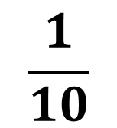
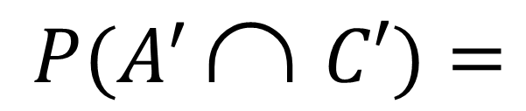
10
$$\frac{1}{10}$$
$$P(A \text{∩} B)=$$
$P(B∪C′)=$
$P(A^{′ }\text{∩} C′)=$
$$P (A∪B∪C)=$$

Slide 14
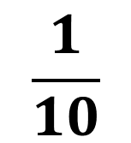
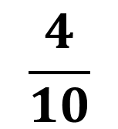
10
$$P(A \text{∩} B)=$$
$$\frac{1}{10}$$
$P(B∪C′)=$
$P(A^{′ }\text{∩} C′)=$
$$\frac{4}{10}$$
$$P (A∪B∪C)=$$

Slide 15
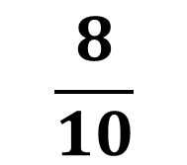
10
$$P(A \text{∩} B)=$$
$$\frac{1}{10}$$
$$\frac{8}{10}$$
$P(B∪C′)=$
$P(A^{′ }\text{∩} C′)=$
$$\frac{4}{10}$$
$$P (A∪B∪C)=$$

Slide 16

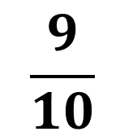
10
$$P(A \text{∩} B)=$$
$$\frac{1}{10}$$
$$\frac{8}{10}$$
$P(B∪C′)=$
$P(A^{′ }\text{∩} C′)=$
$$\frac{4}{10}$$
$$P (A∪B∪C)=$$
$$\frac{9}{10}$$

