Slide 1
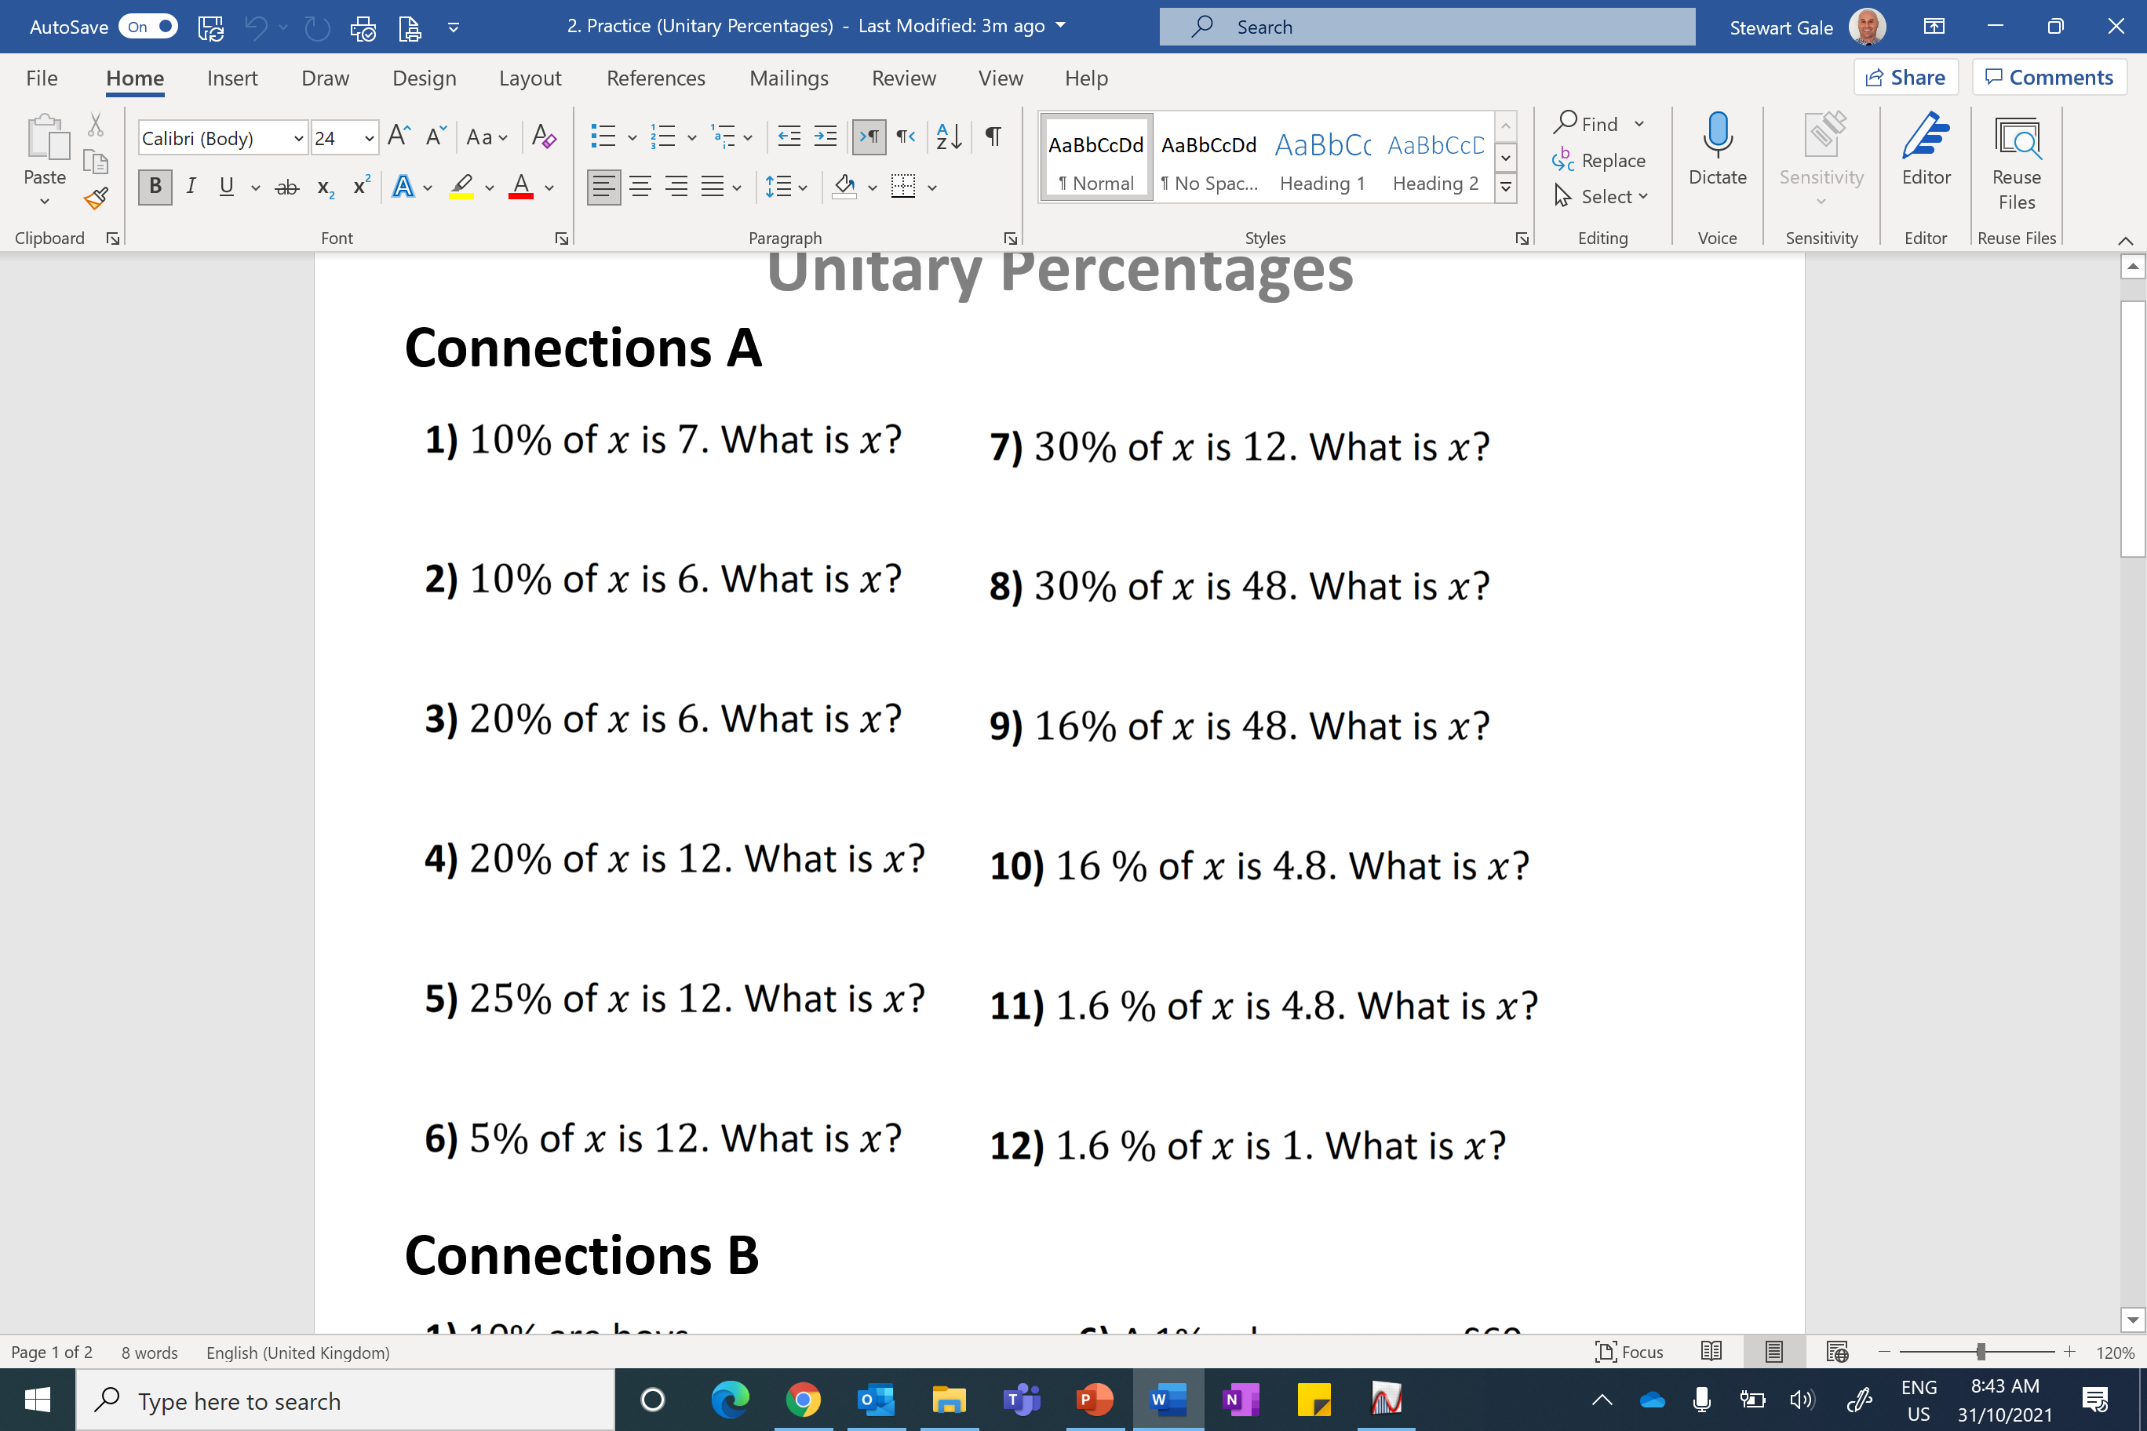
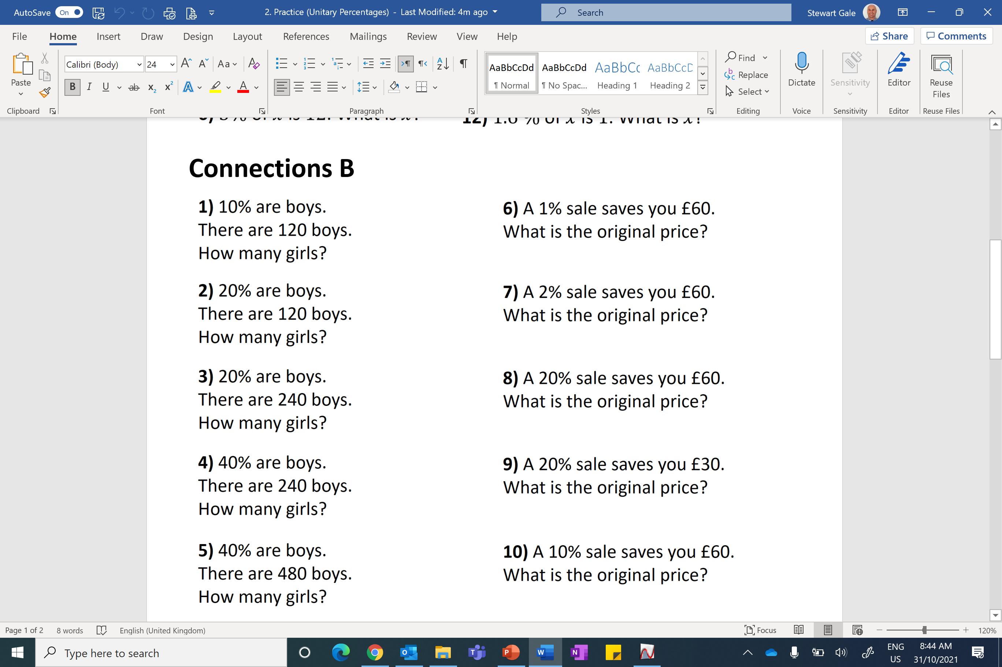

Slide 2
ANSWERS

Slide 3
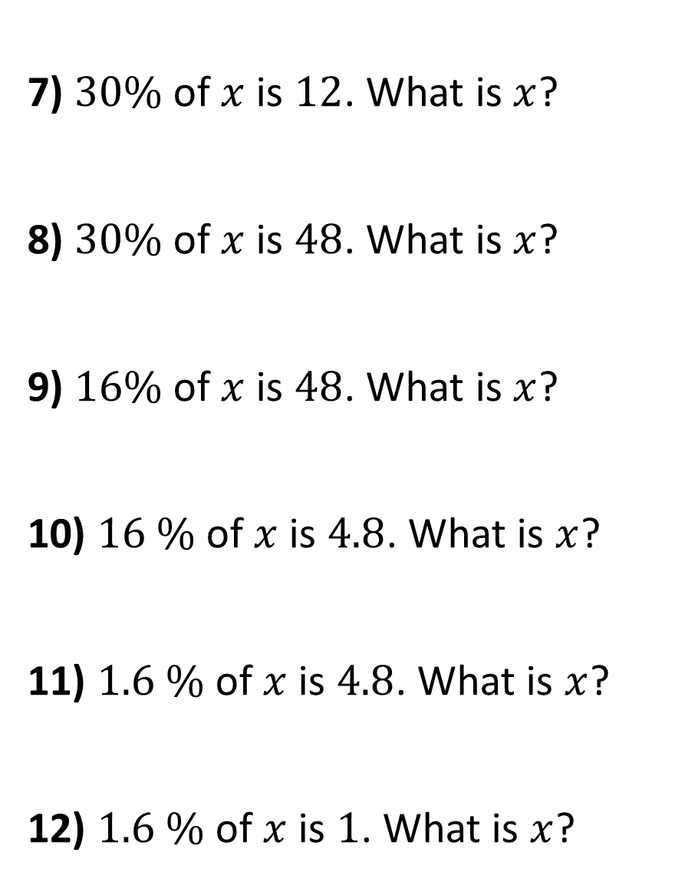
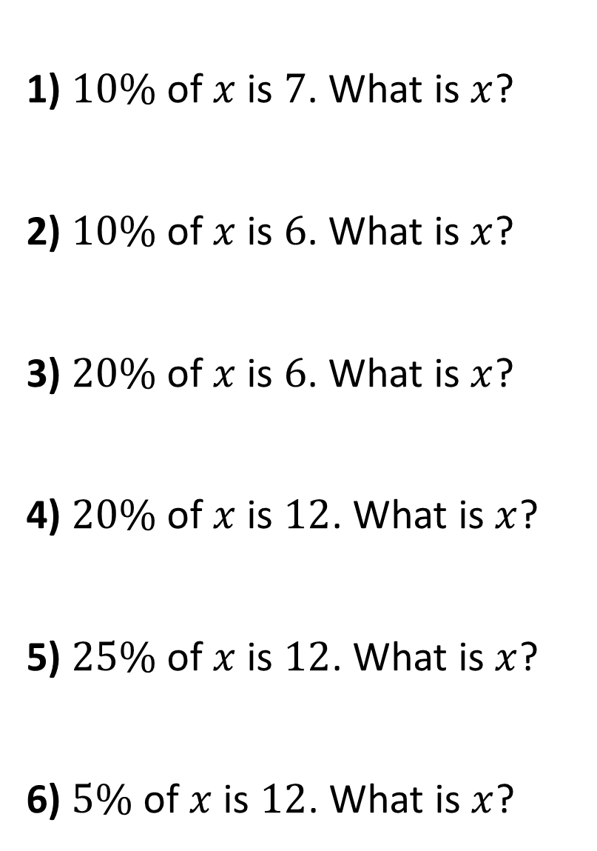
1) $10\%$ of $x$ is $7$. What is $x$?
2) $10\%$ of $x$ is $6$. What is $x$?
3) $20\%$ of $x$ is $6$. What is $x$?
4) $20\%$ of $x$ is $12$. What is $x$?
5) $25\%$ of $x$ is $12$. What is $x$?
6) $5\%$ of $x$ is $12$. What is $x$?
7) $30\%$ of $x$ is $12$. What is $x$?
8) $30\%$ of $x$ is $48$. What is $x$?
9) $16\%$ of $x$ is $48$. What is $x$?
10) $16 \%$ of $x$ is $4.8$. What is $x$?
11) $1.6 \%$ of $x$ is $4.8$. What is $x$?
12) $1.6 \%$ of $x$ is $1$. What is $x$?
70
40
60
160
30
300
60
30
48
300
240
62.5

Slide 4
1) 10% are boys.
There are 120 boys.
How many girls?
100% = 1200
1080 girls
6) A 1% sale saves you £60.
What is the original price?
100% = £6000
2) 20% are boys.
There are 120 boys.
How many girls?
100% = 600
480 girls
7) A 2% sale saves you £60.
What is the original price?
100% = £3000
3) 20% are boys.
There are 240 boys.
How many girls?
100% = 1200
960 girls
8) A 20% sale saves you £60.
What is the original price?
100% = £300
4) 40% are boys.
There are 240 boys.
How many girls?
9) A 20% sale saves you £30.
What is the original price?
100% = 600
360 girls
100% = £150
5) 40% are boys.
There are 480 boys.
How many girls?
100% = 1200
720 girls
10) A 10% sale saves you £60.
What is the original price?
100% = £600

