Slide 1
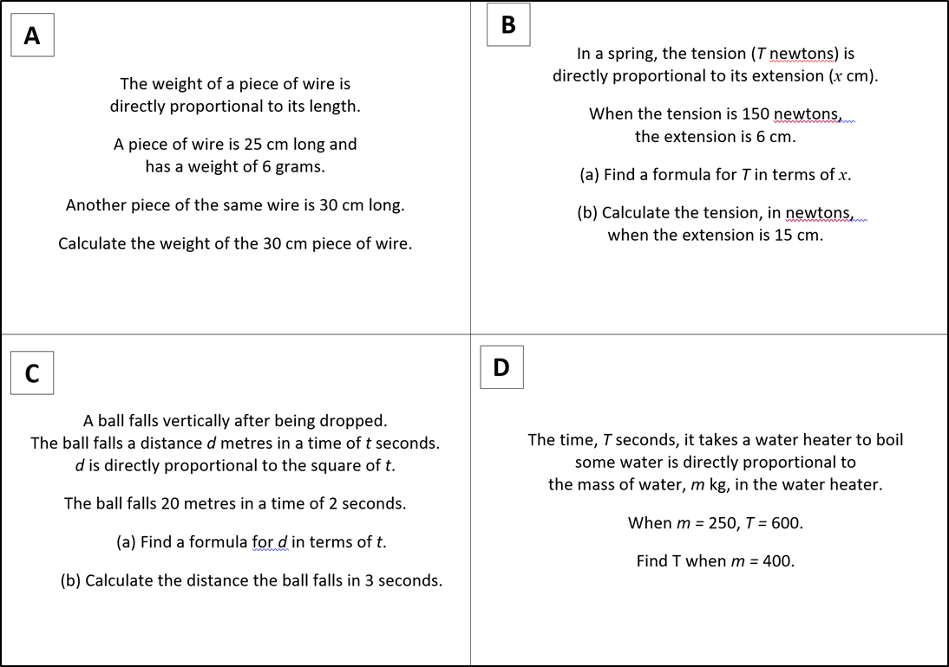

Slide 2
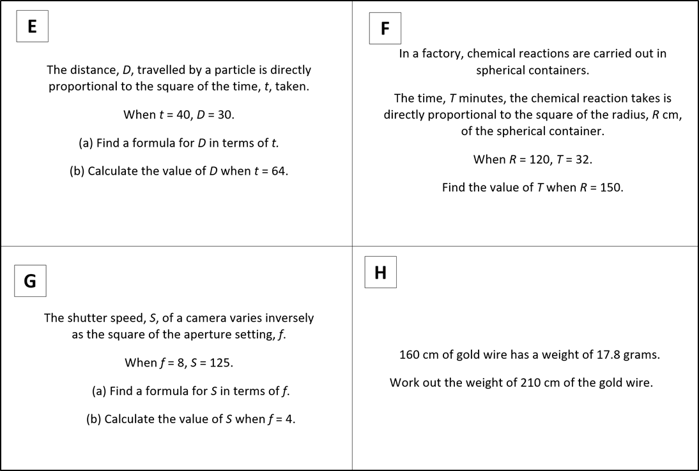

Slide 3
ANSWERS

Slide 4
w = 0.24l
w = 7.2 grams

Slide 5
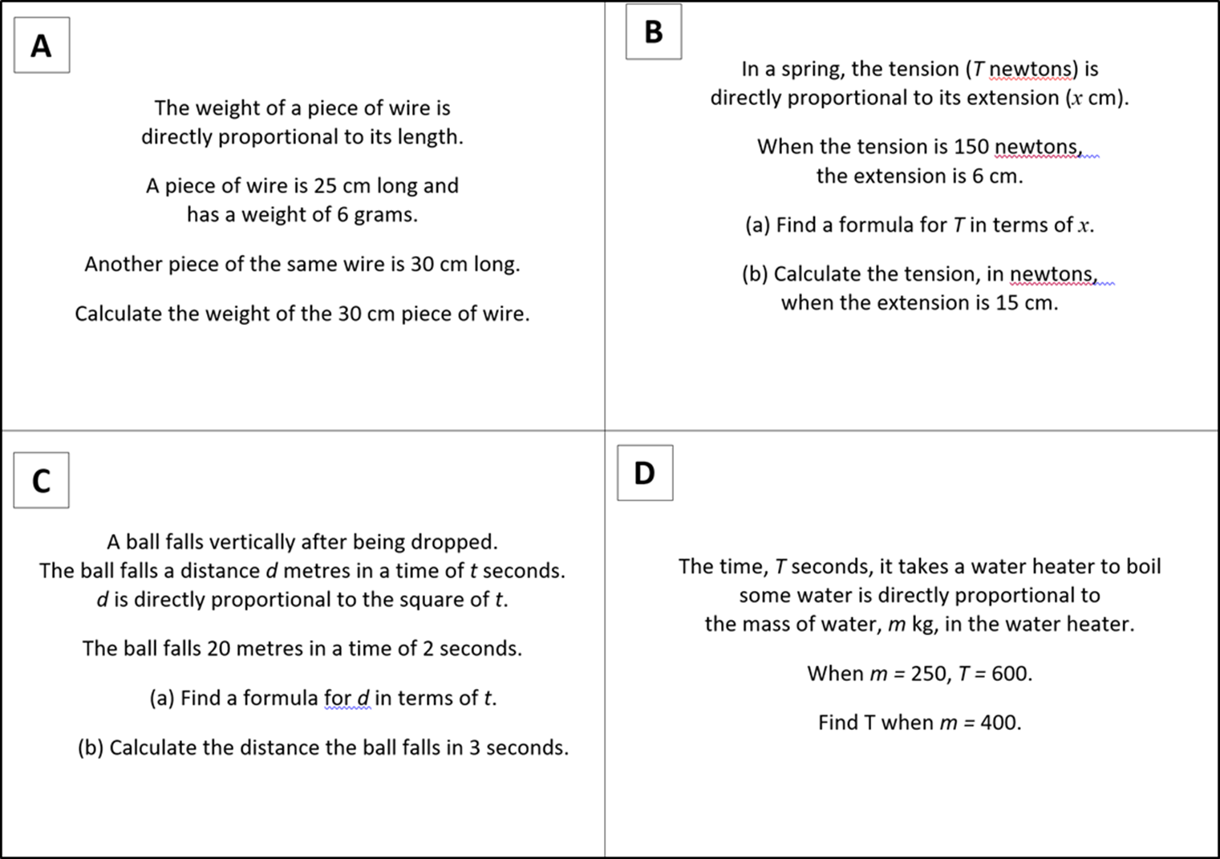
t = 25x
t = 375 Newtons

Slide 6
d = 5t²
d = 45 metres

Slide 7
T = 2.4 m
T = 960 seconds

Slide 8

D = 0.01875t²
D = 76.8

Slide 9
T = 0.00222R²
T = 50 minutes

Slide 10
S = 8000 ÷ f²
S = 500

Slide 11
w = 0.11125 L
w = 23.3625grams

