Slide 1

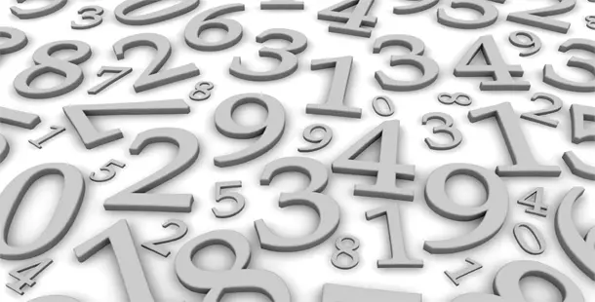
Words and Numbers

Slide 2
Question: 1 = T of the P
Answer: 1 = Top of the Pops
Question: 99 = OL than H
Answer: 99 = One Less than Hundred

Slide 3
 |  | Hints
1) | 12 = Z in a B | Numbers
2) | 911 = ES | Phone call
3) | 8 = P in the SS | Science
4) | 1912 = S of the T | An event
5) | 7 = D in SW | Disney
6) | 57 = HV | Beans
7) | 999 = OL than a T | Number
8) | 7 = W of the W | Travel
9) | 18 = H on the GC | Sport
10) | 15 = FP in T | Sport
11) | 5 = OR | Every 4 years
12) | 3 = PC (RBY) | Art
13) | 11 = P in a FT | Sport
14) | 13 = UFS | Saying
Hints
15) | 1 = W on a U | Vehicle
16) | 80 = DA the W | Fog
17) | 3 = LP | Nursery
18) | 9 = L of a C | Saying
19) | 40 = W | Tired
20) | 206 = B in the HB | Science
21) | 90 = D in a RA | Maths
22) | 1000 = M in a M | Maths
23) | 25 = Y for a SWA | An event
24) | 101 = D | Disney
25) | 29 = D in F in a LY | An event
26) | 3600 = S in an H | Time
27) | 747 = JJ | Vehicle
28) | 10 = Y in a D | Time
29) | 10 = DS | A place

Slide 4
ANSWERS

Slide 5
1) | 12 = Z in a B | 12 Zeros in a Billion
2) | 911 = ES | 911 = Emergency Services
3) | 8 = P in the SS | 8 Plants in the Solar System
4) | 1912 = S of the T | 1912 Sinking of the Titanic
5) | 7 = D in SW | 7 Dwarfs in Snow White
6) | 57 = HV | 57 Heinz Varieties
7) | 999 = OL than a T | 999 One Less than a Thousand
8) | 7 = W of the W | 7 Wonders of the World
9) | 18 = H on the GC | 18 Hole on a Golf Course
10) | 15 = FP in T | 15 First Point in Tennis
11) | 5 = OR | 5 Olympic Rings
12) | 3 = PC (RBY) | 3 Primary Colors (Red Blue Yellow)
13) | 11 = P in a FT | 11 Players in a Football Team
14) | 13 = UFS | 13 Unlucky For Some
15) | 1 = W on a U | 1 Wheels on a Unicycle
16) | 80 = DA the W | 80 Days Around the World
17) | 3 = LP | 3 Little Pigs
18) | 9 = L of a C | 9 Lives of a Cat
19) | 40 = W | 40 Winks
20) | 206 = B in the HB | 206 Bones in the Human Body
21) | 90 = D in a RA | 90 Degrees in a Right Angle
22) | 1000 = M in a M | 1000 Millimeters in a Meter
23) | 25 = Y for a SWA | 25 Years for a Silver Wedding Anniversary
24) | 101 = D | 101 Dalmatians
25) | 29 = D in F in a LY | 29 Days in February in a Leap Year
26) | 3600 = S in an H | 3600 Seconds in an Hour
27) | 747 = JJ | 747 Jumbo Jet
28) | 10 = Y in a D | 10 Years in a Decade
29) | 10 = DS | Downing Street

