Slide 1
FM: Increasing and Decreasing Functions

Slide 2
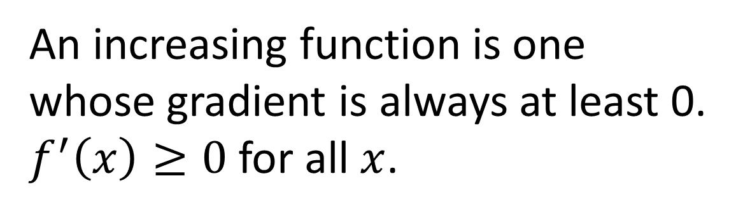
Increasing and Decreasing Functions
What do you think it means for a function
to be an ‘increasing function’?
An increasing function is one whose gradient is always at least 0.
$f^{′}\left(x\right)≥0$ for all $x$.

Slide 3
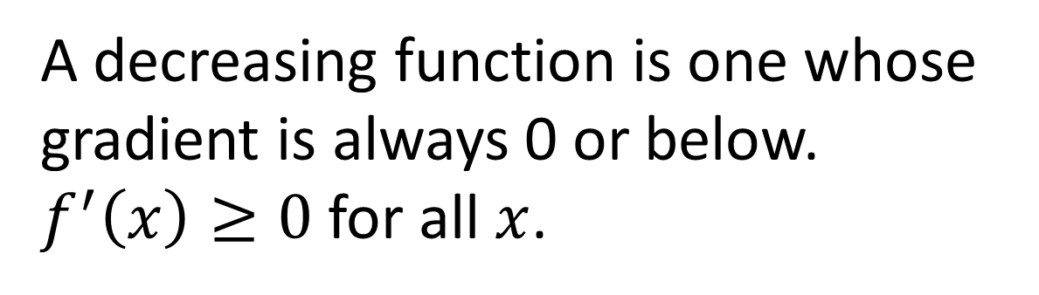
Increasing and Decreasing Functions
What do you think it means for a function
to be an ‘decreasing function’?
A decreasing function is one whose gradient is always 0 or below.
$f^{′}\left(x\right)≥0$ for all $x$.

Slide 4

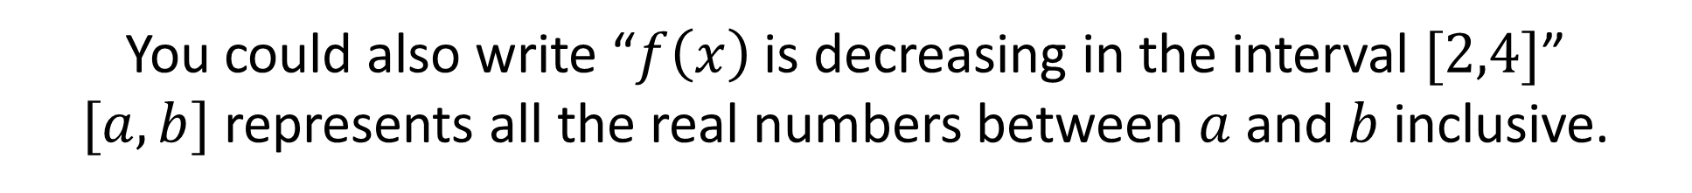

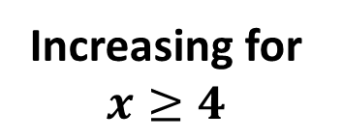
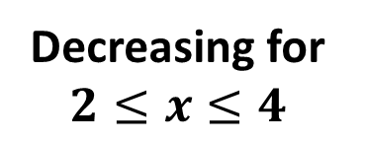
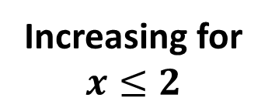
A function can also be increasing and decreasing in certain intervals.
$$\left(2,3\right)$$
$$\left(4,−1\right)$$
Increasing for
$$x≤2$$
Decreasing for
$$2≤x≤4$$
Increasing for
$$x≥4$$
You could also write “$f\left(x\right)$ is decreasing in the interval $[2,4]$”
$[a,b]$ represents all the real numbers between $a$ and $b$ inclusive.

Slide 5



$$y$$
$$y=f\left(x\right)$$
$$x$$
4
For what values of x is f(x) increasing?
x > 4

Slide 6



$$y$$
$$y=f\left(x\right)$$
$$x$$
4
For what values of x is f(x) decreasing?
x < 4

Slide 7



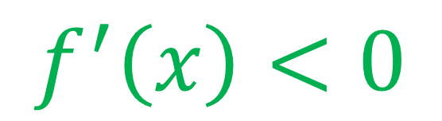

$$y$$
$$y=f\left(x\right)$$
$$x$$
For what values of $f^{′}\left(x\right)$ is $f\left(x\right)$decreasing?
$$f^{′}\left(x\right)<0$$

Slide 8

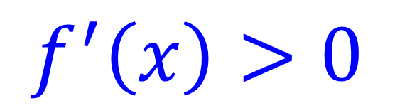

$$y$$
$$y=f\left(x\right)$$
$$x$$
For what values of $f^{′}\left(x\right)$ is $f\left(x\right)$decreasing?
$$f^{′}\left(x\right)>0$$

Slide 9
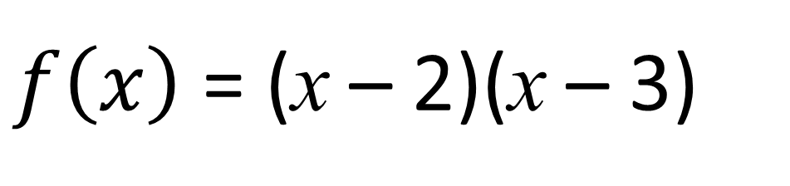
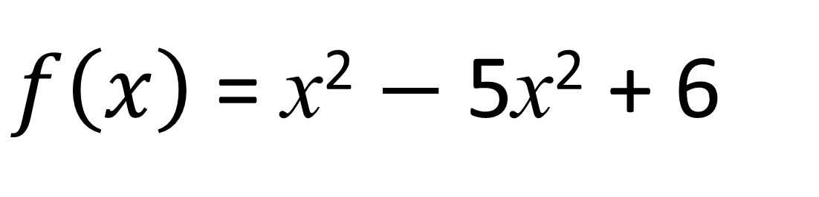
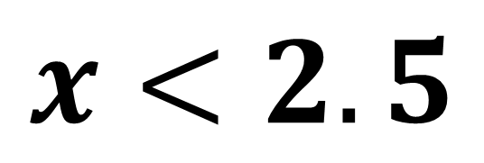


$f\left(x\right)$ = x² $−$ 5x² + 6
For what values of x is f(x) decreasing?
$f\left(x\right)$ = (x – 2)(x – 3)
$$y$$
$$x<2.5$$
$$x$$
2
3

Slide 10
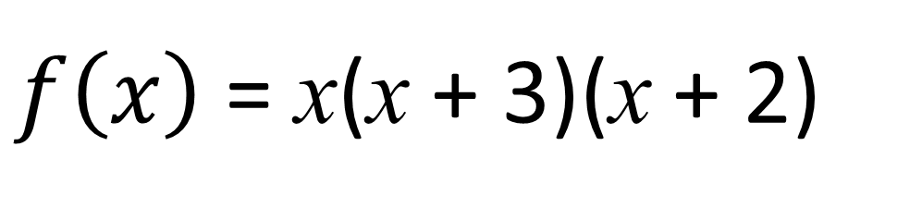
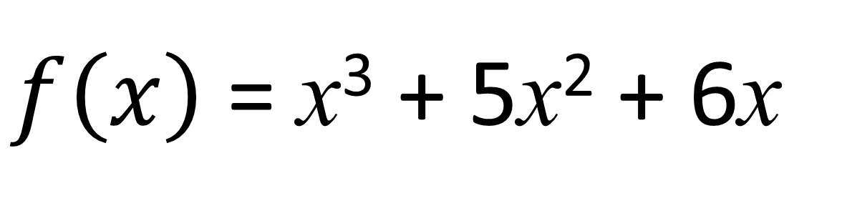
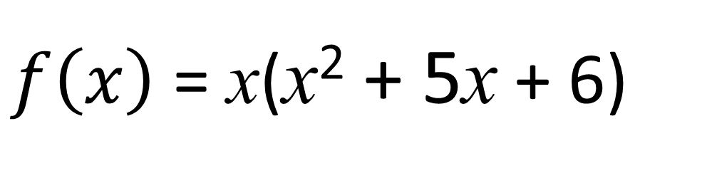


$f\left(x\right)$ = x³ + 5x² + 6x
For what values of x is f(x) decreasing?
$f\left(x\right)$ = x(x² + 5x + 6)
$$y$$
$f\left(x\right)$ = x(x + 3)(x + 2)
It is very difficult to find the turning point of a cubic.
So you will need to answer the question algebraically
-3
-2
0
$$x$$

Slide 11
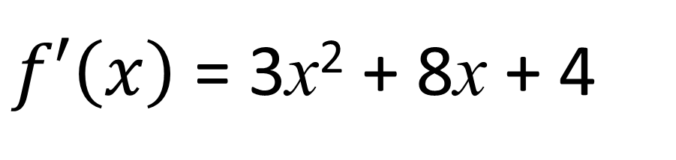
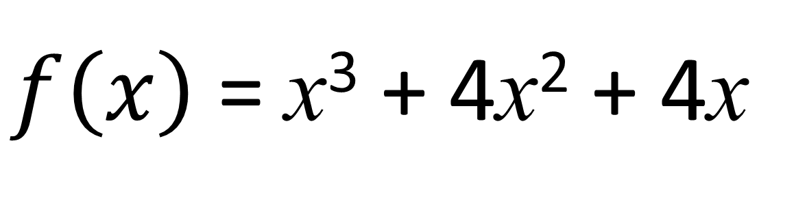
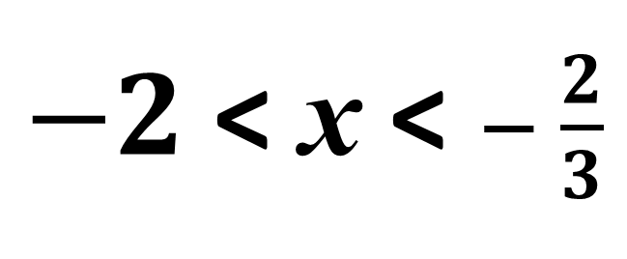
$f\left(x\right)$ = x³ + 4x² + 4x
For what values of x is f(x) decreasing?
$f′\left(x\right)$ = 3x² + 8x + 4
3x² + 8x + 4 < 0
$−2$ < x < $− \frac{2}{3}$
(3x – 2)(x – 2) < 0

Slide 12




$$y$$
$$x$$
$$\frac{dy}{dx}$$
$$x$$

Slide 13




$$y$$
$$x$$
$$\frac{dy}{dx}$$
$$x$$

Slide 14




$$y$$
$$x$$
$$\frac{dy}{dx}$$
$$x$$

Slide 15
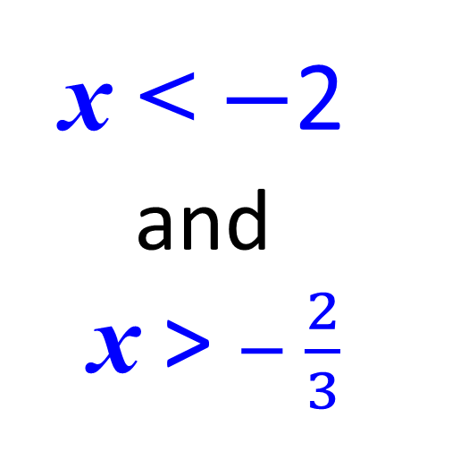
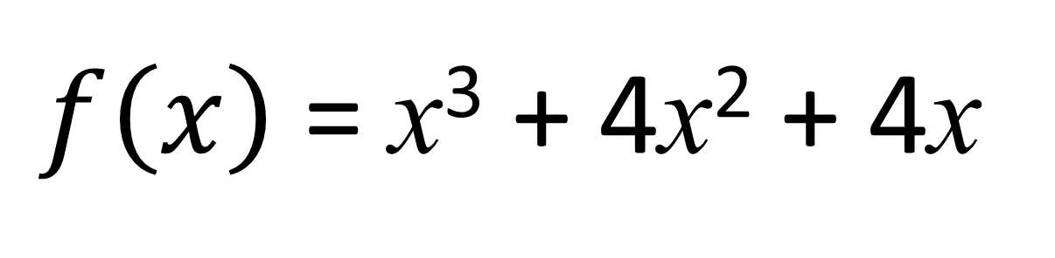
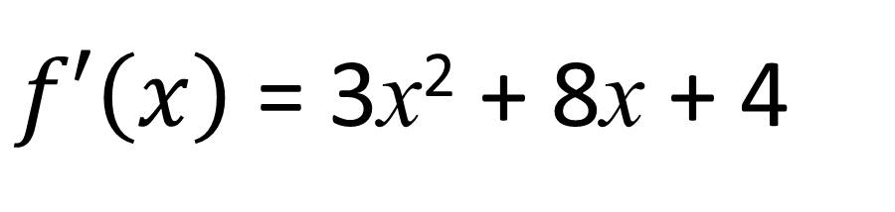
$f\left(x\right)$ = x³ + 4x² + 4x
For what values of x is f(x) increasing?
$f′\left(x\right)$ = 3x² + 8x + 4
x < $−$2
and
x > $− \frac{2}{3}$
3x² + 8x + 4 < 0
(3x – 2)(x – 2) < 0

Slide 16
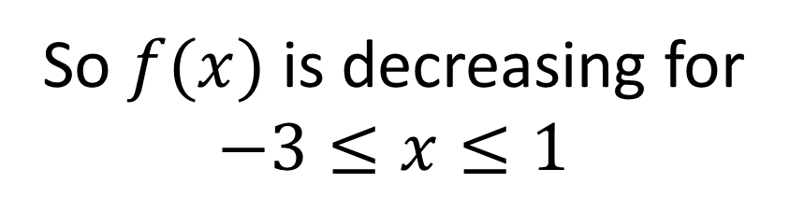
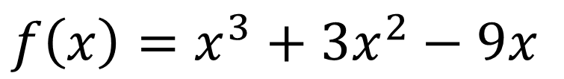
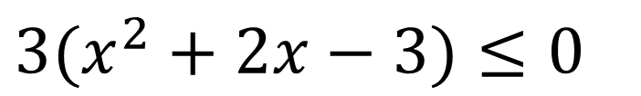
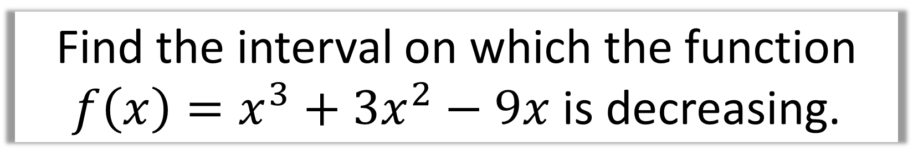
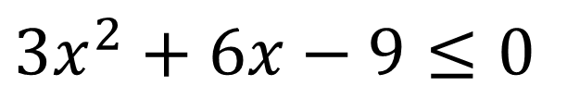
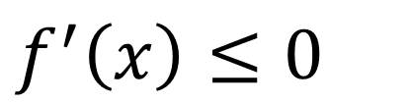
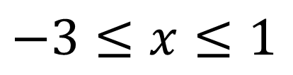
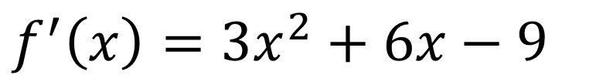
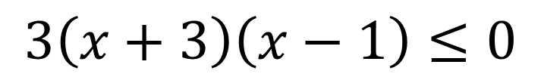
Find the interval on which the function
$f\left(x\right)=x^{3}+3x^{2}−9x$ is decreasing.
$$3(x^{2}+2x−3)≤0$$
$$f\left(x\right)=x^{3}+3x^{2}−9x$$
$$f^{′}\left(x\right)=3x^{2}+6x−9$$
$$3\left(x+3\right)\left(x−1\right)≤0$$
$$−3≤x≤1$$
$$f^{′}\left(x\right)≤0$$
So $f(x)$ is decreasing for
$$−3≤x≤1$$
$$3x^{2}+6x−9≤0$$

Slide 17

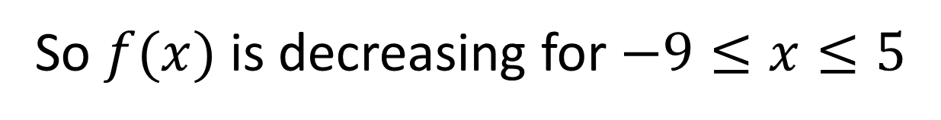

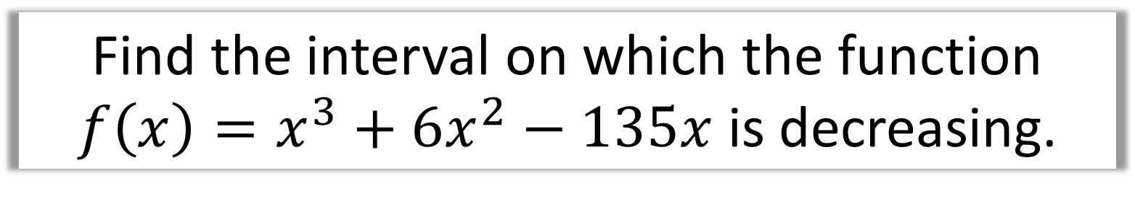
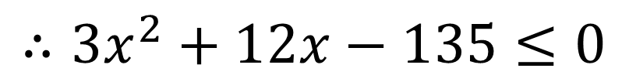
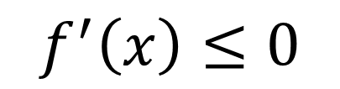
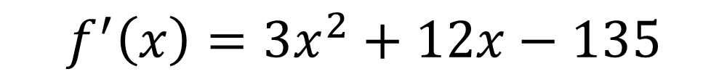
Find the interval on which the function
$f\left(x\right)=x^{3}+6x^{2}−135x$ is decreasing.
$$f^{′}\left(x\right)=3x^{2}+12x−135$$
$$f^{′}\left(x\right)≤0$$
$$∴3x^{2}+12x−135≤0$$
$$x^{2}+4x−45≤0$$
$$\left(x+9\right)\left(x−5\right)≤0$$
So $f(x)$ is decreasing for $−9≤x≤5$

Slide 18
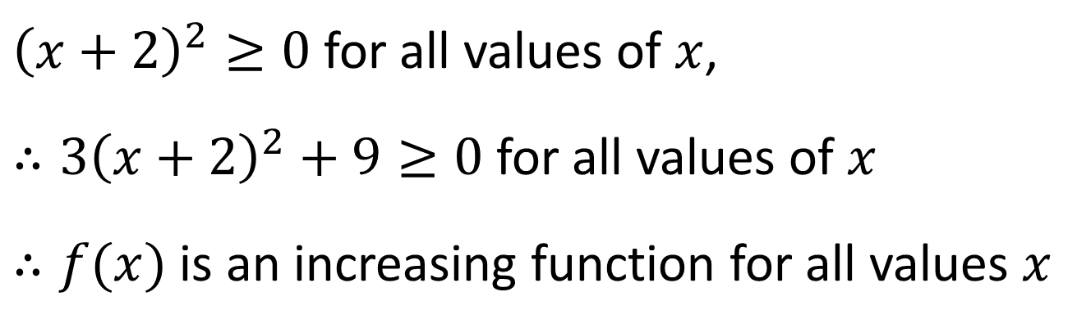
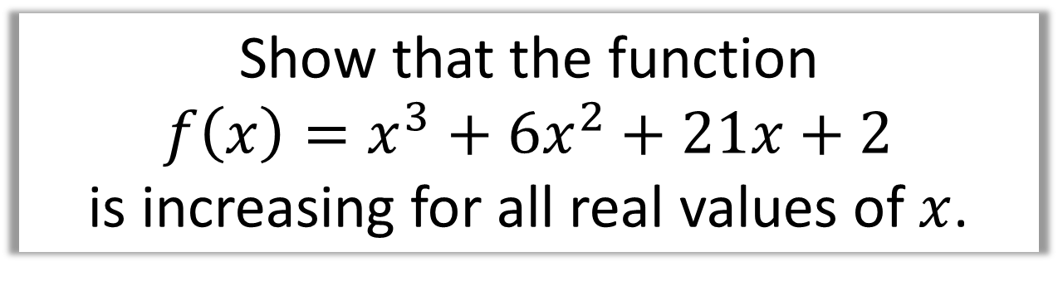
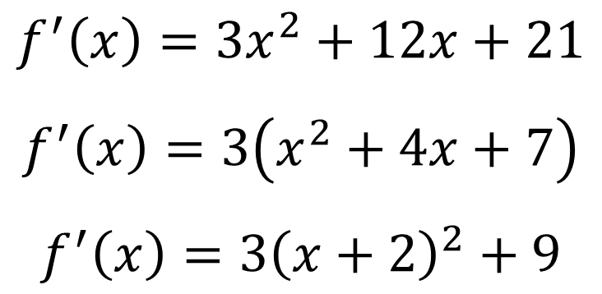
Show that the function
$f\left(x\right)=x^{3}+6x^{2}+21x+2$
is increasing for all real values of $x$.
$$f^{′}\left(x\right)=3x^{2}+12x+21$$
$$f^{′}\left(x\right)=3\left(x^{2}+4x+7\right)$$
$$f^{′}\left(x\right)=3{\left(x+2\right)}^{2}+9$$
Tip: To show a quadratic is always positive,
complete the square,
${\left(x+2\right)}^{2}≥0$ for all values of $x$,
$∴3{\left(x+2\right)}^{2}+9≥0$ for all values of $x$
$∴f(x)$ is an increasing function for all values $x$

Slide 19
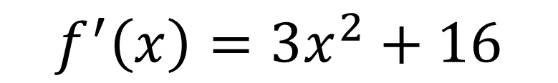
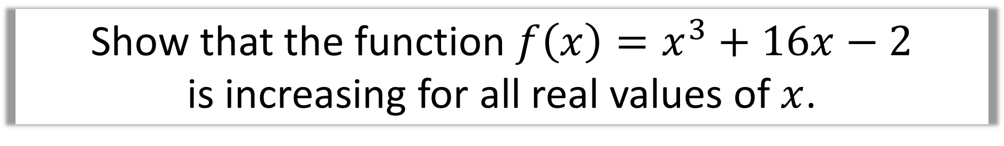
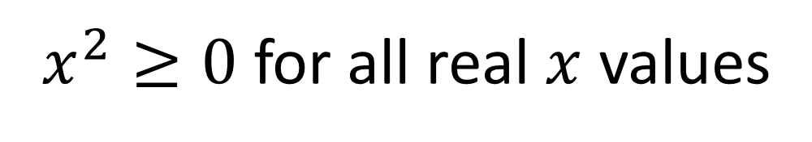
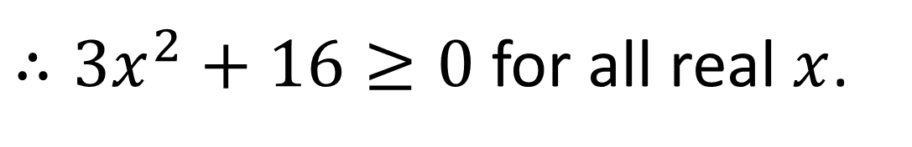
Show that the function $f\left(x\right)=x^{3}+16x−2$
is increasing for all real values of $x$.
$$f^{′}\left(x\right)=3x^{2}+16$$
$x^{2}≥0$ for all real $x$ values
$∴3x^{2}+16≥0$ for all real $x$.
Therefore $f(x)$ is an increasing function for all real $x$.

