Slide 1
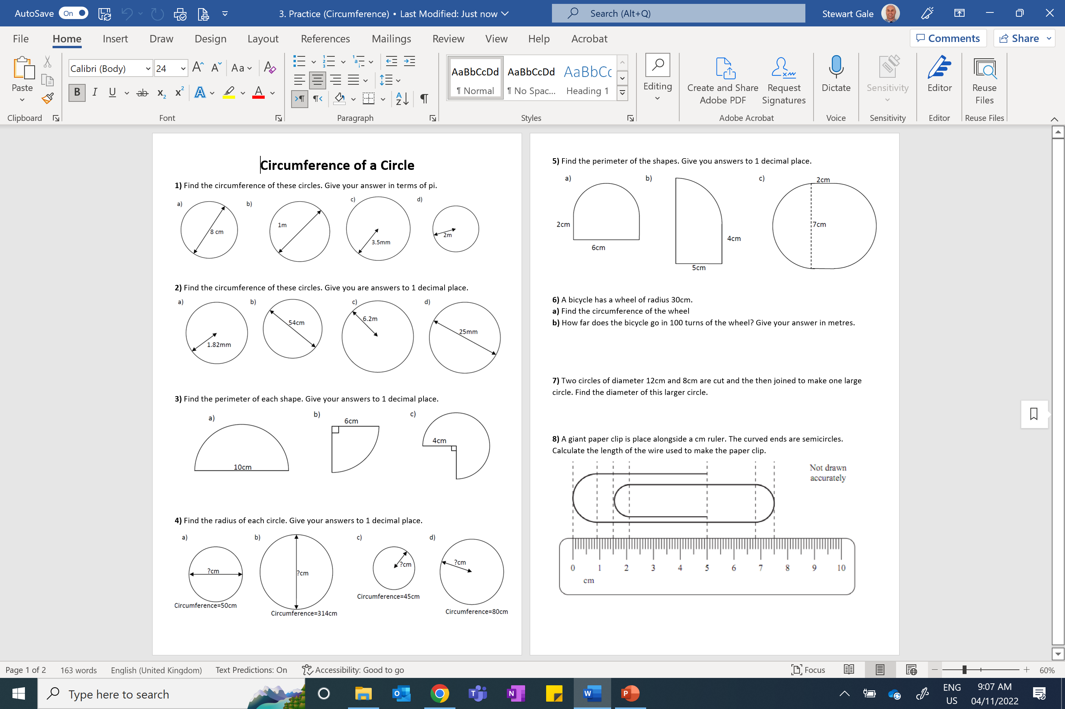

Slide 2
ANSWERS

Slide 3
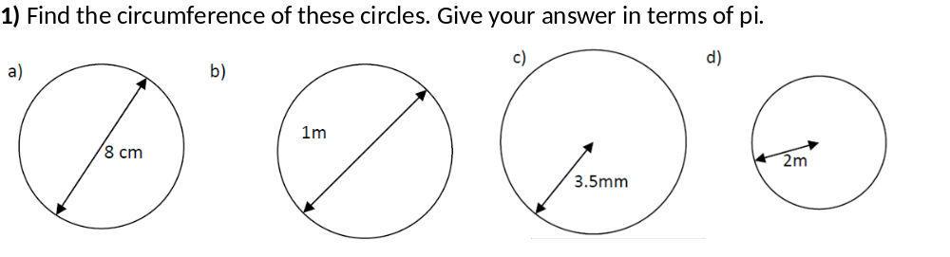
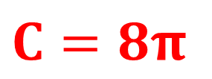
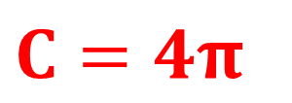
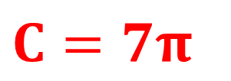
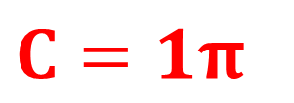
$$C=8π$$
$$C=1π$$
$$C=7π$$
$$C=4π$$

Slide 4
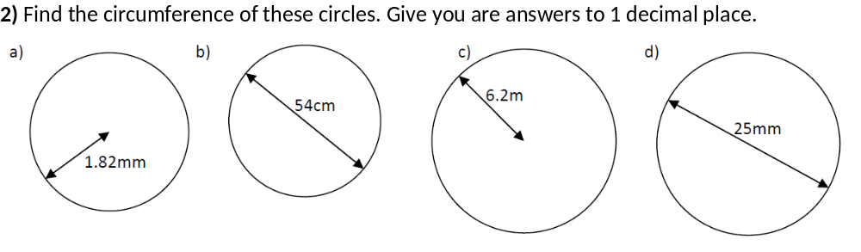


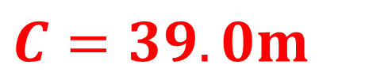
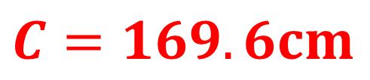
$$C=11.4mm$$
$$C=169.6cm$$
$$C=39.0m$$
$$C=78.5mm$$

Slide 5
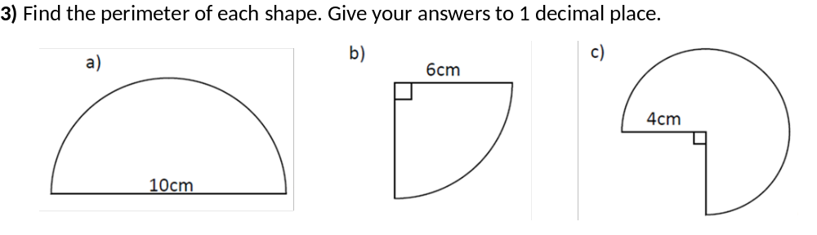
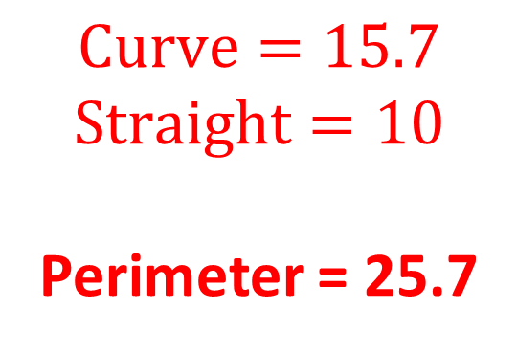
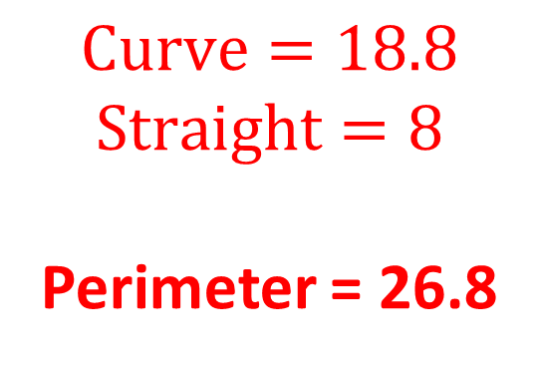
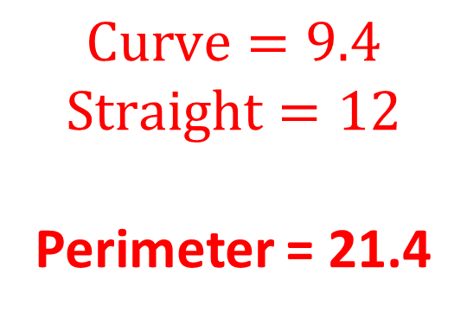
$$Curve=15.7$$
$$Straight=10$$
Perimeter = 25.7
$$Curve=9.4$$
$$Straight=12$$
Perimeter = 21.4
$$Curve=18.8$$
$$Straight=8$$
Perimeter = 26.8

Slide 6
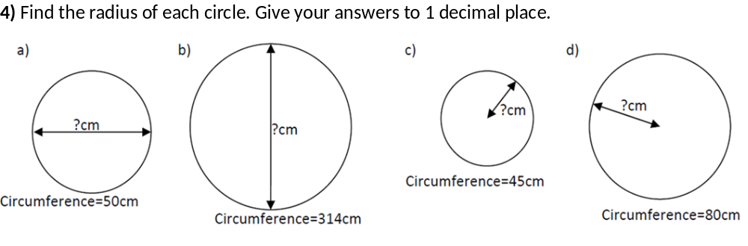
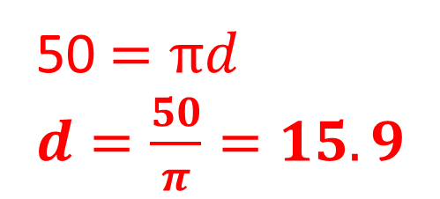
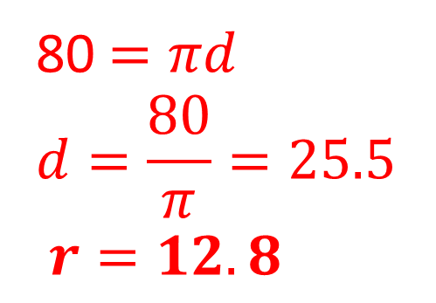
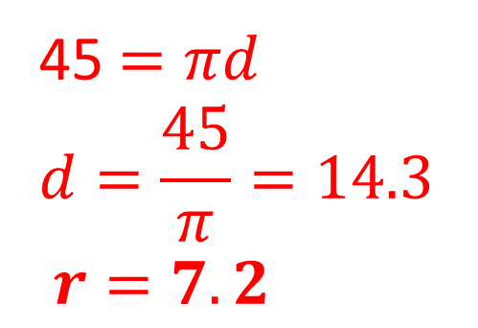
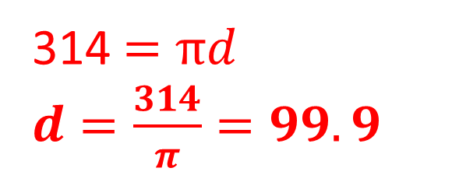
45$=πd$
$$d=\frac{45}{π}=14.3$$
$r=7.2$
50$=πd$
$d=\frac{50}{π}=15.9$
314$=πd$
$d=\frac{314}{π}=99.9$
80$=πd$
$$d=\frac{80}{π}=25.5$$
$r=12.8$

Slide 7
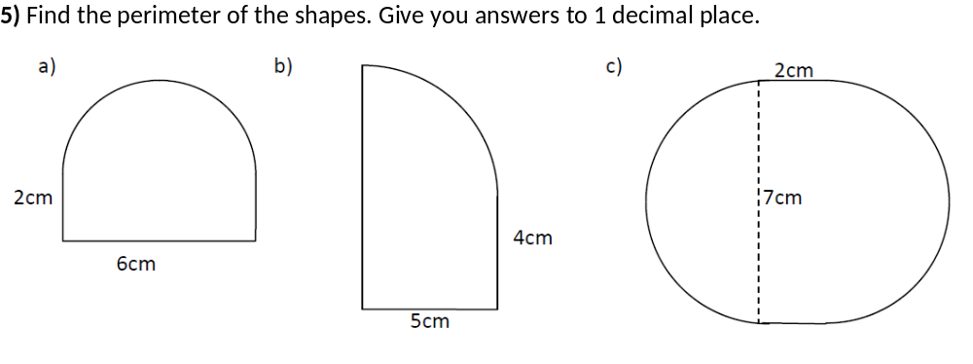
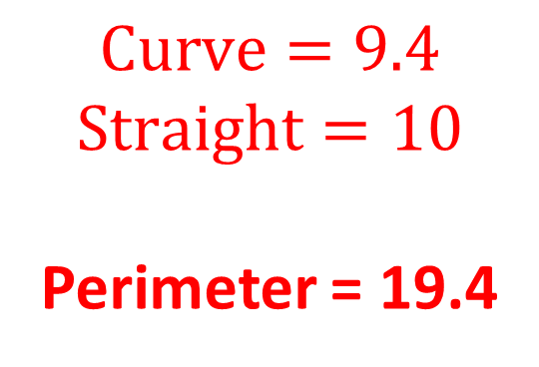
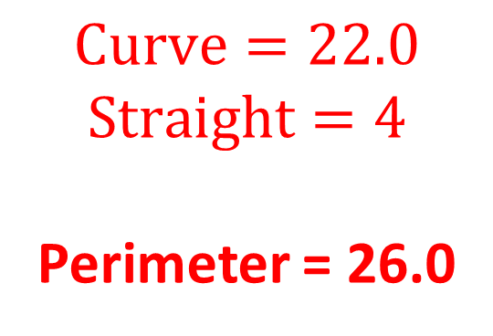
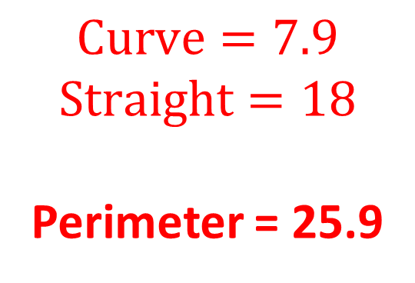
$$Curve=9.4$$
$$Straight=10$$
Perimeter = 19.4
$$Curve=7.9$$
$$Straight=18$$
Perimeter = 25.9
$$Curve=22.0$$
$$Straight=4$$
Perimeter = 26.0

Slide 8
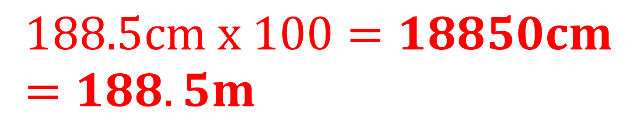
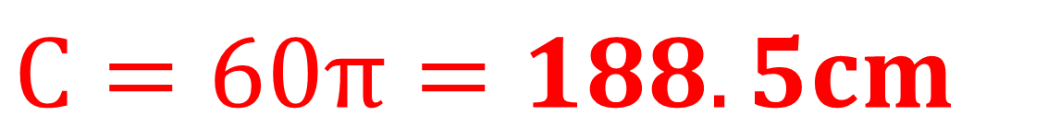
6) A bicycle has a wheel of radius 30cm.
a) Find the circumference of the wheel
b) How far does the bicycle go in 100 turns of the wheel? Give your answers in metres.
$$C=60π=188.5cm$$
$$188.5cm x 100=18850cm=188.5m$$

Slide 9
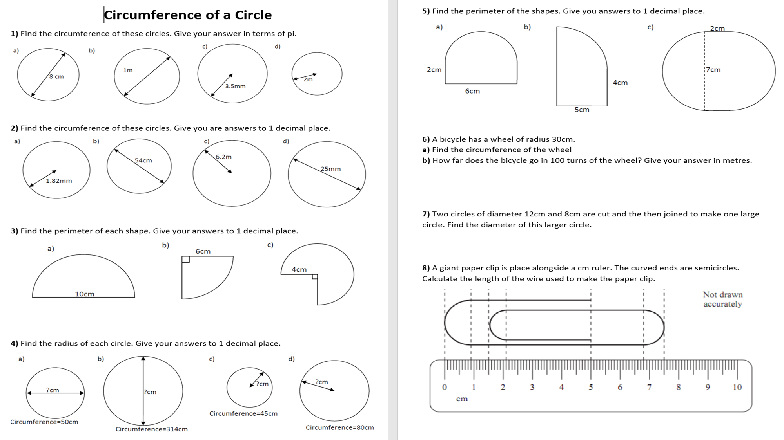
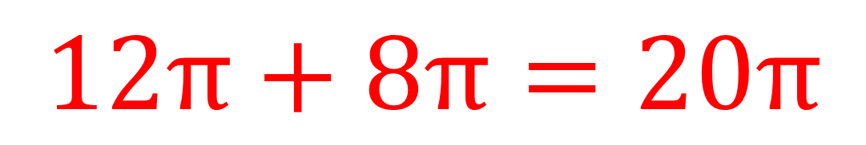
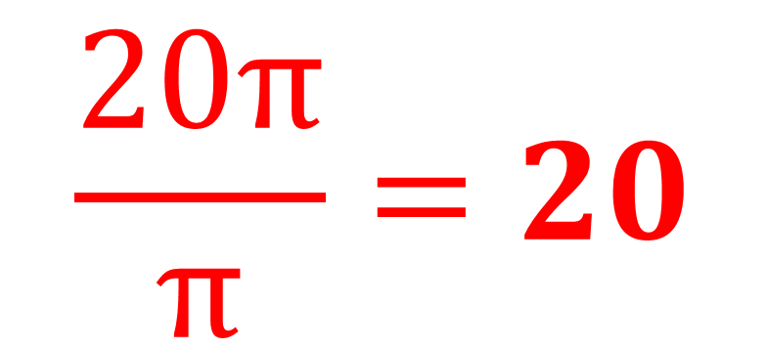
$$12π+8π=20π$$
$$\frac{20π}{π}=20$$

Slide 10
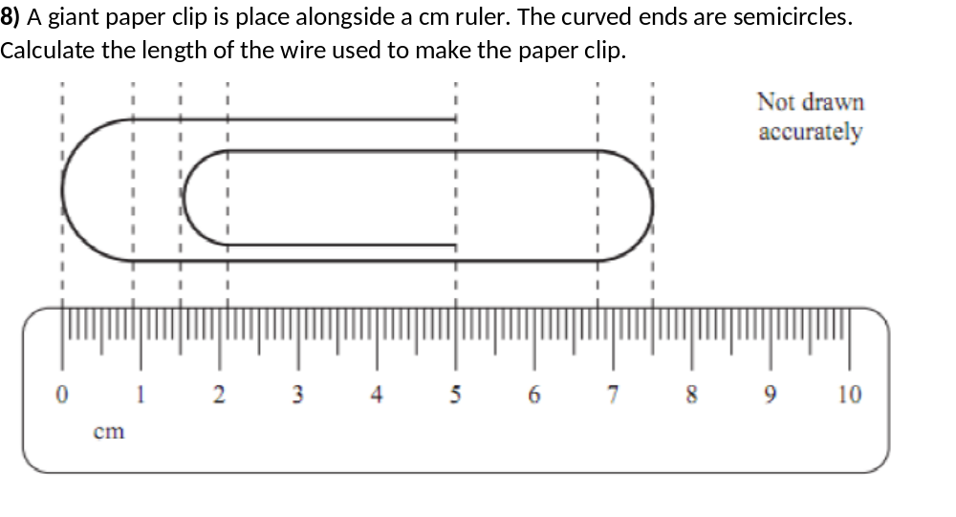
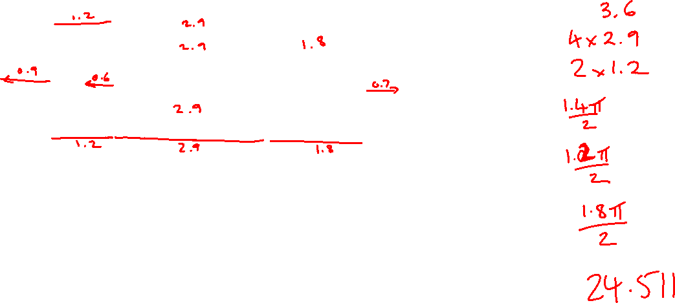
2x1.8 + 4x2.9 + 2x1.2 + 0.7pi + 0.6pi + 0.9pi = 24.51cm

