Slide 1
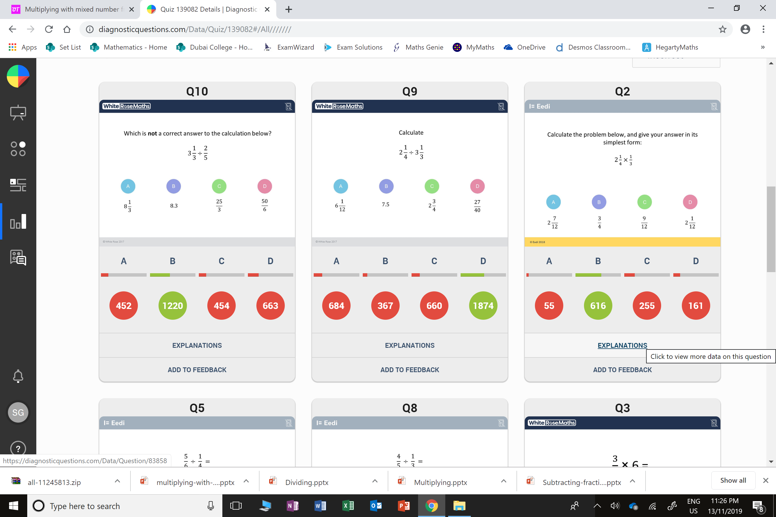
Which question had the lowest percentage of
correct answers?
For each question, what was the most common
wrong answer?

Slide 2
ANSWERS

Slide 3
Which question had the lowest percentage of
correct answers?

Slide 4
D
The student has
pick an equivalent and correct fraction.

Slide 5
C
The student has chosen
a correct fraction
but it has not been simplified.

