Slide 1

Intermediate Challenge 1
BRONZE

Slide 2
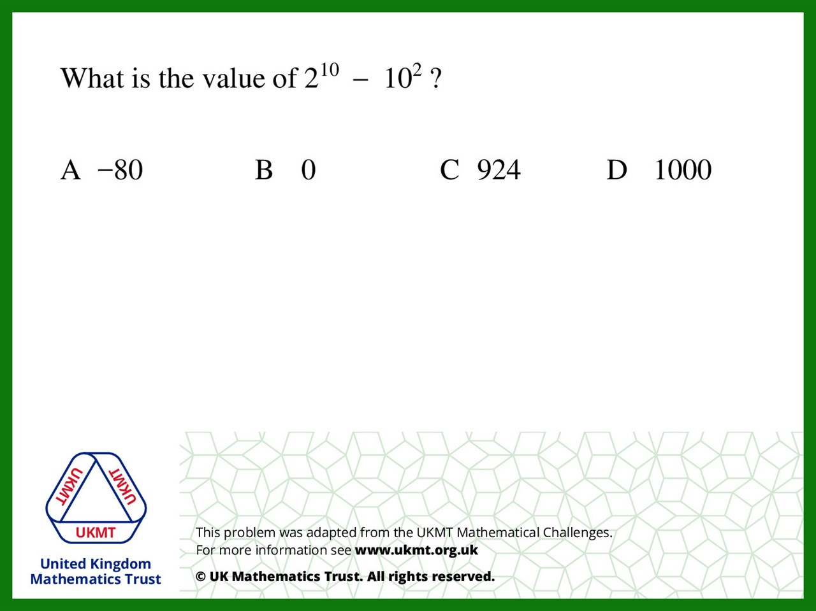
Q1.
1024 – 100 = 924

Slide 3
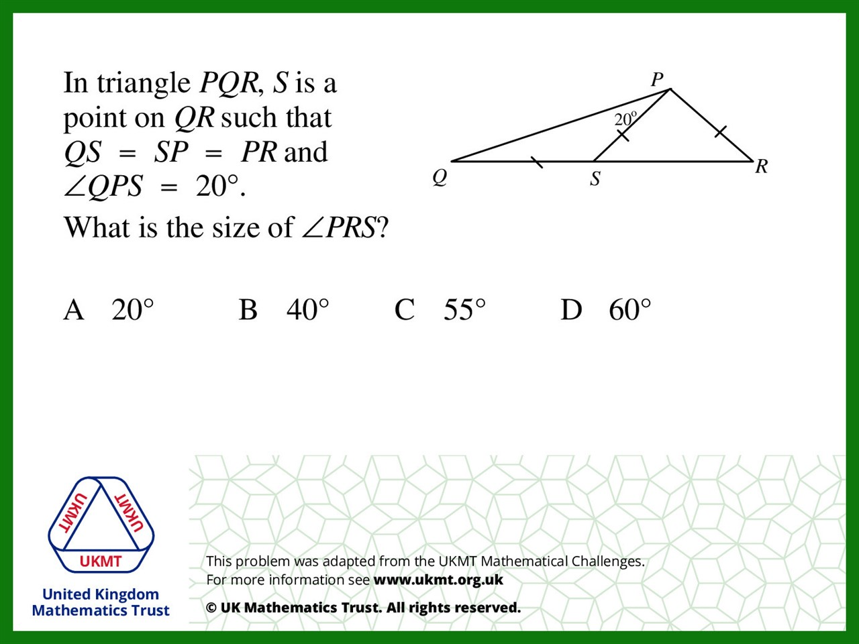
Q2.
PQS=20, PSQ=140, PSR=40 so PRS=40

Slide 4
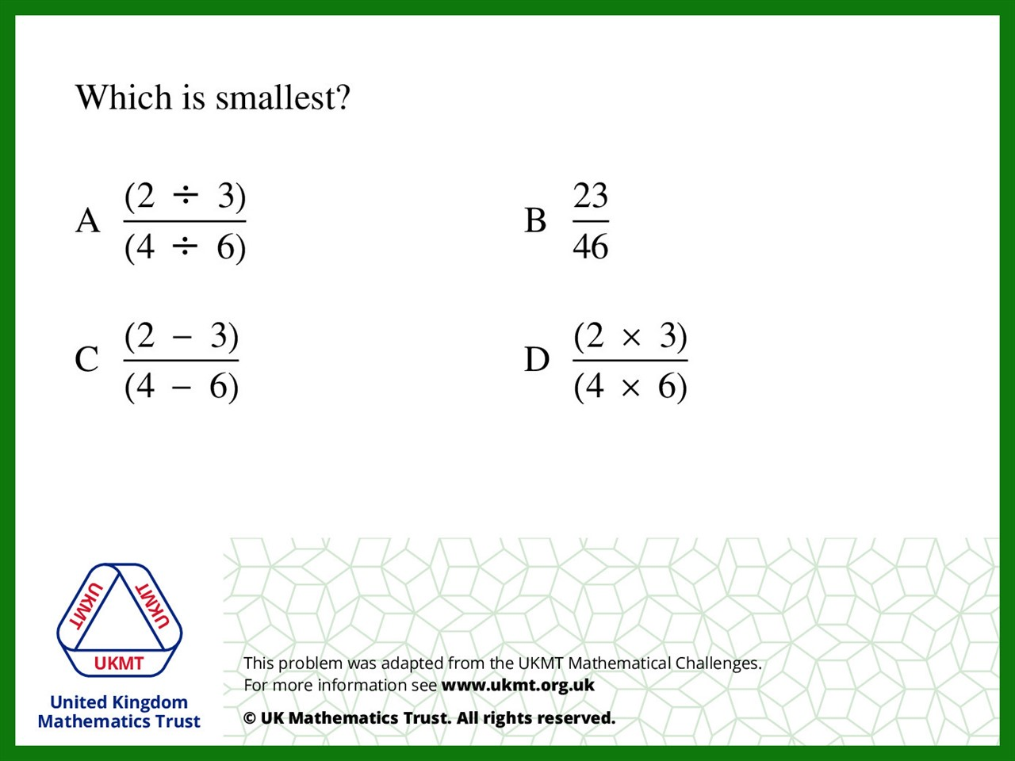
Q3.
A = 1 B = 0.5 C = 0.5 D = 0.25

Slide 5

Q4.
2 goes down to 1.5. If you multiply both by two you get 4 goes down to 3

Slide 6
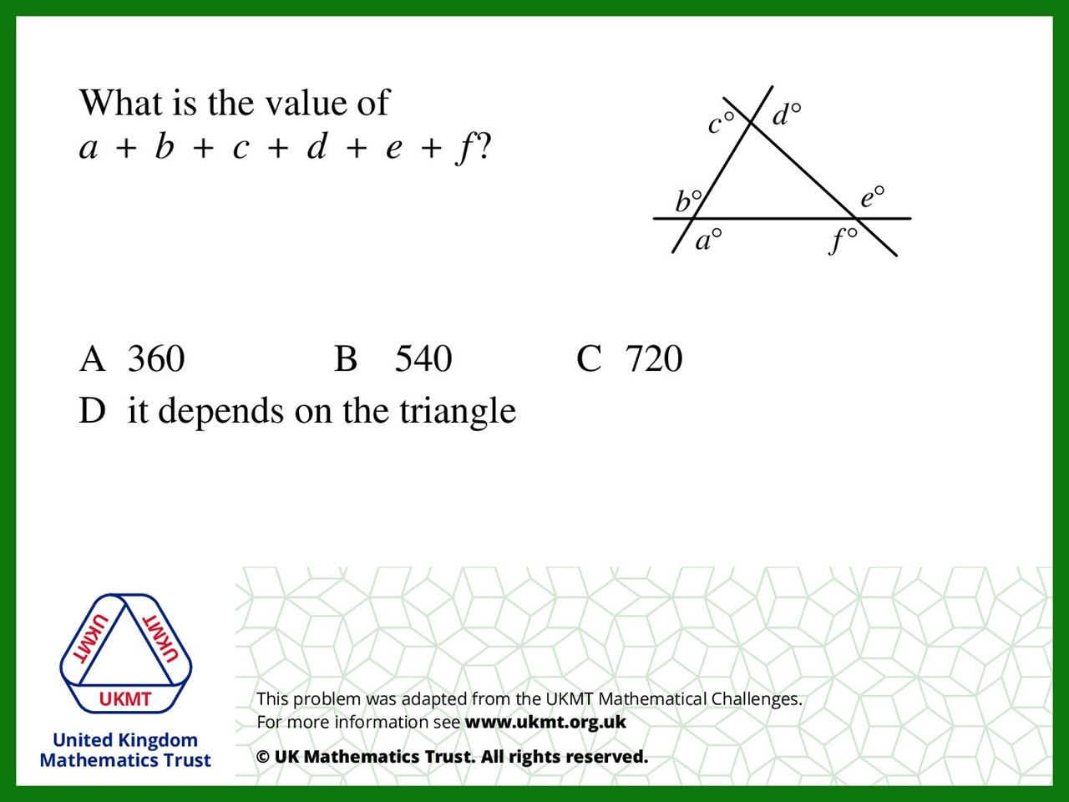
Q5.
Exterior angles add up to 360 but
the sum of this doubled so it is equal to 720 degrees.

