Slide 1
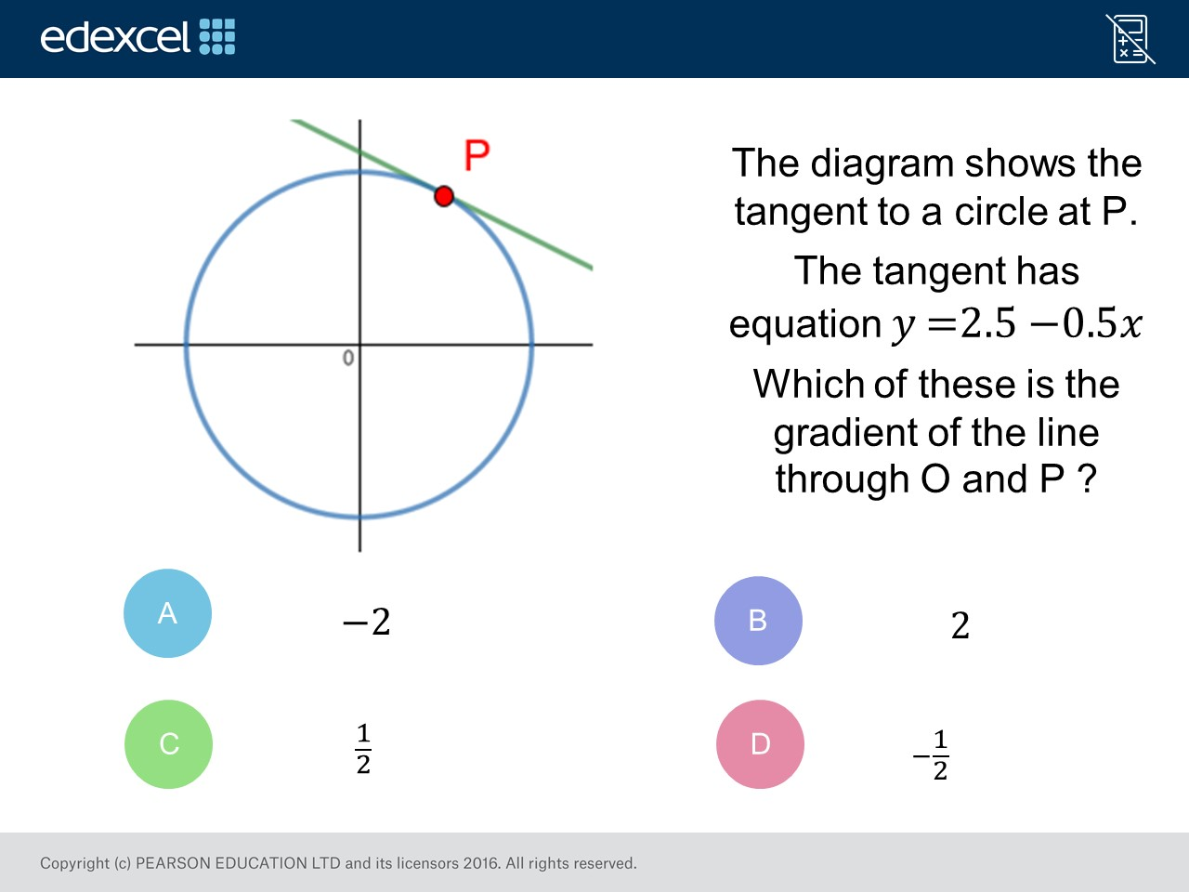
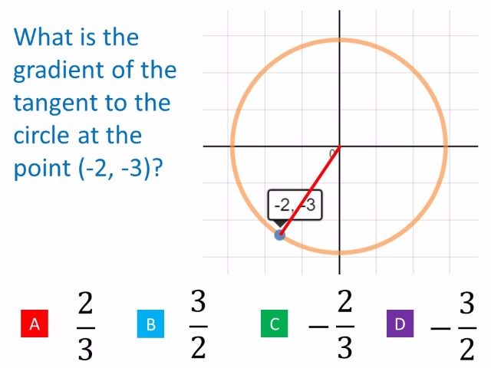
Worst answered question?
Most common wrong answer?

Slide 2
ANSWERS

Slide 3
Worst answered question?

Slide 4
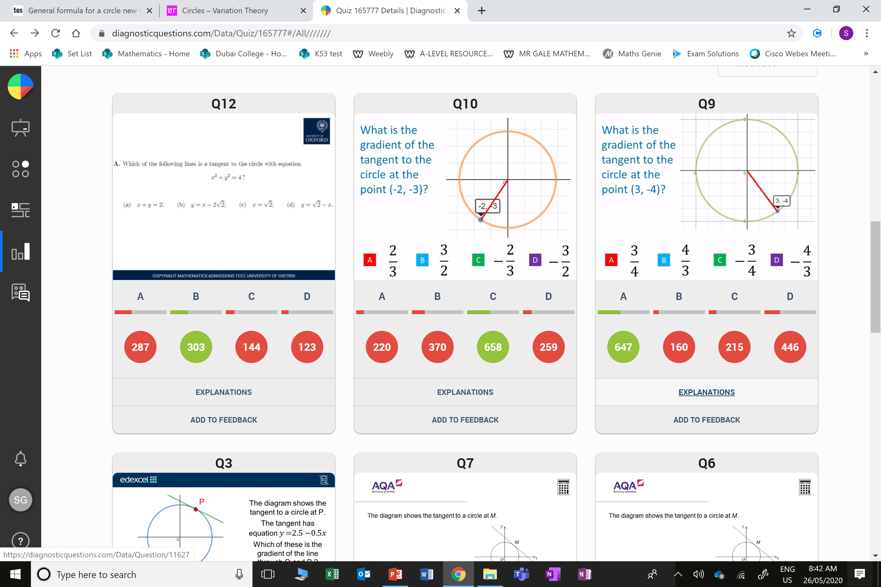
B
They found the gradient of the radius and not the tangent.

Slide 5
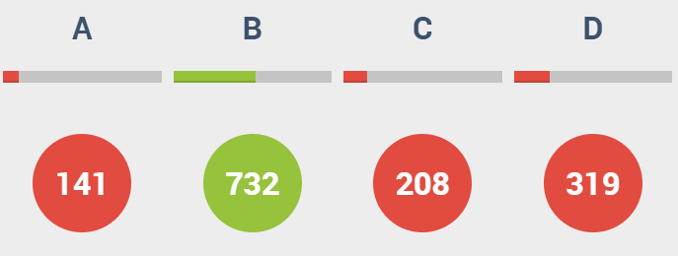
D
The found the gradient of the tangent and instead of the radius.

