Slide 1
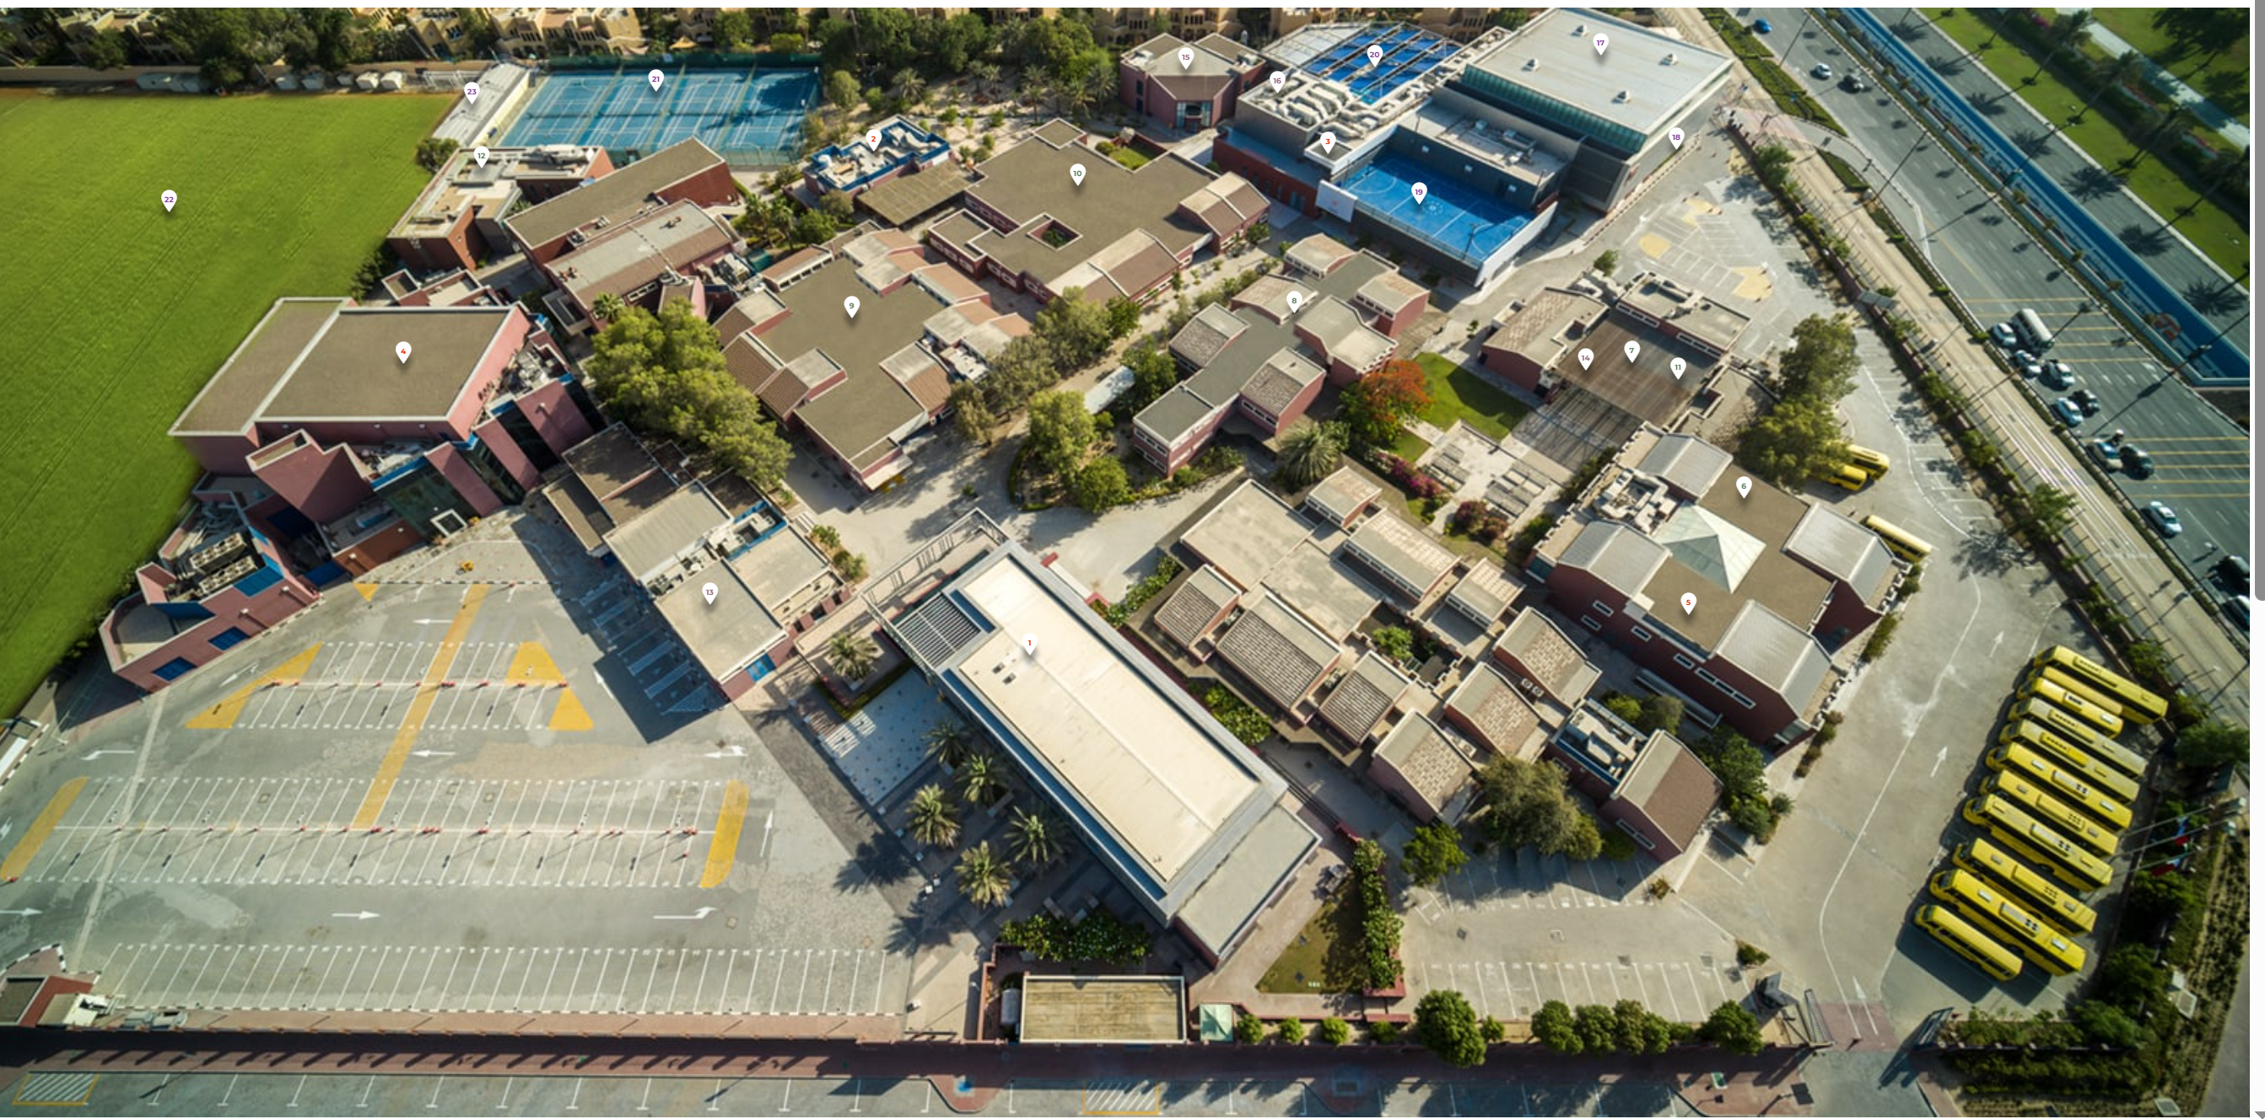
Music
Space
(Drama, PE, Music)
E Block
(English)
Canteen
Sxith Form Centre
S Block
(Science)
Jafar
Centre
(Maths, Art, CS)
B Block
(Languages)
AUD
DT
Block
D Block
(Geog, History)
Construction
Reception
and Admin Block

Slide 2
Netball Courts
E Block
(English)
Music
Canteen
Sports Field
AUD
S Block
(Science)
Sxith Form Centre
Space
(Drama, PE, Music)
DT
Block
B Block
(Languages)
Jafar
Centre
(Maths, Art, CS)
Construction
Reception
and Admin Block
D Block
(Geog, History)
Form Room
Buses

