Slide 1
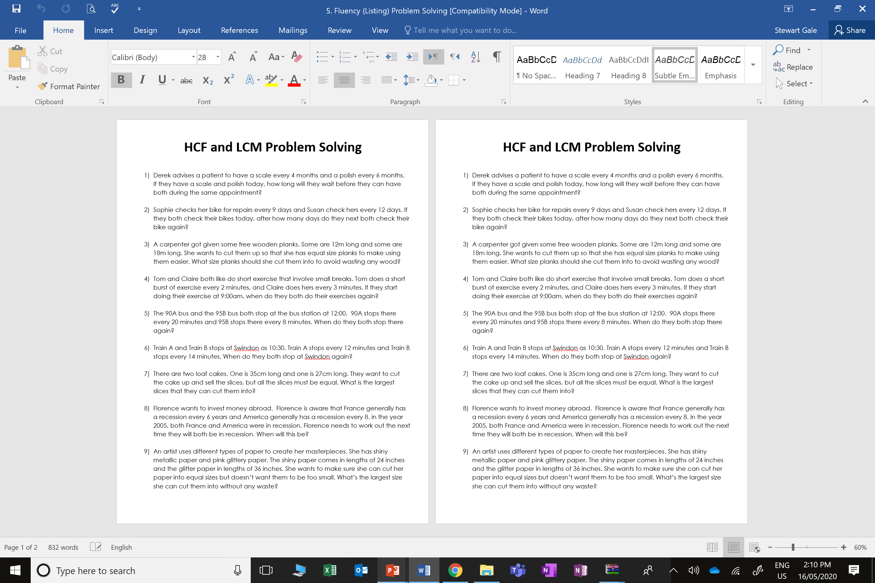
HCF and LCM

Slide 2
ANSWERS

Slide 3
1) Derek advises a patient to have a scale every 4 months and a polish every 6 months. If they have a scale and polish today, how long will they wait before they can have both during the same appointment? 12 Months

Slide 4
2) Sophie checks her bike for repairs every 9 days and Susan check hers every 12 days. If they both check their bikes today, after how many days do they next both check their bike again? 36 days

Slide 5
3) A carpenter got given some free wooden planks. Some are 12m long and some are 18m long. She wants to cut them up so that she has equal size planks to make using them easier. What size planks should she cut them into to avoid wasting any wood? 6m

Slide 6
4) Tom and Claire both like do short exercise that involve small breaks. Tom does a short burst of exercise every 2 minutes, and Claire does hers every 3 minutes. If they start doing their exercise at 9:00am, when do they both do their exercises again? 9:06am

Slide 7
5) The 90A bus and the 95B bus both stop at the bus station at 12:00. 90A stops there every 20 minutes and 95B stops there every 8 minutes. When do they both stop there again? 12:40 (after 40 minutes)

Slide 8
6) Train A and Train B stops at Swindon as 10:30. Train A stops every 12 minutes and Train B stops every 14 minutes. When do they both stop at Swindon again? 84 minutes later – 11:54

Slide 9
7) There are two loaf cakes. One is 35cm long and one is 27cm long. They want to cut the cake up and sell the slices, but all the slices must be equal. What is the largest slices that they can cut them into? 1cm

Slide 10
8) Florence wants to invest money abroad. Florence is aware that France generally has a recession every 6 years and America generally has a recession every 8. in the year 2005, both France and America were in recession. Florence needs to work out the next time they will both be in recession. When will this be?
In 24 years - 2029

Slide 11
9) An artist uses different types of paper to create her masterpieces. She has shiny metallic paper and pink glittery paper. The shiny paper comes in lengths of 24 inches and the glitter paper in lengths of 36 inches. She wants to make sure she can cut her paper into equal sizes but doesn’t want them to be too small. What’s the largest size she can cut them into without any waste? 12 inches

