Slide 1
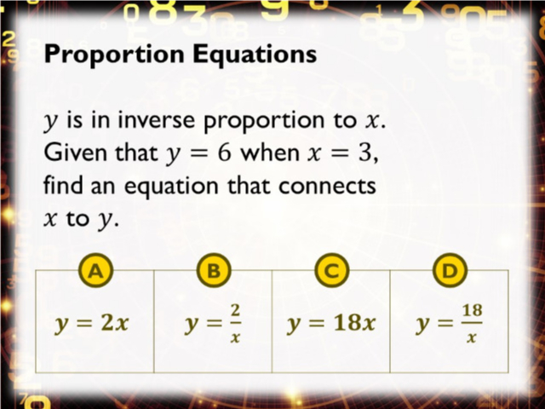
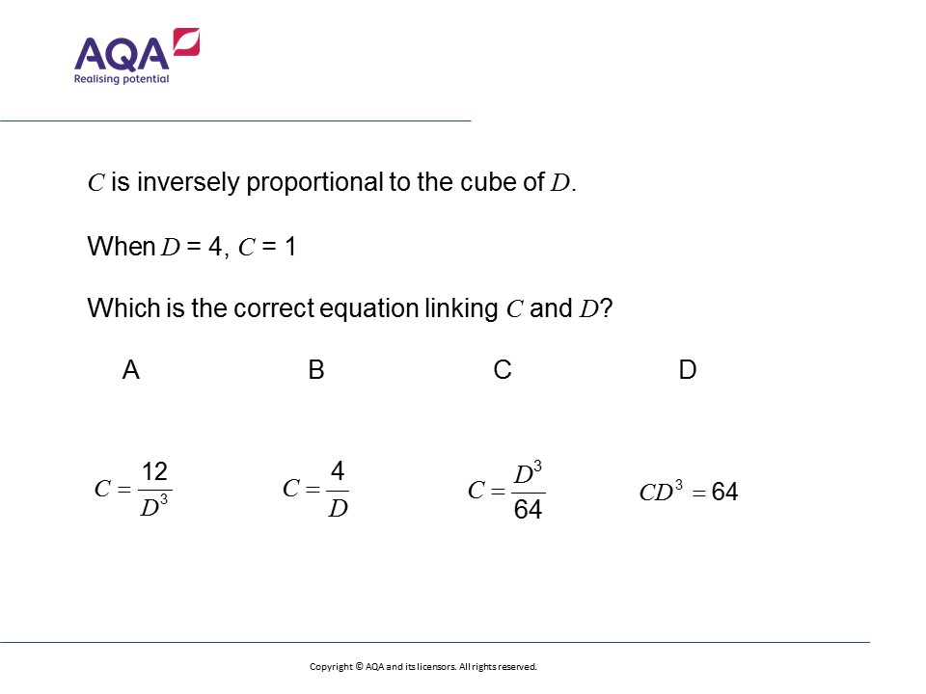
Worst answered question?
Most common wrong answer?

Slide 2
ANSWERS

Slide 3
Worst answered question?
Most common wrong answer?

Slide 4
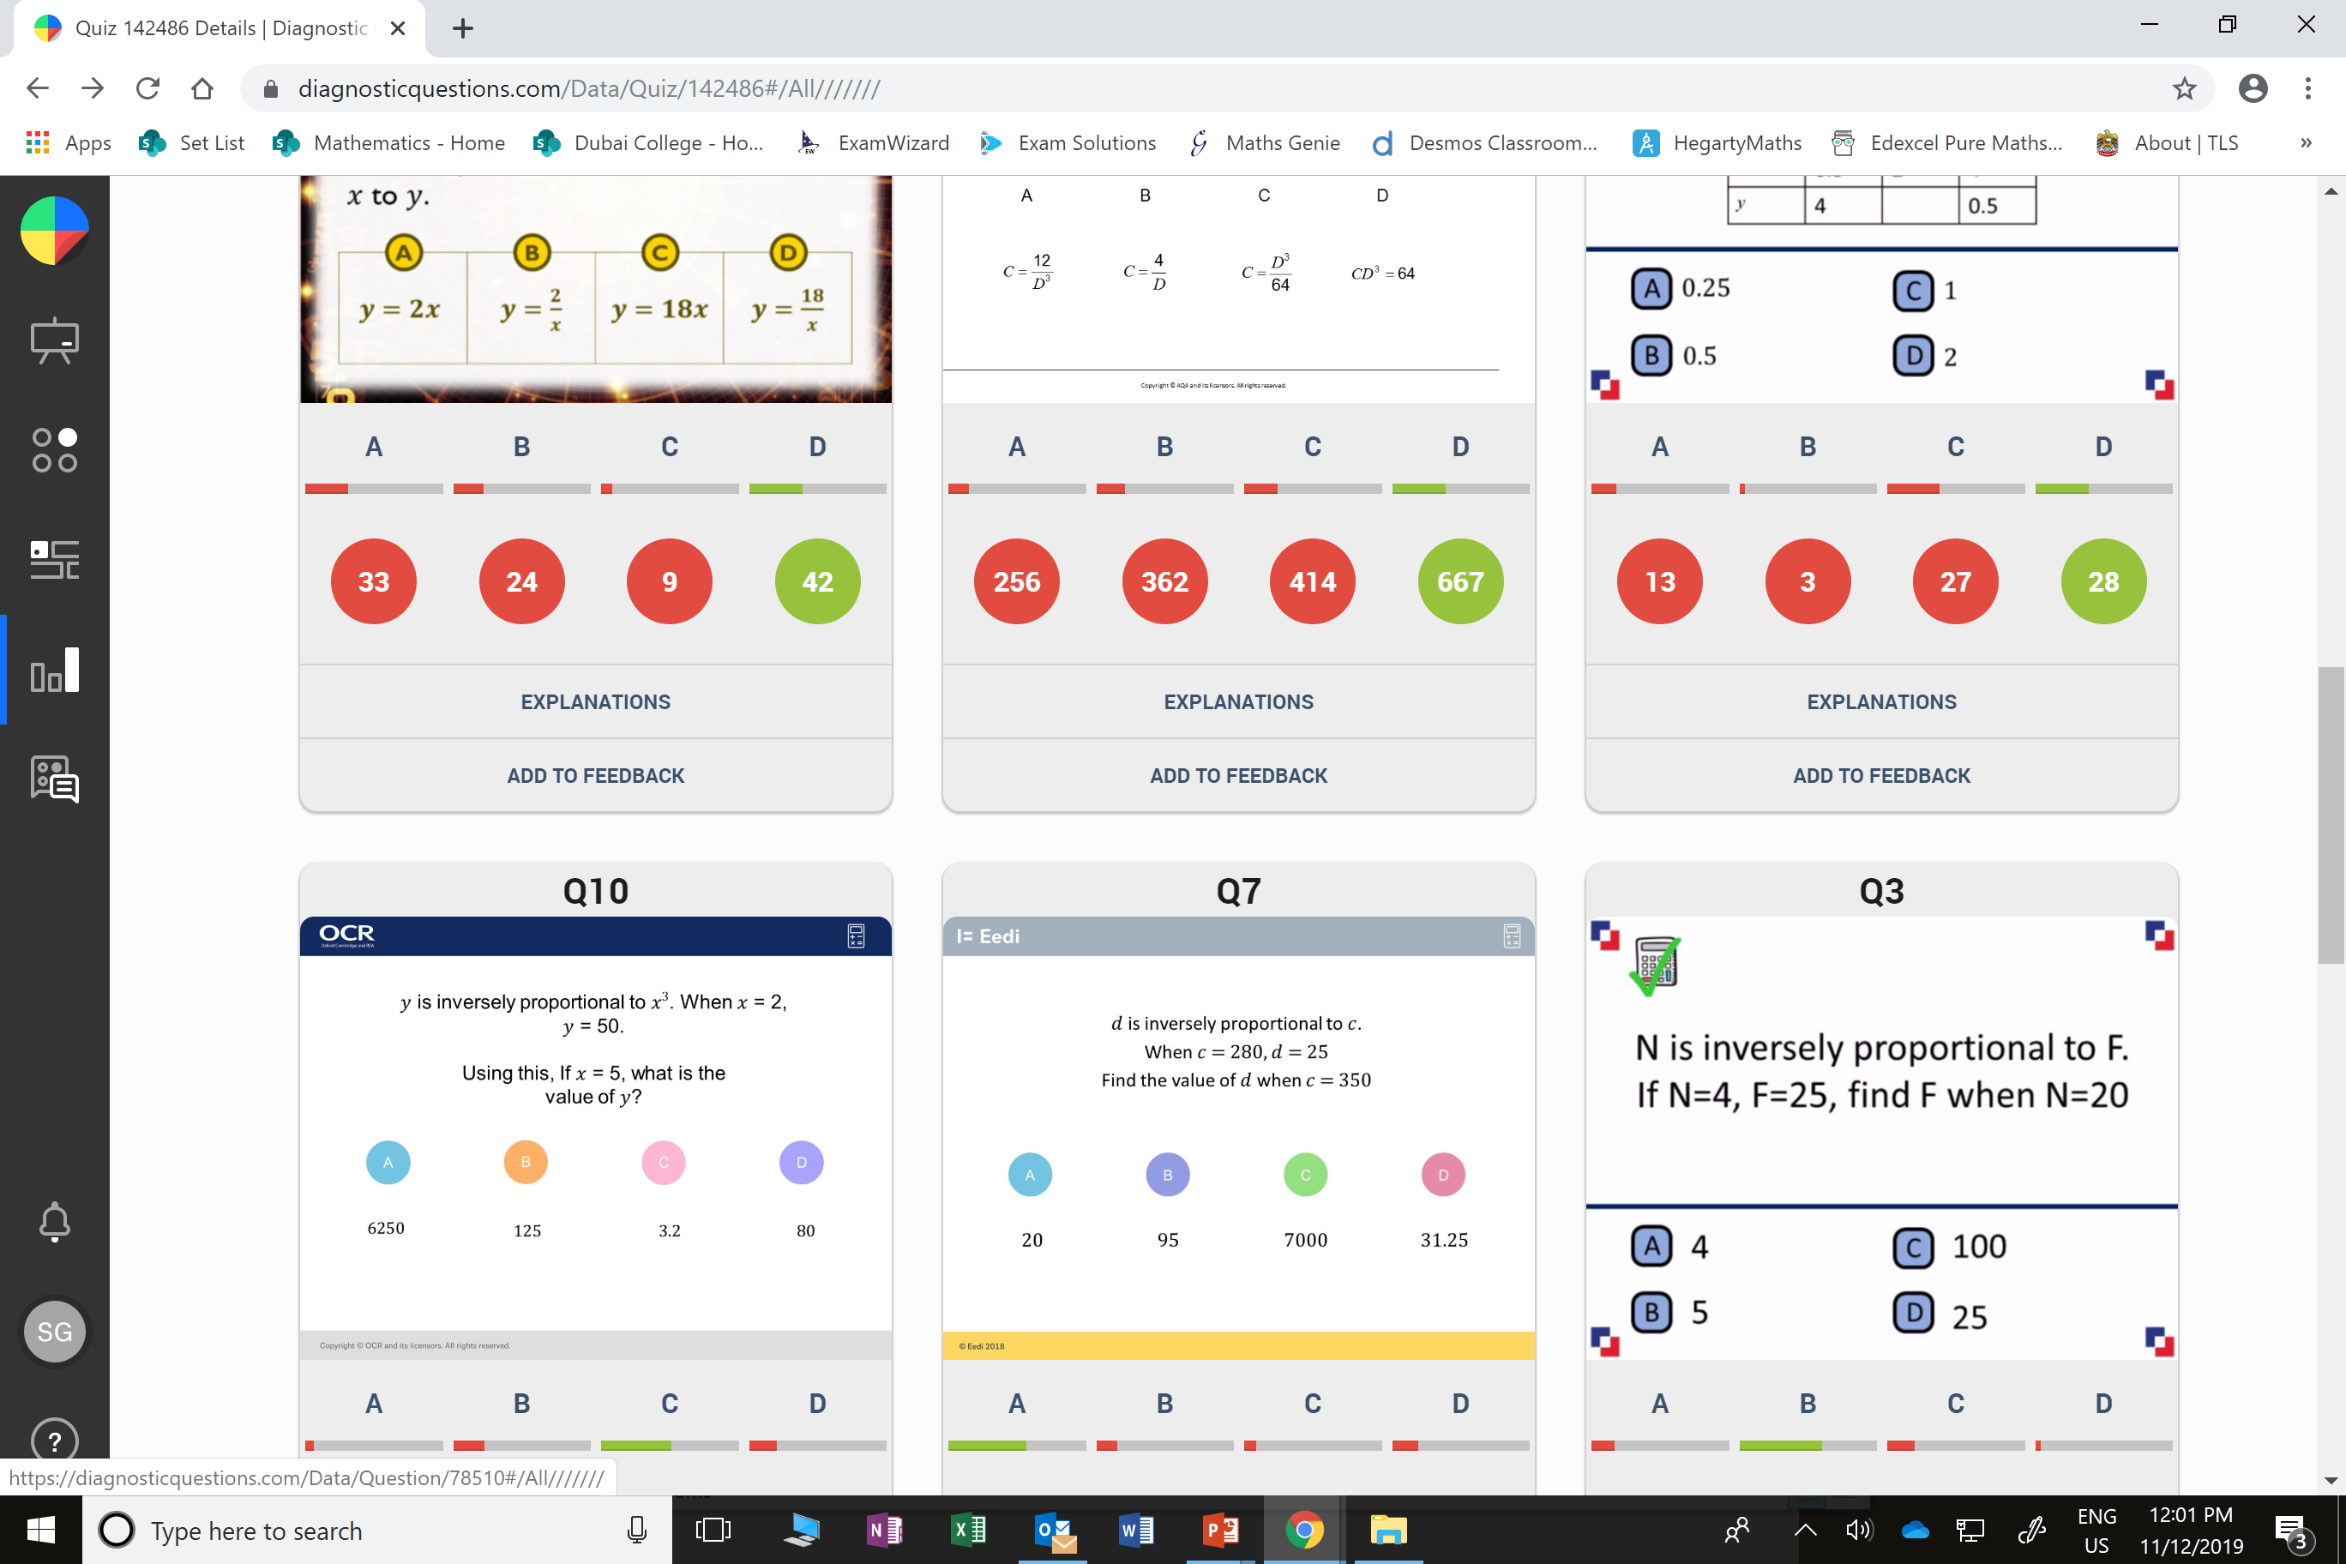
A
They have done direct proportion.

Slide 5
B
4³ x 1 = 64
they did
4 x 1= 4

