Slide 1
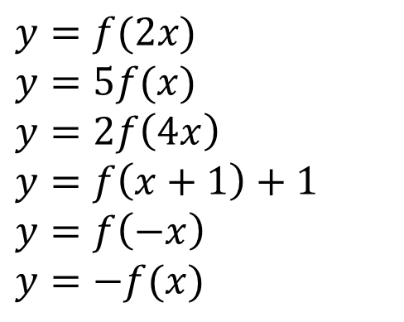
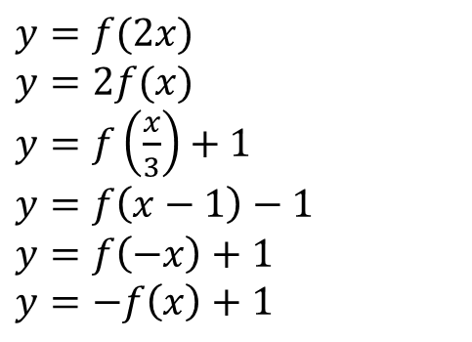
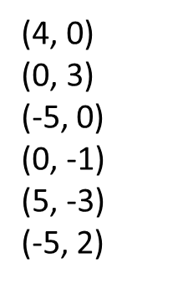
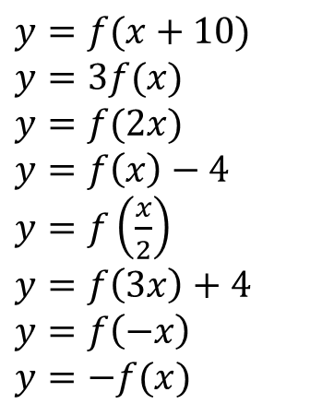
1
Describe the affects of the following graph transformations.
3
The point (0, 0) on a curve y = f(x) is mapped to the following points. Find the equation for the translated curve.
$y=f(x+10)$
$y=3f(x)$
$y=f(2x)$
$y=f\left(x\right)−4$
$y=f\left(\frac{x}{2}\right)$
$y=f\left(3x\right)+4$
$y=f\left(−x\right)$
$y=−f(x)$
(4, 0)
(0, 3)
(-5, 0)
(0, -1)
(5, -3)
(-5, 2)
4
To what points will (-2, 0) on the curve y = f(x)
be transformed to under the following transformations?
$y=f(2x)$
$y=2f(x)$
$y=f\left(\frac{x}{3}\right)+1$
$y=f\left(x−1\right)−1$
$$y=f\left(−x\right)+1$$
$$y=−f\left(x\right)+1$$
2
To what point will (4, -1) on the curve y = f(x)
be transformed to under the following transformations?
$y=f(2x)$
$y=5f(x)$
$y=2f\left(4x\right)$
$y=f\left(x+1\right)+1$
$y=f\left(−x\right)$
$y=−f(x)$
5
Find the equation of the curve obtained when $y=x^{2}+3x$ is:
Translated 5 units up. Translated 2 units right. Reflected in x-axis.

Slide 2
ANSWERS

Slide 3
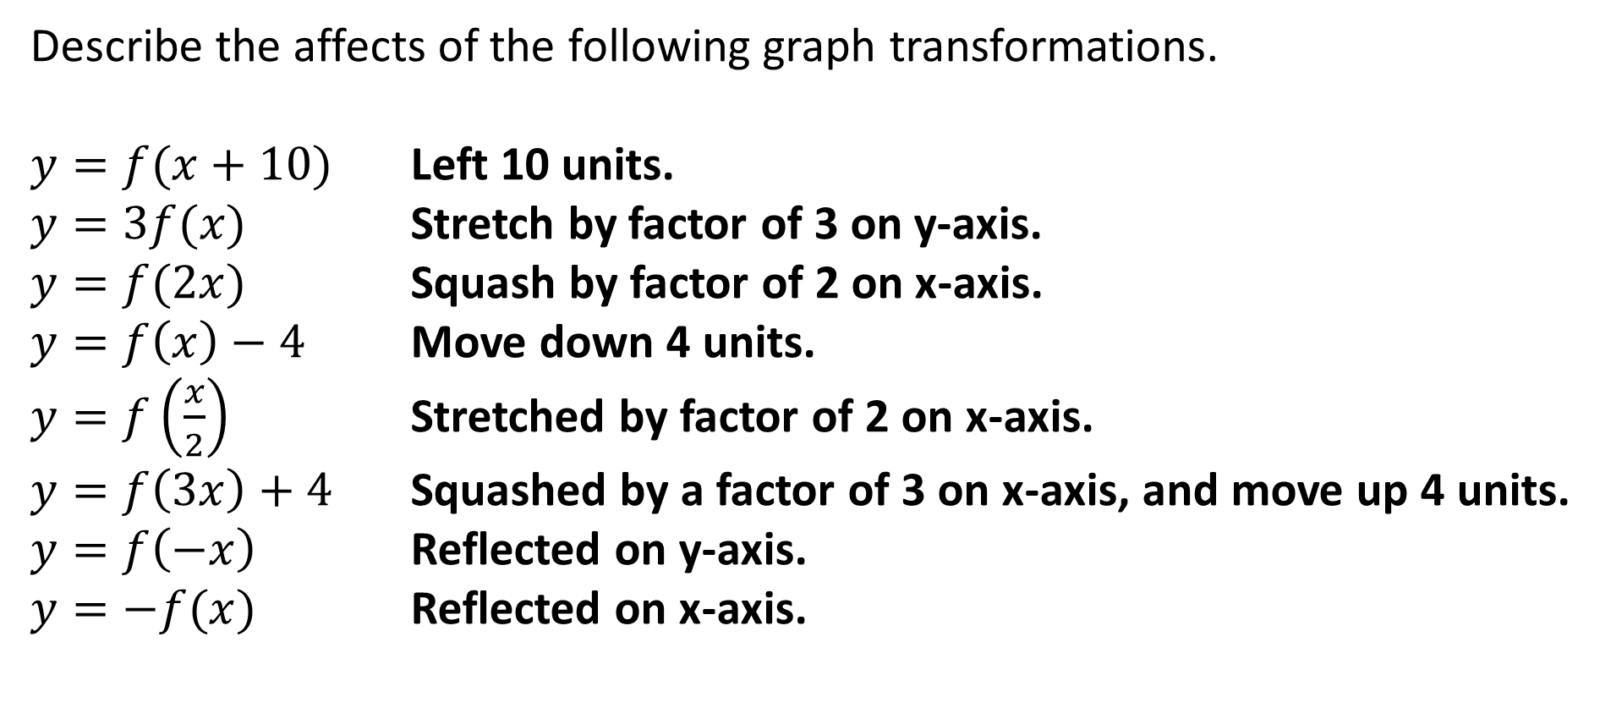
1
Describe the affects of the following graph transformations.
$y=f(x+10)$ Left 10 units.
$y=3f(x)$ Stretch by factor of 3 on y-axis.
$y=f(2x)$ Squash by factor of 2 on x-axis.
$y=f\left(x\right)−4$ Move down 4 units.
$y=f\left(\frac{x}{2}\right)$ Stretched by factor of 2 on x-axis.
$y=f\left(3x\right)+4$ Squashed by a factor of 3 on x-axis, and move up 4 units.
$y=f\left(−x\right)$ Reflected on y-axis.
$y=−f(x)$ Reflected on x-axis.

Slide 4
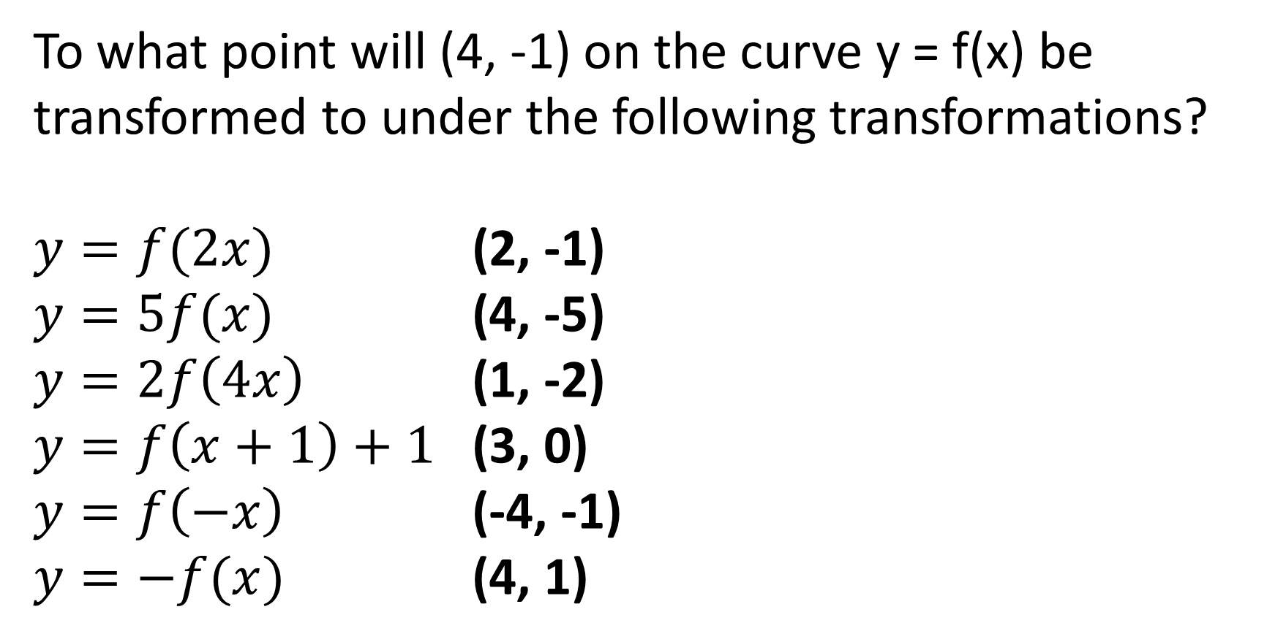
2
To what point will (4, -1) on the curve y = f(x) be transformed to under the following transformations?
$y=f(2x)$ (2, -1)
$y=5f(x)$ (4, -5)
$y=2f\left(4x\right)$ (1, -2)
$y=f\left(x+1\right)+1$ (3, 0)
$y=f\left(−x\right)$ (-4, -1)
$y=−f(x)$ (4, 1)

Slide 5
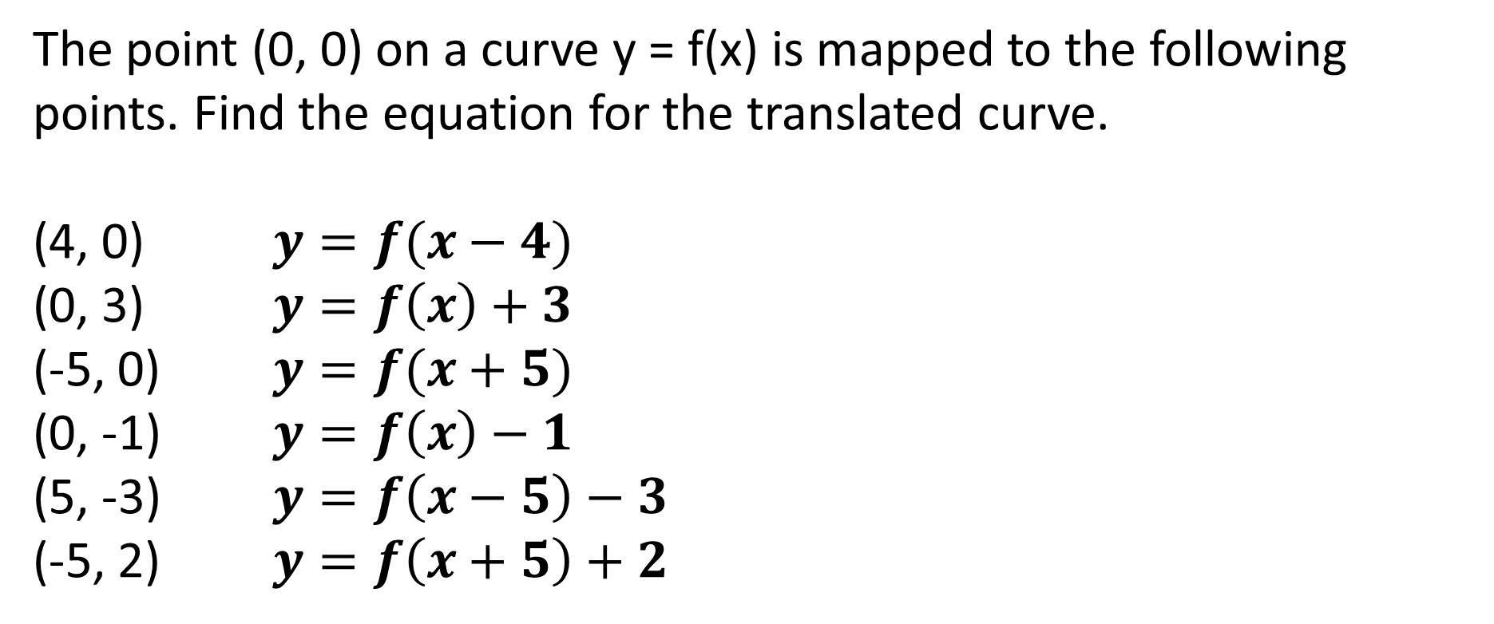
3
The point (0, 0) on a curve y = f(x) is mapped to the following points. Find the equation for the translated curve.
(4, 0) $y=f(x−4)$
(0, 3) $y=f\left(x\right)+3$
(-5, 0) $y=f(x+5)$
(0, -1) $y=f\left(x\right)−1$
(5, -3) $y=f\left(x−5\right)−3$
(-5, 2) $y=f\left(x+5\right)+2$

Slide 6
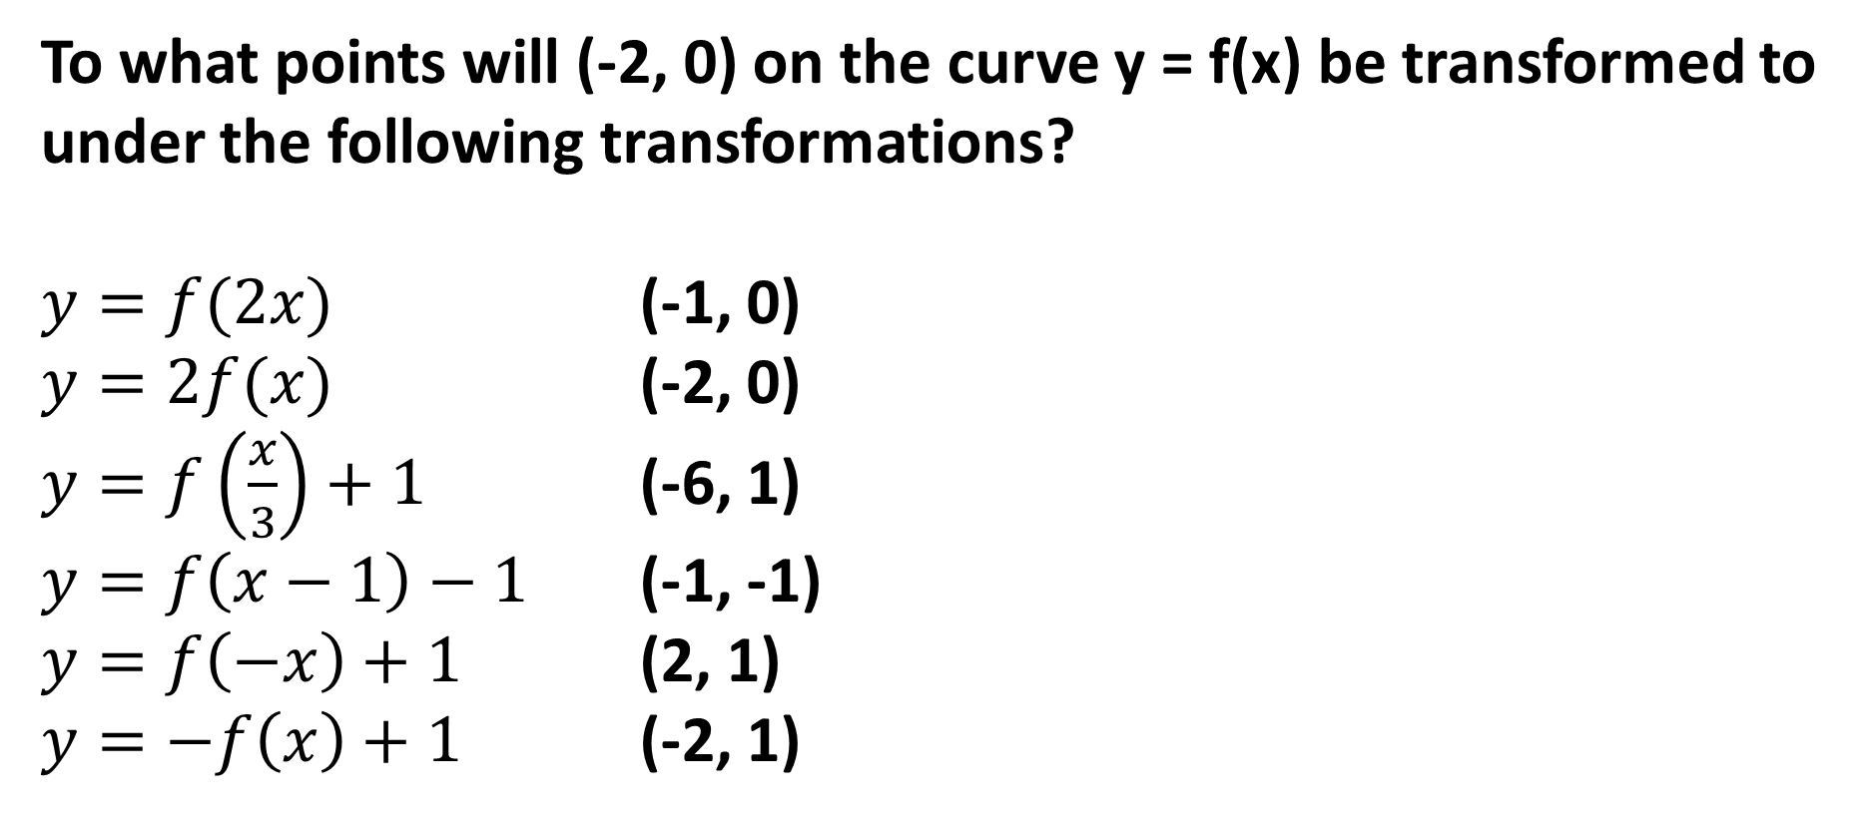
4
To what points will (-2, 0) on the curve y = f(x) be transformed to under the following transformations?
$y=f(2x)$ (-1, 0)
$y=2f(x)$ (-2, 0)
$y=f\left(\frac{x}{3}\right)+1$ (-6, 1)
$y=f\left(x−1\right)−1$ (-1, -1)
$y=f\left(−x\right)+1$ (2, 1)
$y=−f\left(x\right)+1$ (-2, 1)

Slide 7
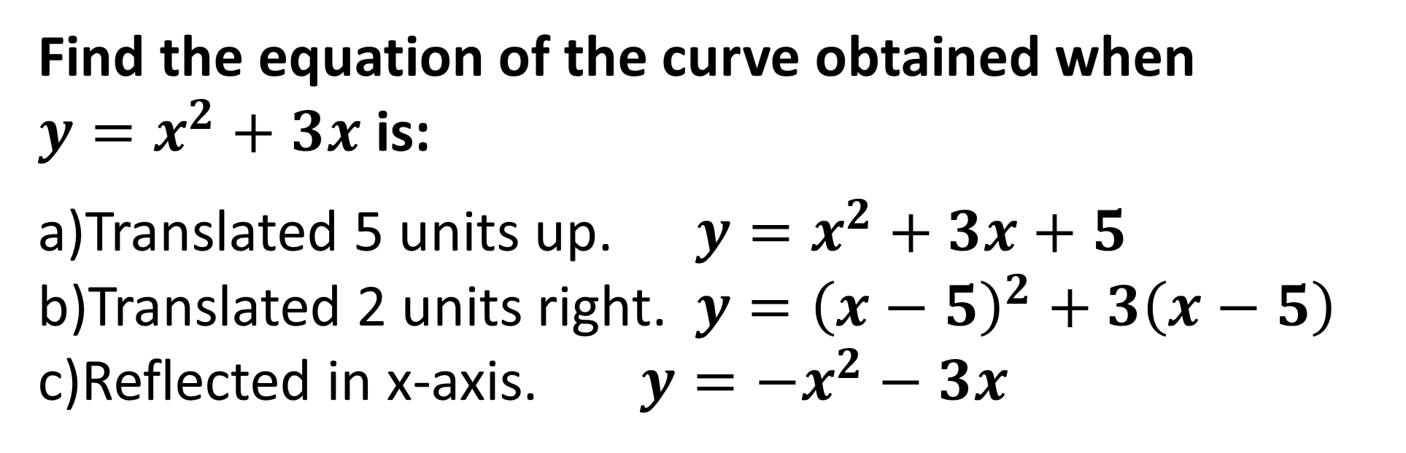
5
Find the equation of the curve obtained when
$y=x^{2}+3x$ is:
Translated 5 units up. $y=x^{2}+3x+5$
Translated 2 units right. $y={\left(x−5\right)}^{2}+3\left(x−5\right)$
Reflected in x-axis. $y=−x^{2}−3x$

