Slide 1
Differentiation
First Principles
Chapter 12
(Part 8 of 8)

Slide 2
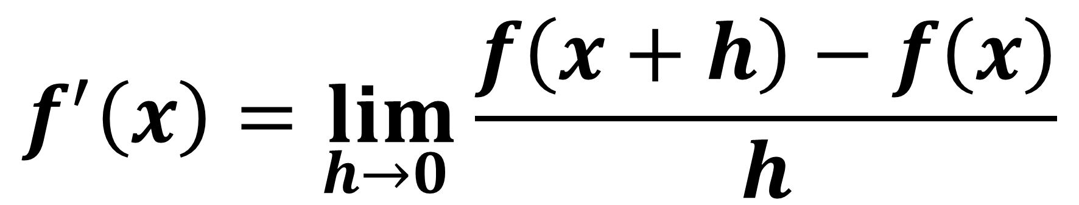
Differentiation
by first principles
$$f^{′}\left(x\right)=\lim_{h→0 }{\frac{f\left(x+h\right)−f\left(x\right)}{h}}$$

Slide 3
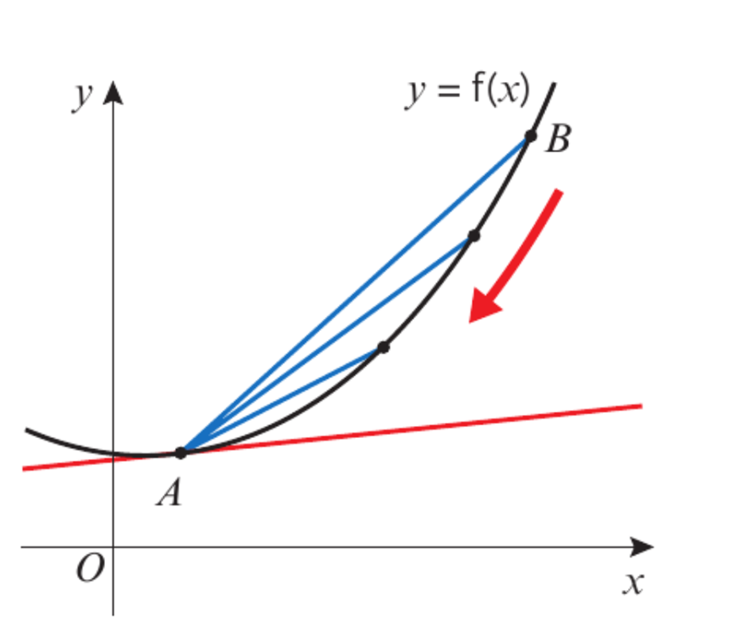
As B gets closer to A,
What do you notice about the gradient of AB compared to the gradient of the tangent?
As B gets close to A, the gradient of AB
and the tangent become more similar.

Slide 4
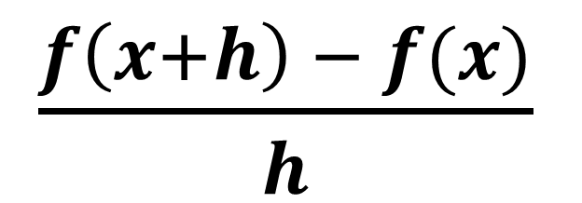



What is the gradient of AB?
B
x + h
f (x + h)
$$f\left(x+h\right) − f(x)$$
A
f (x)
$$h$$
x
x + h
$\frac{f\left(x+h\right) − f(x)}{h}$
Gradient of AB $=$

Slide 5





B
$$h$$
$$h$$
$$h$$
$$h$$
A
As $h$ gets close to 0 the gradient of AB
gets close to the gradient of the tangent.

Slide 6

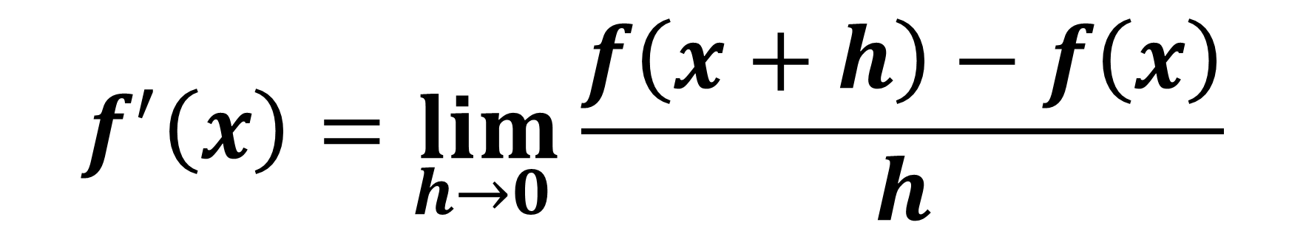
Differentiation by first principles
$$f^{′}\left(x\right)=\lim_{h→0 }{\frac{f\left(x+h\right)−f\left(x\right)}{h}}$$
$\lim_{h→0 }$
means the limit as $h$ tends to 0

Slide 7
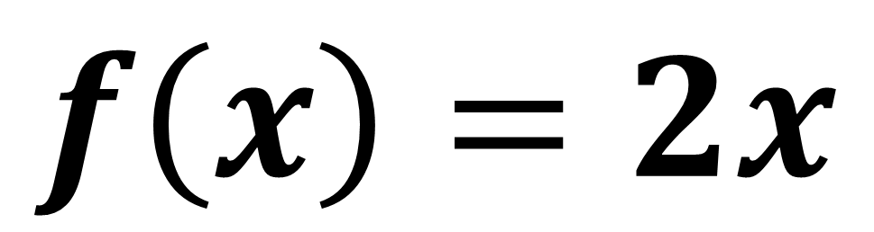
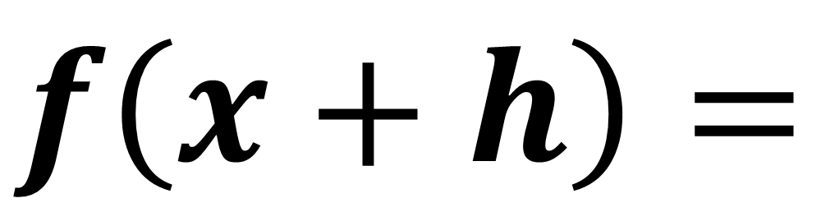
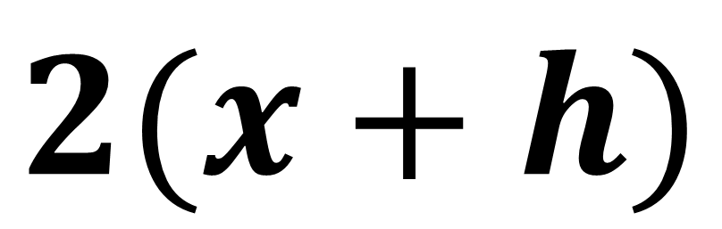
$$f\left(x\right)=2x$$
$$f\left(x+h\right)=$$
$$2(x+h)$$

Slide 8
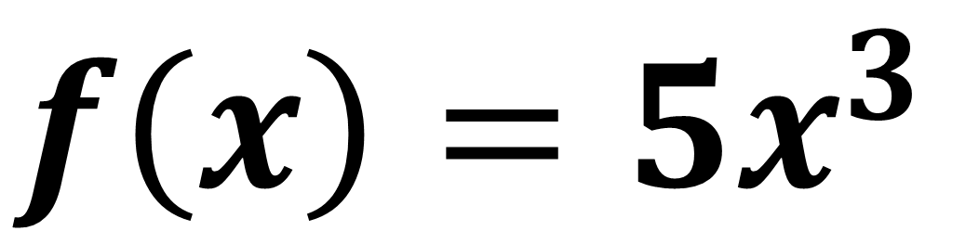
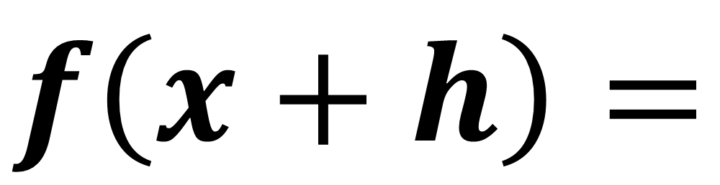
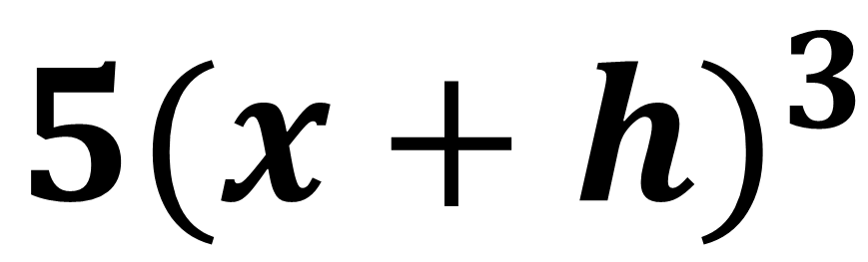
$$f\left(x\right)=5x^{3}$$
$$f\left(x+h\right)=$$
$$5{(x+h)}^{3}$$

Slide 9
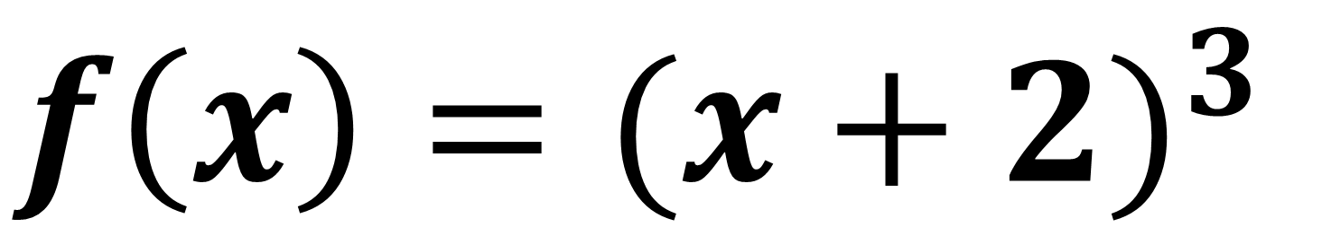
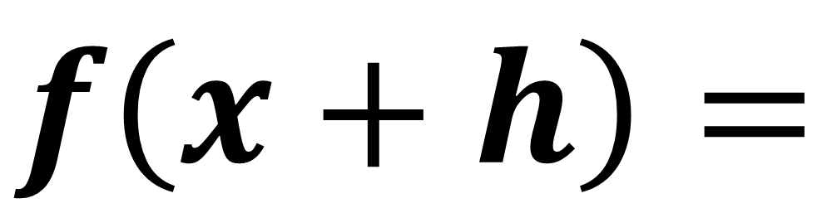
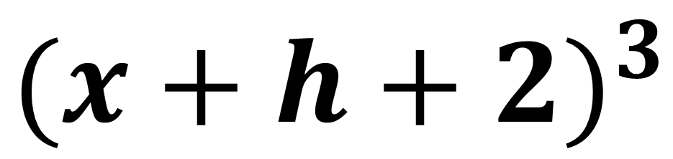
$$f\left(x\right)={(x+2)}^{3}$$
$$f\left(x+h\right)=$$
$${(x+h+2)}^{3}$$

Slide 10
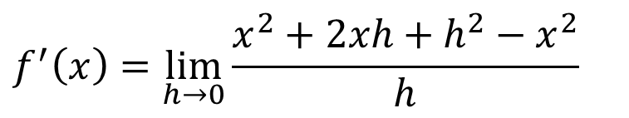
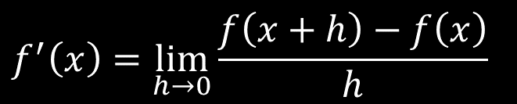
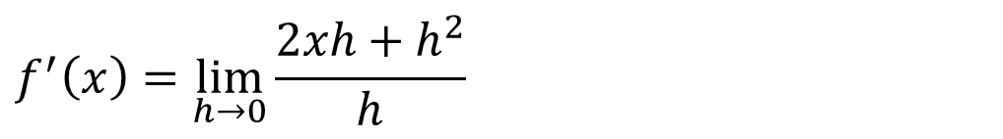


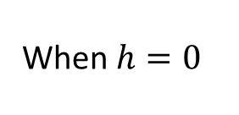
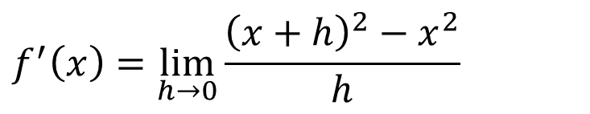
Prove from first principles that the derivative of $x^{2}$ is $2x$.
$$f^{′}\left(x\right)=\lim_{h→0}{\frac{f\left(x+h\right)−f\left(x\right)}{h}}$$
$$f^{′}\left(x\right)=\lim_{h→0}{\frac{{\left(x+h\right)}^{2}−x^{2}}{h}}$$
$$f^{′}\left(x\right)=\lim_{h→0}{\frac{x^{2}+2xh+h^{2}−x^{2}}{h}}$$
$$f^{′}\left(x\right)=\lim_{h→0}{\frac{2xh+h^{2}}{h}}$$
$$f^{′}\left(x\right)=\lim_{h→0}{2x+h}$$
When $h=0$
$$f^{′}\left(x\right)=2x$$

Slide 11
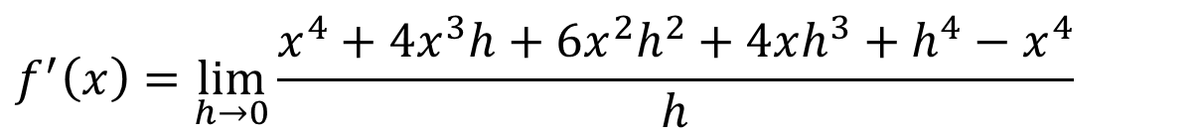
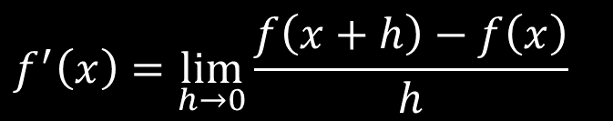
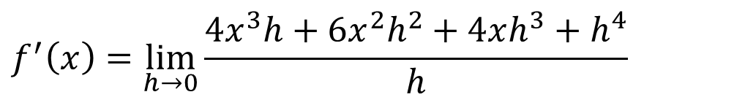


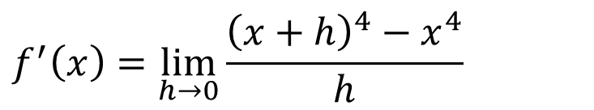
Prove from first principles that the derivative of $x^{4}$ is $4x^{3}$.
$$f^{′}\left(x\right)=\lim_{h→0}{\frac{f\left(x+h\right)−f\left(x\right)}{h}}$$
$$f^{′}\left(x\right)=\lim_{h→0}{\frac{{\left(x+h\right)}^{4}−x^{4}}{h}}$$
$$f^{′}\left(x\right)=\lim_{h→0}{\frac{x^{4}+4x^{3}h+6x^{2}h^{2}+4xh^{3}+h^{4}−x^{4}}{h}}$$
$$f^{′}\left(x\right)=\lim_{h→0}{\frac{4x^{3}h+6x^{2}h^{2}+4xh^{3}+h^{4}}{h}}$$
$$f^{′}\left(x\right)=\lim_{h→0}{4x^{3}+6x^{2}h+4xh^{2}+h^{3}}$$
When $h=0$
$$f^{′}\left(x\right)=4x^{3}$$

Slide 12
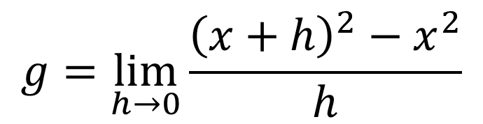
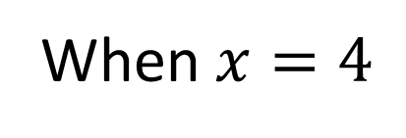
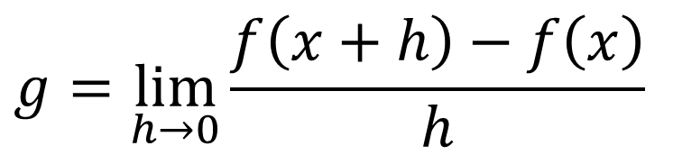
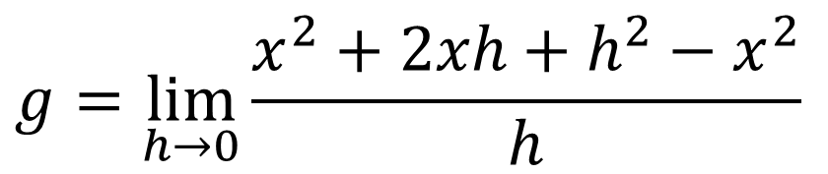

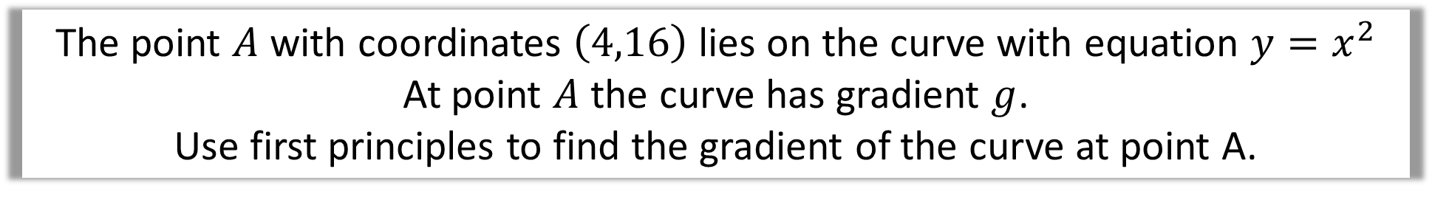
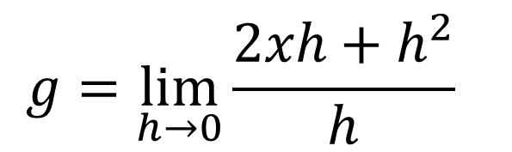
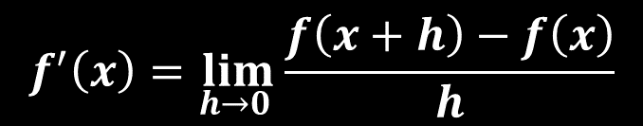

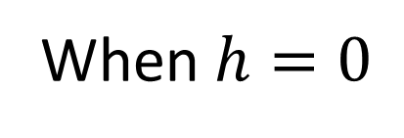
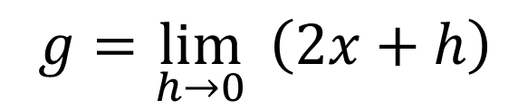
The point $A$ with coordinates $\left(4,16\right)$ lies on the curve with equation $y=x^{2}$
At point $A$ the curve has gradient $g$.
Use first principles to find the gradient of the curve at point A.
$$f^{′}\left(x\right)=\lim_{h→0 }{\frac{f\left(x+h\right)−f\left(x\right)}{h}}$$
$$g=\lim_{h→0}{\frac{2xh+h^{2}}{h}}$$
$$g=\lim_{h→0}{\frac{f\left(x+h\right)−f\left(x\right)}{h}}$$
$$g=\lim_{h→0}{ \left(2x+h\right)}$$
$$g=\lim_{h→0}{\frac{{\left(x+h\right)}^{2}−x^{2}}{h}}$$
When $h=0$
$$g=2x$$
$$g=\lim_{h→0}{\frac{x^{2}+2xh+h^{2}−x^{2}}{h}}$$
When $x=4$
$$g=8$$

