Slide 1
LO: Plotting Linear Graphs

Slide 2
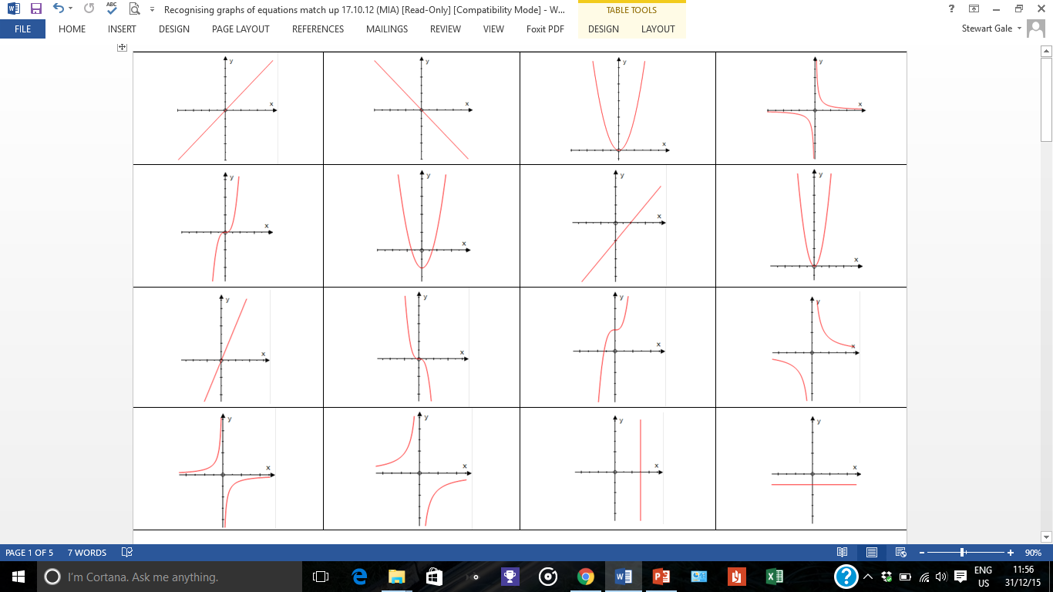
Linear or Not?
YES

Slide 3
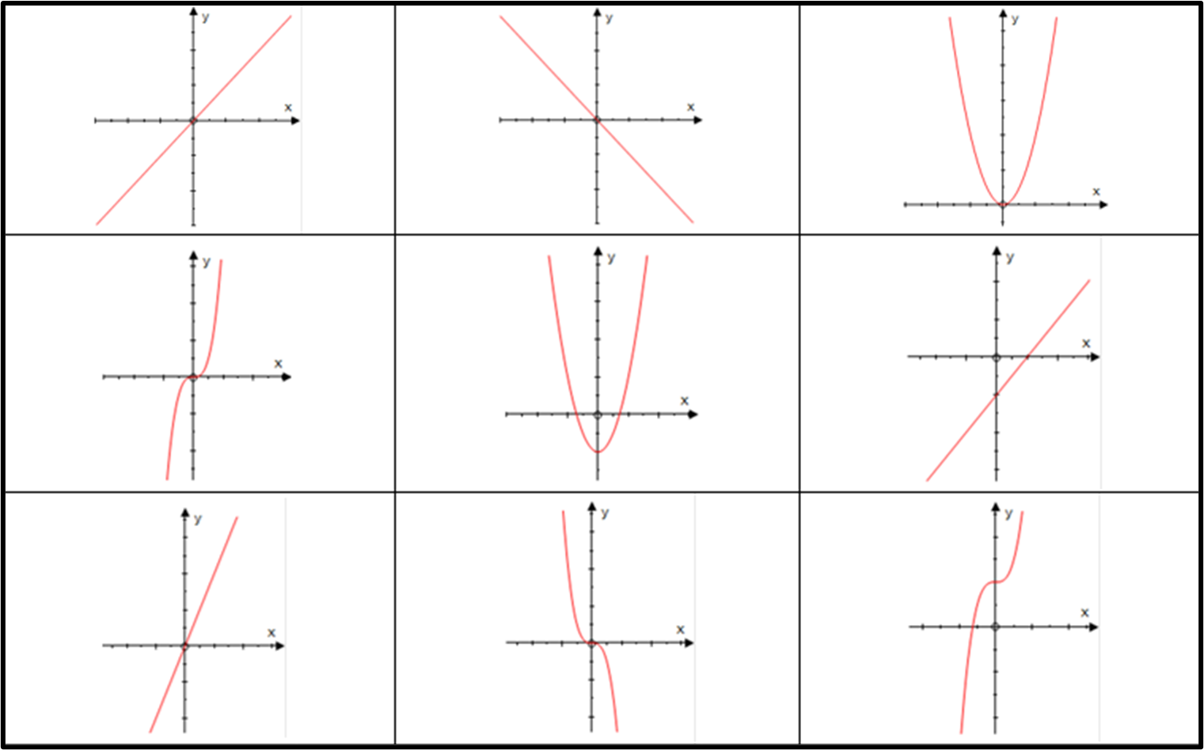
Linear or Not?
NO

Slide 4
Linear or Not?
NO

Slide 5
Linear or Not?
YES

Slide 6
POINTS
A line is a collection of ______________.

Slide 7
In graphing, a point is called a ____________.
CO-ORDINATE
A co-ordinate is made up by
what two values?
x and y

Slide 8
To generate a co-ordinate you need an ______________.
EQUATION
EQUATION → CO-ORDINATES → GRAPH

Slide 9
Can you give an example of a Linear Equations?
y = 2x
y = 3x
y = 2x + 1
y = 3x - 1

Slide 10
Complete the co-ordinate for
the equation y = 2x + 1
( 1 , )
3

Slide 11
Complete the co-ordinate for
the equation y = 3x - 2
( -2 , )
-8

Slide 12
Complete the co-ordinate for
the equation y = 5x + 3
( -1 , )
-2

Slide 13
Complete the co-ordinate for
the equation y = 5x + 3
( , 28 )
5

Slide 14
Complete the co-ordinate for
the equation y = 2x – 2
( , -6 )
-2

Slide 15
Did the equation y = x – 2
produce the following co-ordinate?
( 3 , 1 )
Yes

Slide 16
Did the equation y = 2x + 3
produce the following co-ordinate?
( 5 , 12 )
No

Slide 17
Did the equation y = 1 – 2x
produce the following co-ordinate?
( 2 , 5 )
No

Slide 18
Did the equation y = x
produce the following co-ordinate?
( -3 , -3 )
Yes

Slide 19
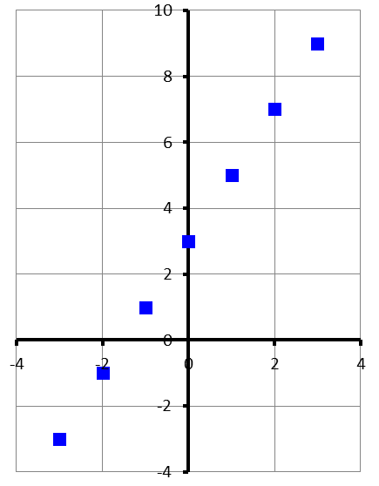
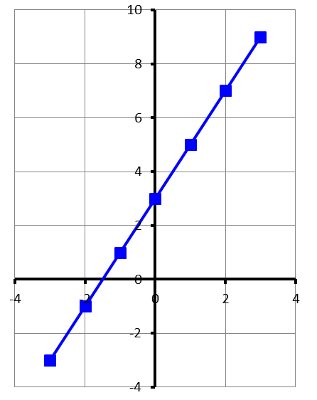
Step 1
Step 2
Step 3
Calculate the co-ordinates
Plot the coordinates
Join the coordinates
(-3,-3)
(-2,-1)
(-1,1)
(0,3)
(1,5)
(2,7)
(3,9)

Slide 20
y = 2x + 3
Complete the table.
x | -2 | -1 | 0 | 1 | 2
y
-1
1
3
5
7
List the co-ordinates.
( | -2 | , | -1 | )
( | -1 | , | 1 | )
( | 0 | , | 3 | )
( | 1 | , | 5 | )
( | 2 | , | 7 | )

Slide 21
y = 3x – 1
Complete the table.
x | -2 | -1 | 0 | 1 | 2
y
-7
-4
-1
2
5
List the co-ordinates.
( | -2 | , | -7 | )
( | -1 | , | -4 | )
( | 0 | , | -1 | )
( | 1 | , | 2 | )
( | 2 | , | 5 | )

Slide 22
y = 2 – 3x
Complete the table.
x | -2 | -1 | 0 | 1 | 2
y
8
5
2
-1
-4
List the co-ordinates.
( | -2 | , | 8 | )
( | -1 | , | 5 | )
( | 0 | , | 2 | )
( | 1 | , | -1 | )
( | 2 | , | -4 | )

