Slide 1
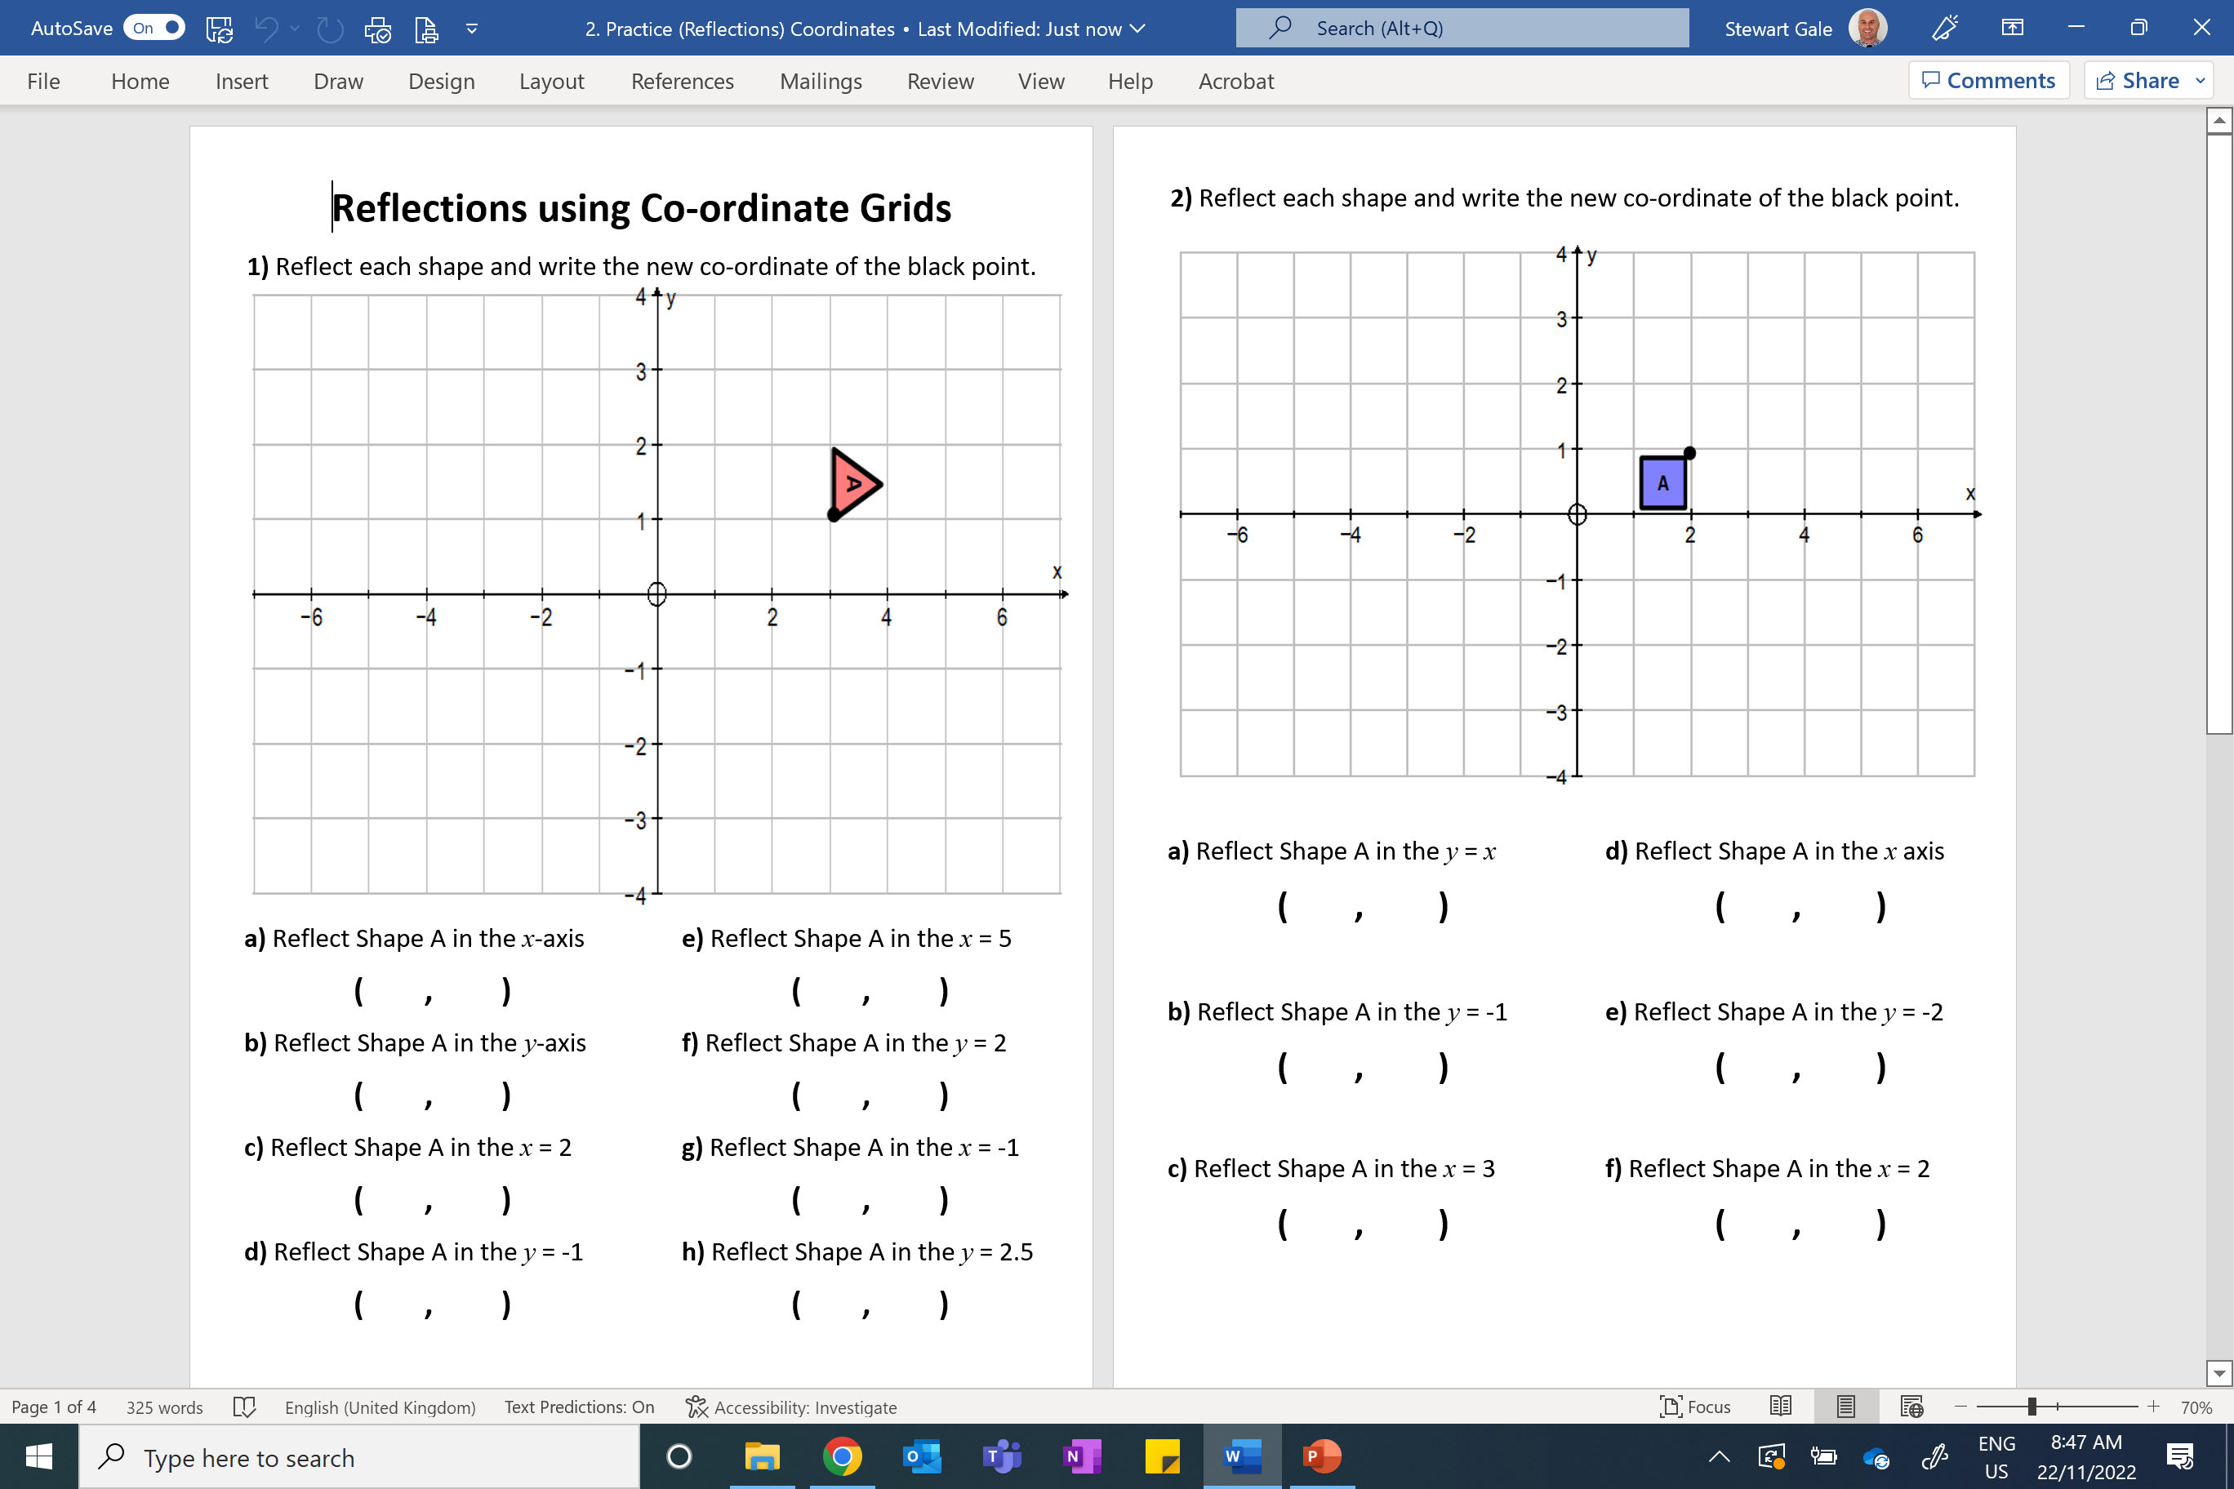

Slide 2
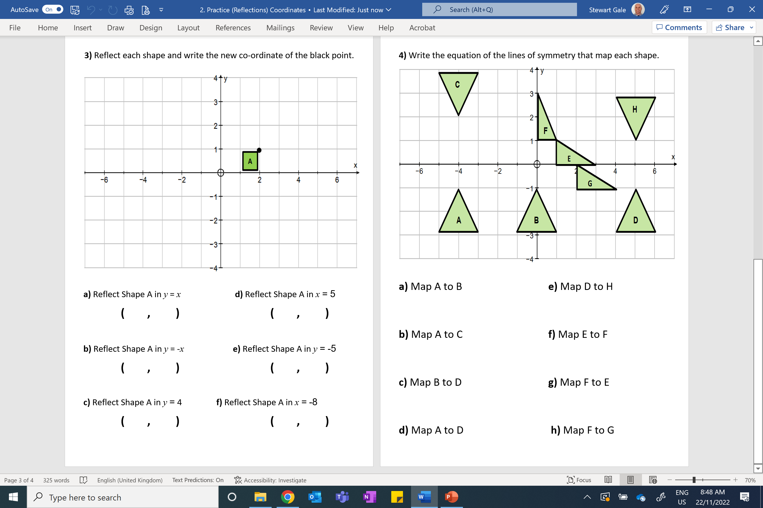

Slide 3
ANSWERS

Slide 4
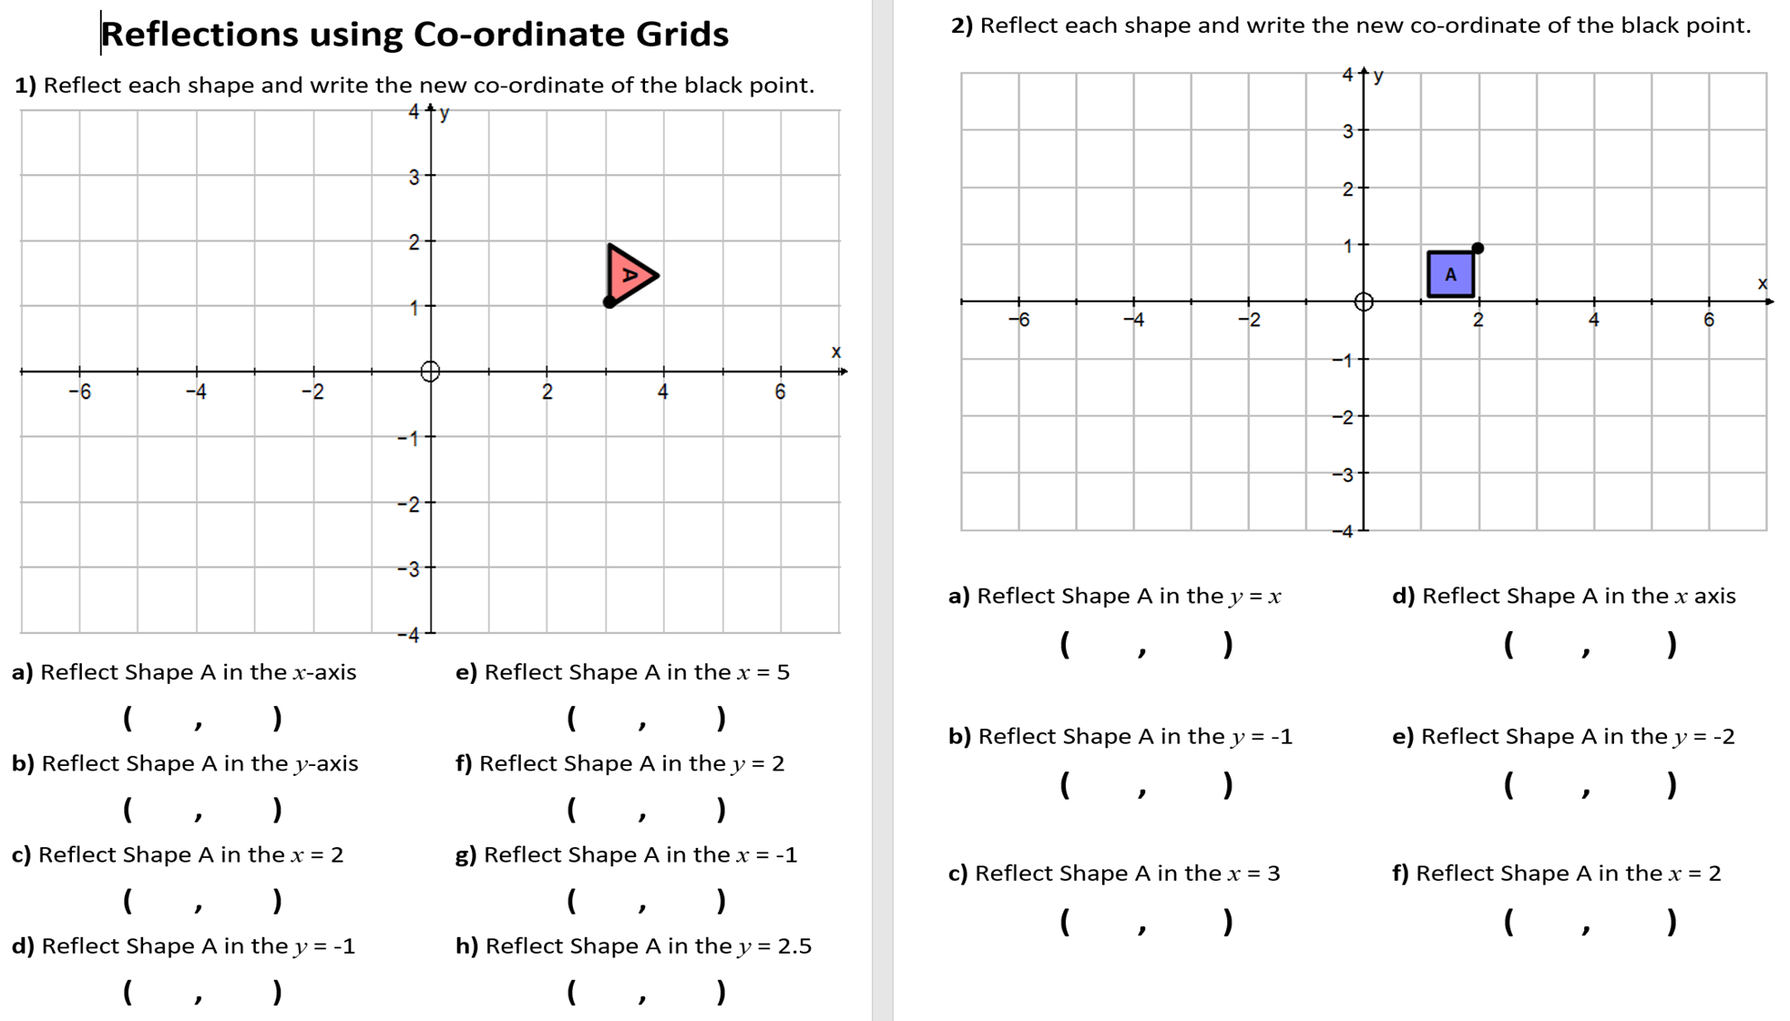
3 -1
7 1
-3 1
3 3
1 1
-5 1
3 -3
3 4

Slide 5
1 2
2 -1
2 -3
2 -5
4 1
2 1

Slide 6
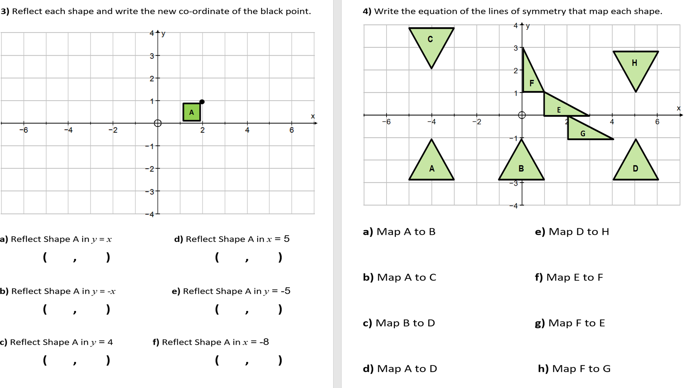
1 2
8 1
-1 -2
2 -11
2 7
-18 , 1

Slide 7
x = -2
y = 0
y = 0.5
y = x
x = 2.5
y = x
x = 0.5
y = x - 1

