Slide 1
Parametric Equations
Trig Identities
Chapter 8
(Part 2 of 3)

Slide 2
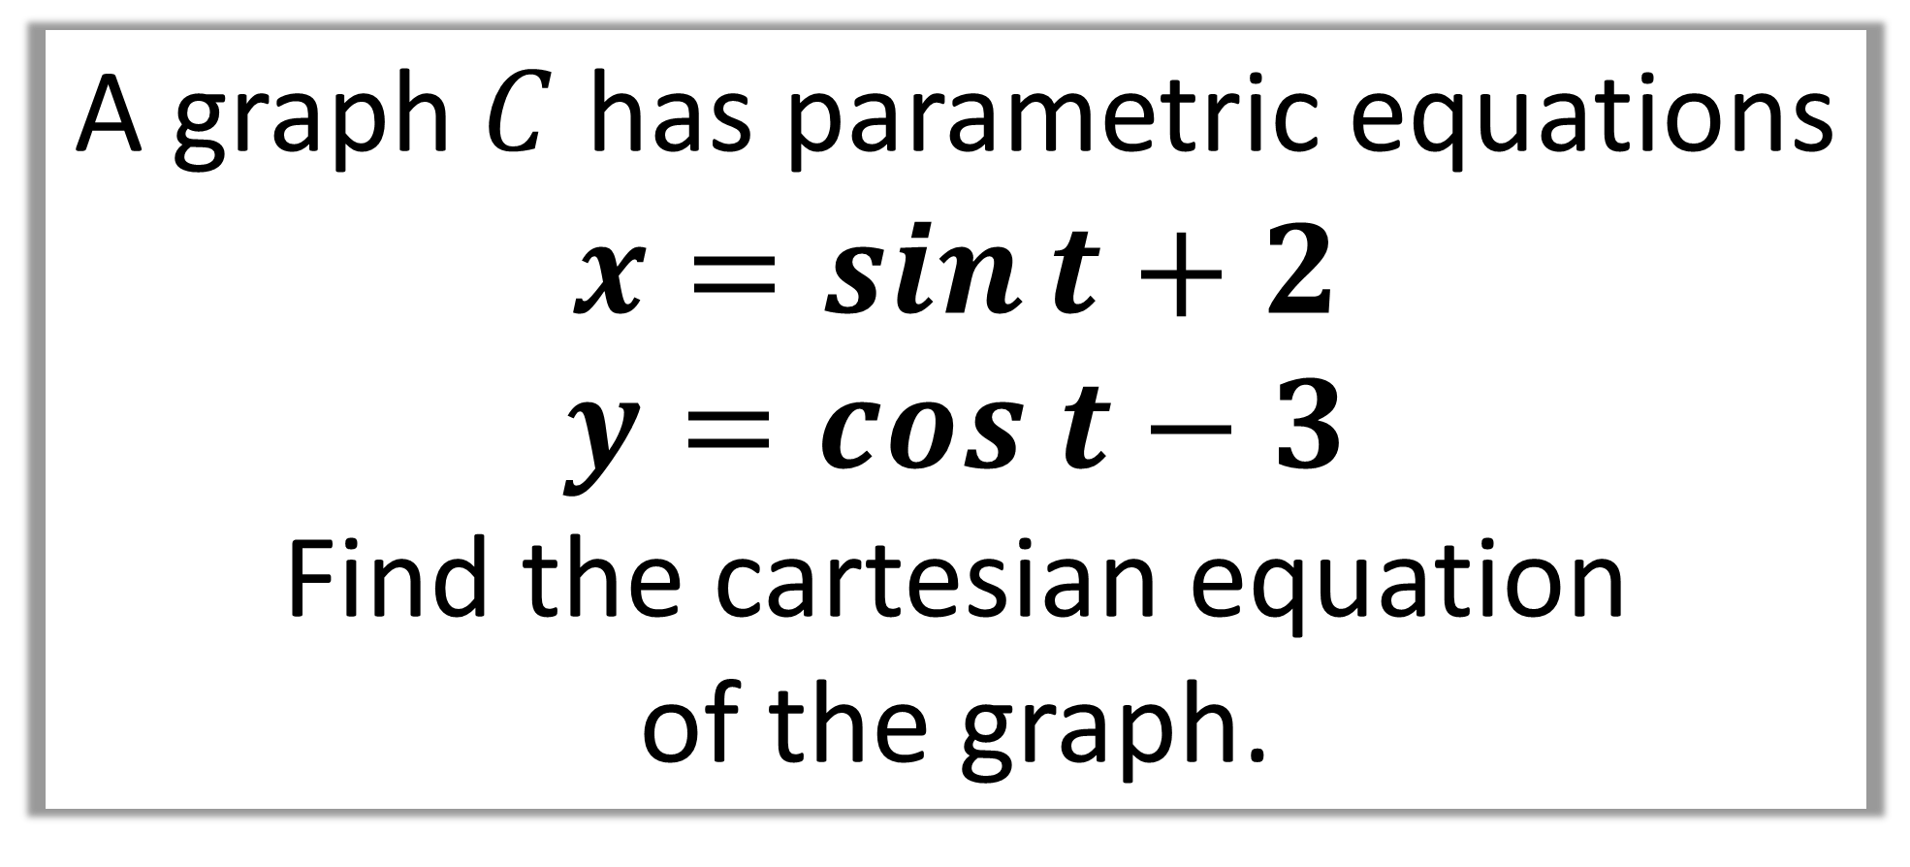
Question A
A graph $C$ has parametric equations
$$x=\sin{t}+2$$
$$y=cos t−3$$
Find the cartesian equation
of the graph.

Slide 3
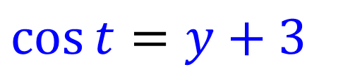
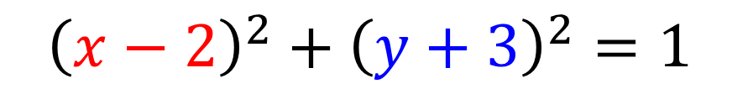
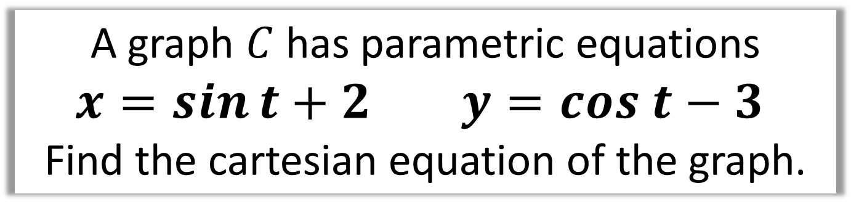
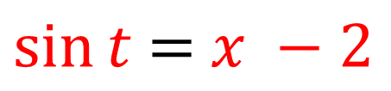
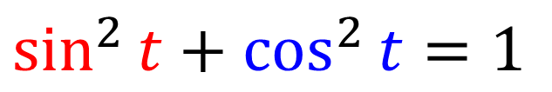
A graph $C$ has parametric equations
$$x=\sin{t}+2 y=cos t−3$$
Find the cartesian equation of the graph.
Make sin t the subject
$\sin{t}$ $=$ $x −2$
Make cos t the subject
$$\cos{t}=y+3$$
Use the identity:
$$\sin^{2}{t}+\cos^{2}{t}=1$$
Substitution:
$${\left(x−2\right)}^{2}+{\left(y+3\right)}^{2}=1$$
It’s a circle!

Slide 4
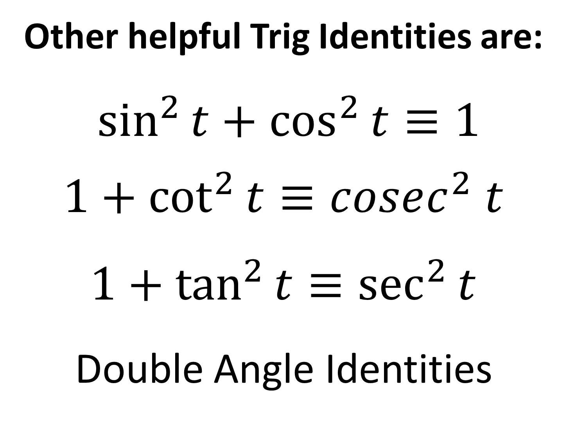
Other helpful Trig Identities are:
$\sin^{2}{t}+\cos^{2}{t}≡1$
$1+\cot^{2}{t}≡cosec^{2} t$
$1+\tan^{2}{t}≡\sec^{2}{t}$
Double Angle Identities

Slide 5
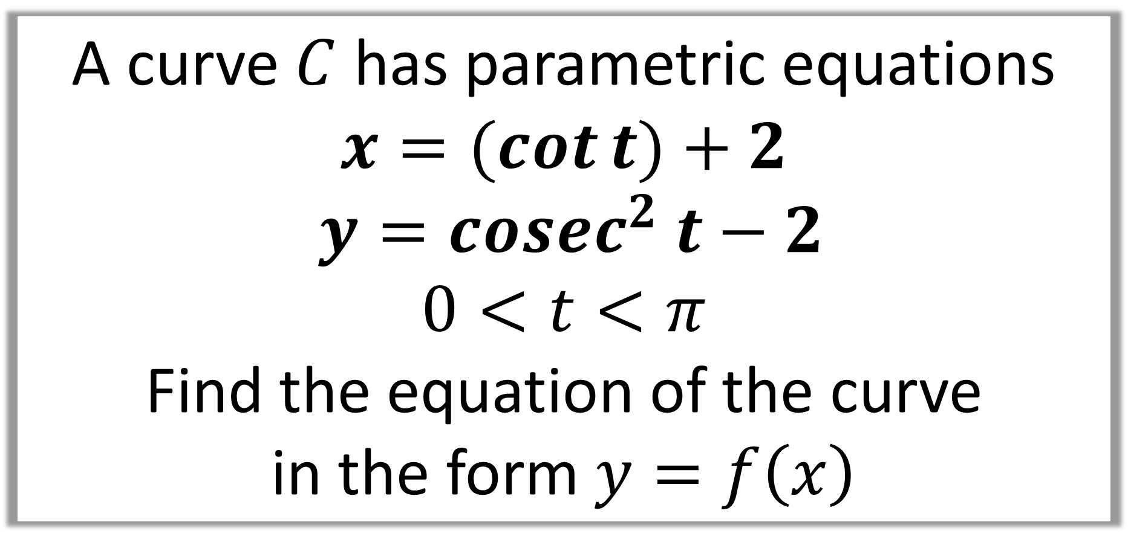
Question B
A curve $C$ has parametric equations
$$x=(cot{t)}+2$$
$$y=cosec^{2} t−2$$
$$0<t<π$$
Find the equation of the curve
in the form $y=f\left(x\right)$

Slide 6
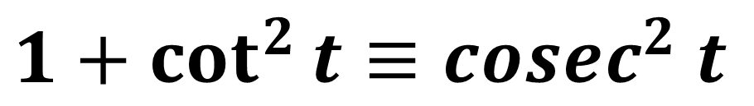
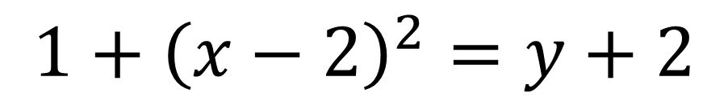
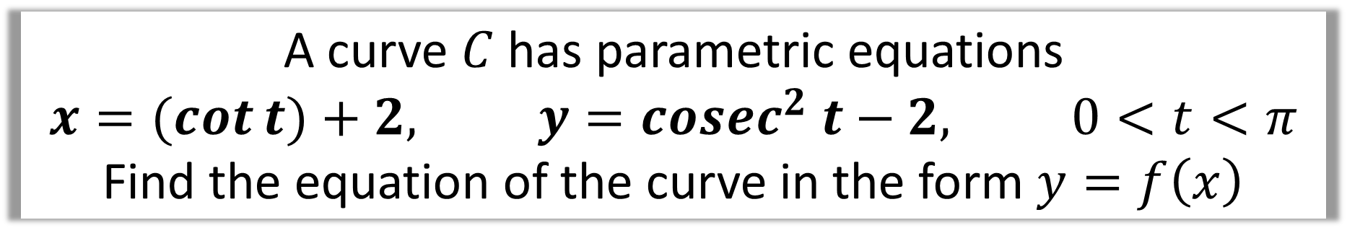
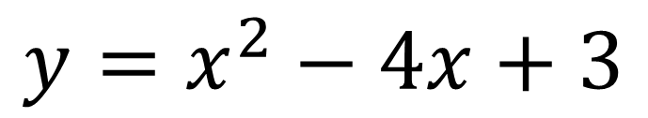
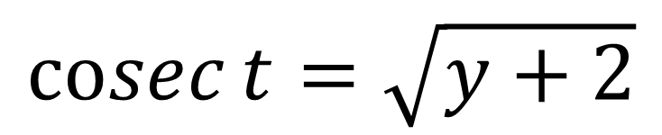
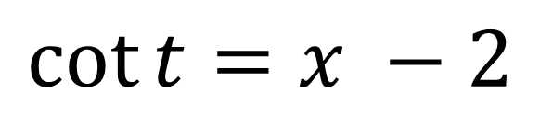
A curve $C$ has parametric equations
$$x=(cot{t)}+2, y=cosec^{2} t−2, 0<t<π$$
Find the equation of the curve in the form $y=f\left(x\right)$
$$\cot{t}=x −2$$
$$\operatorname{cosec}{t}=\sqrt{y+2}$$
$$1+\cot^{2}{t}≡cosec^{2} t$$
$$1+{\left(x−2\right)}^{2}=y+2$$
$$y=x^{2}−4x+3$$

Slide 7
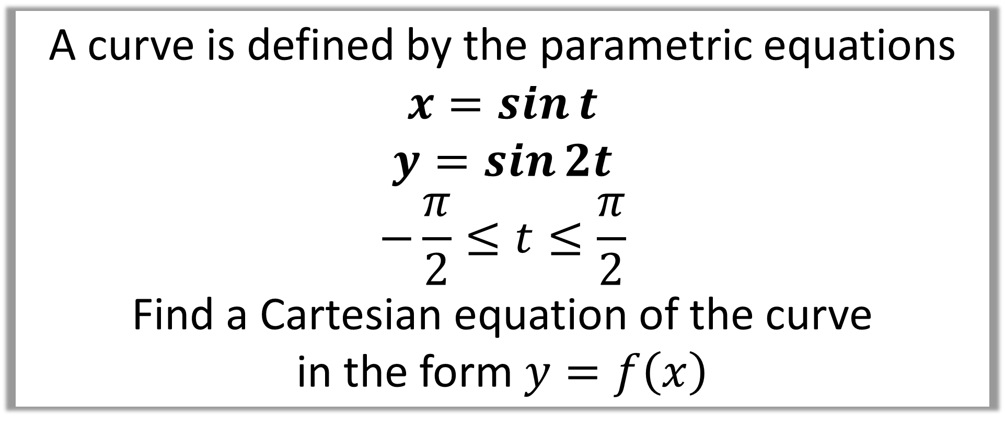
Question C
A curve is defined by the parametric equations
$$x=\sin{t}$$
$$y=\sin{2t}$$
$$−\frac{π}{2}≤t≤\frac{π}{2}$$
Find a Cartesian equation of the curve
in the form $y=f\left(x\right)$

Slide 8
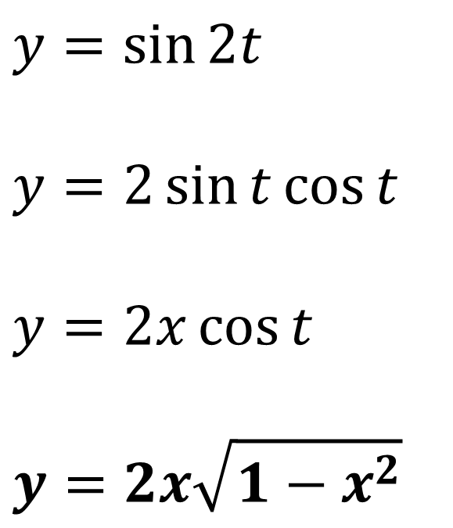
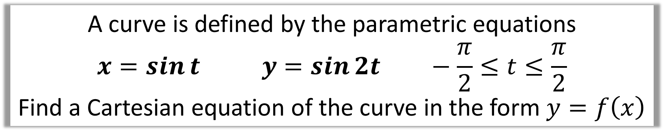

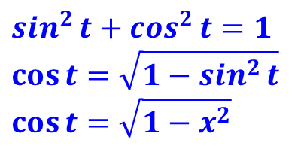
A curve is defined by the parametric equations
$$x=\sin{t} y=\sin{2t} −\frac{π}{2}≤t≤\frac{π}{2}$$
Find a Cartesian equation of the curve in the form $y=f\left(x\right)$
$$y=\sin{2t}$$
$$y=2\sin{t}\cos{t}$$
$$y=2x\cos{t}$$
$$y=2x\sqrt{1−x^{2}}$$
Double Angle
$$x=\sin{t}$$
$$\sin^{2}{t}+\cos^{2}{t}=1$$
$$\cos{t}=\sqrt{1−\sin^{2}{t}}$$
$$\cos{t}=\sqrt{1−x^{2}}$$

Slide 9
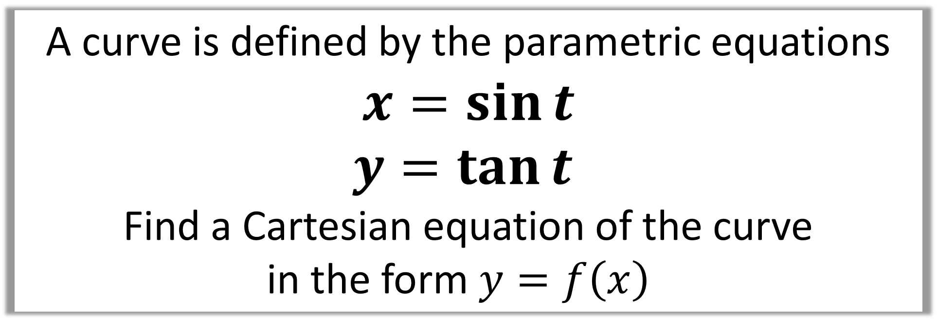
Question D
A curve is defined by the parametric equations
$$x=\sin{t}$$
$$y=\tan{t}$$
Find a Cartesian equation of the curve
in the form $y=f\left(x\right)$

Slide 10
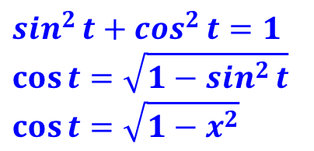
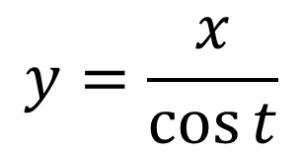
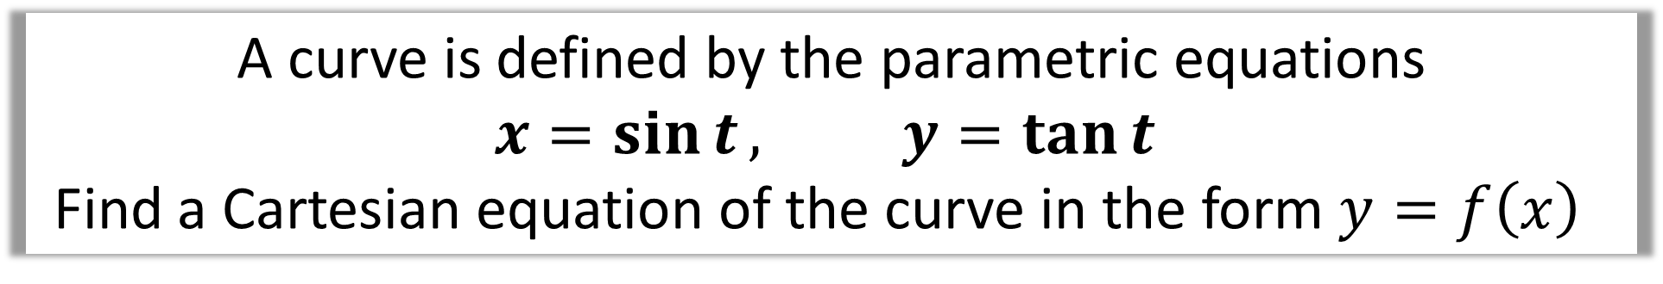
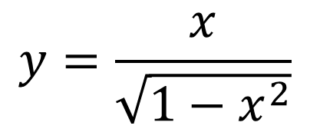
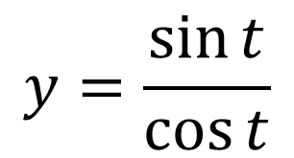

A curve is defined by the parametric equations
$$x=\sin{t}, y=\tan{t}$$
Find a Cartesian equation of the curve in the form $y=f\left(x\right)$
$$y=\tan{t}$$
$$y=\frac{\sin{t}}{\cos{t}}$$
$$y=\frac{x}{\cos{t}}$$
$$\sin^{2}{t}+\cos^{2}{t}=1$$
$$\cos{t}=\sqrt{1−\sin^{2}{t}}$$
$$\cos{t}=\sqrt{1−x^{2}}$$
$$y=\frac{x}{\sqrt{1−x^{2}}}$$

Slide 11
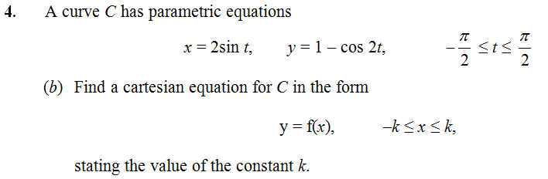
Question E

Slide 12
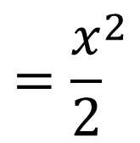
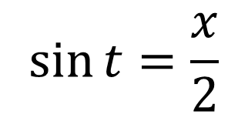
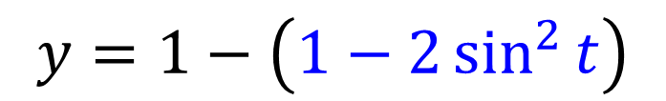
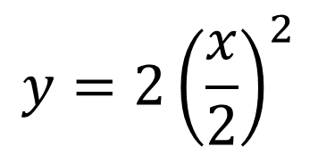


$$\sin{t}=\frac{x}{2}$$
$$y=1−\left(\cos{2t}\right)$$
Double angle formula
$$y=1−\left(1−2\sin^{2}{t}\right)$$
$$y= 2\sin^{2}{t}$$
$$y=2{\left(\frac{x}{2}\right)}^{2}$$
$$={\frac{x}{2}}^{2}$$

Slide 13
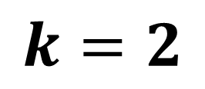
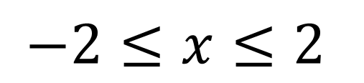
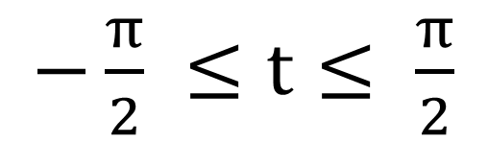
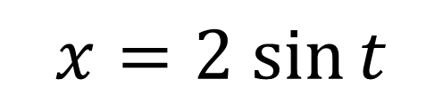
$$x=2 sin{t}$$
$−\frac{π}{2} ≤t≤ \frac{π}{2}$
$$−2≤x≤2$$
$$k=2$$

