Slide 1
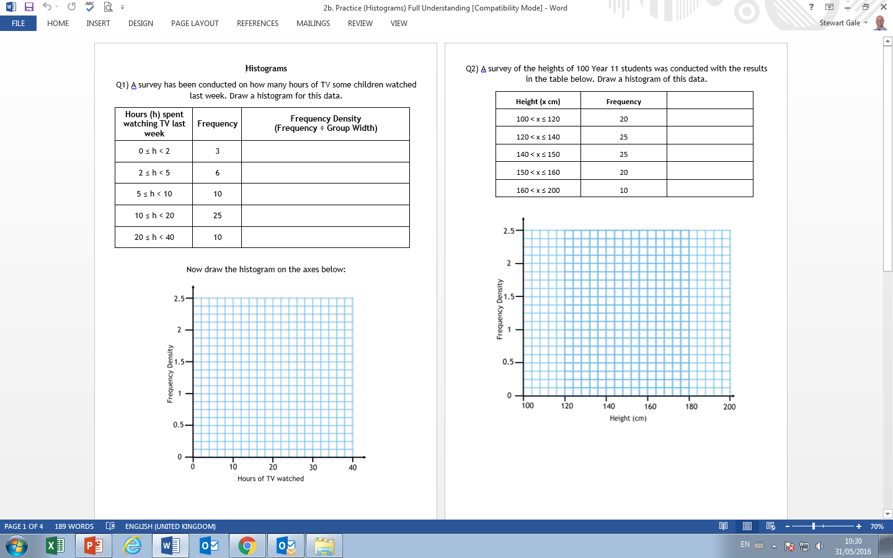

Slide 2
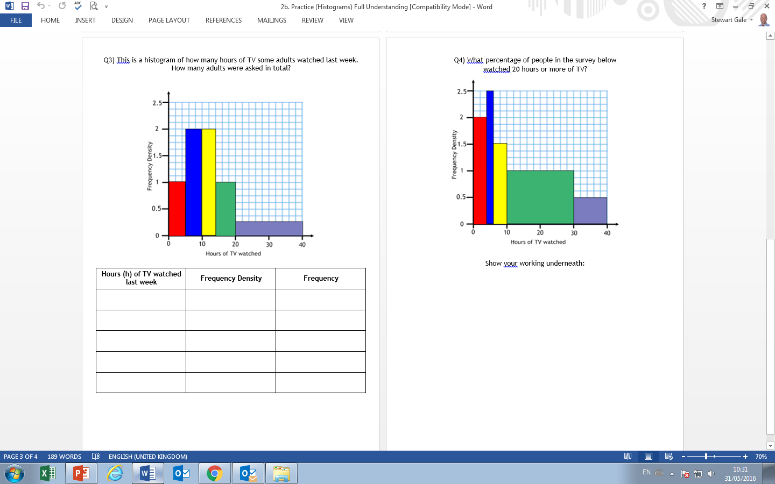

Slide 3
ANSWERS

Slide 4
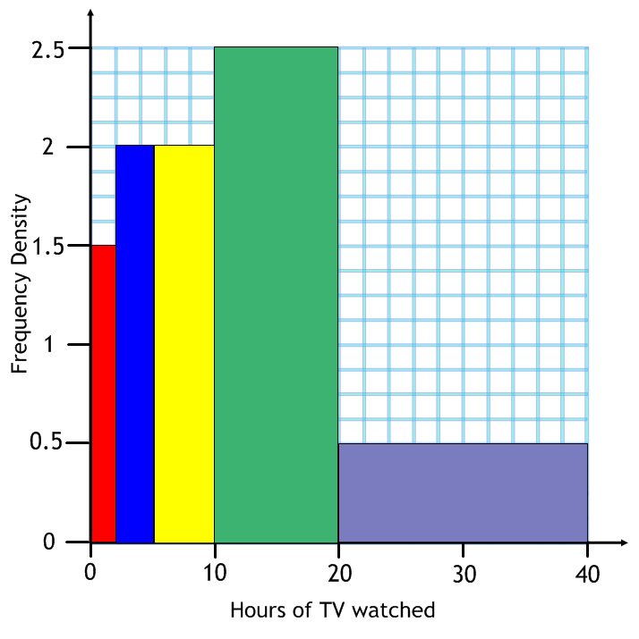
Question 1
Hours (h) spent watching TV last week | Frequency | Frequency Density (Frequency ÷ Group Width)
0 ≤ h < 2 | 3 | 3 ÷ 2 = 1.5
2 ≤ h < 5 | 6 | 6 ÷ 3 = 2
5 ≤ h < 10 | 10 | 10 ÷ 5 = 2
10 ≤ h < 20 | 25 | 25 ÷ 10 = 2.5
20 ≤ h < 40 | 10 | 10 ÷ 20 = 0.5

Slide 5
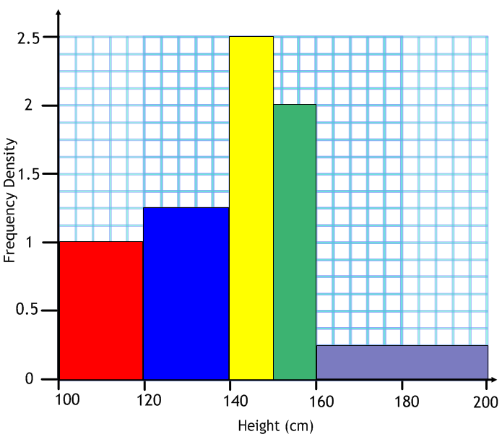
Question 2
Height (cm) | Frequency | Frequency Density
100 < x ≤ 120 | 20 | 1
120 < x ≤ 140 | 25 | 1.25
140 < x ≤ 150 | 25 | 2.5
150 < x ≤ 160 | 20 | 2
160 < x ≤ 200 | 10 | 0.25

Slide 6
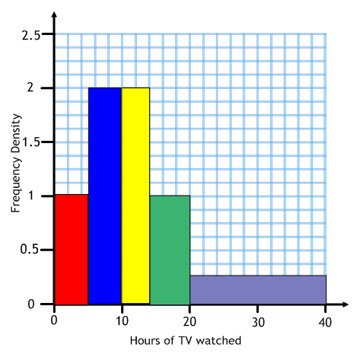
Question 3
Hours (h) of TV watched | Frequency Density | Frequency
0≤h<5 | 1 | 5
5≤h<10 | 2 | 10
10≤h<14 | 2 | 8
14≤h<20 | 1 | 6
20≤h<40 | 0.25 | 5
Answer: 34

Slide 7
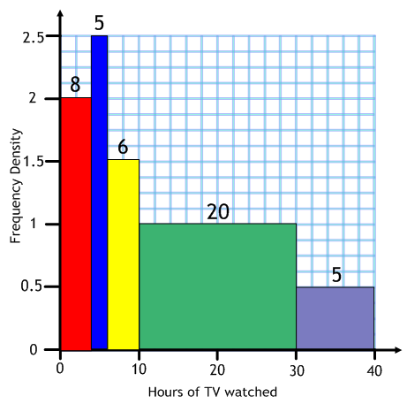
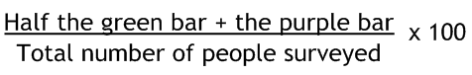
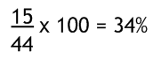
Questions 4

