Slide 1
LO: Parallel and
Perpendicular Lines
(from Two Co-ordinates)

Slide 2
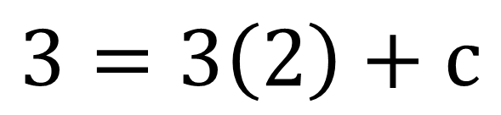
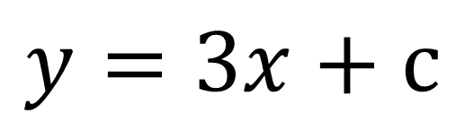
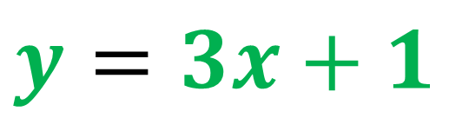
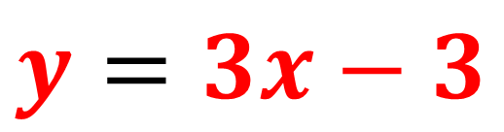
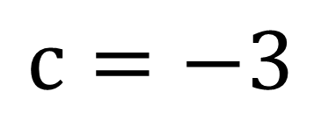
Line A passes through (2,7) and (0,1).
Find the equation of the line that is parallel to A and passes through (2,3)?
$$y=3x+1$$
y
(2,7)
$$y=3x+c$$
(0,1)
(2,3)
$$3=3\left(2\right)+c$$
x
$$c=−3$$
$$y=3x−3$$

