Slide 1

Diagnostic Assessment .Delta 3
Unit 5
Direct Proportion
Inverse Proportion
Arcs and Sectors

Slide 2
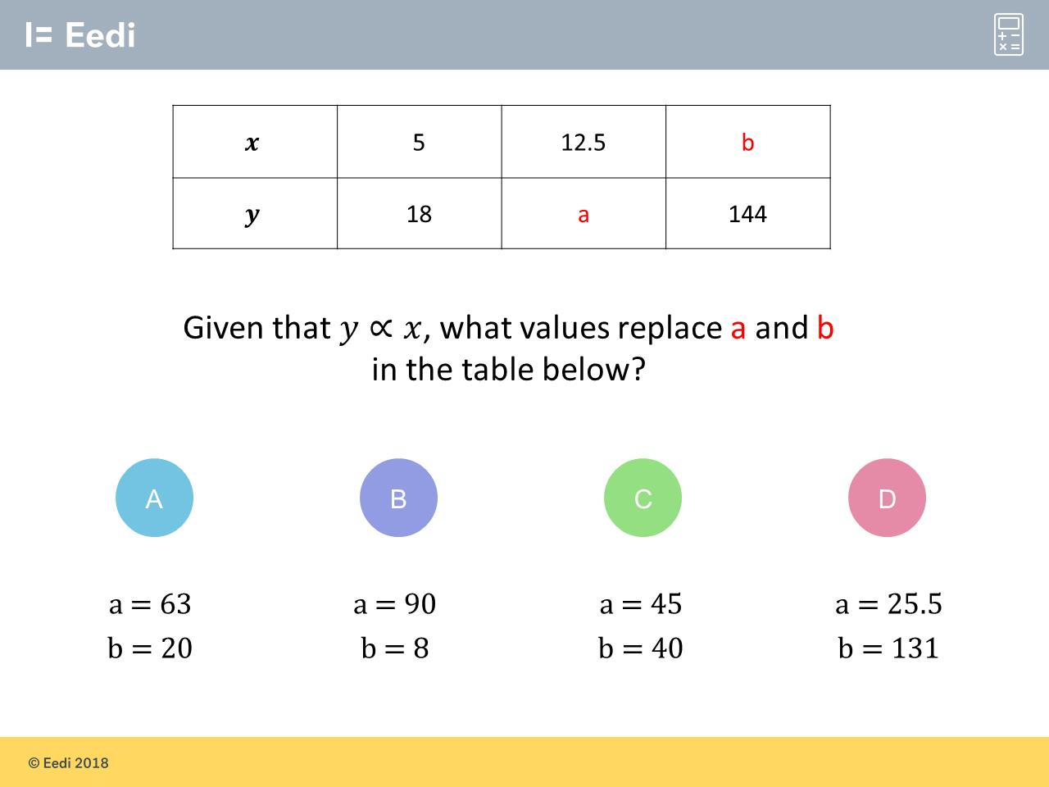
Question 1 – Direct Proportion

Slide 3
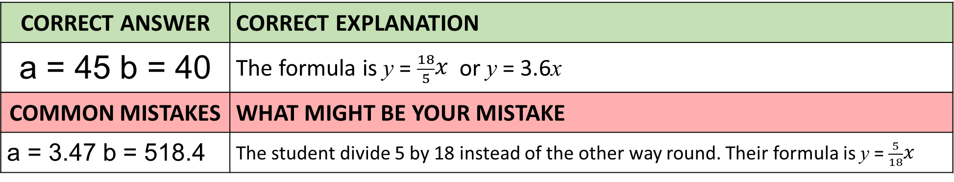
Answer 1 – Direct Proportion
CORRECT ANSWER | CORRECT EXPLANATION
a = 45 b = 40 | The formula is y = $\frac{18}{5}x$ or y = 3.6x
COMMON MISTAKES | WHAT MIGHT BE YOUR MISTAKE
a = 3.47 b = 518.4 | The student divide 5 by 18 instead of the other way round. Their formula is y = $\frac{5}{18}x$

Slide 4
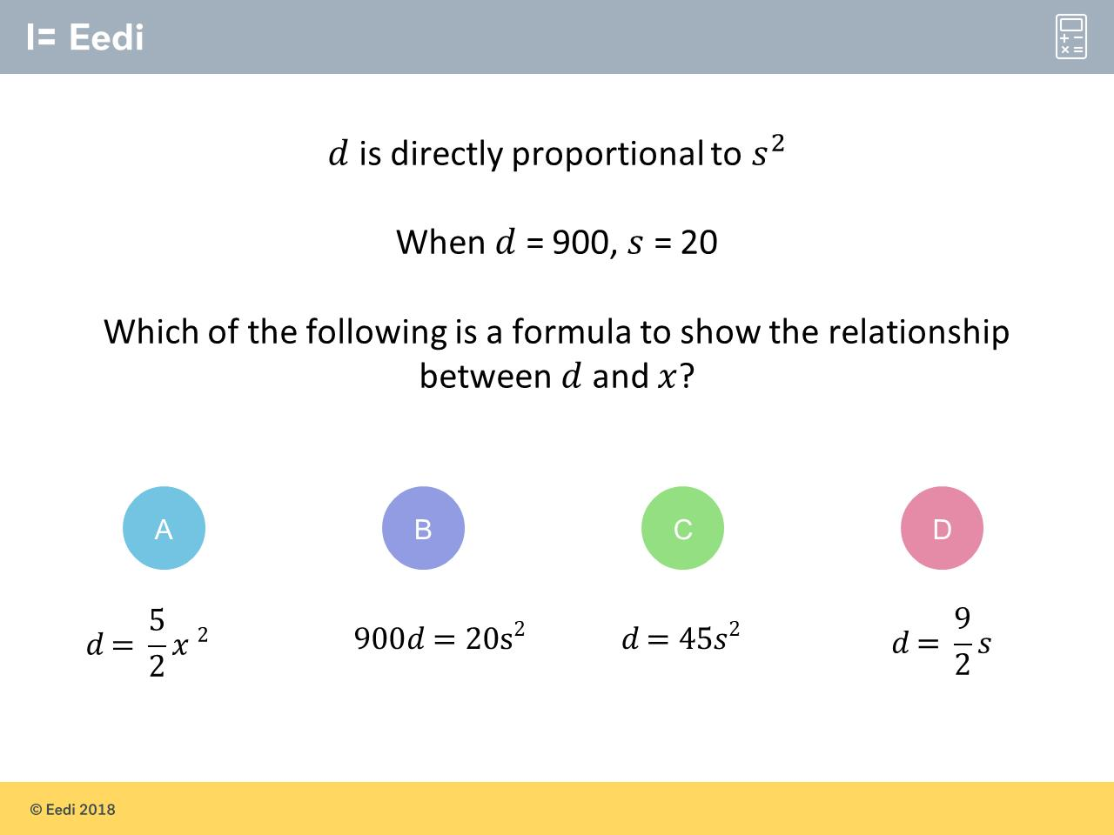
Question 2 – Direct Proportion
What is the formula connecting d and s?

Slide 5
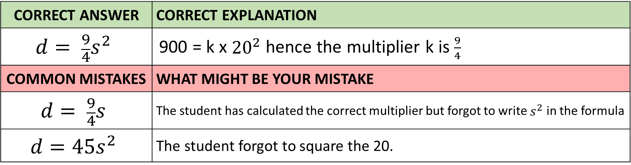
Answer 2 – Direct Proportion
What is the formula connecting d and s?
CORRECT ANSWER | CORRECT EXPLANATION
$$d= \frac{9}{4}s^{2}$$ | 900 = k x ${20}^{2}$ hence the multiplier k is $\frac{9}{4}$
COMMON MISTAKES | WHAT MIGHT BE YOUR MISTAKE
$$d= \frac{9}{4}s$$ | The student has calculated the correct multiplier but forgot to write $s^{2}$ in the formula
$$d=45s^{2}$$ | The student forgot to square the 20.

Slide 6
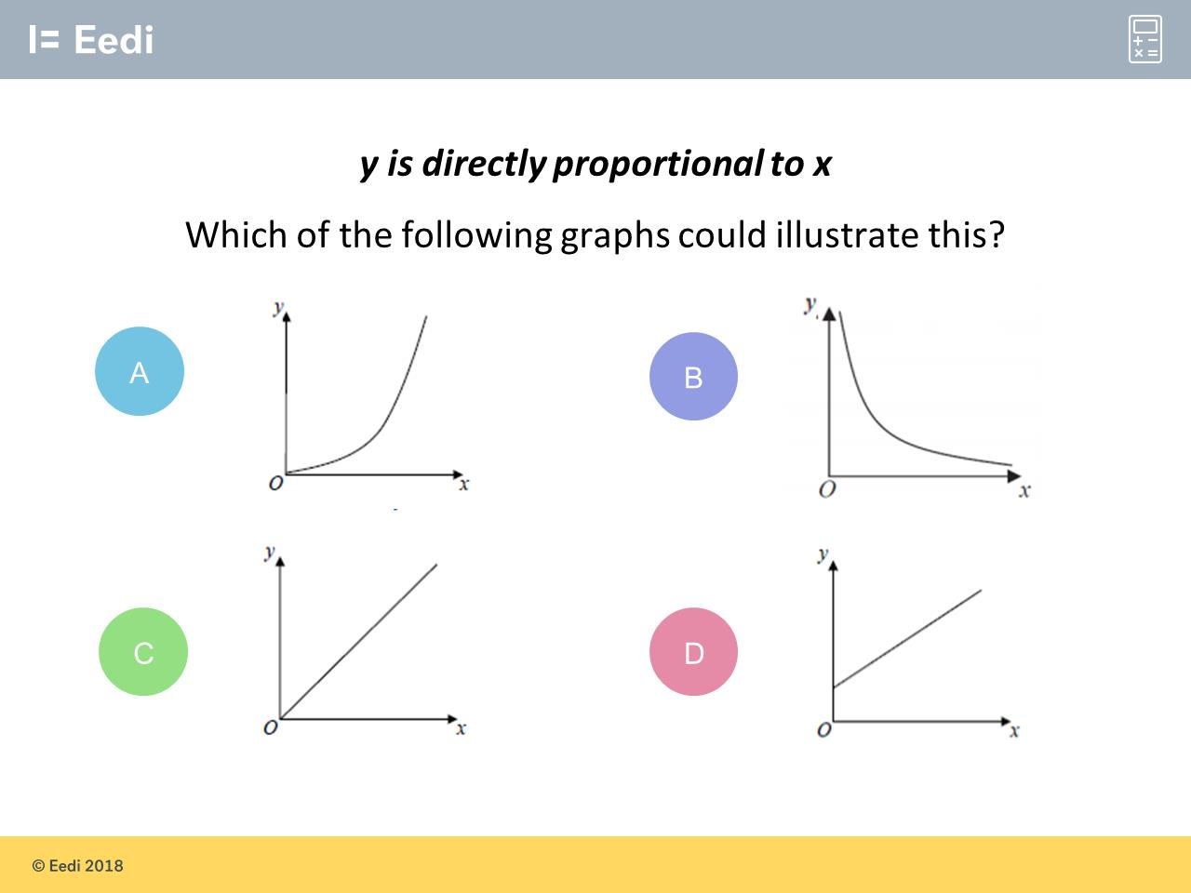
Question 3 – Direct Proportion

Slide 7
Answer 3 – Direct Proportion
CORRECT ANSWER | CORRECT EXPLANATION
C | It is linear and starts at the origin (0,0)
COMMON MISTAKES | WHAT MIGHT BE YOUR MISTAKE
A | It is curved so cant be in proportion
B | It si curved so cant be in proportion
D | It does not start at (0,0)

Slide 8
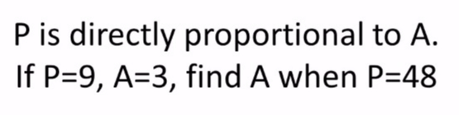
Question 4 – Direct Proportion

Slide 9
Answer 4 – Direct Proportion
CORRECT ANSWER | CORRECT EXPLANATION
16 | P = 3A therefore A = 48 ÷ 3
COMMON MISTAKES | WHAT MIGHT BE YOUR MISTAKE
144 | The student multiplied by 3 instead of dividing by 3
5.333… | The student thought the formula was A = 3P

Slide 10
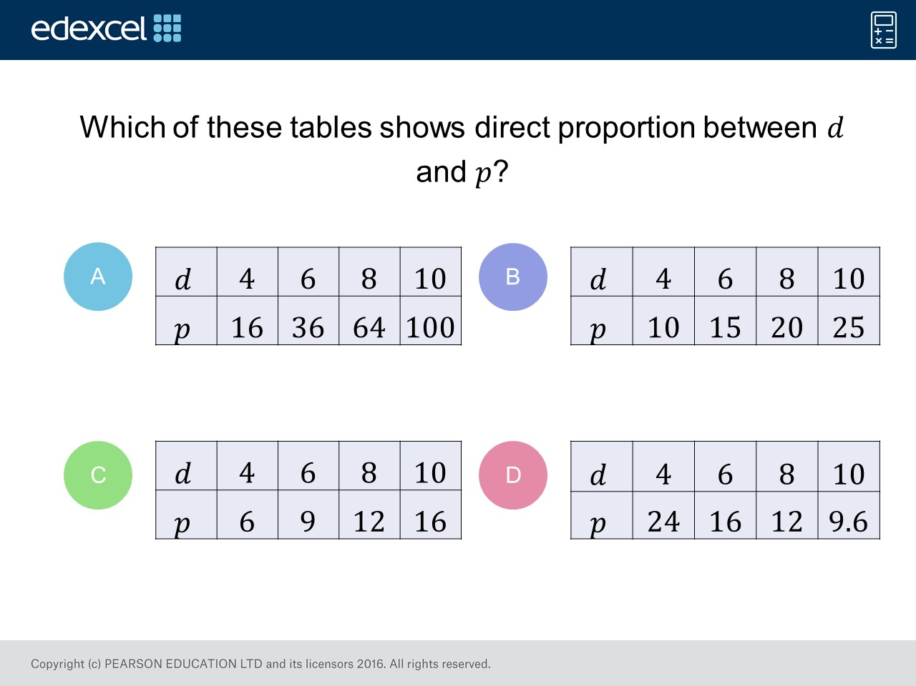
Question 5 – Direct Proportion

Slide 11
Answer 5 – Direct Proportion
CORRECT ANSWER | CORRECT EXPLANATION
B | If you multiply p by 2.5, you get q. This is consistent for each pair of values in the table
COMMON MISTAKES | WHAT MIGHT BE YOUR MISTAKE
A | The student may not know that this shows a squared relationship
C | The pair 10,16 isn’t correct. The student may not have checked all the values
D | The student may not know that this shows inverse proportion

Slide 12
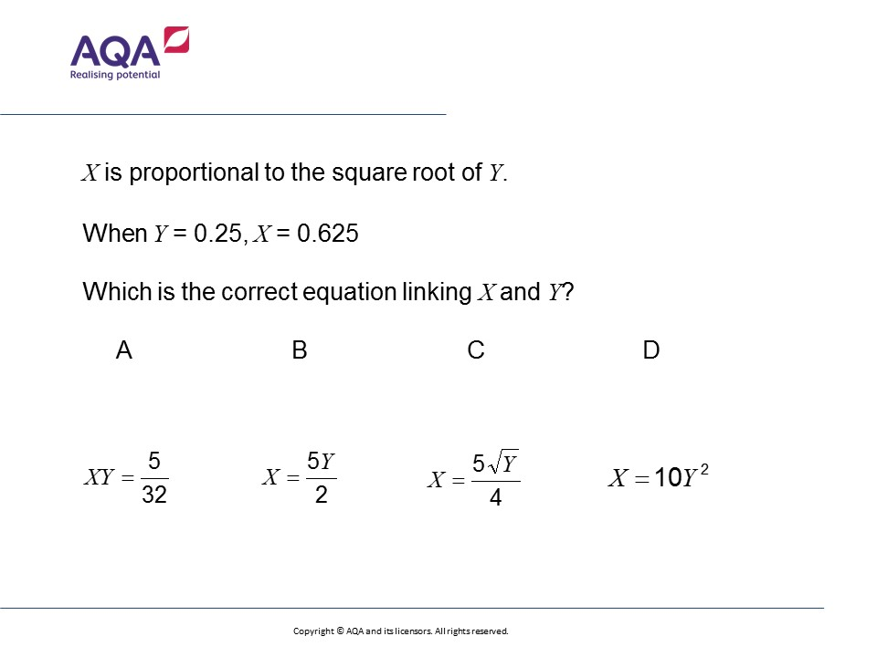
Question 6 – Direct Proportion
What is the formula connecting Y and X?

Slide 13
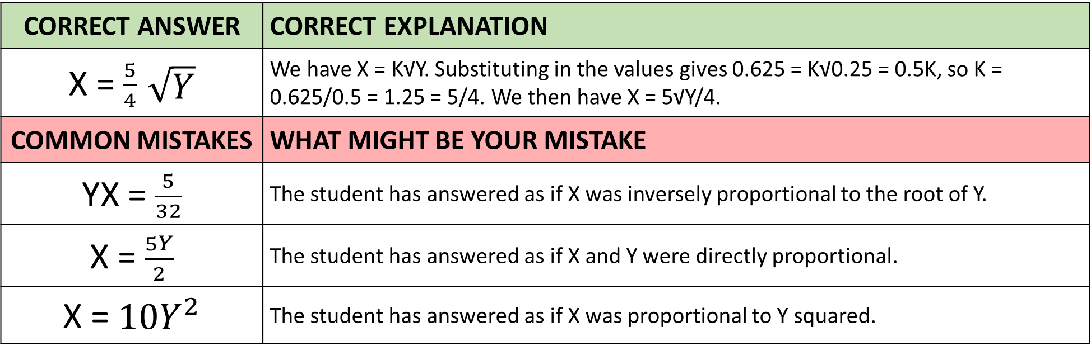
Answer 6 – Direct Proportion
What is the formula connecting X and Y?
CORRECT ANSWER | CORRECT EXPLANATION
X = $\frac{5}{4}$ $\sqrt{Y}$ | We have X = K√Y. Substituting in the values gives 0.625 = K√0.25 = 0.5K, so K = 0.625/0.5 = 1.25 = 5/4. We then have X = 5√Y/4.
COMMON MISTAKES | WHAT MIGHT BE YOUR MISTAKE
YX = $\frac{5}{32}$ | The student has answered as if X was inversely proportional to the root of Y.
X = $\frac{5Y}{2}$ | The student has answered as if X and Y were directly proportional.
X = $10Y^{2}$ | The student has answered as if X was proportional to Y squared.

Slide 14
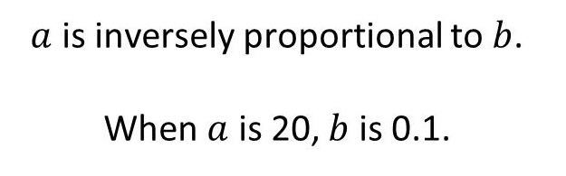
Question 7 – Inverse Proportion
What is the formula connecting a and b?

Slide 15
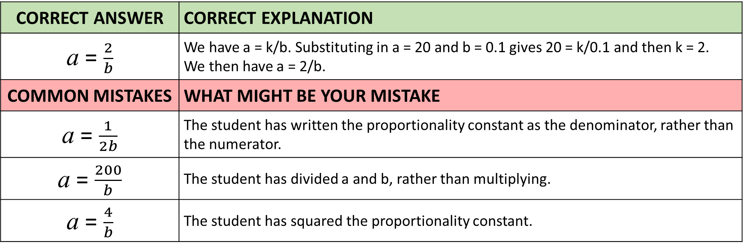
Answer 7 – Inverse Proportion
What is the formula connecting a and b?
CORRECT ANSWER | CORRECT EXPLANATION
a = $\frac{2}{b}$ | We have a = k/b. Substituting in a = 20 and b = 0.1 gives 20 = k/0.1 and then k = 2. We then have a = 2/b.
COMMON MISTAKES | WHAT MIGHT BE YOUR MISTAKE
a = $\frac{1}{2b}$ | The student has written the proportionality constant as the denominator, rather than the numerator.
a = $\frac{200}{b}$ | The student has divided a and b, rather than multiplying.
a = $\frac{4}{b}$ | The student has squared the proportionality constant.

Slide 16
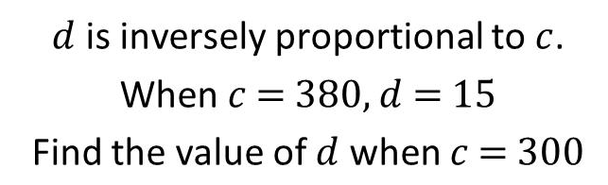
Question 8 – Inverse Proportion

Slide 17
Answer 8 – Inverse Proportion
CORRECT ANSWER | CORRECT EXPLANATION
19 | The constant of proportion (k) is 5700, which comes from c × d. When you do 5700/300 you get 19
COMMON MISTAKES | WHAT MIGHT BE YOUR MISTAKE
5700 | The student has found the (correct) constant of proportion
-65 | If 𝑥 = -1, we have 𝑦 = (-1)² - 2(-1) = 1 + 2 = 3.
11.84 | The student has treated it as a direct proportion question

Slide 18
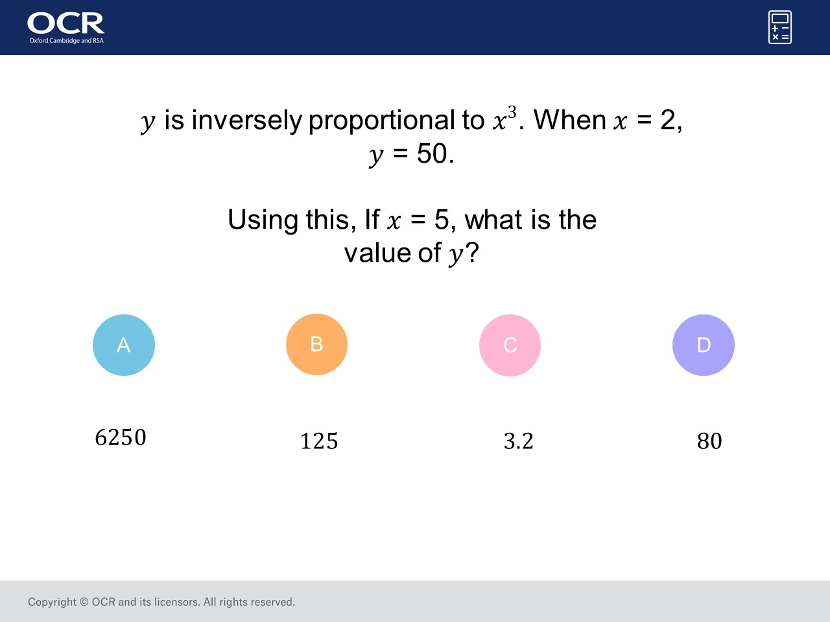
Question 9 – Inverse Proportion

Slide 19
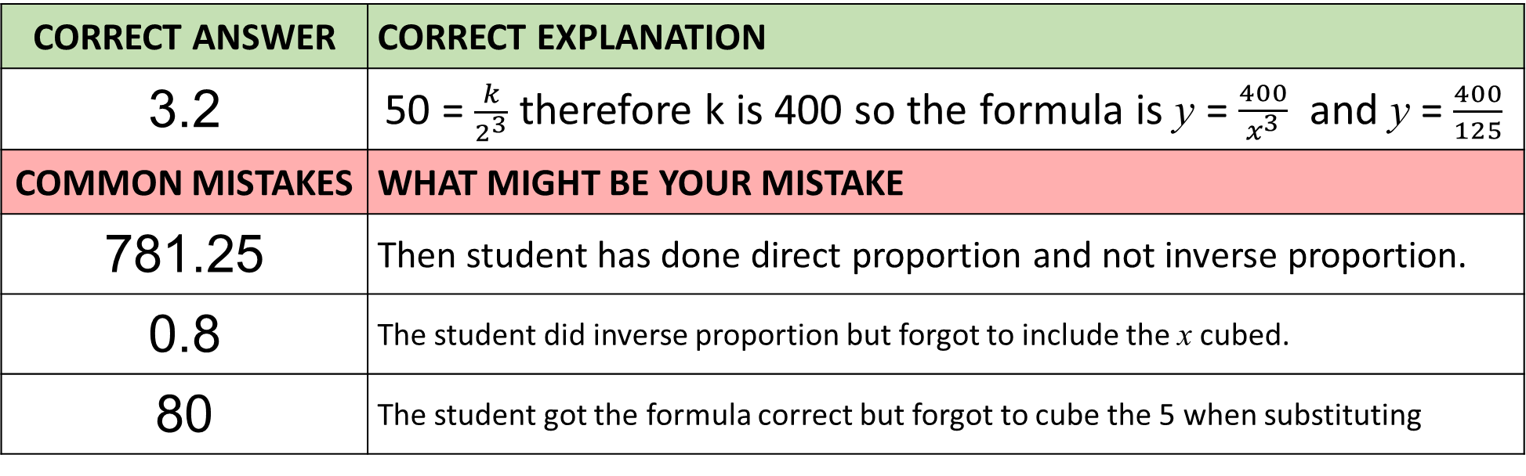
Answer 9 – Inverse Proportion
CORRECT ANSWER | CORRECT EXPLANATION
3.2 | 50 = $\frac{k}{2^{3}}$ therefore k is 400 so the formula is y = $\frac{400}{x^{3}}$ and y = $\frac{400}{125}$
COMMON MISTAKES | WHAT MIGHT BE YOUR MISTAKE
781.25 | Then student has done direct proportion and not inverse proportion.
0.8 | The student did inverse proportion but forgot to include the x cubed.
80 | The student got the formula correct but forgot to cube the 5 when substituting

Slide 20
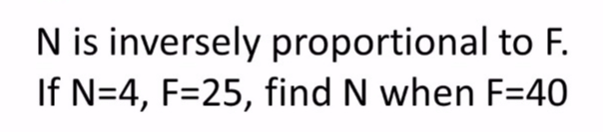
Question 10 – Inverse Proportion

Slide 21
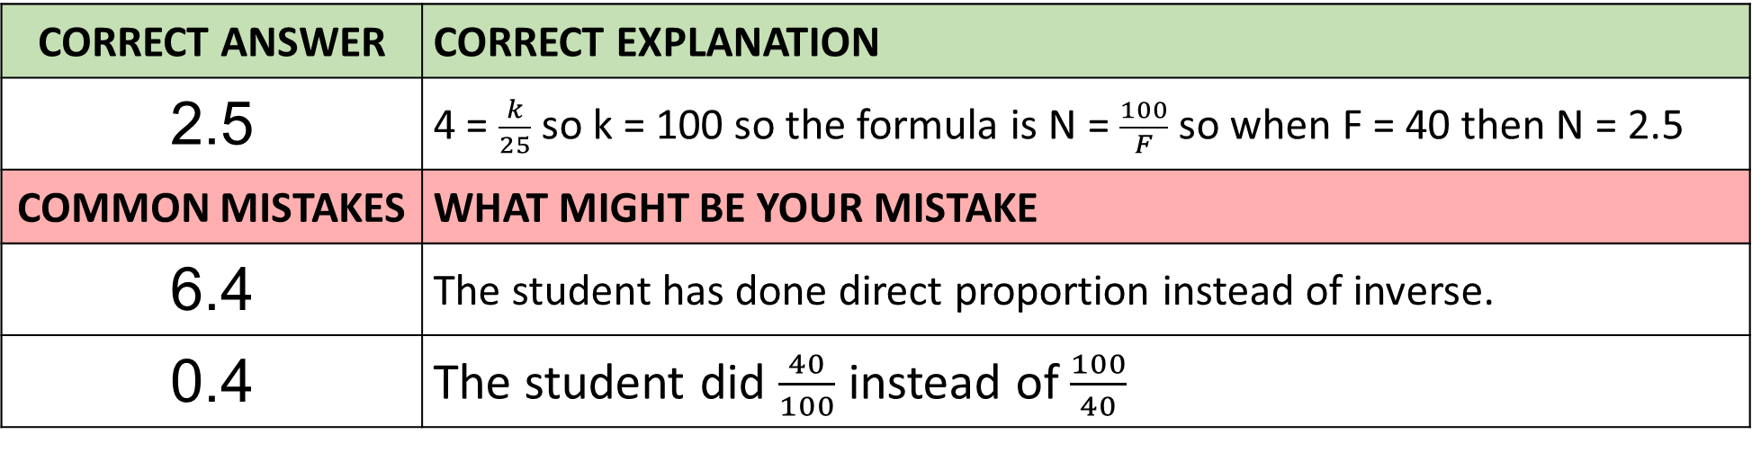
Answer 10 – Inverse Proportion
CORRECT ANSWER | CORRECT EXPLANATION
2.5 | 4 = $\frac{k}{25}$ so k = 100 so the formula is N = $\frac{100}{F}$ so when F = 40 then N = 2.5
COMMON MISTAKES | WHAT MIGHT BE YOUR MISTAKE
6.4 | The student has done direct proportion instead of inverse.
0.4 | The student did $\frac{40}{100}$ instead of $\frac{100}{40}$

Slide 22
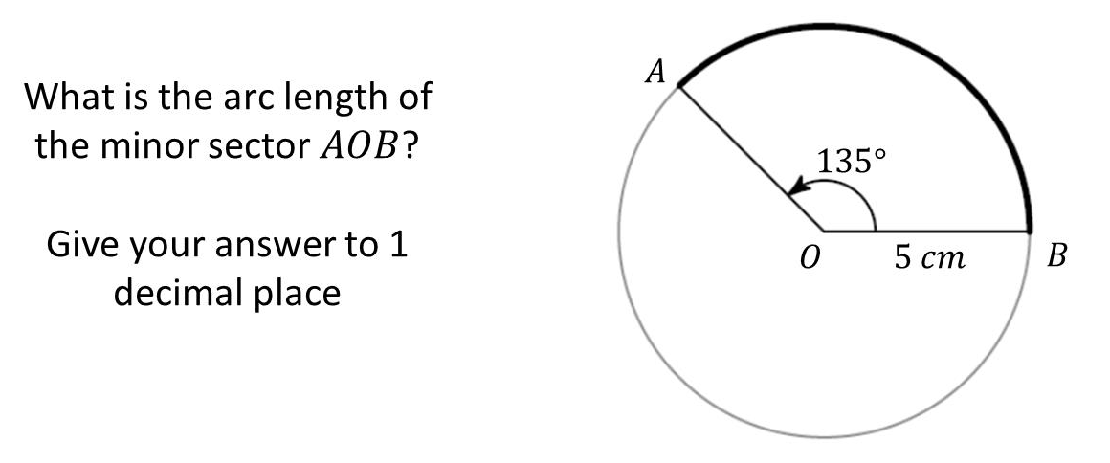
Question 11 – Arcs and Sectors

Slide 23
Answer 11 – Arcs and Sectors
CORRECT ANSWER | CORRECT EXPLANATION
11.8cm | We have 135/180 × 𝜋 × 5 = 11.8 cm.
COMMON MISTAKES | WHAT MIGHT BE YOUR MISTAKE
83.8cm | The student has done 360/135, instead of 135/360.
29.5cm | The student has found the area, not the arc length.
5.9cm | The student has multiplied by the radius, not the diameter.

Slide 24
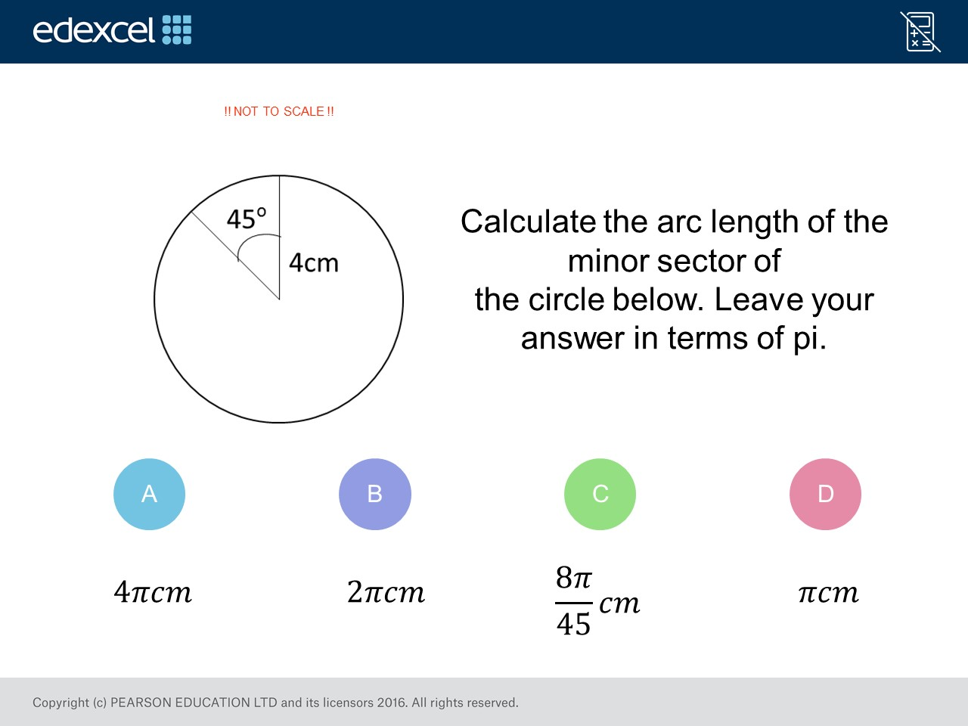
Question 12 – Arcs and Sectors

Slide 25
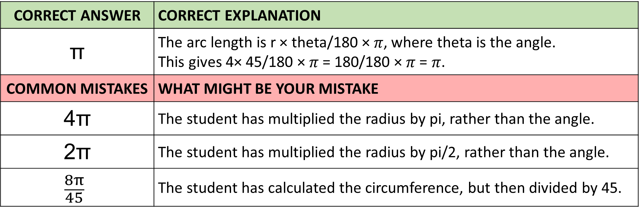
Answer 12 – Arcs and Sectors
CORRECT ANSWER | CORRECT EXPLANATION
π | The arc length is r × theta/180 × 𝜋, where theta is the angle. This gives 4× 45/180 × 𝜋 = 180/180 × 𝜋 = 𝜋.
COMMON MISTAKES | WHAT MIGHT BE YOUR MISTAKE
4π | The student has multiplied the radius by pi, rather than the angle.
2π | The student has multiplied the radius by pi/2, rather than the angle.
$$\frac{8π}{45}$$ | The student has calculated the circumference, but then divided by 45.

Slide 26
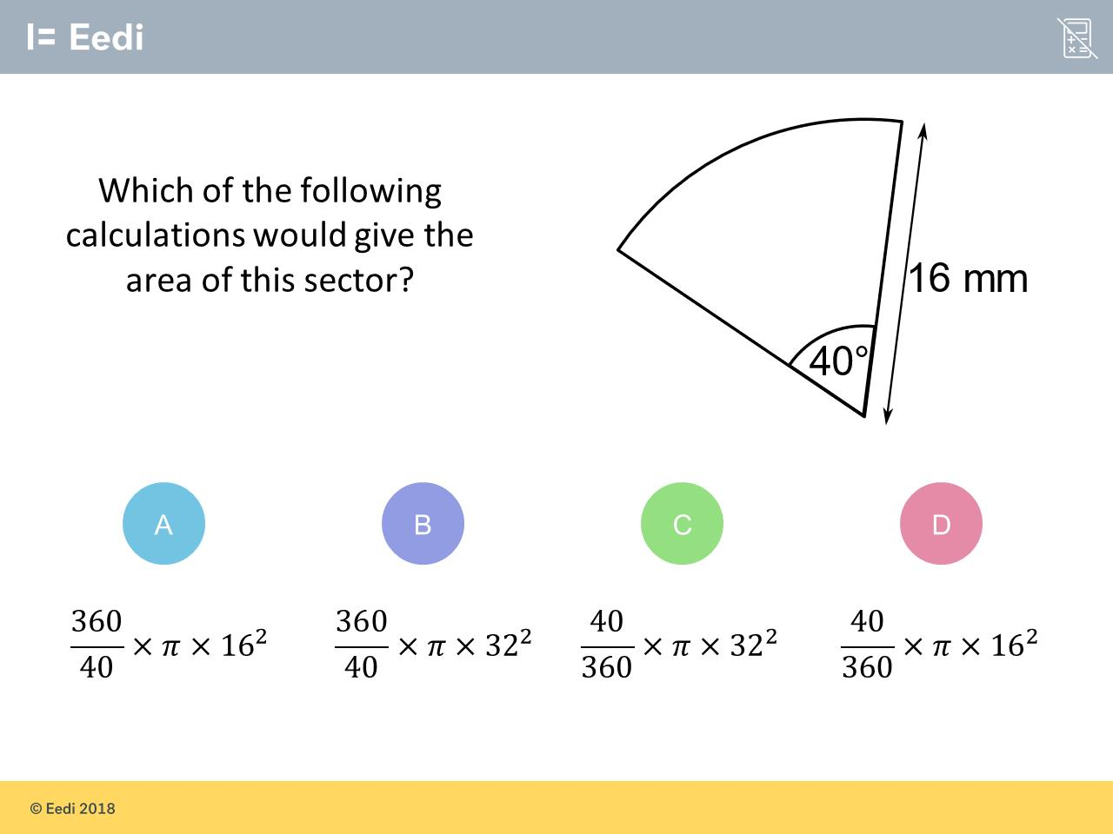
Question 13 – Arcs and Sectors

Slide 27
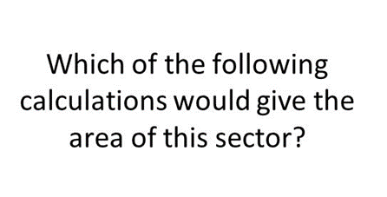
Answer 13 – Arcs and Sectors
CORRECT ANSWER | CORRECT EXPLANATION
D | The area of a sector is theta/360 × 𝜋 × r², so we have 40/360 × 𝜋 × 16².
COMMON MISTAKES | WHAT MIGHT BE YOUR MISTAKE
A | The student has written the fraction the wrong way around.
B | The student has written the fraction the wrong way around, and has used the diameter rather than the radius.
C | The student has used the diameter, rather than the radius.

Slide 28
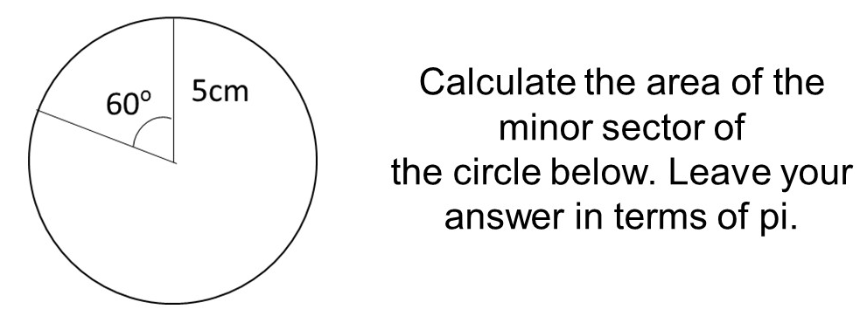
Question 14 – Arcs and Sectors

Slide 29
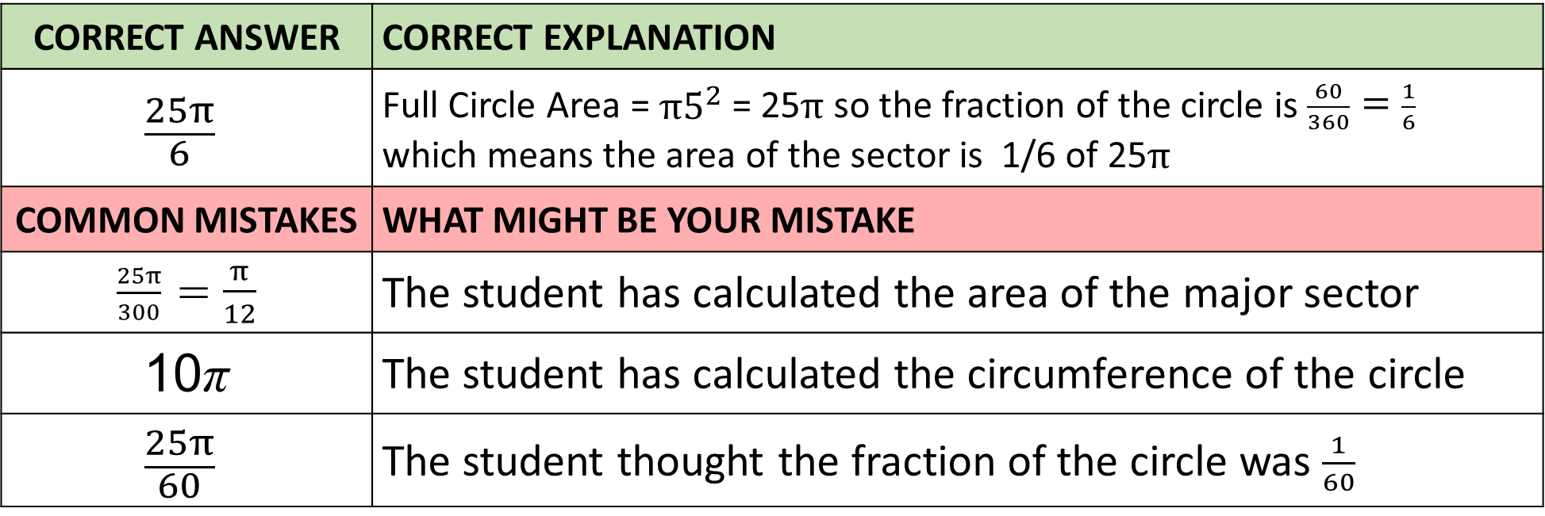
Answer 14 – Arcs and Sectors
CORRECT ANSWER | CORRECT EXPLANATION
$$\frac{25π}{6}$$ | Full Circle Area = $π5^{2}$ = 25$π$ so the fraction of the circle is $\frac{60}{360}=\frac{1}{6}$ which means the area of the sector is 1/6 of 25$π$
COMMON MISTAKES | WHAT MIGHT BE YOUR MISTAKE
$\frac{25π}{300}$ = $\frac{π}{12}$ | The student has calculated the area of the major sector
10π | The student has calculated the circumference of the circle
$$\frac{25π}{60}$$ | The student thought the fraction of the circle was $\frac{1}{60}$

Slide 30
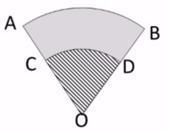
Question 15 – Arcs and Sectors
OD = 15 metres
OB = 40 metres
Angle COD = 70˚
Find the area of the grey section ACDB
Give you answer to 1 decimal place.

Slide 31
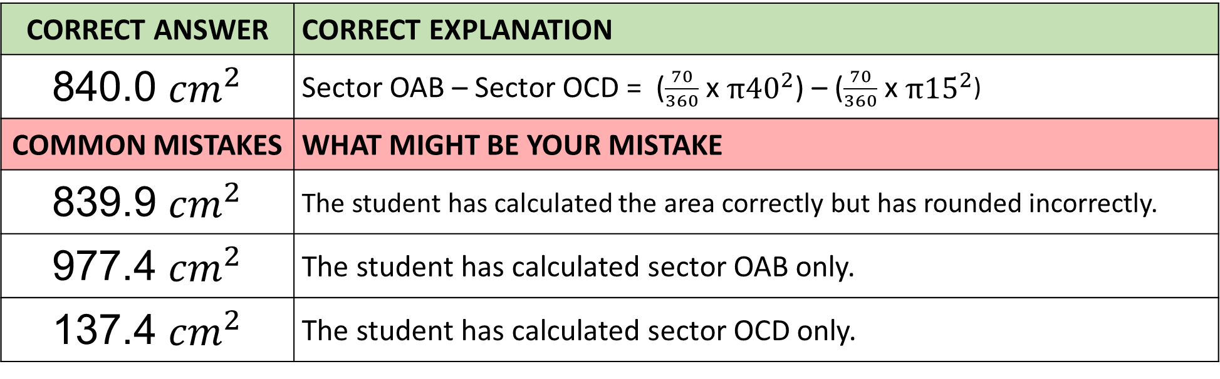
Answer 15 – Arcs and Sectors
OD = 15 metres
OB = 40 metres
Angle COD = 70˚
Find the area of the grey section ACDB
Give you answer to 1 decimal place.
CORRECT ANSWER | CORRECT EXPLANATION
840.0 ${cm}^{2}$ | Sector OAB – Sector OCD = ($\frac{70}{360}$ x $π{40}^{2}$) – ($\frac{70}{360}$ x $π{15}^{2}$)
COMMON MISTAKES | WHAT MIGHT BE YOUR MISTAKE
839.9 ${cm}^{2}$ | The student has calculated the area correctly but has rounded incorrectly.
977.4 ${cm}^{2}$ | The student has calculated sector OAB only.
137.4 ${cm}^{2}$ | The student has calculated sector OCD only.

