Slide 1
Differentiation
2nd Derivative
Chapter 12
(Part 5 of 8)

Slide 2
Second Order Derivatives
When you differentiate once, the expression you get is the first order derivative.
When you differentiate a second time,
the resulting expression is the
second order derivative.

Slide 3
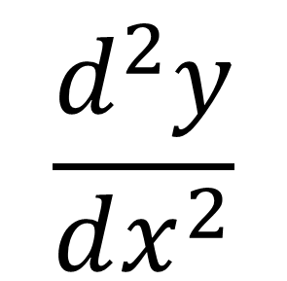
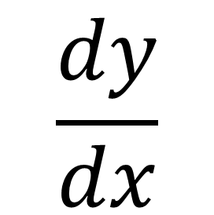
Notation
$$\frac{dy}{dx}$$
First Derivative
$$\frac{d^{2}y}{dx^{2}}$$
Second Derivative

Slide 4
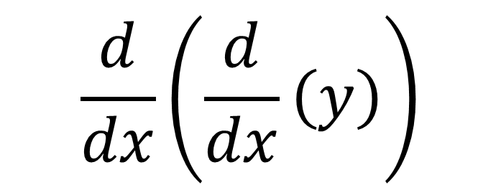

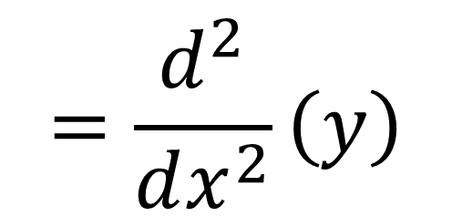
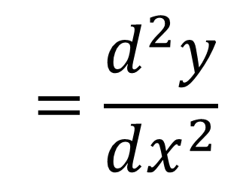
How does the notation $\frac{d^{2}y}{dx^{2}}$ work?
$$\frac{d}{dx}\left(\frac{d}{dx}\left(y\right)\right)$$
$$=\frac{d^{2}}{dx^{2}}\left(y\right)$$
$$=\frac{d^{2}y}{dx^{2}}$$

Slide 5
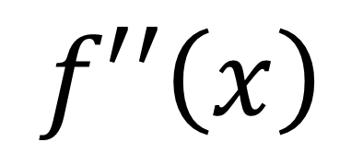
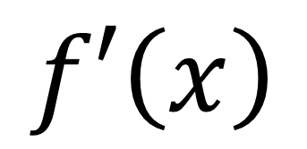
Notation
$$f′\left(x\right)$$
First Derivative
$$f′′\left(x\right)$$
Second Derivative

Slide 6
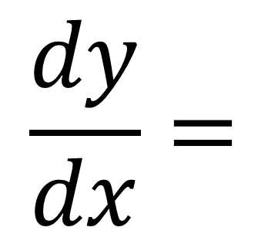
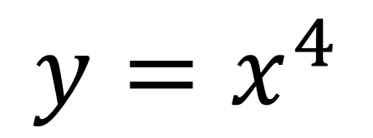
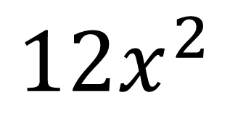
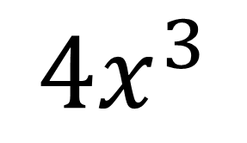
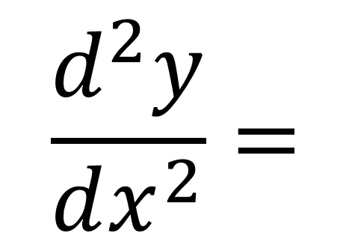
$$y=x^{4}$$
$$\frac{dy}{dx}=$$
$$4x^{3}$$
First Derivative
$$\frac{d^{2}y}{dx^{2}}=$$
Second Derivative
$$12x^{2}$$

Slide 7
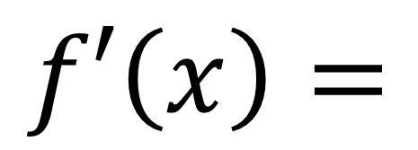
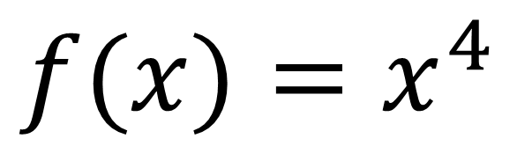
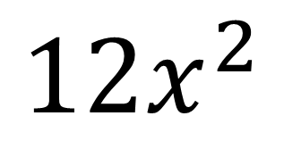
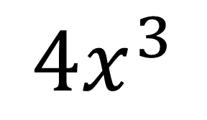
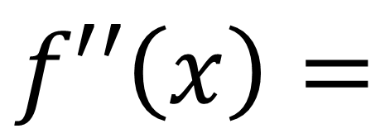
$$f(x)=x^{4}$$
$$f′\left(x\right)=$$
$$4x^{3}$$
First Derivative
$$f′′\left(x\right)=$$
$$12x^{2}$$
Second Derivative

Slide 8
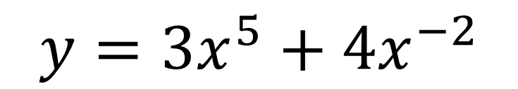
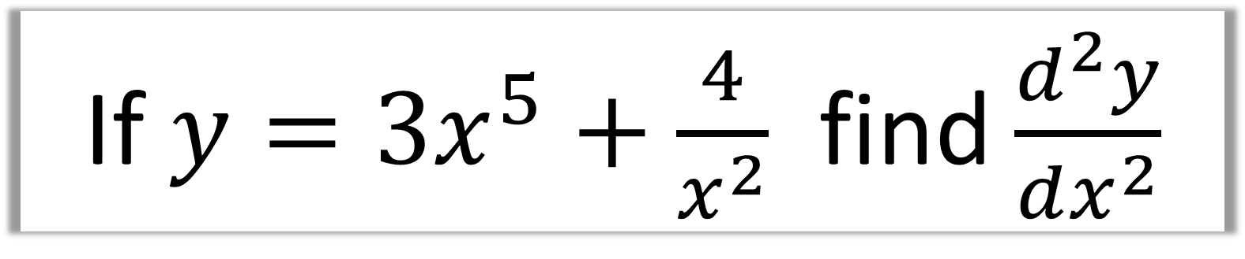
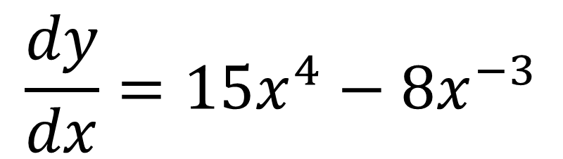
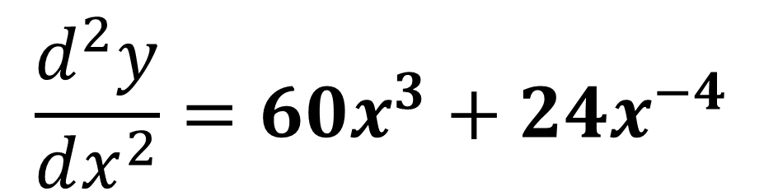
If $y=3x^{5}+\frac{4}{x^{2}}$ find $\frac{d^{2}y}{dx^{2}}$
$$y=3x^{5}+4x^{−2}$$
$$\frac{dy}{dx}=15x^{4}−8x^{−3}$$
$$\frac{d^{2}y}{dx^{2}}=60x^{3}+24x^{−4}$$

Slide 9
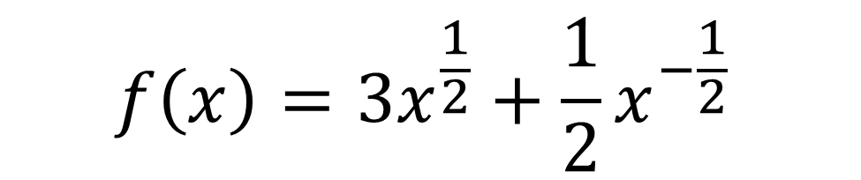
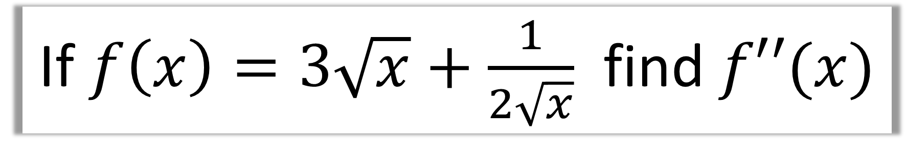
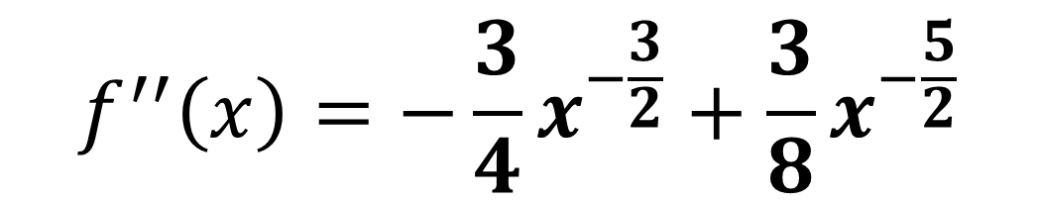
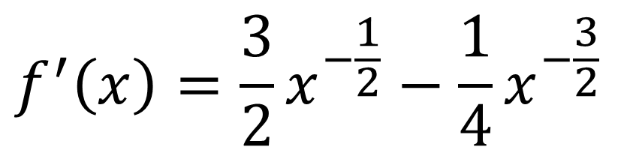
If $f\left(x\right)=3\sqrt{x}+\frac{1}{2\sqrt{x}}$ find $f′′(x)$
$$f\left(x\right)=3x^{\frac{1}{2}}+\frac{1}{2}x^{−\frac{1}{2}}$$
$$f^{′}\left(x\right)=\frac{3}{2}x^{−\frac{1}{2}}−\frac{1}{4}x^{−\frac{3}{2}}$$
$$f^{′′}\left(x\right)=−\frac{3}{4}x^{−\frac{3}{2}}+\frac{3}{8}x^{−\frac{5}{2}}$$

Slide 10
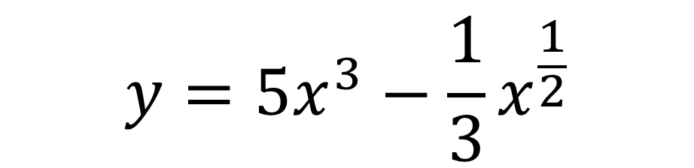
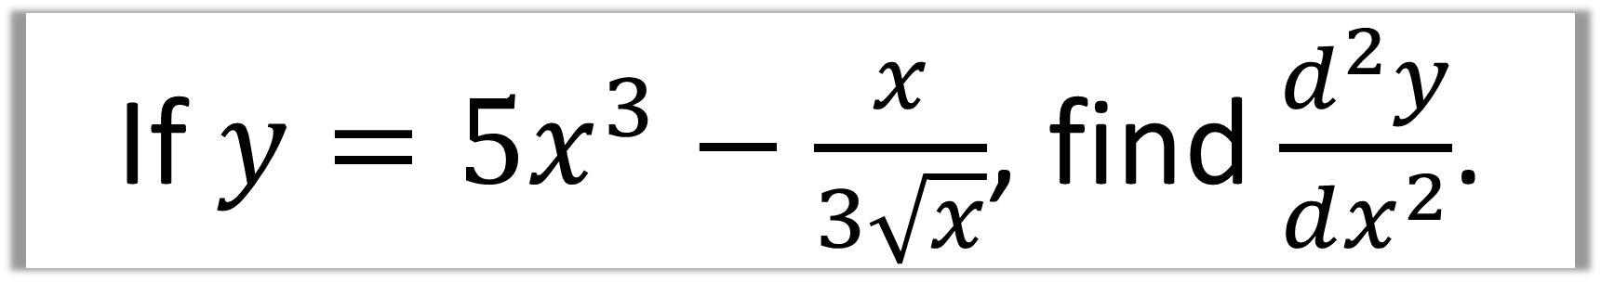
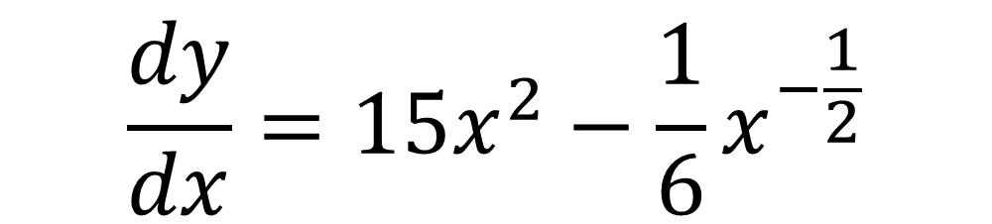
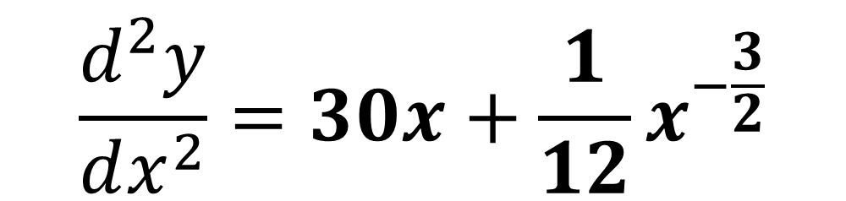
If $y=5x^{3}−\frac{x}{3\sqrt{x}}$, find $\frac{d^{2}y}{dx^{2}}$.
$$y=5x^{3}−\frac{1}{3}x^{\frac{1}{2}}$$
$$\frac{dy}{dx}=15x^{2}−\frac{1}{6}x^{−\frac{1}{2}}$$
$$\frac{d^{2}y}{dx^{2}}=30x+\frac{1}{12}x^{−\frac{3}{2}}$$

Slide 11
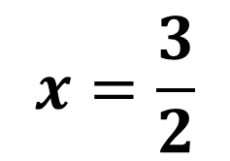
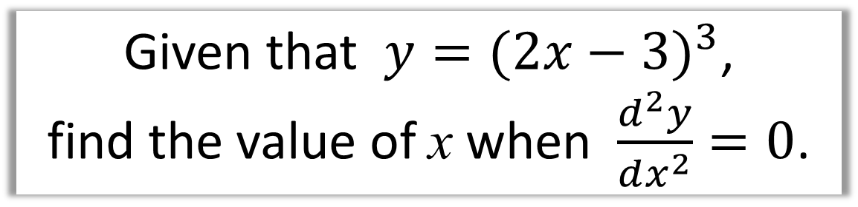

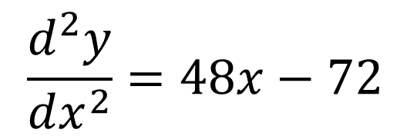
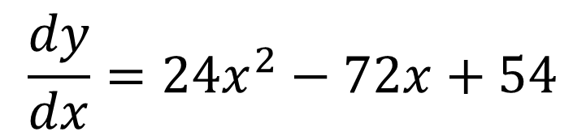
Given that $y=(2x−{3)}^{3}$,
find the value of x when $\frac{d^{2}y}{dx^{2}}=0$.
$$y= 8x^{3}− 36x^{2}+ 54x − 27$$
$$\frac{dy}{dx}=24x^{2}−72x+54$$
$$\frac{d^{2}y}{dx^{2}}=48x−72$$
$$48x−72=0$$
$$x=\frac{3}{2}$$

Slide 12

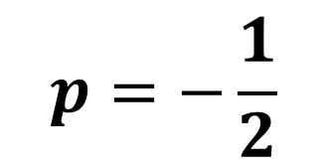
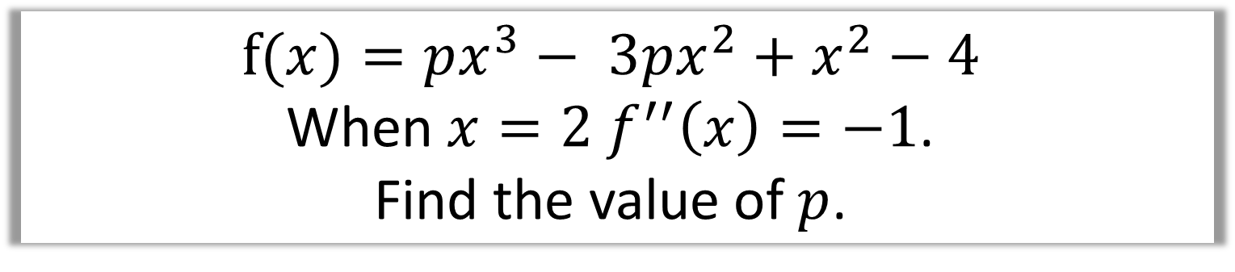

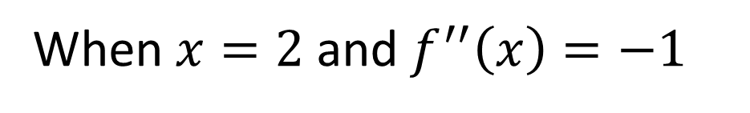

$$f(x)=px^{3}− 3px^{2}+x^{2}−4$$
When $x=2$ $f^{′′}\left(x\right)=−1$.
Find the value of $p$.
$$f′(x)=3px^{2}− 6px+2x$$
$$f^{′′}\left(x\right)=6px−6p+2$$
When $x=2$ and $f^{′′}\left(x\right)=−1$
$$−1=6p(2)−6p+2$$
$$p=−\frac{1}{2}$$

