Slide 1
Answer the questions and find the corresponding letters to reveal the celebrity’s names.
A | B | C | D | E | F | G | H | I | J | K | L | M
8 | 2 | 10 | 26 | 6 | 15 | 20 | 24 | 1 | 19 | 3 | 7 | 25
N | O | P | Q | R | S | T | U | V | W | X | Y | Z
13 | 12 | 22 | 14 | 23 | 9 | 4 | 5 | 21 | 17 | 11 | 18 | 16

Slide 2
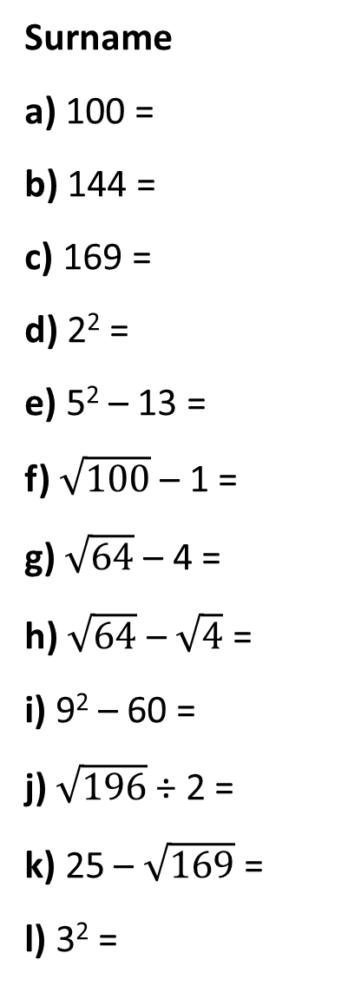
Surname
a) 100 =
b) 144 =
c) 169 =
d) 2² =
e) 5² – 13 =
f) $\sqrt{100}$ – 1 =
g) $\sqrt{64}$– 4 =
h) $\sqrt{64}$ – $\sqrt{4}$=
i) 9² – 60 =
j) $\sqrt{196}$÷ 2 =
k) 25 – $\sqrt{169}$ =
l) 3² =
Celebrity Person A
First Name
Write down the positive square root:
a) 16 =
b) 25 =
c) 49 =
d) 1 =
e) 81 =
f) 64 =

Slide 3
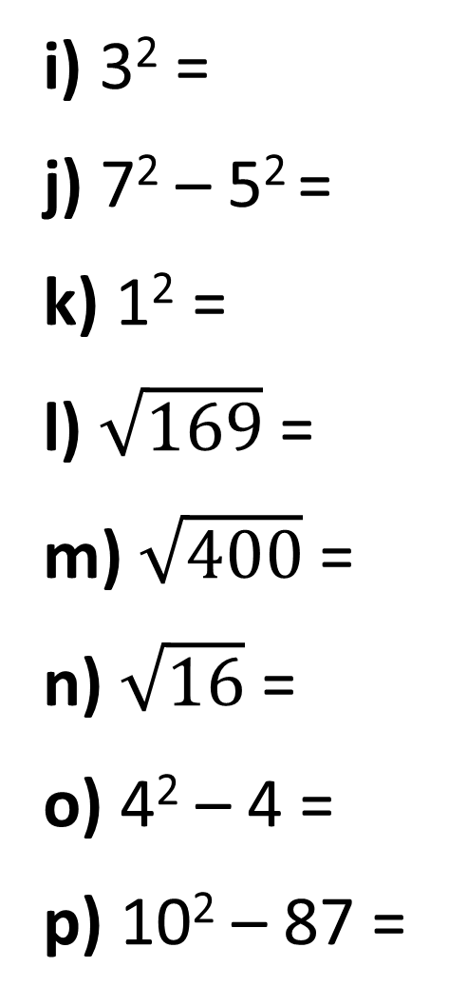
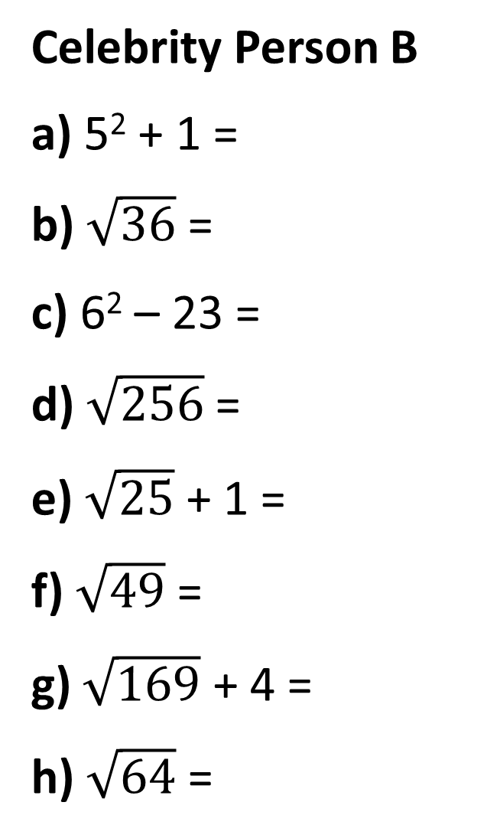
Celebrity Person B
a) 5² + 1 =
b) $\sqrt{36}$ =
c) 6² – 23 =
d) $\sqrt{256}$=
e) $\sqrt{25}$ + 1 =
f) $\sqrt{49}$ =
g) $\sqrt{169}$ + 4 =
h) $\sqrt{64}$ =
i) 3² =
j) 7² – 5² =
k) 1² =
l) $\sqrt{169}$ =
m) $\sqrt{400}$=
n) $\sqrt{16}$ =
o) 4² – 4 =
p) 10² – 87 =

Slide 4
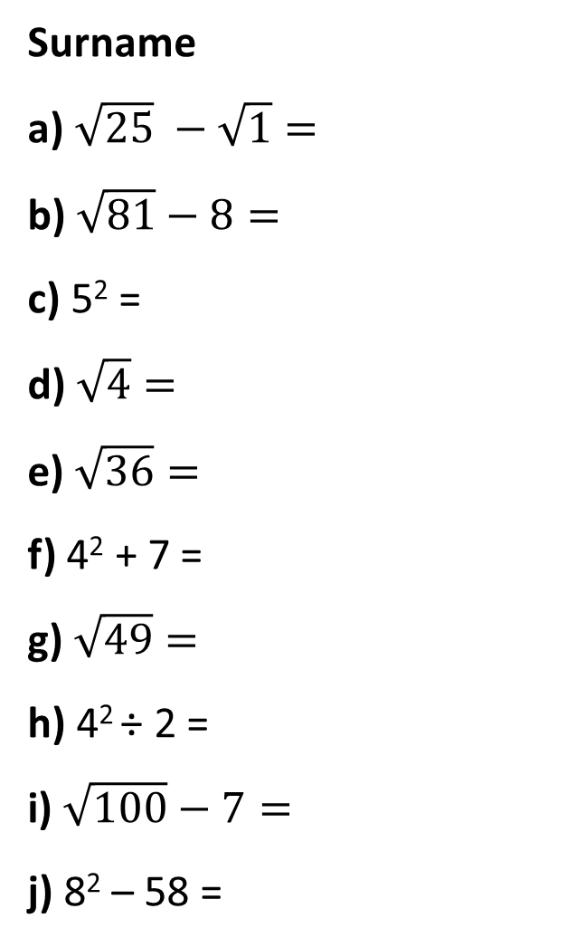
Celebrity Person C
First Name
Write down the
positive square root
a) 361 =
b) 25 =
c) 81 =
d) 16 =
e) 1 =
f) 169 =
Surname
a) $\sqrt{25} −\sqrt{1}=$
b) $\sqrt{81}−8=$
c) 5² =
d) $\sqrt{4}=$
e) $\sqrt{36}=$
f) 4² + 7 =
g) $\sqrt{49}=$
h) 4² ÷ 2 =
i) $\sqrt{100}−7=$
j) 8² – 58 =

Slide 5
ANSWERS

Slide 6
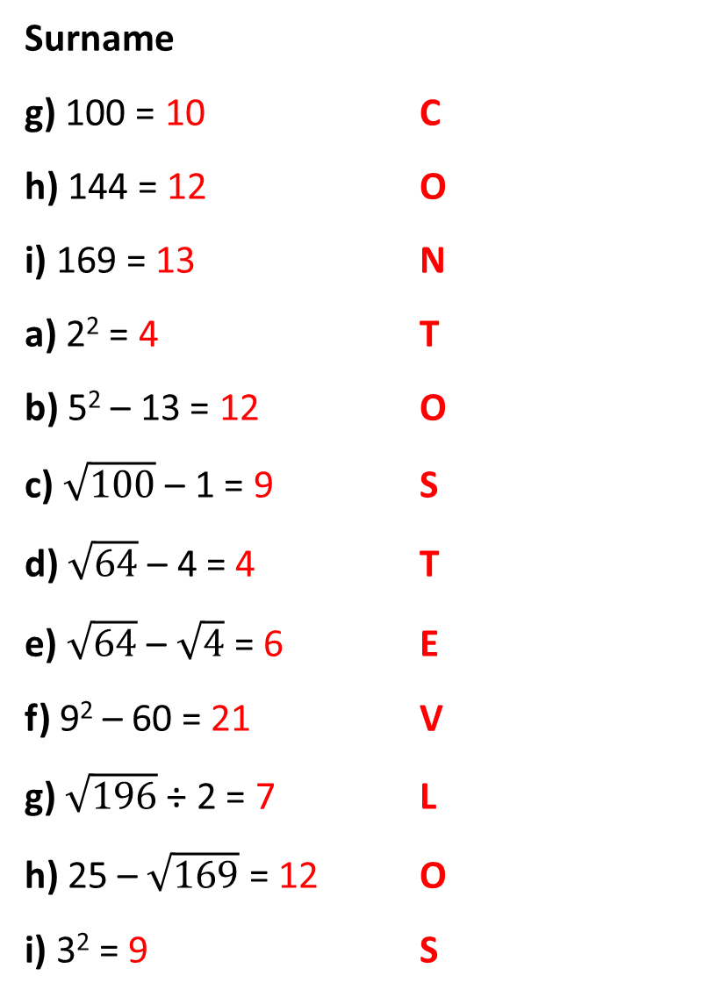
Celebrity Person A
First Name
Write down the positive square root:
a) 16 = 4 T
b) 25 = 5 U
c) 49 = 7 L
d) 1 = 1 I
e) 81 = 9 S
f) 64 = 8 A
Surname
g) 100 = 10 C
h) 144 = 12 O
i) 169 = 13 N
a) 2² = 4 T
b) 5² – 13 = 12 O
c) $\sqrt{100}$ – 1 = 9 S
d) $\sqrt{64}$– 4 = 4 T
e) $\sqrt{64}$ – $\sqrt{4}$= 6 E
f) 9² – 60 = 21 V
g) $\sqrt{196}$÷ 2 = 7 L
h) 25 – $\sqrt{169}$ = 12 O
i) 3² = 9 S

Slide 7
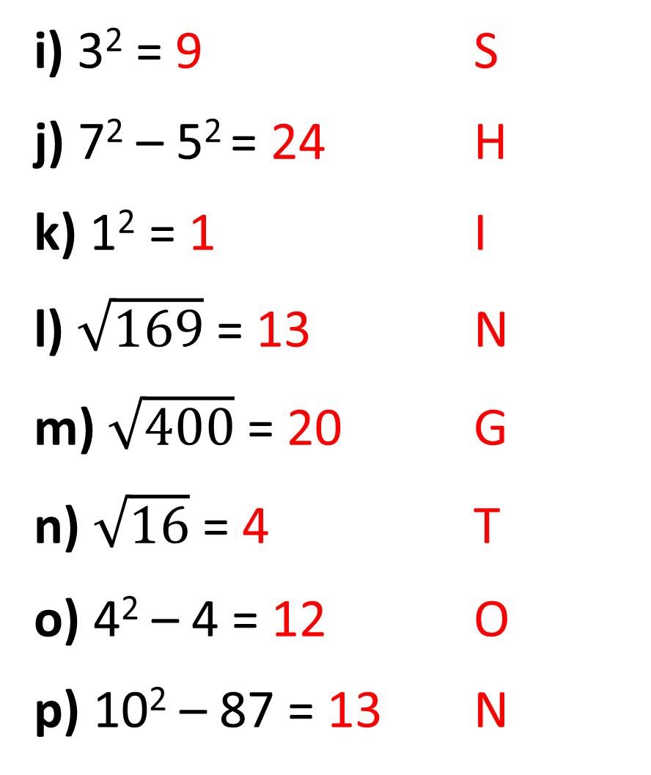
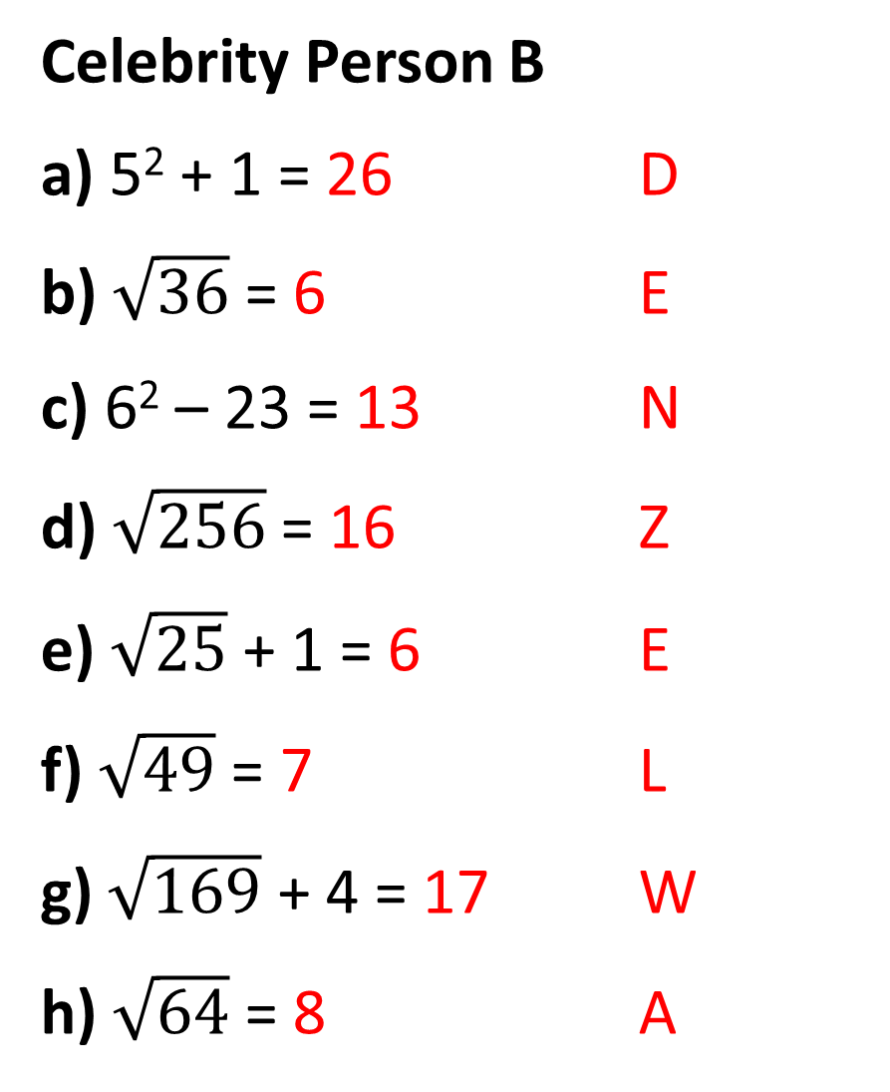
Celebrity Person B
a) 5² + 1 = 26 D
b) $\sqrt{36}$ = 6 E
c) 6² – 23 = 13 N
d) $\sqrt{256}$= 16 Z
e) $\sqrt{25}$ + 1 = 6 E
f) $\sqrt{49}$ = 7 L
g) $\sqrt{169}$ + 4 = 17 W
h) $\sqrt{64}$ = 8 A
i) 3² = 9 S
j) 7² – 5² = 24 H
k) 1² = 1 I
l) $\sqrt{169}$ = 13 N
m) $\sqrt{400}$= 20 G
n) $\sqrt{16}$ = 4 T
o) 4² – 4 = 12 O
p) 10² – 87 = 13 N

Slide 8
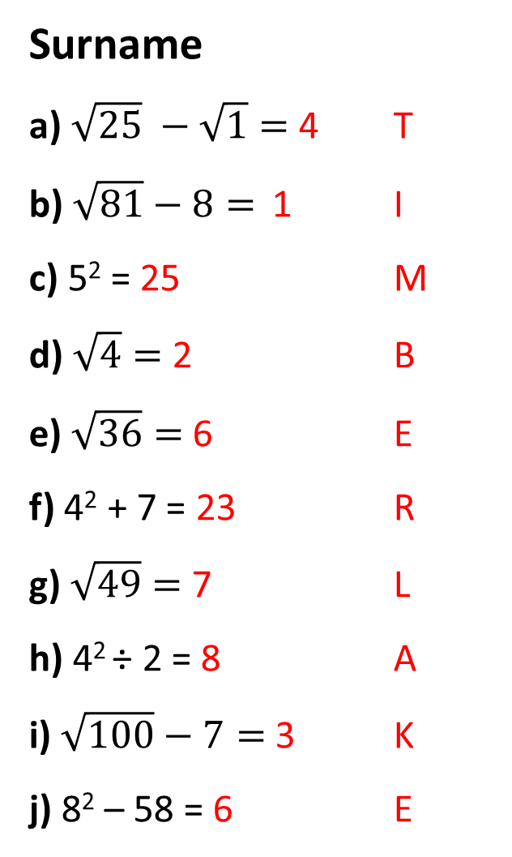
Celebrity Person C
First Name
Write down the positive square root
a) 361 = 19 J
b) 25 = 5 U
c) 81 = 9 S
d) 16 = 4 T
e) 1 = 1 I
f) 169 = 13 N
Surname
a) $\sqrt{25} −\sqrt{1}=$ 4 T
b) $\sqrt{81}−8=$ 1 I
c) 5² = 25 M
d) $\sqrt{4}=$ 2 B
e) $\sqrt{36}=$ 6 E
f) 4² + 7 = 23 R
g) $\sqrt{49}=$ 7 L
h) 4² ÷ 2 = 8 A
i) $\sqrt{100}−7=$ 3 K
j) 8² – 58 = 6 E

