Slide 1
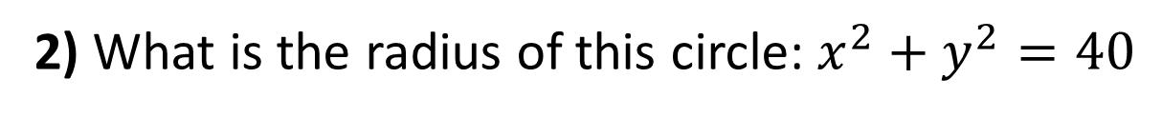
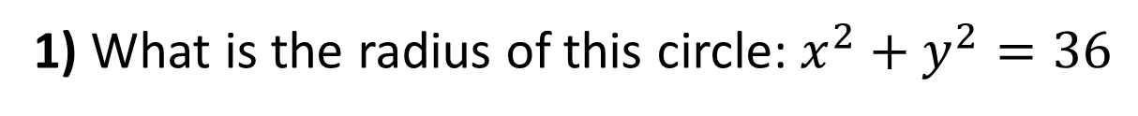
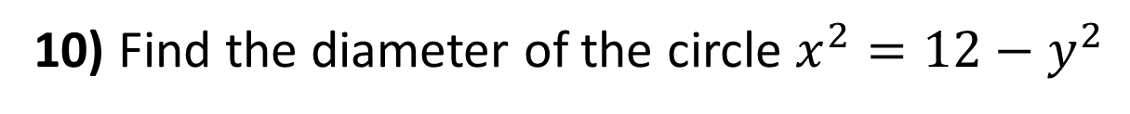
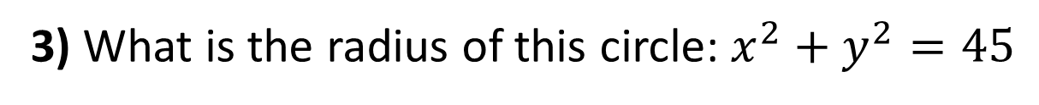
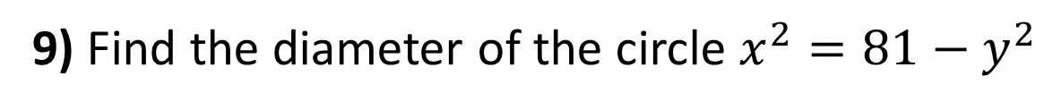
1) What is the radius of this circle: $x^{2}+y^{2}=36$
2) What is the radius of this circle: $x^{2}+y^{2}=40$
3) What is the radius of this circle: $x^{2}+y^{2}=45$
4) $x^{2}+y^{2}=25.$ A is the point (3, y), work out the value of $y$.
5) $x^{2}+y^{2}=169.$ A is the point (x, 12), work out the value of $x$.
6) Write the equation of a circle with centre (0, 0) and radius 3 cm.
7) Write the equation of a circle with centre (0, 0) and radius $\sqrt{11}$cm.
8) Write the equation of a circle with centre (0, 0) and radius $2\sqrt{3}$cm.
9) Find the diameter of the circle $x^{2}=81−y^{2}$
10) Find the diameter of the circle $x^{2}=12−y^{2}$

Slide 2
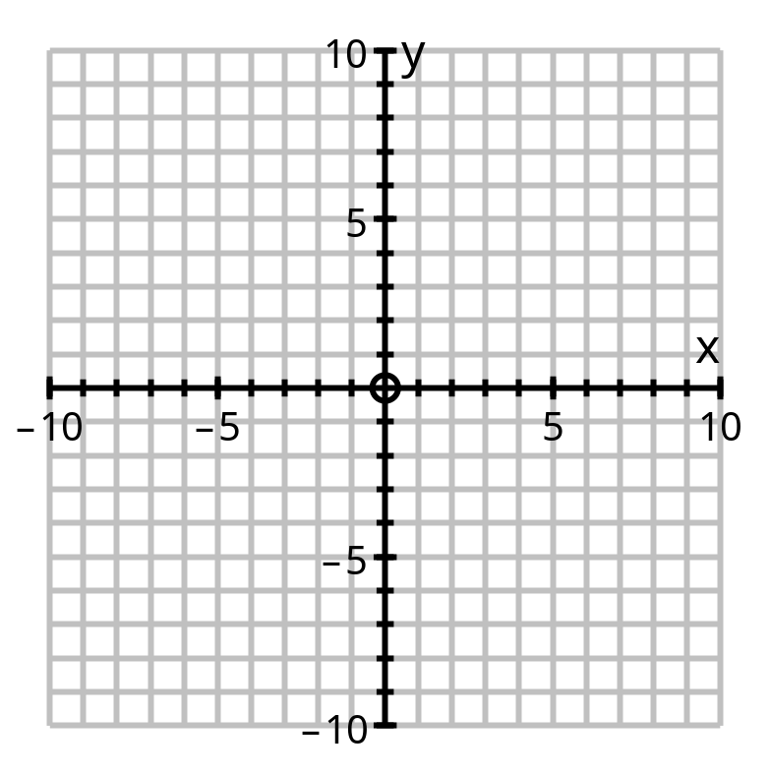
11) Write the equation of each circle
12) Write the equation of each circle
(8,6)
(-5,-2)
(1,-7)

Slide 3
ANSWERS

Slide 4
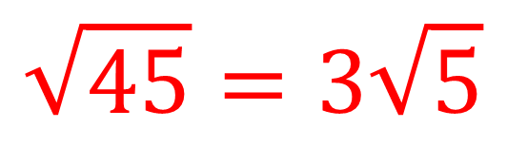
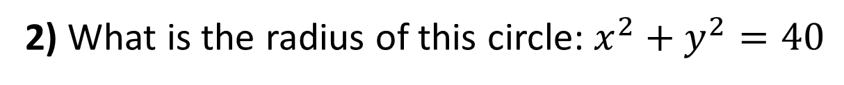
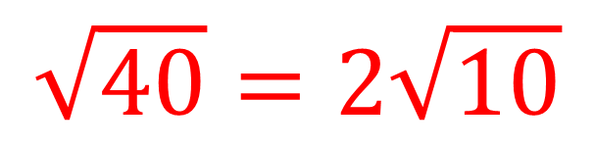
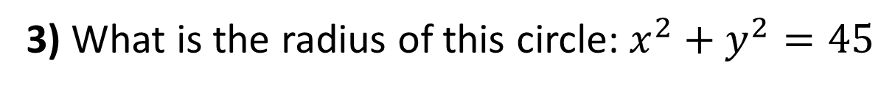
6
1) What is the radius of this circle: $x^{2}+y^{2}=36$
$$\sqrt{40}=2\sqrt{10}$$
2) What is the radius of this circle: $x^{2}+y^{2}=40$
$$\sqrt{45}=3\sqrt{5}$$
3) What is the radius of this circle: $x^{2}+y^{2}=45$
4
4) $x^{2}+y^{2}=25.$ A is the point (3, y), work out the value of $y$.
5
5) $x^{2}+y^{2}=169.$ A is the point (x, 12), work out the value of $x$.

Slide 5
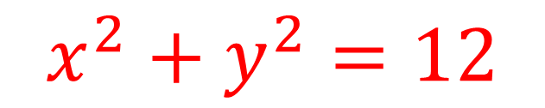
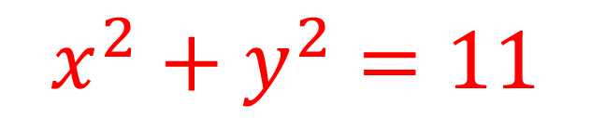
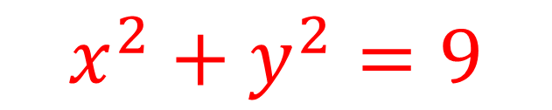
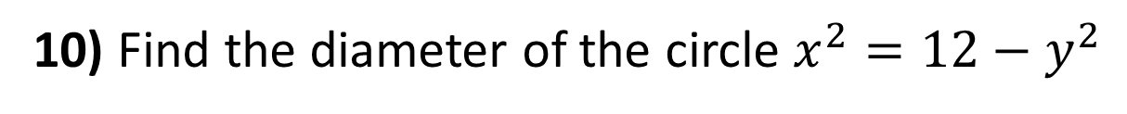
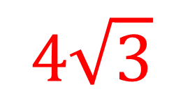
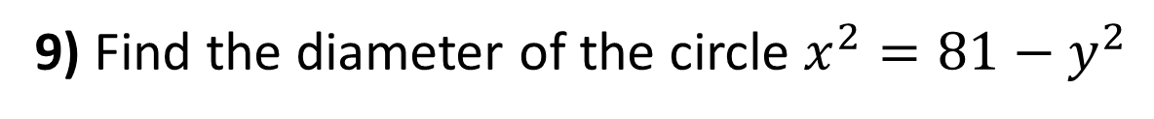
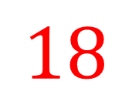
6) Write the equation of a circle with centre (0, 0) and radius 3 cm.
$$x^{2}+y^{2}=9$$
7) Write the equation of a circle with centre (0, 0) and radius $\sqrt{11}$cm.
$$x^{2}+y^{2}=11$$
8) Write the equation of a circle with centre (0, 0) and radius $2\sqrt{3}$cm.
$$x^{2}+y^{2}=12$$
9) Find the diameter of the circle $x^{2}=81−y^{2}$
$$18$$
10) Find the diameter of the circle $x^{2}=12−y^{2}$
$$4\sqrt{3}$$

Slide 6
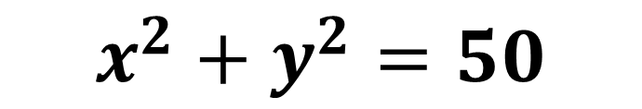
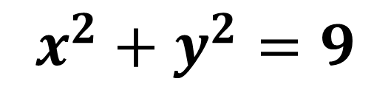
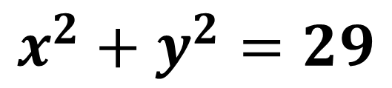
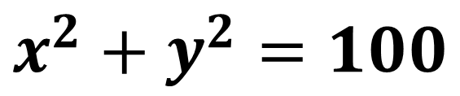
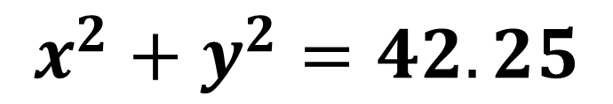
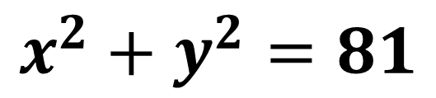
11) Write the equation of each circle
$$x^{2}+y^{2}=9$$
$$x^{2}+y^{2}=42.25$$
$$x^{2}+y^{2}=81$$
12) Write the equation of each circle
(8,6)
$$x^{2}+y^{2}=100$$
$$x^{2}+y^{2}=50$$
$$x^{2}+y^{2}=29$$
(-5,-2)
(1,-7)

