Slide 1
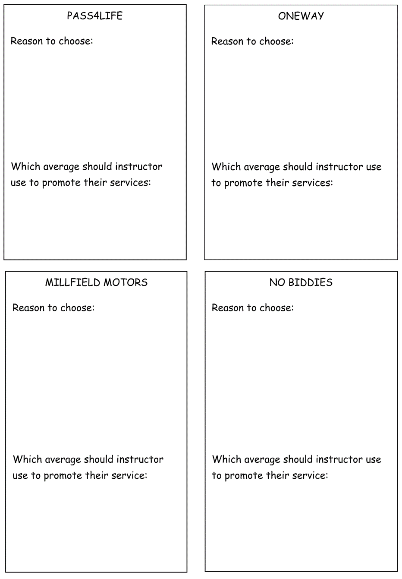
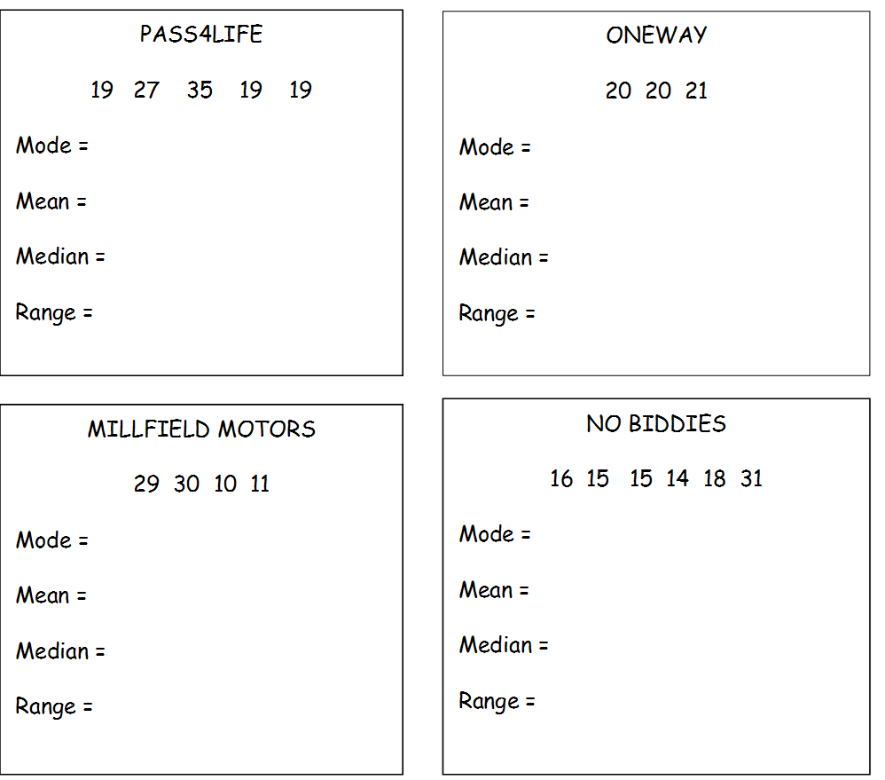

Slide 2
ANSWERS

Slide 3
19
20
23.8
20.3
19
20
16
1
Median or Mode
Range
No Mode
15
20
18.2
20
15.5
20
17
Mean or Range
or Median
Mode

