Slide 1
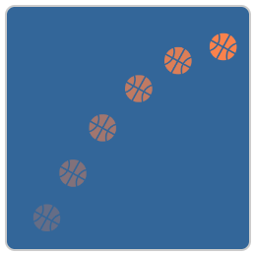
Will It Hit the Hoop?
Activity: Click on the icon
Use parabolas to guess if the ball will make it in the basket.

