Slide 1
LO: Averages
(Group Frequency Tables)

Slide 2
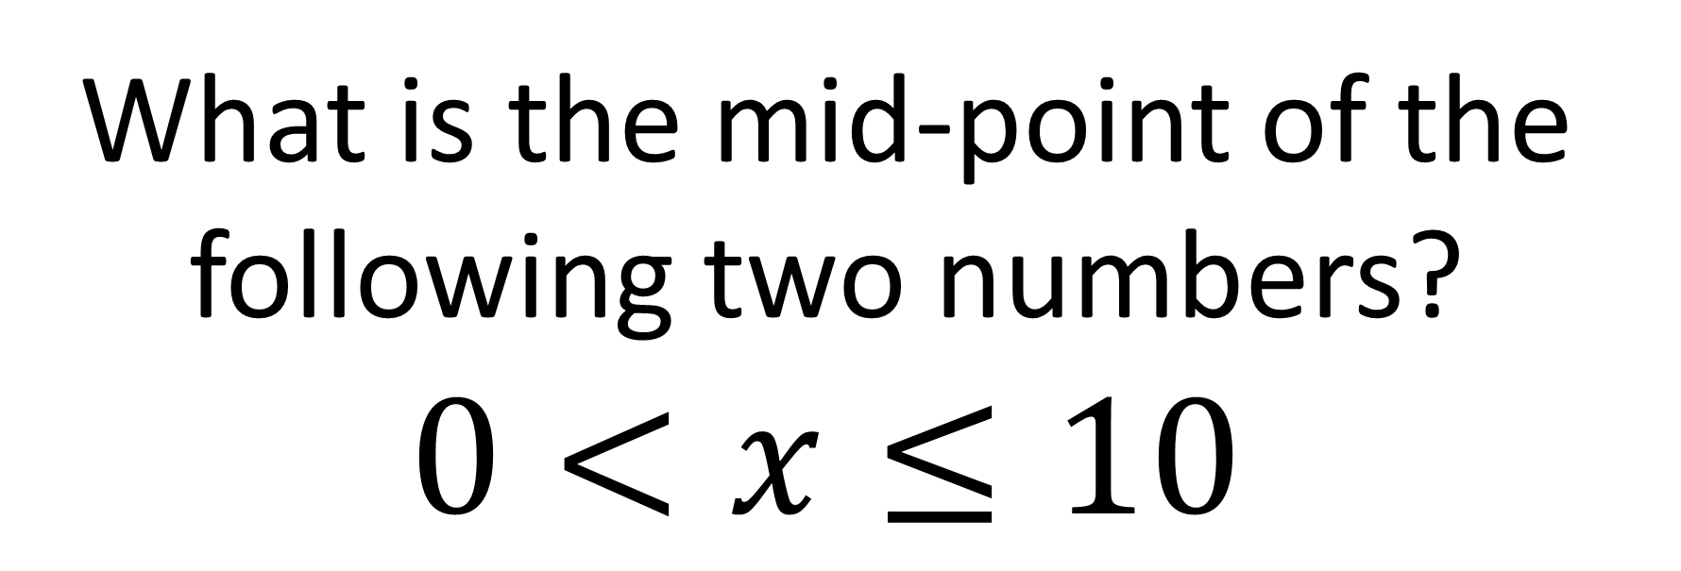
What is the mid-point of the following two numbers?
$$0<x≤10$$
5

Slide 3
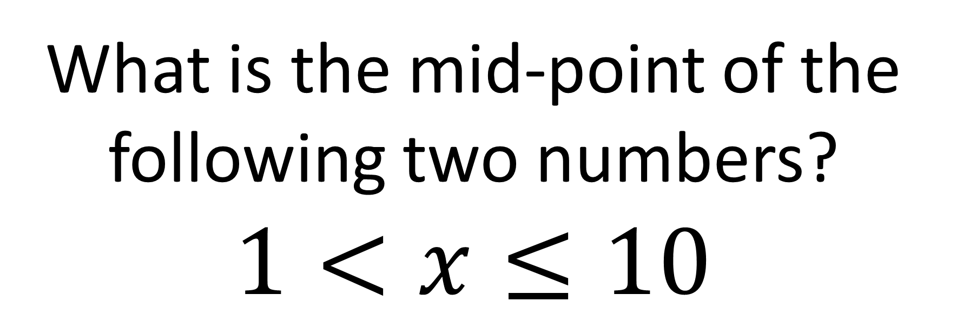
What is the mid-point of the following two numbers?
$$1<x≤10$$
5.5

Slide 4
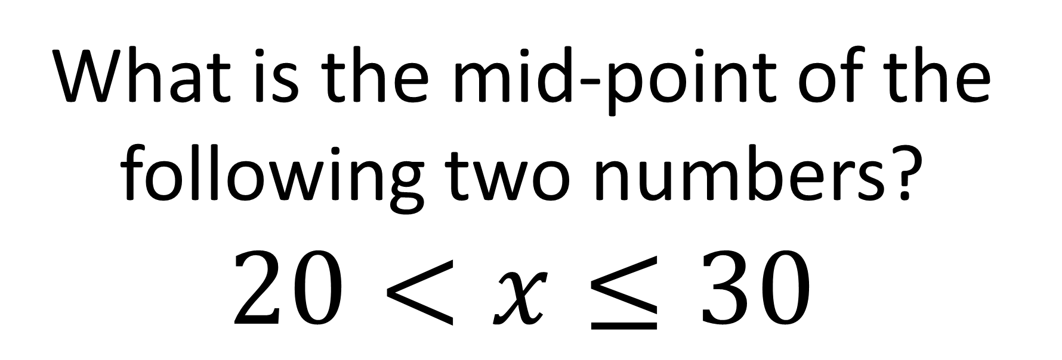
What is the mid-point of the following two numbers?
$$20<x≤30$$
25

Slide 5
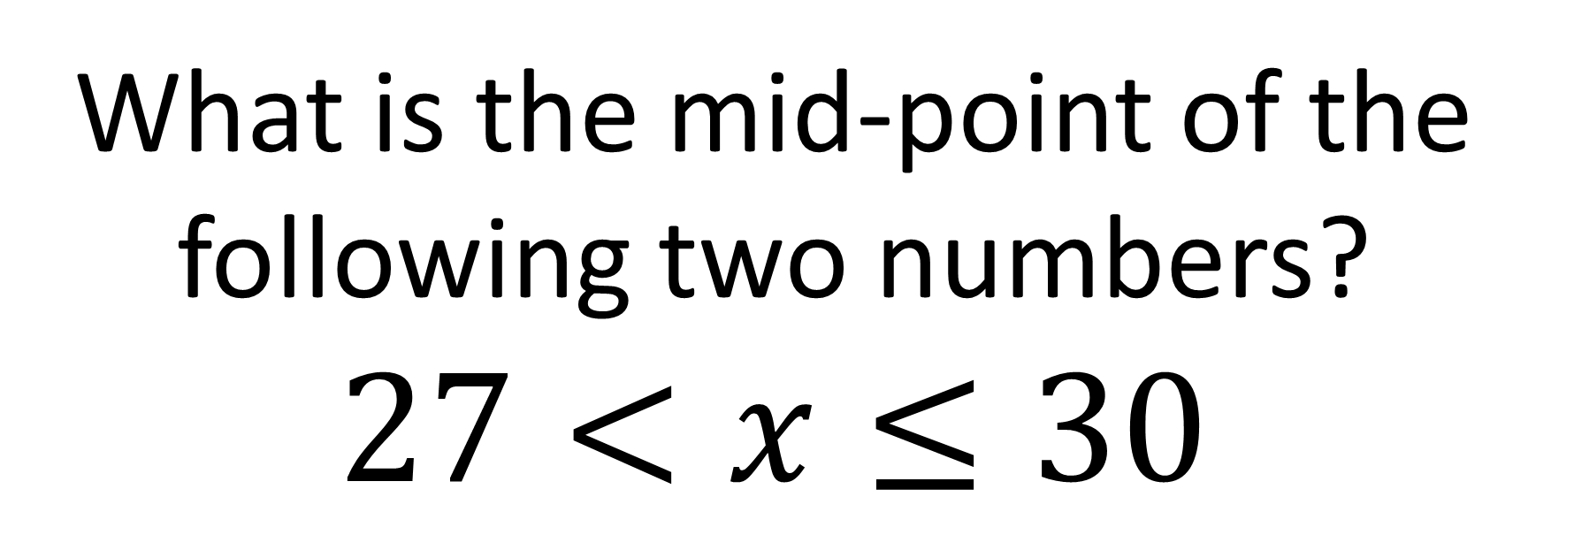
What is the mid-point of the following two numbers?
$$27<x≤30$$
28.5

Slide 6
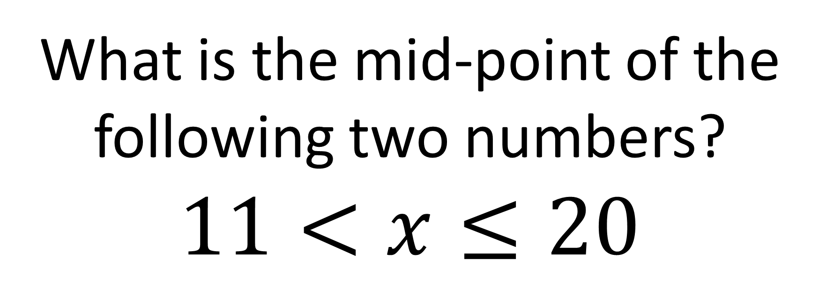
What is the mid-point of the following two numbers?
$$11<x≤20$$
15.5

Slide 7
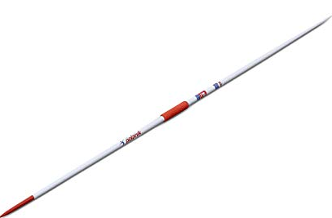

Distance (d) | Frequency
0 ≤ d < 10 | 0
10 ≤ d < 20 | 2
20 ≤ d < 30 | 5
30 ≤ d < 40 | 3
40 ≤ d < 50 | 1
In which group would
this throw be recorded?
50
40
38
30
20
10
0

Slide 8
Distance (d) | Frequency
0 ≤ d < 10 | 0
10 ≤ d < 20 | 2
20 ≤ d < 30 | 5
30 ≤ d < 40 | 3
40 ≤ d < 50 | 1
In which group would
this throw be recorded?
50
40
30
20
10
0

Slide 9
Distance (d) | Frequency
0 ≤ d < 10 | 0
10 ≤ d < 20 | 2
20 ≤ d < 30 | 5
30 ≤ d < 40 | 3
40 ≤ d < 50 | 1
In which group would
this throw be recorded?
50
40
30
20
10
0

Slide 10
Distance (d) | Frequency
0 ≤ d < 10 | 0
10 ≤ d < 20 | 2
20 ≤ d < 30 | 5
30 ≤ d < 40 | 3
40 ≤ d < 50 | 1
What distance did Mario throw?
50
?
40
30
20
10
0

Slide 11
Distance (d) | Frequency
0 ≤ d < 10
10 ≤ d < 20 | 1
20 ≤ d < 30
30 ≤ d < 40
40 ≤ d < 50
If you had to estimate
what distance he threw,
what would it be?
?
50
40
30
20
10
0

Slide 12
Distance (d) | Frequency
0 ≤ d < 10
10 ≤ d < 20
20 ≤ d < 30 | 1
30 ≤ d < 40
40 ≤ d < 50
If you had to guess
what distance he threw,
what would it be?
?
50
40
30
20
10
0

Slide 13
Distance (d) | Frequency
0 ≤ d < 10
10 ≤ d < 20
20 ≤ d < 30
30 ≤ d < 40
40 ≤ d < 50 | 1
If you had to guess
what distance he threw,
what would it be?
50
40
30
20
10
0

Slide 14
Distance (d) | Frequency
0 ≤ d < 10 | 0
10 ≤ d < 20 | 2
20 ≤ d < 30 | 4
30 ≤ d < 40 | 3
40 ≤ d < 50 | 1
How many throws did Mario take?
10
50
40
30
20
10
0

Slide 15
Estimate the total distance of all 10 throws?
Distance (d) | Frequency
0 ≤ d < 10 | 0
10 ≤ d < 20 | 2
20 ≤ d < 30 | 4
30 ≤ d < 40 | 3
40 ≤ d < 50 | 1
15 + 15
280
25 + 25 + 25 + 25
35 + 35 + 35
45
50
40
30
20
10
0

Slide 16
Estimate the mean average of his throws?
Distance (d) | Frequency
0 ≤ d < 10 | 0
10 ≤ d < 20 | 2
20 ≤ d < 30 | 4
30 ≤ d < 40 | 3
40 ≤ d < 50 | 1
15 + 15
28
25 + 25 + 25 + 25
35 + 35 + 35
45
10
280
Number of throw
Total Distance Thrown
50
40
30
20
10
0

Slide 17
Distance (d) | Frequency
0 ≤ d < 10 | 0
10 ≤ d < 20 | 2
20 ≤ d < 30 | 4
30 ≤ d < 40 | 3
40 ≤ d < 50 | 1
What is the
modal group?
20 ≤ d < 30
50
40
30
20
10
0

Slide 18
Distance (d) | Frequency
0 ≤ d < 10 | 0
10 ≤ d < 20 | 2
20 ≤ d < 30 | 4
30 ≤ d < 40 | 3
40 ≤ d < 50 | 1
Which group has the median value?
20 ≤ d < 30
1st
2nd
3rd
4th
5th
6th
7th
8th
9th
10th
10 ≤ d < 20
10 ≤ d < 20
20 ≤ d < 30
20 ≤ d < 30
20 ≤ d < 30
30 ≤ d < 40
30 ≤ d < 40
20 ≤ d < 30
30 ≤ d < 40
40 ≤ d < 50

Slide 19
Group Frequency Table
Goals Scored | Frequency
0 ≤ d < 2 | 0
2 ≤ d < 4 | 2
4 ≤ d < 6 | 5
6 ≤ d < 8 | 3
8 ≤ d < 10 | 1
Mid Point | Frequency
1 | 0
3 | 2
5 | 5
7 | 3
9 | 1

Slide 20
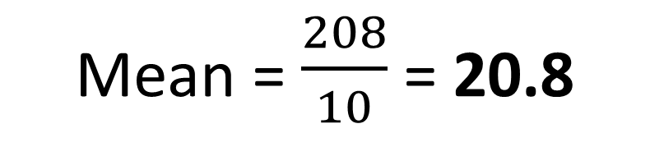
Calculate an estimate for modal group, mean and median group.
Distance (d) | Frequency
0 ≤ d < 8 | 0
8 ≤ d < 16 | 3
16 ≤ d < 24 | 4
24 ≤ d < 32 | 2
32 ≤ d < 40 | 1
Modal Group =
16 ≤ d < 24
0
36
80
56
36
208
Mean = $\frac{208}{10}$ = 20.8
Median Group =
16 ≤ d < 24
10

Slide 21
Spot the Mistakes
Time | Frequency | Mid Point | Frequency x Mid point
0 ≤ t < 6 | 0 | 3 | 3
7 ≤ t < 13 | 3 | 9 | 27
14 ≤ t < 20 | 5 | 17 | 85
21 ≤ t < 27 | 1 | 24 | 24
28 ≤ t < 34 | 1 | 31 | 31
 | 9 |  | 170
Mean =
170
= 18.9 (1d.p.)
9

