Slide 1
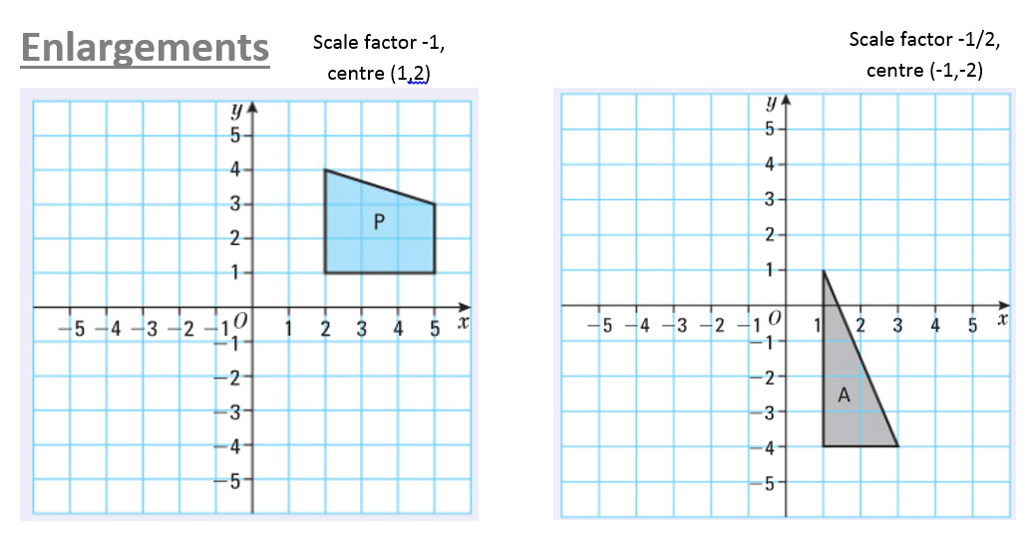

Slide 2
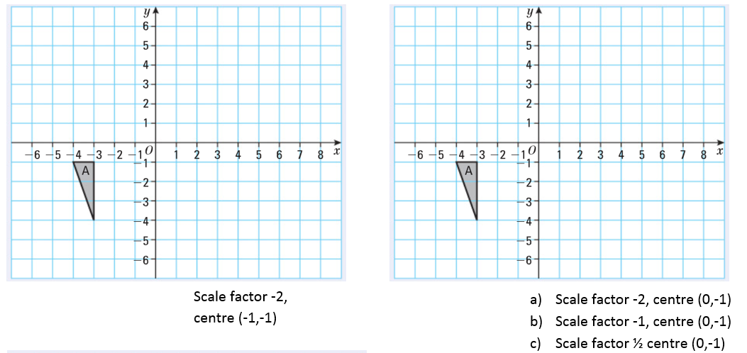

Slide 3
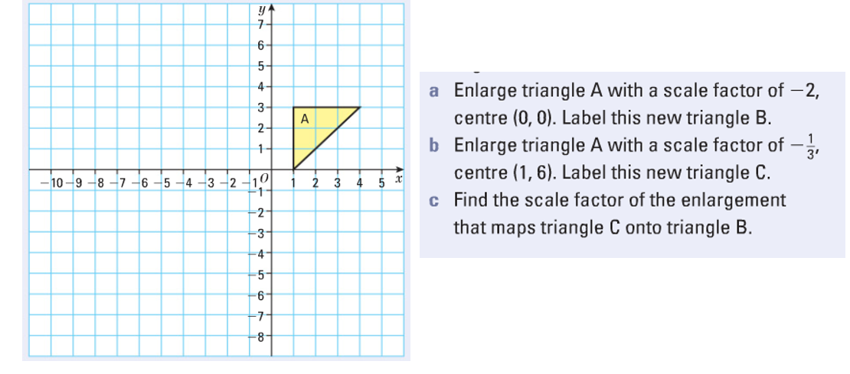

Slide 4
ANSWERS

Slide 5


Slide 6
a
b
c

Slide 7
c
B
6

