Slide 1
LO: Surds
(Simplifying)

Slide 2










How have the following numbers
been grouped?
$$\sqrt{4}$$
$$\sqrt{2}$$
$$\sqrt{9}$$
$$\sqrt{10}$$
$$\sqrt{100}$$
$$\sqrt{15}$$
$$\sqrt{7}$$
$$\sqrt{16}$$
$$\sqrt{81}$$
$$\sqrt{80}$$

Slide 3










Not Surds
Surds
$$\sqrt{4}$$
$$\sqrt{2}$$
$$\sqrt{10}$$
$$\sqrt{9}$$
$$\sqrt{100}$$
$$\sqrt{15}$$
$$\sqrt{7}$$
$$\sqrt{16}$$
$$\sqrt{81}$$
$$\sqrt{80}$$

Slide 4
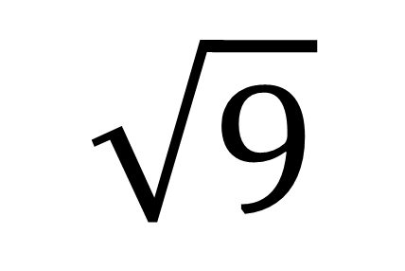
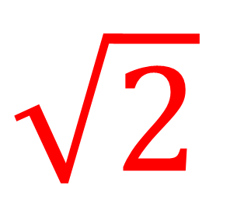
A surd is a square root that cannot be turned into a whole number.
Surd
Not a Surd
$\sqrt{2}$
$$\sqrt{9}$$

Slide 5











How have the following numbers
been grouped?
$$\sqrt{4}$$
$$\sqrt{2}$$
$$\sqrt{9}$$
$$\sqrt{10}$$
$$\sqrt{100}$$
$$\frac{1}{3}$$
$$\sqrt{15}$$
$$π$$
$$\frac{2}{5}$$
$$1.5$$
$$\sqrt{80}$$

Slide 6

Rational Numbers
Irrational Numbers
$$\sqrt{4}$$
$$\sqrt{2}$$
$$\sqrt{9}$$
$$\sqrt{10}$$
$$\sqrt{100}$$
$$\frac{1}{3}$$
$$\sqrt{15}$$
$$π$$
$$\frac{2}{5}$$
$$1.5$$
$$\sqrt{80}$$

Slide 7
Rational Numbers
Irrational Numbers
A number which can be written as a fraction of two integers.
p/q
(where q is not equal to zero)
A number that cannot be written as a fraction with integers.

Slide 8
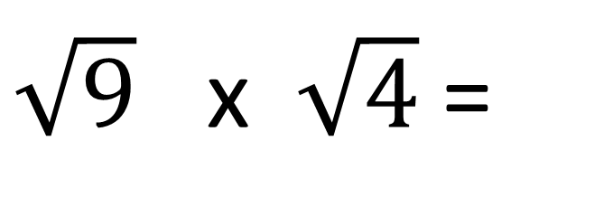
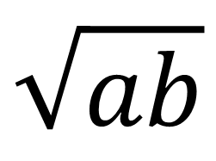
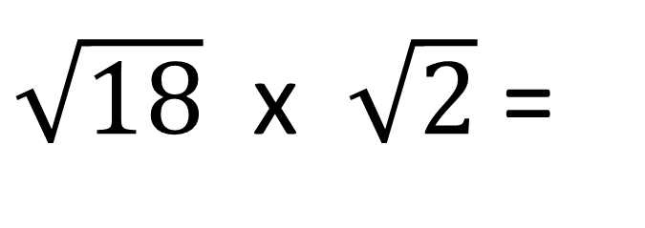
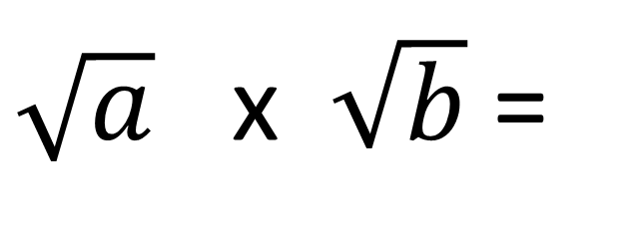
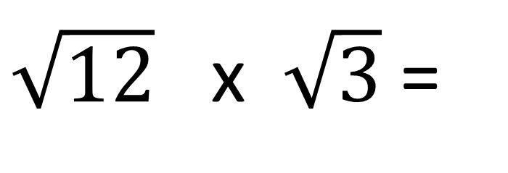
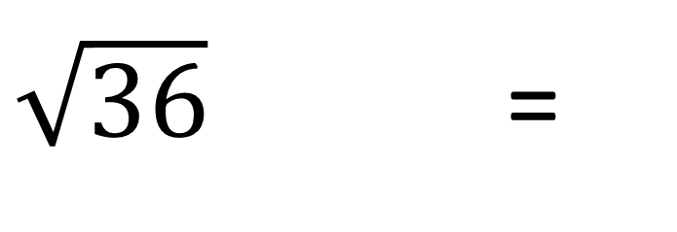
Multiplying Surds
$\sqrt{36}$ =
6
$\sqrt{18}$ x $\sqrt{2}$ =
6
$\sqrt{9}$ x $\sqrt{4}$ =
6
$\sqrt{12}$ x $\sqrt{3}$ =
6
$\sqrt{a}$ x $\sqrt{b}$ =
$$\sqrt{ab}$$

Slide 9
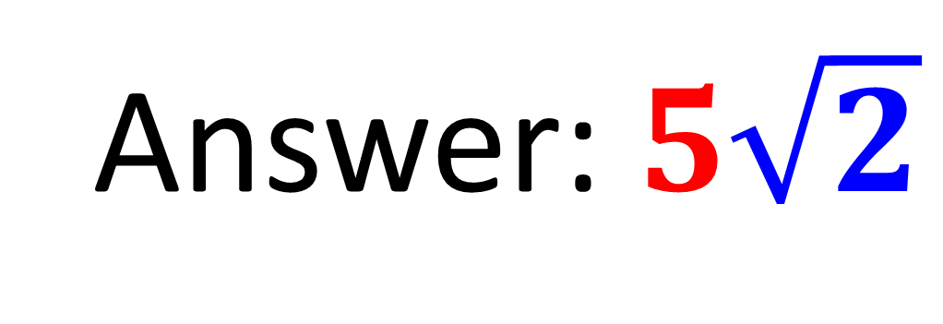
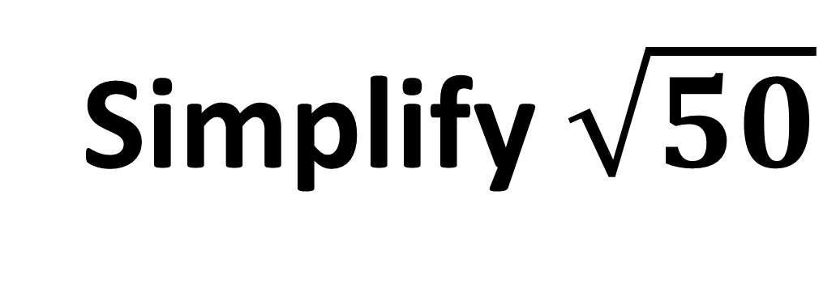
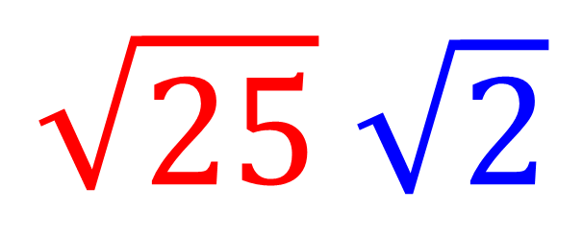
Simplify $\sqrt{50}$
$$\sqrt{25} \sqrt{2}$$
Answer: $5\sqrt{2}$

Slide 10
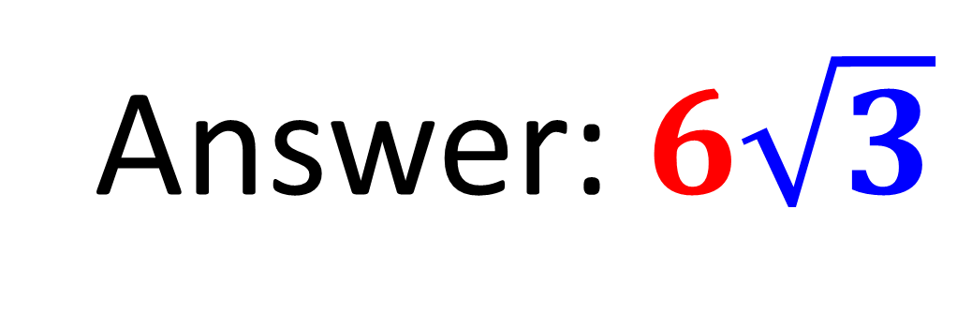
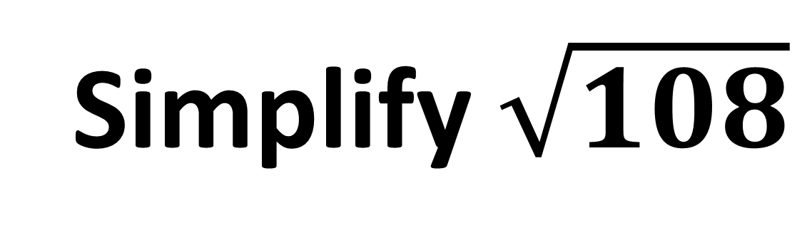
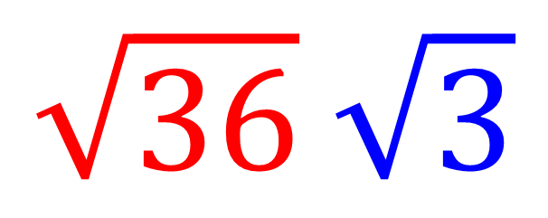
Simplify $\sqrt{108}$
$$\sqrt{36} \sqrt{3}$$
Answer: $6\sqrt{3}$

Slide 11
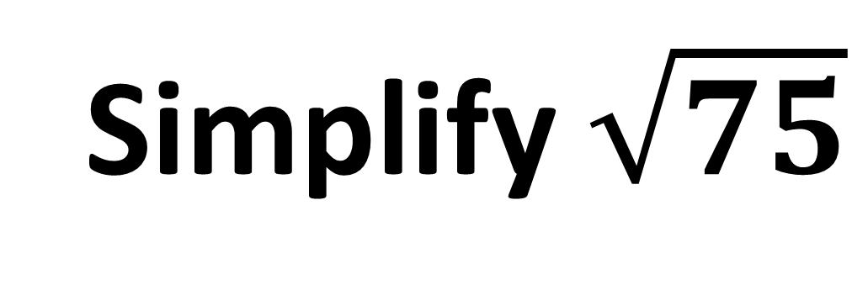
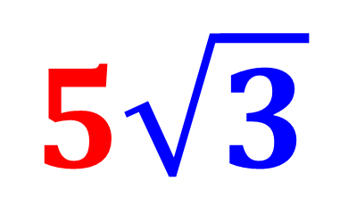
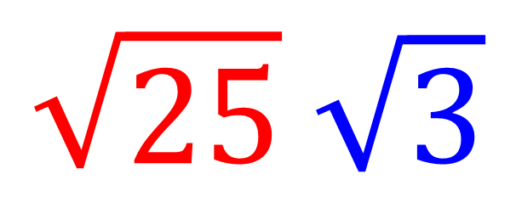
Simplify $\sqrt{75}$
$$\sqrt{25} \sqrt{3}$$
Answer:
$$5\sqrt{3}$$

Slide 12
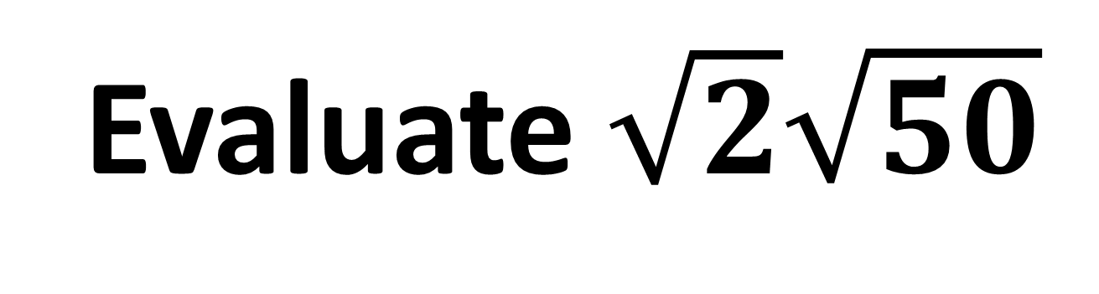
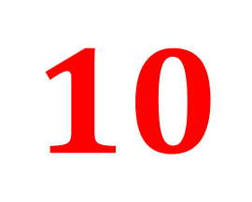
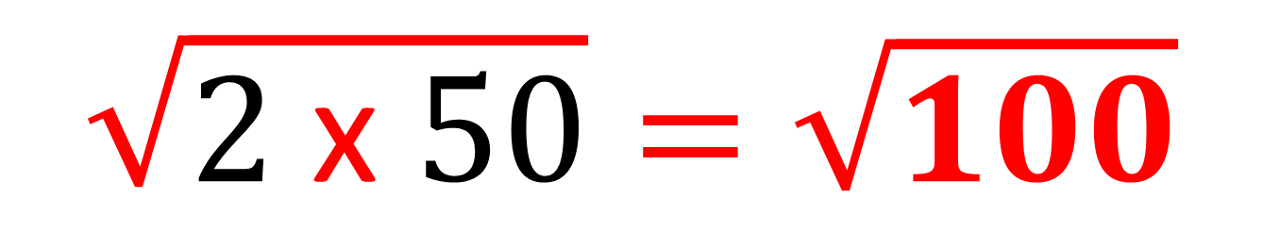
Evaluate $\sqrt{2}\sqrt{50}$
$$\sqrt{2 \text{x} 50}=\sqrt{100}$$
Answer:
$$10$$

Slide 13
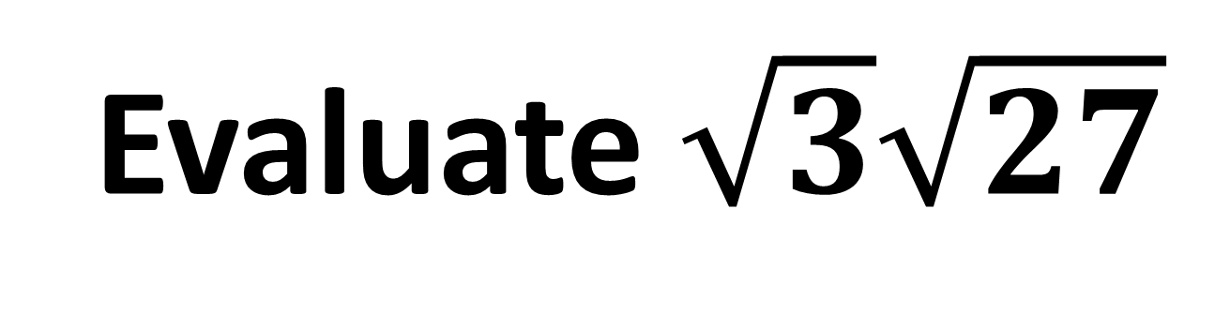


Evaluate $\sqrt{3}\sqrt{27}$
$$\sqrt{3 \text{x} 27}=\sqrt{81}$$
Answer:
$$9$$

Slide 14



Evaluate ${\sqrt{5}}^{2}$
$$\sqrt{5 \text{x} 5}=\sqrt{25}$$
Answer:
$$5$$

Slide 15




Evaluate 4$\sqrt{3}\sqrt{3}$
$$4\sqrt{3 \text{x} 3}=4\sqrt{9}$$
$$=4 \text{x} 3$$
Answer:
$$12$$

Slide 16









Dividing Surds
$\sqrt{9}$ =
3
$\sqrt{18}$ ÷ $\sqrt{2}$ =
$\sqrt{9}$ =
3
$\sqrt{27}$ ÷ $\sqrt{3}$ =
$\sqrt{9}$ =
3
$\sqrt{36}$ ÷ $\sqrt{4}$ =
$\sqrt{9}$ =
3
$$\sqrt{\frac{a}{b}}$$
$\sqrt{a}$ ÷ $\sqrt{b}$ =

Slide 17



Evaluate $\sqrt{12}÷\sqrt{3}$
$$\sqrt{12 ÷ 3}=\sqrt{4}$$
Answer: $2$

Slide 18



Evaluate $\sqrt{50}÷\sqrt{2}$
$$\sqrt{50 ÷ 2}=\sqrt{25}$$
Answer:
$$5$$

Slide 19



Evaluate $\sqrt{72}÷\sqrt{2}$
$$\sqrt{72 ÷ 2}=\sqrt{36}$$
Answer:
$$6$$

Slide 20


Adding and Subtracting Surds
Adding and Subtracting surds is like simplifying algebraic expressions.
7x + 2x =
9x
7$\sqrt{2}$ $+$ 2$\sqrt{2}$ =
9$\sqrt{2}$

Slide 21


Simplify $5\sqrt{7}$ + 3$\sqrt{7}$
8$\sqrt{7}$

Slide 22


Simplify $5\sqrt{7}$ $−$ 3$\sqrt{7}$
2$\sqrt{7}$

Slide 23


Simplify $6\sqrt{3}$ $−$ $\sqrt{3}$
5$\sqrt{3}$

Slide 24


Simplify $\sqrt{5}$ $+ 3\sqrt{5}+$ $6\sqrt{5}$
$$10\sqrt{5}$$

Slide 25

Simplify $5\sqrt{3}$ + 2$\sqrt{7}$
Cannot Simplify

Slide 26




Simplify $\sqrt{20}$ + 3$\sqrt{5}$
$\sqrt{4}\sqrt{5}$ + 3$\sqrt{5}$
$2\sqrt{5}$ + 3$\sqrt{5}$
Answer:
5$\sqrt{5}$

Slide 27




Simplify $\sqrt{45}$ $−$2$\sqrt{5}$
$\sqrt{9}\sqrt{5}$ $−$ 2$\sqrt{5}$
$3\sqrt{5}$ $−$ 2$\sqrt{5}$
Answer:
$$\sqrt{5}$$

