Slide 1
LO: Venn Diagrams

Slide 2
Venn diagrams are used as a way of
organising information.
Tie
Blazer
No Blazer and Tie
Tie Only
Tie AND Blazer
Blazer Only

Slide 3
Venn Diagrams can come in all sorts of shapes and sizes!
B
C
A

Slide 4
A
B
C

Slide 5
What is wrong with this Venn Diagram?
A
B

Slide 6
What is meant by
mutually exclusive events?
Two events that cannot happen at the same time.

Slide 7
Can you draw a Venn diagram for
two mutually exclusive events?
A
B

Slide 8
In Year 12 there are 117 students.
Of these, 51 take biology and 24 take chemistry.
7 students take both.
Complete the Venn diagram to represent this information.
B
C
17
7
44
49

Slide 9
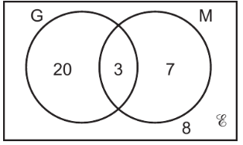
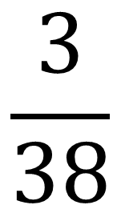
Students Studying German and Mandarin.
$$\frac{3}{38}$$
P(G and M) =

Slide 10
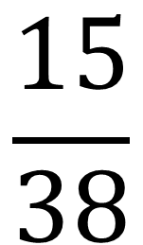
Students not studying German.
$$\frac{15}{38}$$
P(not studying German) =

Slide 11
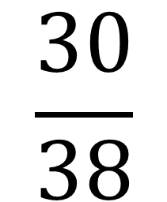
Students Studying German or Mandarin.
$$\frac{30}{38}$$
P(G or M) =

Slide 12
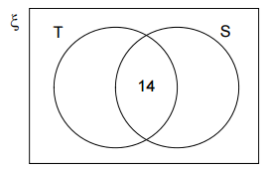
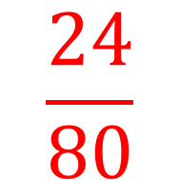
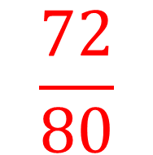
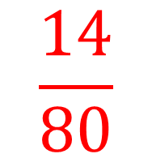
a) Complete the Venn diagram.
42
16
$$\frac{24}{80}$$
b) P(not tennis) =
8
$$\frac{14}{80}$$
c) P(T and S) =
80 people were surveyed.
14 played tennis and squash
56 played tennis
30 played squash.
$$\frac{72}{80}$$
d) P(T or S or Both) =

