Slide 1
LO: Congruent Triangles
(Proofs)

Slide 2
Side, Angle, Side (SAS)
Side, Side, Side (SSS)
Angle, Angle, Side (AAS)
Angle, Side, Angle (ASA)
Right Angle, Hypotenuse, Side (RHS)

Slide 3
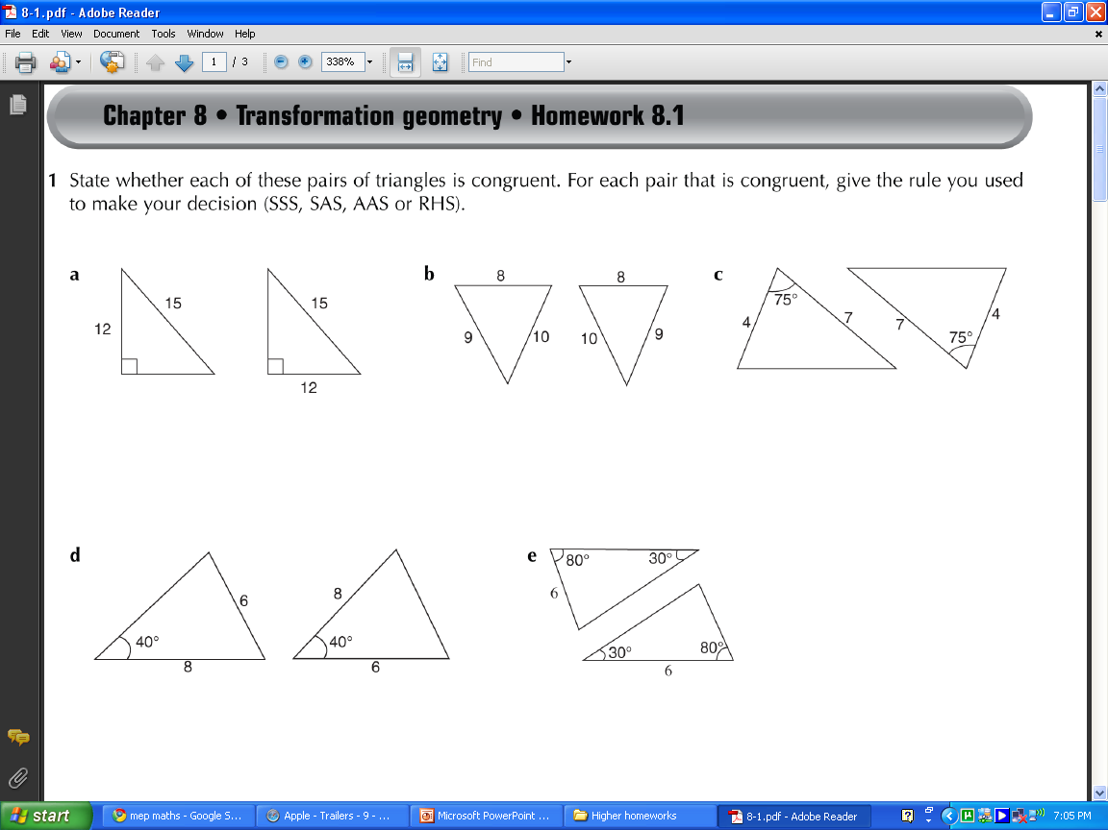
Are these triangles congruent?
If so state one of these reasons
SSS, SAS, ASA, RHS, AAS
AAS
ASA
NO

Slide 4
Are these triangles congruent?
If so state one of these reasons
SSS, SAS, ASA, RHS, AAS
ASS
NO
SAS

Slide 5
Are these triangles congruent?
If so state one of these reasons
SSS, SAS, ASA, RHS, AAS
SAS
YES
SAS

Slide 6
Are these triangles congruent?
If so state one of these reasons
SSS, SAS, ASA, RHS, AAS
SSS
SSS
YES

Slide 7
Are these triangles congruent?
If so state one of these reasons
SSS, SAS, ASA, RHS, AAS
RHS
YES
RHS

Slide 8
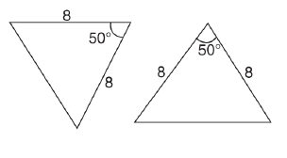
Are these triangles congruent?
If so state one of these reasons
SSS, SAS, ASA, RHS, AAS
SAS
SAS
YES

Slide 9
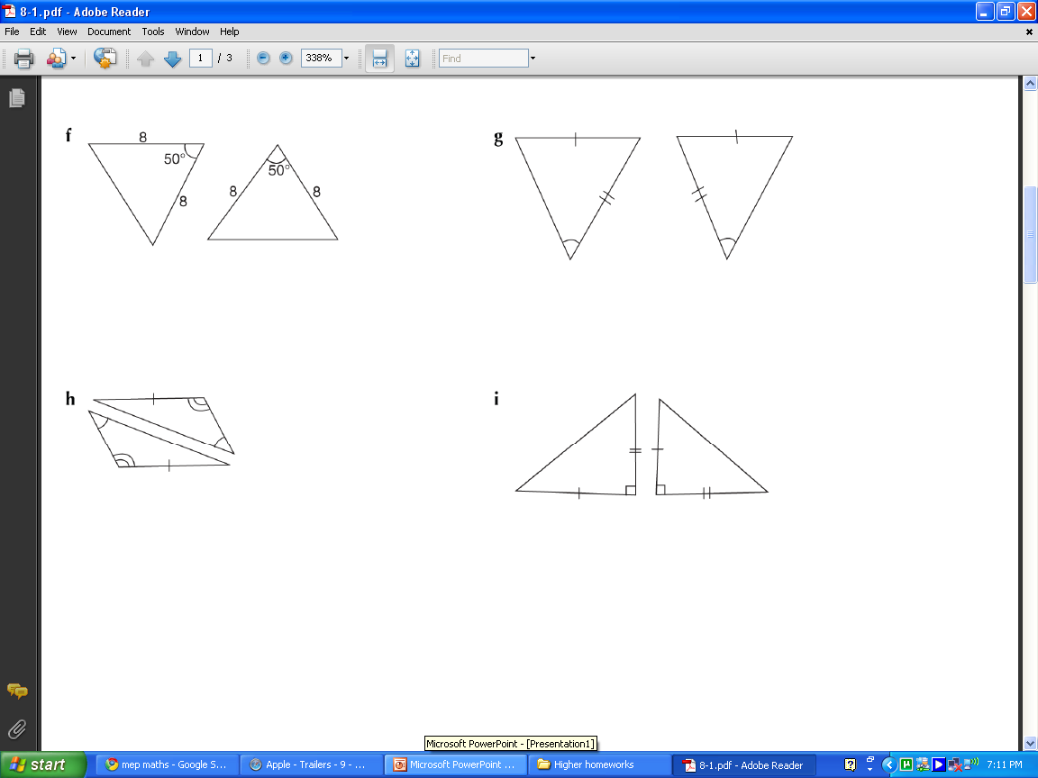
Are these triangles congruent?
If so state one of these reasons
SSS, SAS, ASA, RHS, AAS
SSA
SSA
NO

Slide 10
Are these triangles congruent?
If so state one of these reasons
SSS, SAS, ASA, RHS, AAS
AAS
AAS
YES

Slide 11
How to prove triangles are congruent.
STEP 1:
STEP 2:
STEP 3:
Identify 3 equal sides and/or angles
Justify each of three things.
Conclusion, stating the proof used.

Slide 12
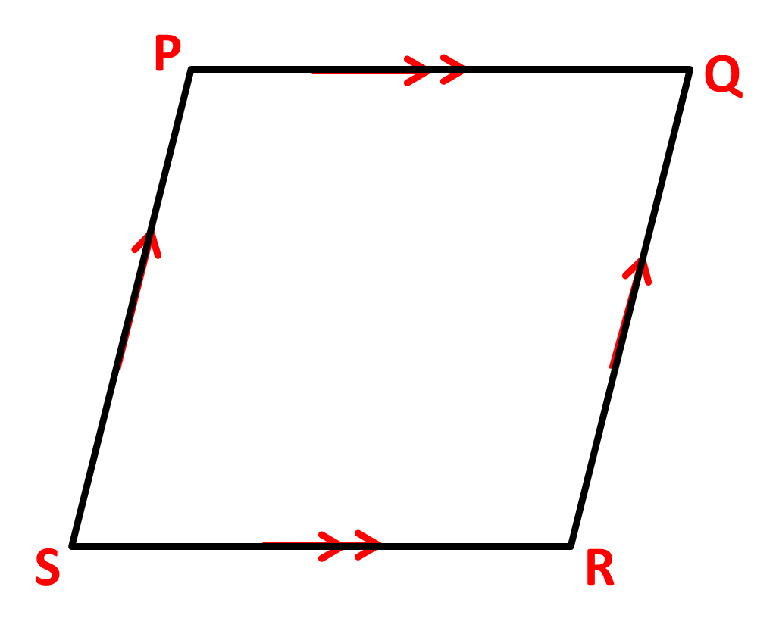
PQRS is a rhombus.
Prove triangles
SPQ and QRS are congruent.
Side: SP = QR
all sides of rhombus are equal.
Angle: SPQ = QRS
opposite angles of a rhombus are equal.
Side: PQ = RS
all sides of rhombus are equal.
Triangles SPQ and QRS
are congruent
because SAS

Slide 13
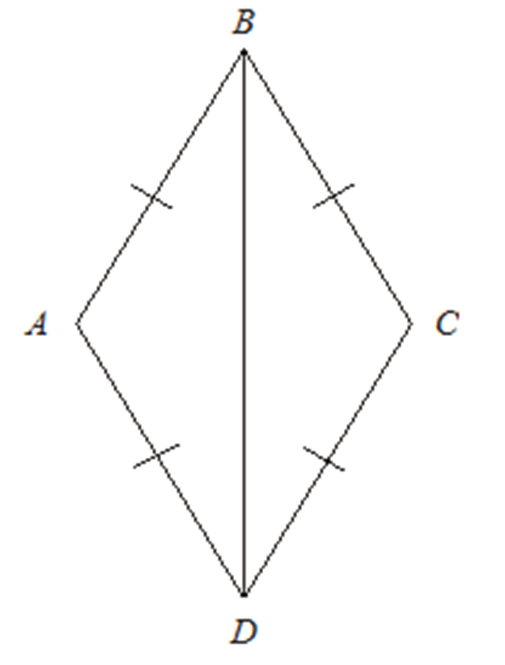
AB = BC = CD = DA
Prove triangle ADB is congruent to triangle CDB.
Side: AD = CD
all sides of rhombus are equal.
Side: AB = BC
all sides of rhombus are equal.
Side: BD
common sides
Side: AD = CD
all sides of rhombus are equal.
Side: AB = BC
all sides of rhombus are equal.
Side: BD
common sides
Triangles ADB and CDB are congruent
because SSS

Slide 14
AB = AC
Prove triangle ABM is congruent to triangle AMC.
R: AMD = AMC
both are 90˚
H: AB = AC
equal side of an isosceles triangles
S: AM = AM
common sides
R: AMB = AMC
both are 90˚
H: AB = AC
equal side of an isosceles triangles
S: AM = AM
common sides
Triangles ADB and CDB are congruent
because RHS
A
B
C
M

Slide 15







ABCD is a parallelogram.
Prove triangle
ABC and ACD
are congruent.
Using $SSS$:
Using $SAS$:
$$A$$
$$B$$
Using $ASA$:
$$D$$
$$C$$

Slide 16





ABCD is a parallelogram.
Prove triangle ABC and ACD are congruent.
Using $SSS$:
Side: AD = BC
opposite sides of a parallelogram are equal.
Side: AB = DC
opposite sides of a parallelogram are equal.
Side: AC
common sides
Side: AD = BC
opposite sides of a parallelogram are equal.
Side: AB = DC
opposite sides of a parallelogram are equal.
Side: AC
common sides
Triangles ABC and ACD
are congruent
because SSS
$$A$$
$$B$$
$$D$$
$$C$$

Slide 17





ABCD is a parallelogram.
Prove triangle ABC and ACD are congruent.
Using $SAS$:
Side: AD = BC
opposite sides of a parallelogram are equal.
Angle: ADC = ABC
opposite angles of a parallelogram are equal.
Side: AB = DC
opposite sides of a parallelogram are equal.
AD = BC
opposite sides of a parallelogram are equal.
ADC = ABC
opposite angles of a parallelogram are equal.
AB = DC
opposite sides of a parallelogram are equal.
Triangles ABC and ACD
are congruent
because SAS
$$A$$
$$B$$
$$D$$
$$C$$

Slide 18





ABCD is a parallelogram.
Prove triangle ABC and ACD are congruent.
Using $ASA$:
Angle: ADC = ABC
opposite angles of a parallelogram are equal.
Side: AB = DC
opposite angles of a parallelogram are equal.
Angle: DAC = ACB
alternative angles are equal.
Angle: ADC = ABC
opposite angles of a parallelogram are equal.
Side: AB = DC
opposite angles of a parallelogram are equal.
Angle: DAC = ACB
alternative angles are equal.
Triangles ABC and ACD
are congruent
because ASA
$$A$$
$$B$$
$$D$$
$$C$$

