Slide 1
LO: Converting
Metric Measurements

Slide 2
Guess the
distance, weight
and the capacity of….

Slide 3
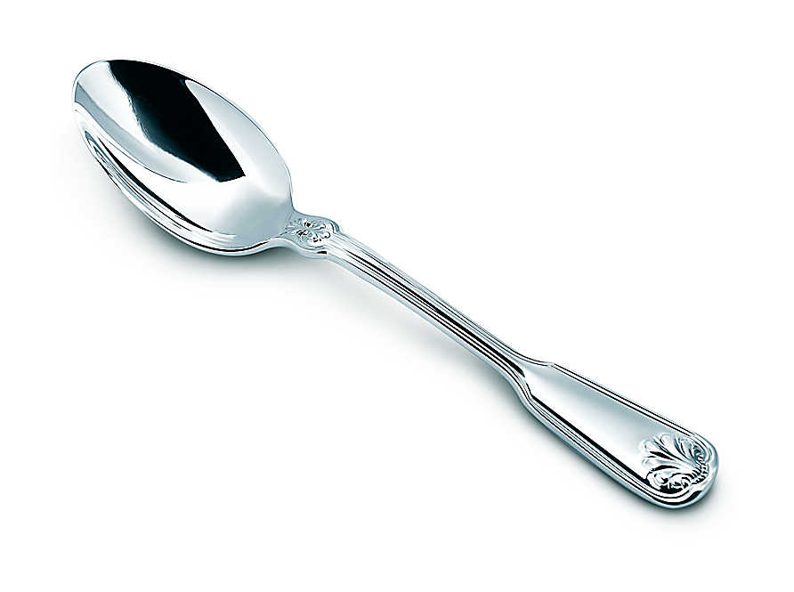
How much liquid does a teaspoon hold in millilitres?
5 millilitres

Slide 4
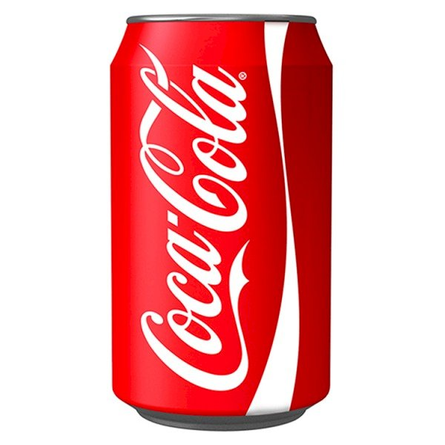
What is the capacity of a
coke cola can in millilitres?
300 millilitres

Slide 5
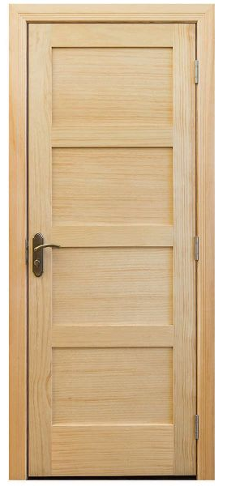
What is the height of an average door in metres?
2 metres

Slide 6
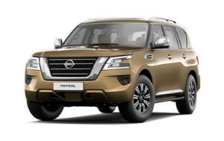
What is the weight of a
Nissan Patrol in kilogram?
3500 kilograms

Slide 7
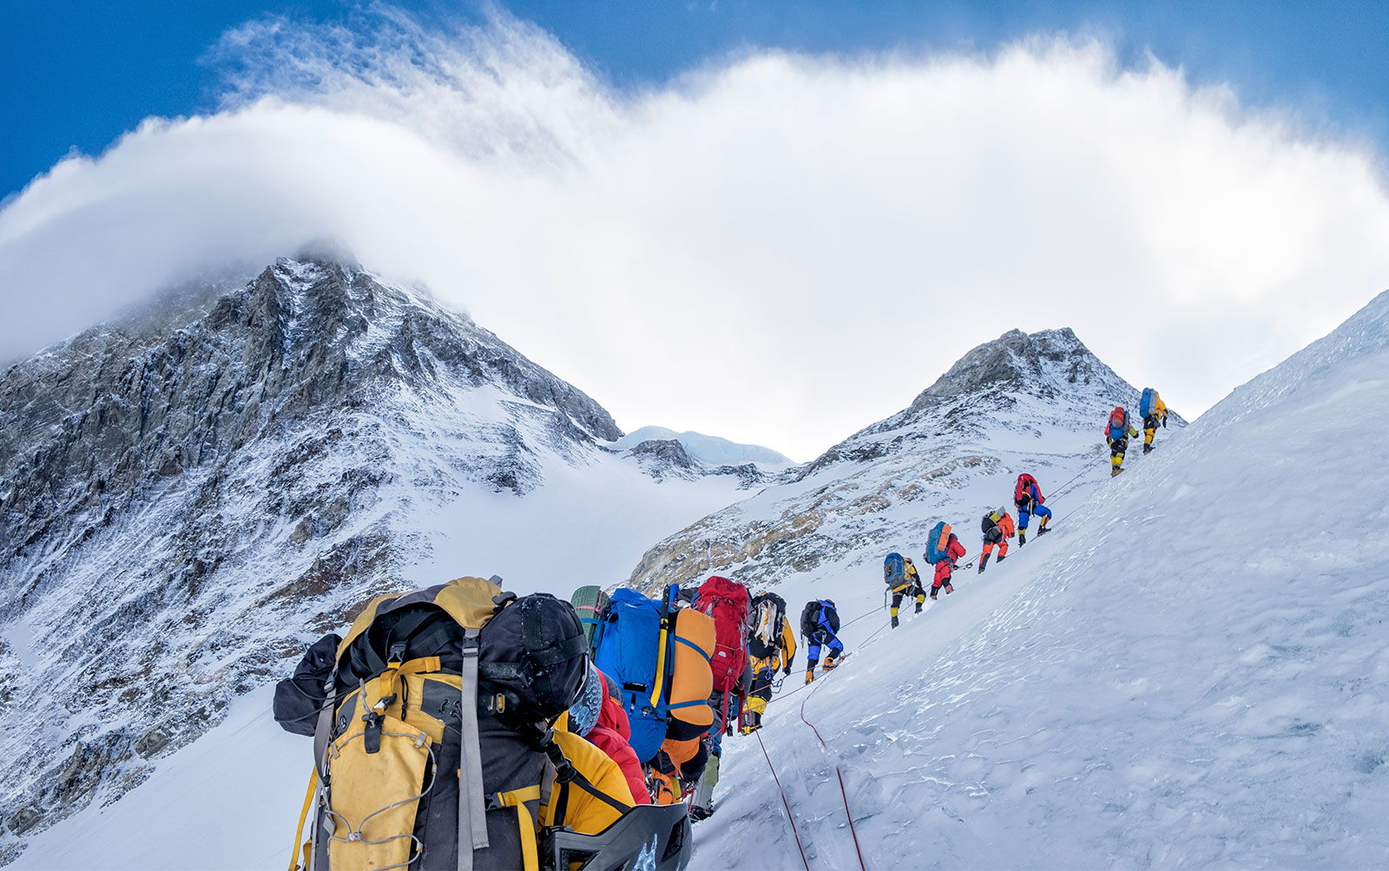
How high is Mount Everest in metres?
Mount Everest 8850 m

Slide 8
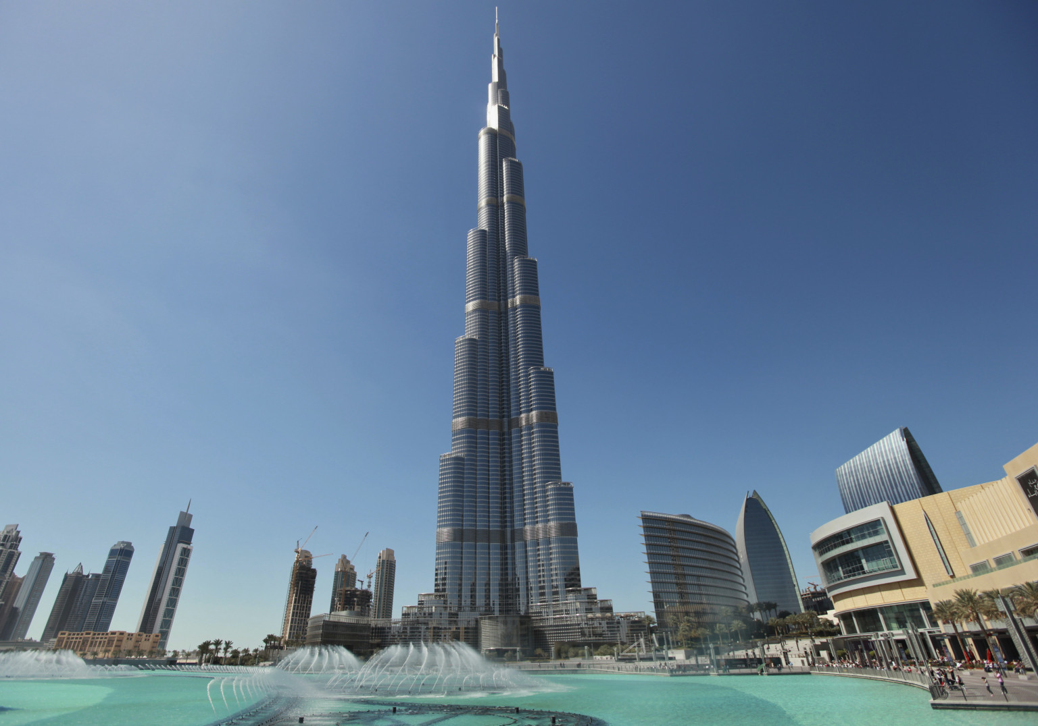
How tall is Burj Khalifa
in metres?
The world’s tallest building – 830m

Slide 9
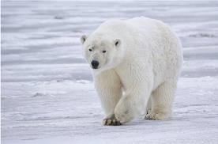
How heavy is a adult polar bear
on average in kilograms?
Polar Bear 500kg

Slide 10
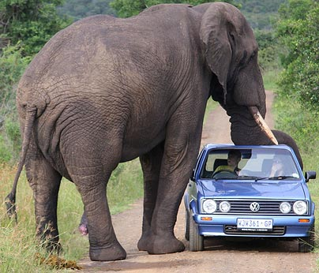
How much water can an
elephant’s trunk hold in litres?
Elephant’s trunk holds 15 litres

Slide 11
Which is the odd one out?
g
km
litres
cl
kg
ml
cm
mm

Slide 12
What is a metric measurement?
A measuring system that uses grouping in powers of 10.
So to convert between units
you need to multiply or dividing by
10,100,1000,10000 etc……

Slide 13
Metric Distances
Kilometres
metres
Centimetres
Millimetres
x 1000
x 100
x 10

Slide 14
Metric Weights
Tonne
Kilograms
Grams
Milligrams
x 1000
x 1000
x 1000

Slide 15
Metric Capacity
litres
Centilitres
Millilitres
x 100
x 10

Slide 16
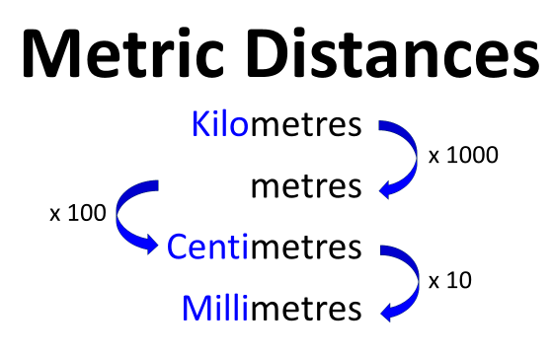
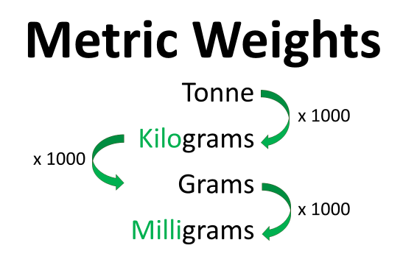
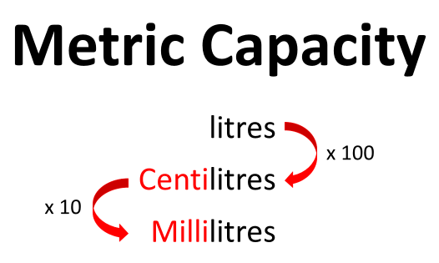

Slide 17
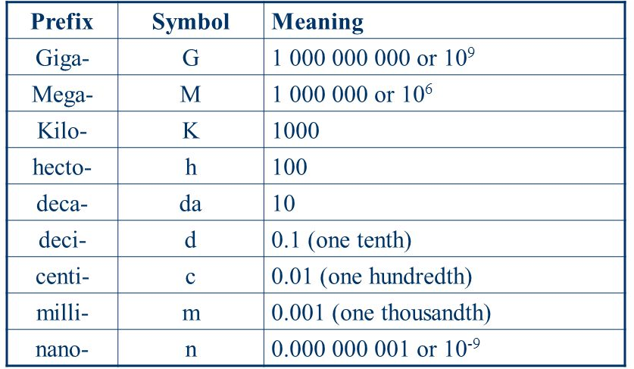

Slide 18
Convert
2
grams
to
milligrams
2000

Slide 19
Convert
3
kilometres
to
centimetres
300,000

Slide 20
Convert
34000
milligrams
to
grams
34

Slide 21
Convert
2700
millilitres
to
litres
2.7

Slide 22
Convert
1
millimetre
to
centimetres
0.1

Slide 23
Convert
25
centilitres
to
millilitres
250

