Slide 1
Exponentials and Logs
Modelling
Chapter 14
(Part 7 of 9)

Slide 2



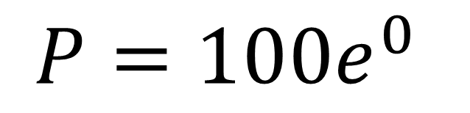

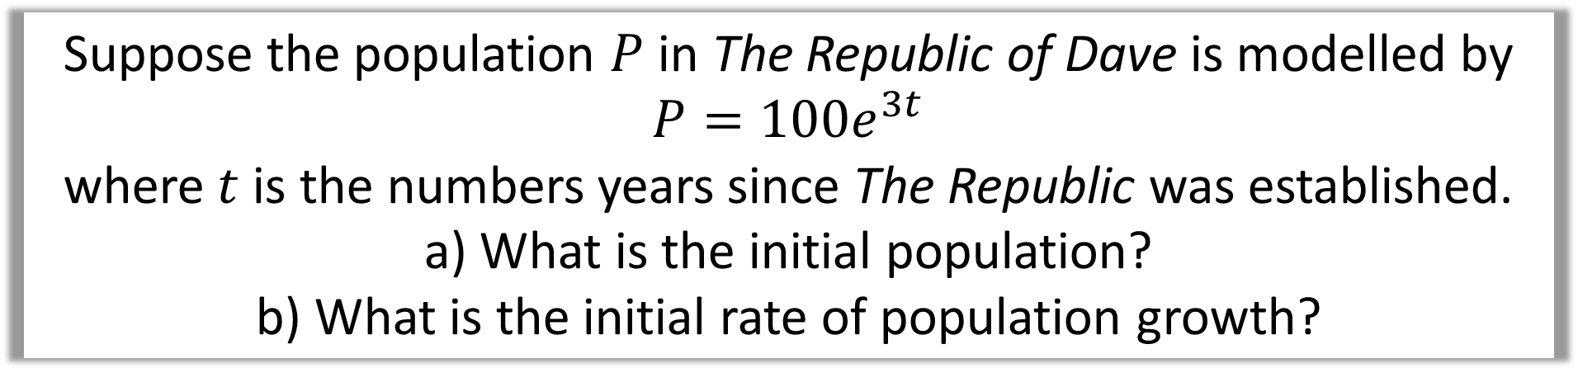
Suppose the population $P$ in The Republic of Dave is modelled by $P=100e^{3t}$
where $t$ is the numbers years since The Republic was established.
a) What is the initial population?
b) What is the initial rate of population growth?
$$P$$
a)
When $t=0$
$$P=100e^{0}$$
$$P=100$$
$$t$$

Slide 3
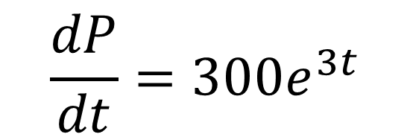
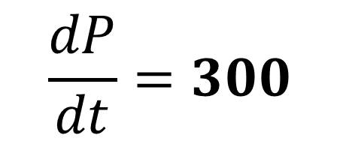
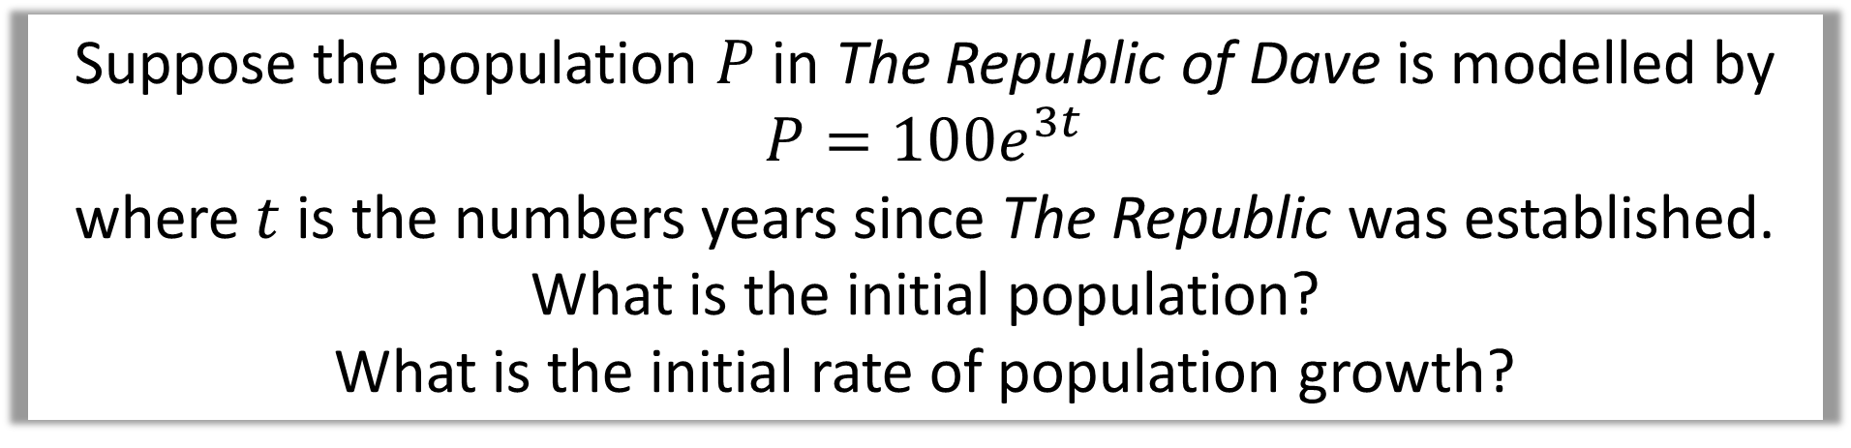
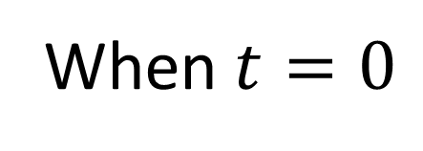


Suppose the population $P$ in The Republic of Dave is modelled by $P=100e^{3t}$
where $t$ is the numbers years since The Republic was established.
What is the initial population?
What is the initial rate of population growth?
$$P$$
$$\frac{dP}{dt}=300e^{3t}$$
b)
When $t=0$
$$\frac{dP}{dt}=300$$
$$t$$

Slide 4
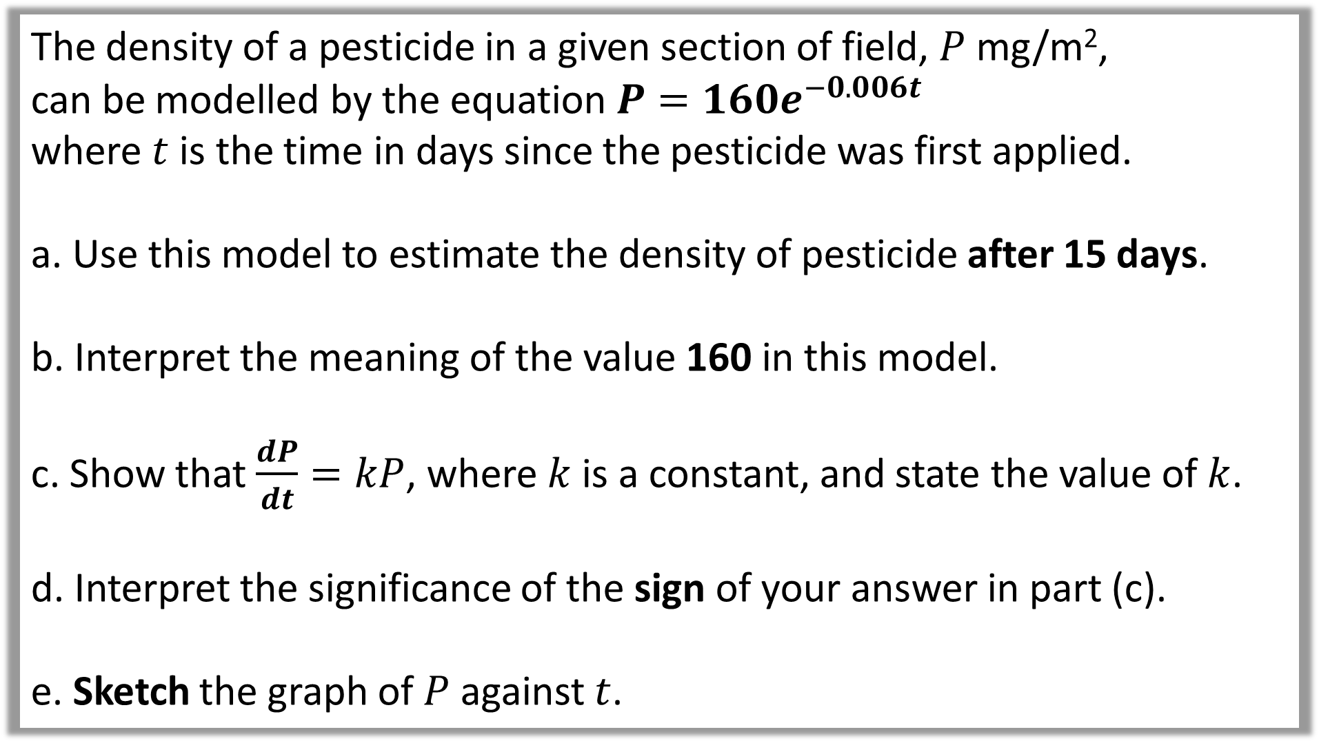
The density of a pesticide in a given section of field, $P$ mg/m²,
can be modelled by the equation $P=160e^{−0.006t}$
where $t$ is the time in days since the pesticide was first applied.
a. Use this model to estimate the density of pesticide after 15 days.
b. Interpret the meaning of the value 160 in this model.
c. Show that $\frac{dP}{dt}=kP$, where $k$ is a constant, and state the value of $k$.
d. Interpret the significance of the sign of your answer in part (c).
e. Sketch the graph of $P$ against $t$.

Slide 5

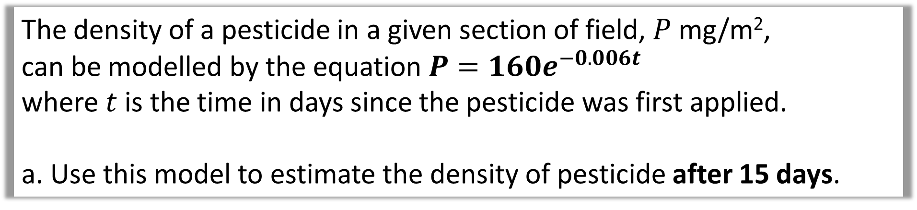
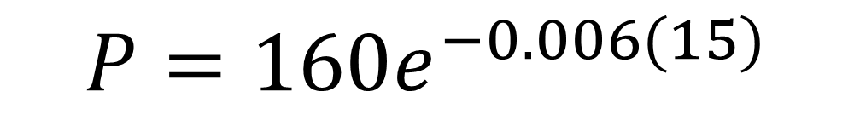
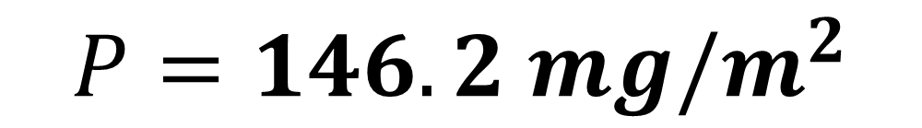
The density of a pesticide in a given section of field, $P$ mg/m²,
can be modelled by the equation $P=160e^{−0.006t}$
where $t$ is the time in days since the pesticide was first applied.
a. Use this model to estimate the density of pesticide after 15 days.
a)
When $t=15$
$$P=160e^{−0.006(15)}$$
$$P=146.2 mg/m^{2}$$

Slide 6

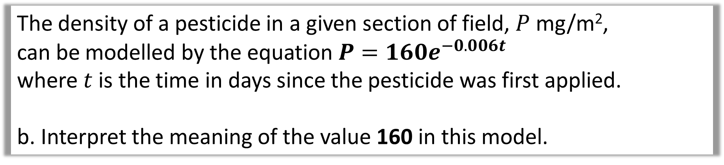
The density of a pesticide in a given section of field, $P$ mg/m²,
can be modelled by the equation $P=160e^{−0.006t}$
where $t$ is the time in days since the pesticide was first applied.
b. Interpret the meaning of the value 160 in this model.
b)
When $t=0$, then $P=160$.
Thus 160 is the initial density of pesticide in the field.

Slide 7
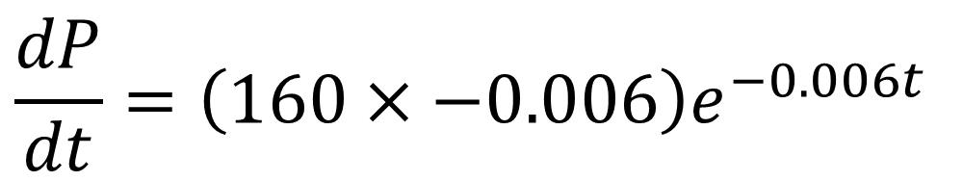
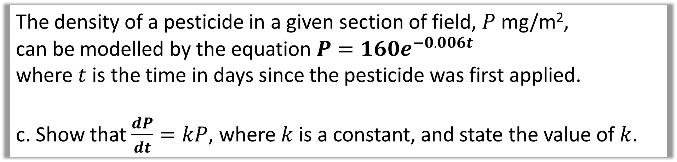
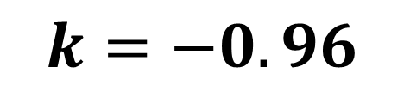
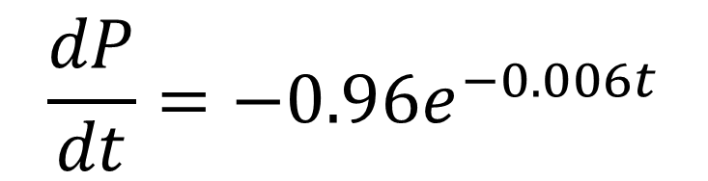
The density of a pesticide in a given section of field, $P$ mg/m²,
can be modelled by the equation $P=160e^{−0.006t}$
where $t$ is the time in days since the pesticide was first applied.
c. Show that $\frac{dP}{dt}=kP$, where $k$ is a constant, and state the value of $k$.
c)
$$\frac{dP}{dt}=\left(160×−0.006\right)e^{−0.006t}$$
$$\frac{dP}{dt}=−0.96e^{−0.006t}$$
$$k=−0.96$$

Slide 8
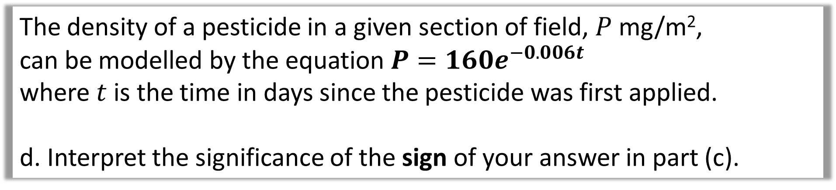
The density of a pesticide in a given section of field, $P$ mg/m²,
can be modelled by the equation $P=160e^{−0.006t}$
where $t$ is the time in days since the pesticide was first applied.
d. Interpret the significance of the sign of your answer in part (c).
d)
The rate is negative,
thus the density of pesticide is decreasing.

Slide 9
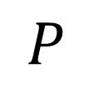
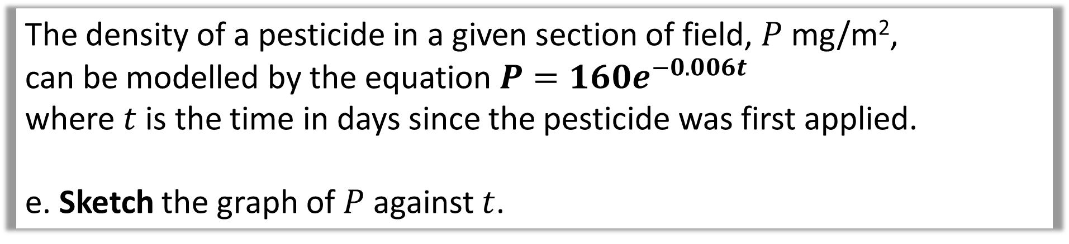
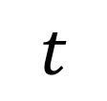
The density of a pesticide in a given section of field, $P$ mg/m²,
can be modelled by the equation $P=160e^{−0.006t}$
where $t$ is the time in days since the pesticide was first applied.
e. Sketch the graph of $P$ against $t$.
$$P$$
e)
160
$$t$$

