Slide 1
LO: Iteration

Slide 2
Iteration is the act of repeating a process.

Slide 3
Solve an Equation using Iteration
Start with a given value
Sub into the iteration formula
Get the answer and sub back into the formula
Repeat the numbers of time required

Slide 4
What does a Iteration formula
look like?
x_{n+1} = 4x_{n} + 1

Slide 5
x_{n+1} = 4x_{n} + 1
x₁= 4x₀ + 1
x₂= 4x₁ + 1
x₃= 4x₂ + 1

Slide 6
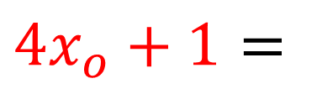
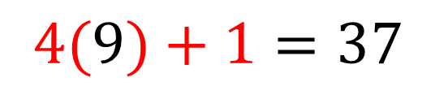
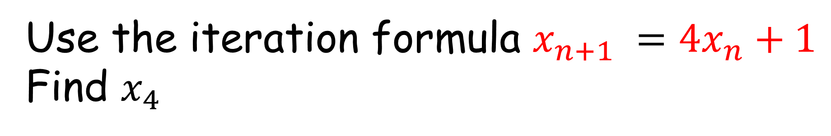
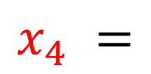
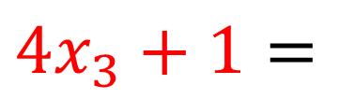
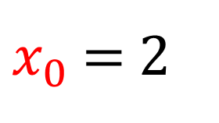
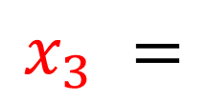
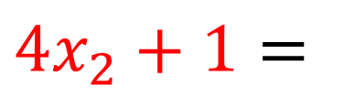
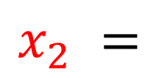
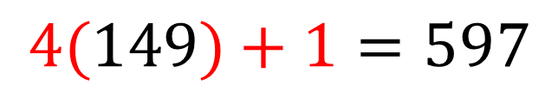
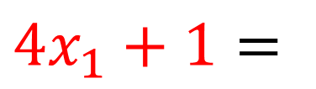
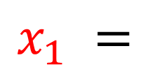
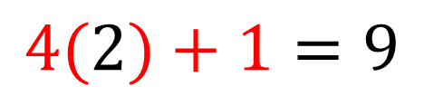
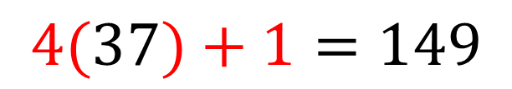
Use the iteration formula $x_{n+1} =4x_{n}+1$
Find $x_{4}$
$x_{0}$ $=$2
$$x_{1} =$$
$$4x_{o}+1=$$
$$4(2)+1=9$$
$$x_{2} =$$
$$4x_{1}+1=$$
$$4(9)+1=37$$
$$x_{3} =$$
$$4x_{2}+1=$$
$$4(37)+1=149$$
$$x_{4} =$$
$$4x_{3}+1=$$
$$4(149)+1=597$$

Slide 7
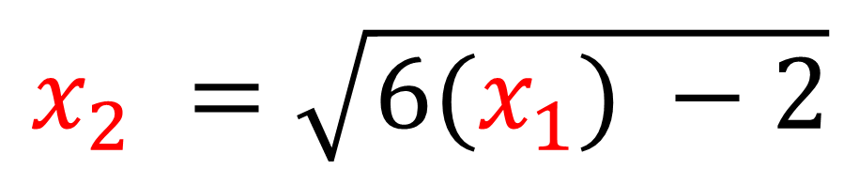
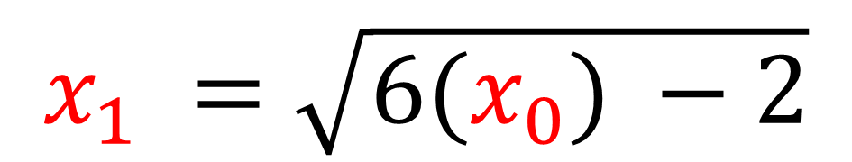
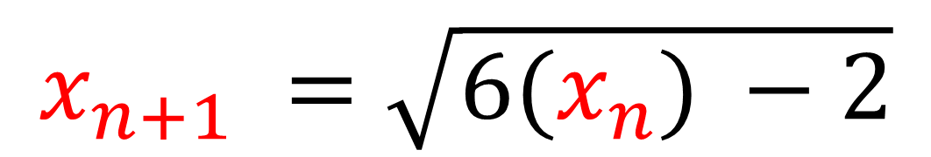
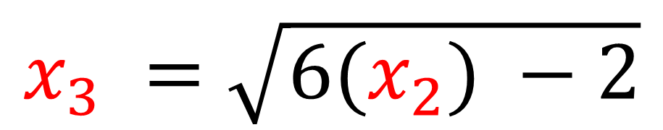
$$x_{n+1} =\sqrt{6(x_{n}) −2}$$
$$x_{1} =\sqrt{6(x_{0}) −2}$$
$$x_{2} =\sqrt{6(x_{1}) −2}$$
$$x_{3} =\sqrt{6(x_{2}) −2}$$

Slide 8
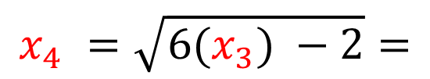
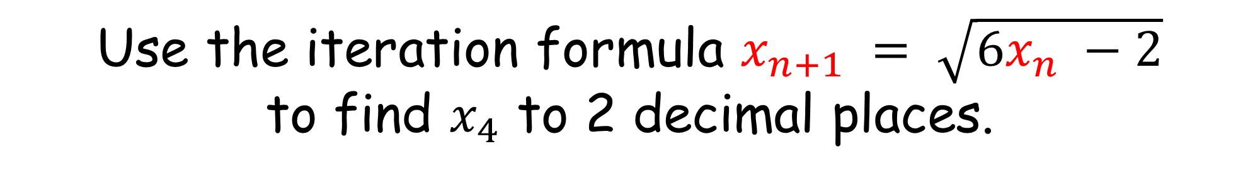
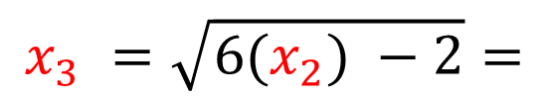
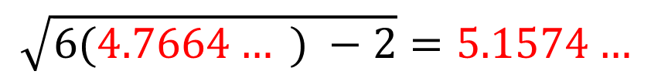
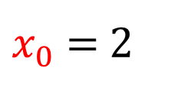
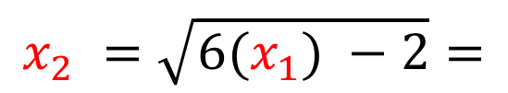
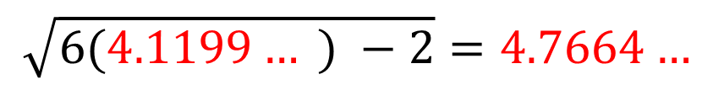

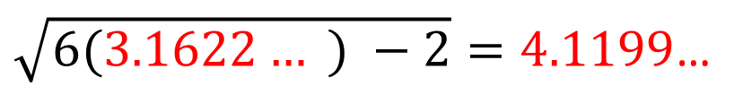
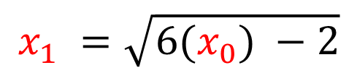
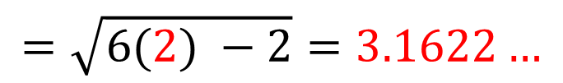
Use the iteration formula $x_{n+1} = \sqrt{6x_{n} −2}$
to find $x_{4}$ to 2 decimal places.
$x_{0}$ $=$2
$$x_{1} =\sqrt{6(x_{0}) −2}$$
$$=\sqrt{6(2) −2}=3.1622…$$
$$x_{2} =\sqrt{6(x_{1}) −2}=$$
$\sqrt{6(3.1622… ) −2}=4.1199$…
$$x_{3} =\sqrt{6(x_{2}) −2}=$$
$$\sqrt{6(4.1199… ) −2}=4.7664…$$
$$x_{4} =\sqrt{6(x_{3}) −2}=$$
$$\sqrt{6(4.7664… ) −2}=5.1574…$$
$$x_{4} =5.16 (2 dp)$$

Slide 9
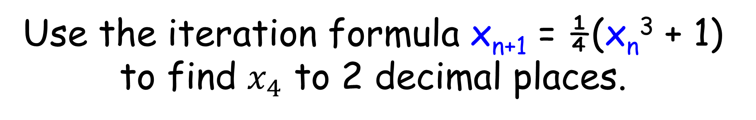
Use the iteration formula x_{n+1} = ¼(x_{n}³ + 1)
to find $x_{4}$ to 2 decimal places.
x₀ = 2
x₁ = 2.25
x₂ = 3.097…
x₃ = 7.680…
x₄ = 113.534…
= 113.53 (2 dp)

Slide 10
A key skill need
for iteration is
rearranging a formula.

Slide 11
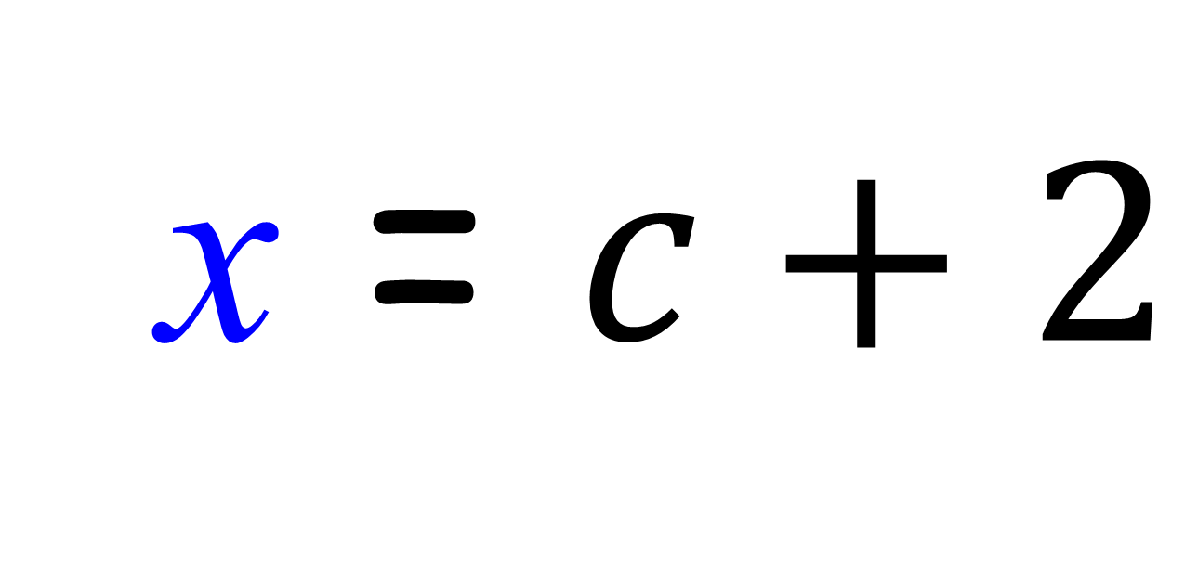
c = x – 2
Make x the subject of the formula.
x = $c+2$

Slide 12
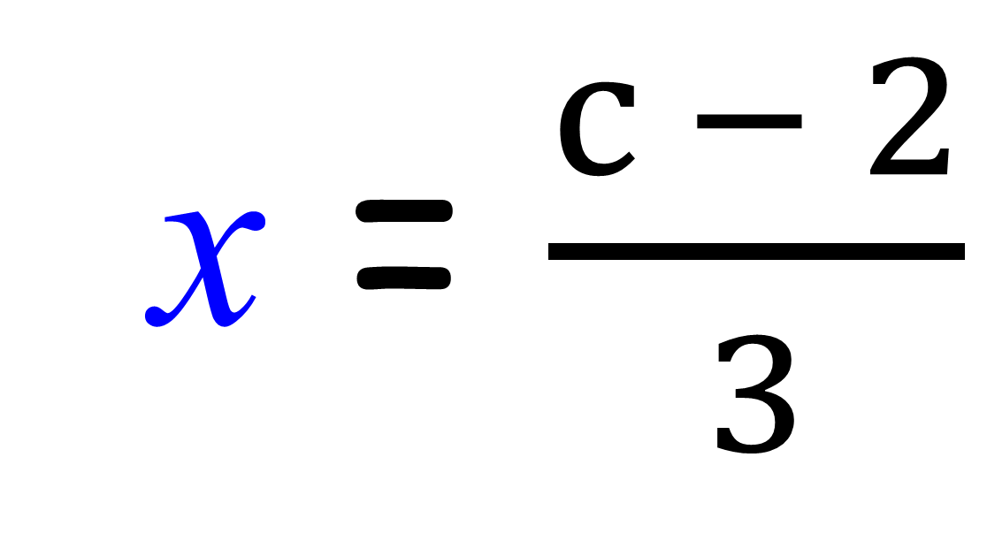
c = 3x + 2
Make x the subject of the formula.
x = $\frac{c − 2}{3}$

Slide 13
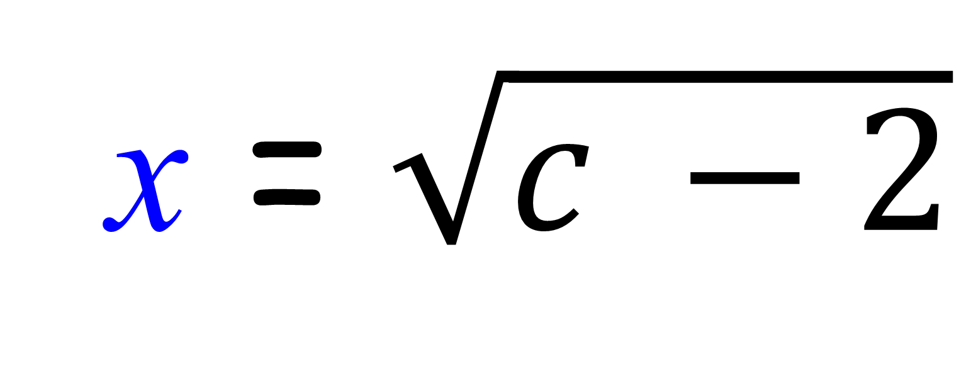
c = x² + 2
Make x the subject of the formula.
x = $\sqrt{c −2}$

Slide 14
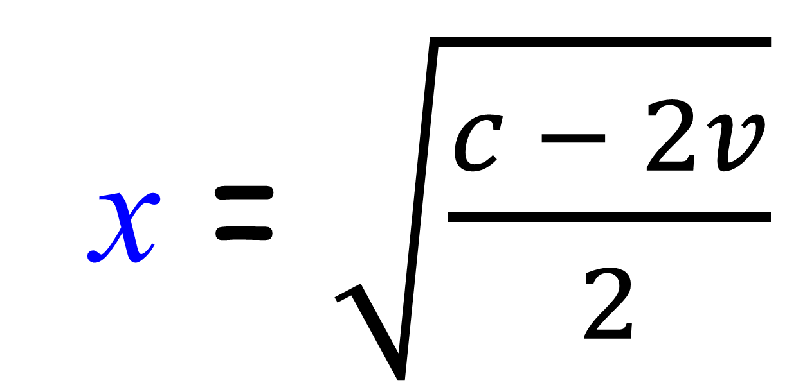
c = 2x² + 2v
Make x the subject of the formula.
x = $\sqrt{\frac{c − 2v}{2}}$

Slide 15
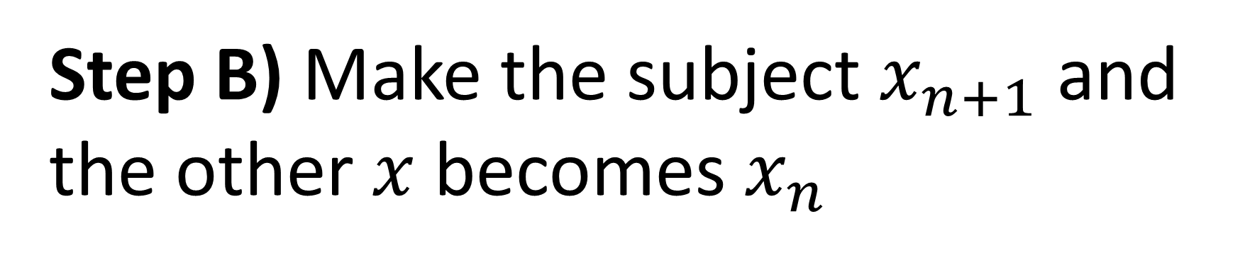

Writing an iterative formulae
to solve quadratics.
Step A) Re-arrange the equation to make one of the $x$s the subject
Step B) Make the subject $x_{n+1}$ and the other $x$becomes $x_{n}$

Slide 16
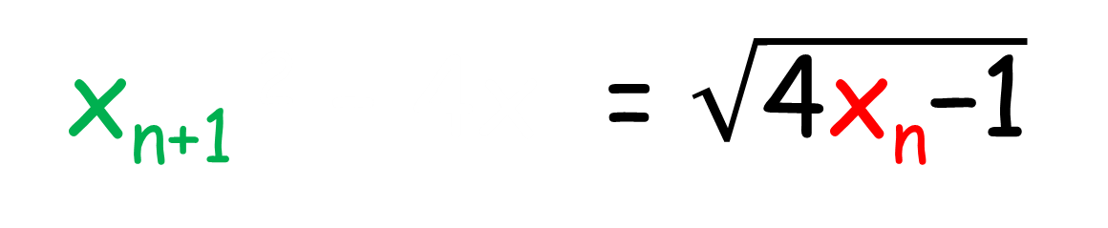
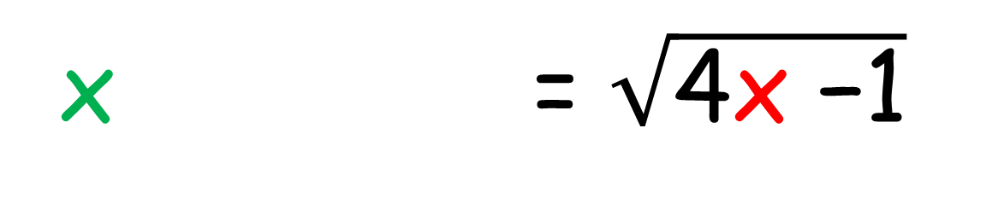
Make x the subject of the formula.
x² – 4x + 1 = 0
x² – 4x + 1 = -1
x² – 4x + = 4x -1
x² – 4x + = $\sqrt{\text{4}\text{x}\text{ −1}}$
x_{n+1} ² – 4x = $\sqrt{\text{4}\text{x}\text{n}\text{−1}}$

Slide 17
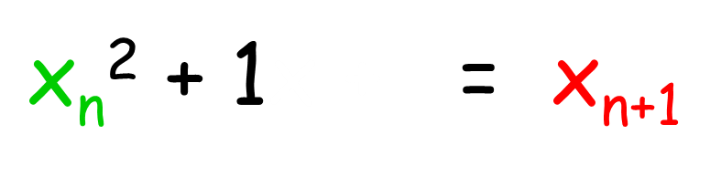
Make x the subject of the formula.
x² – 4x + 1 = 0
x² – 4x + 1 = 4x
x² + 1x + = 4x
4
$\text{x}\text{n}$² + 1x + = x_{n+1}
4

Slide 18
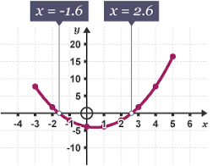

Slide 19
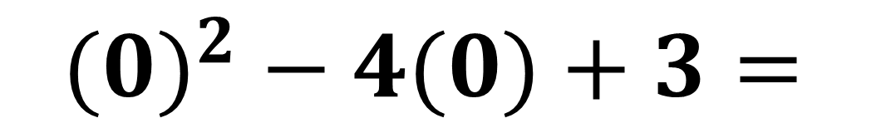
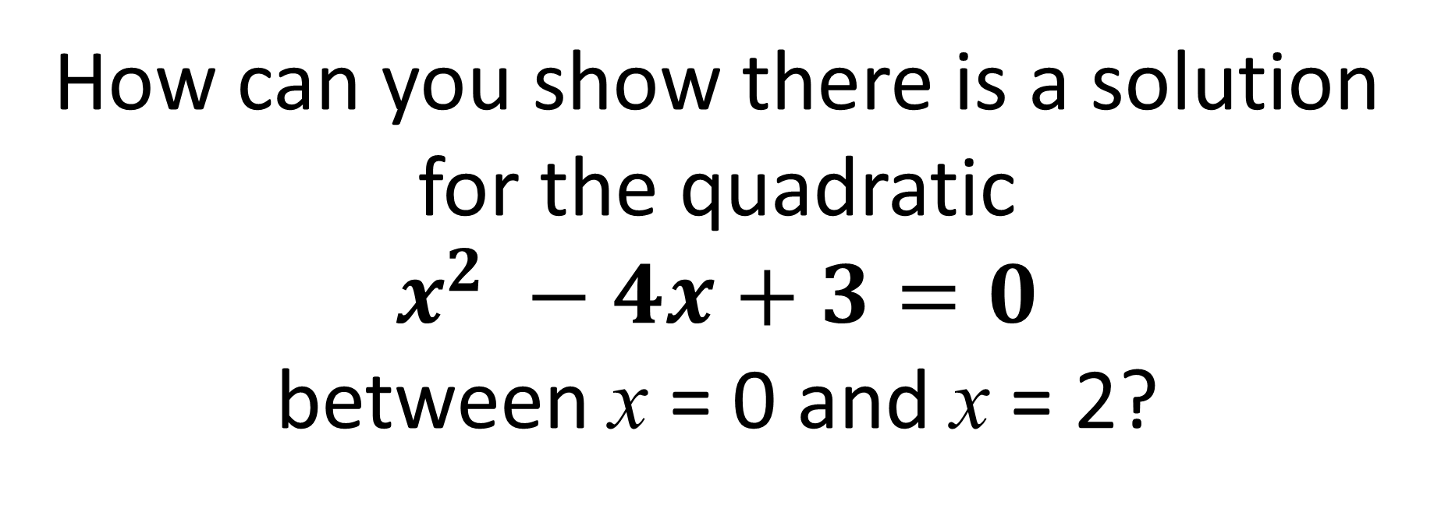


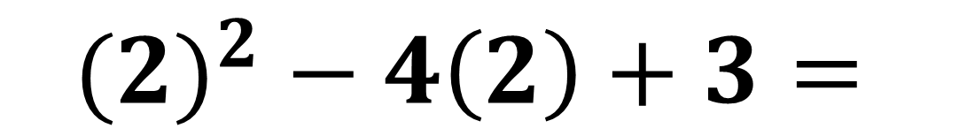
How can you show there is a solution for the quadratic
$x^{2} −4x+3=0$
between x = 0 and x = 2?
$${(0)}^{2} − 4(0)+3=$$
$$3$$
$${(2)}^{2} − 4\left(2\right)+3=$$
$−1$
Zero is in between 3 and $−$1 so there must be a solution.

Slide 20
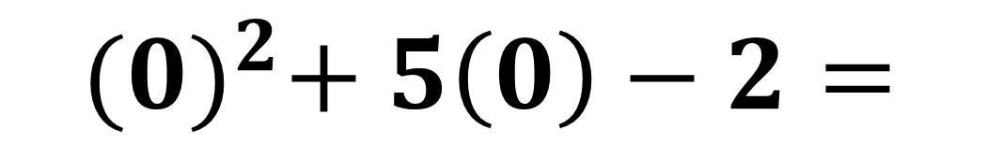
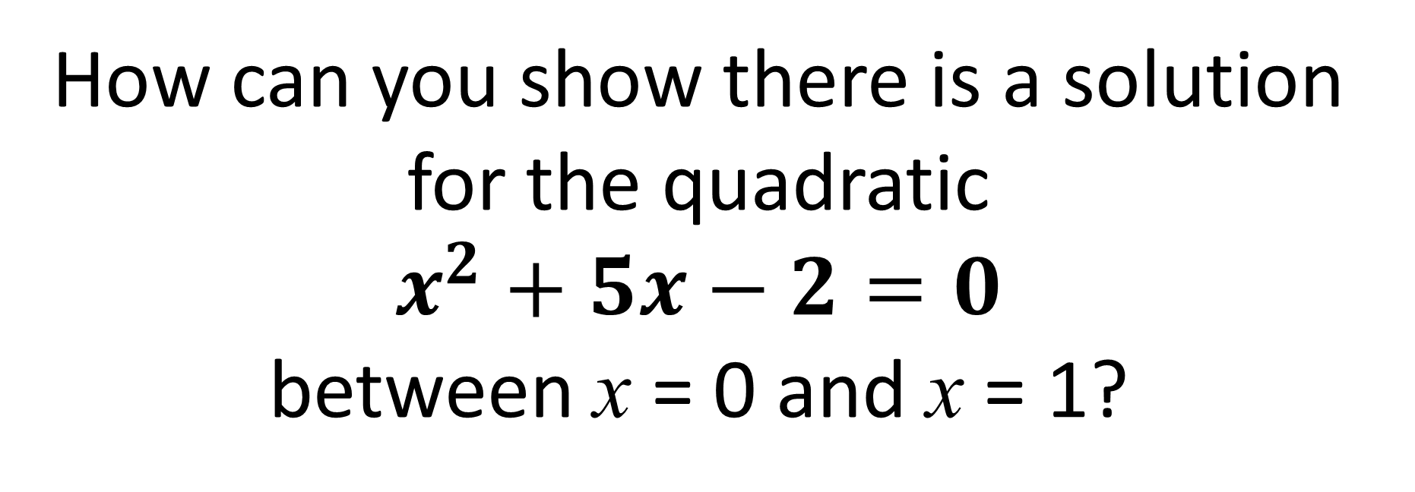

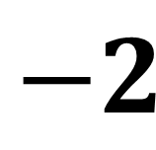
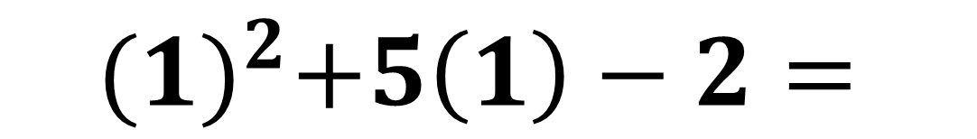
How can you show there is a solution for the quadratic
$x^{2}+5x−2=0$
between x = 0 and x = 1?
$${(0)}^{2}+ 5\left(0\right)−2=$$
$$−2$$
$${(1)}^{2}+5\left(1\right)−2=$$
$$4$$
Zero is in between −2 and $4$ so there must be a solution.

