Slide 1
Trigonometry and Modelling
Double Angle Formulae
Chapter 7
(Part 2 of 6)

Slide 2

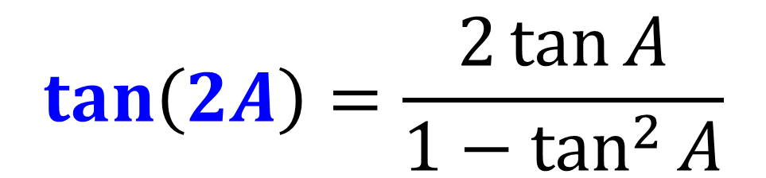
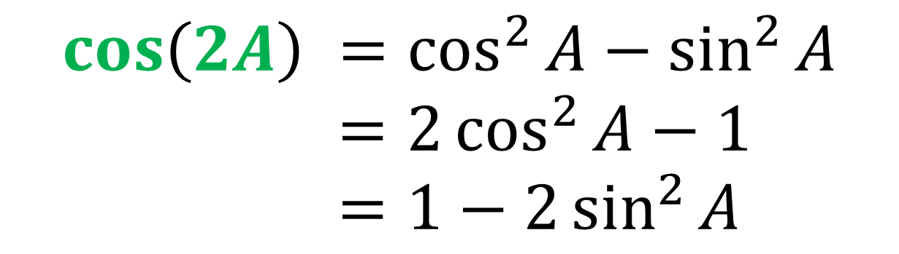
Double-Angle Formulae
$$\sin\left(2A\right)=2\sin{A}\cos{A}$$
$$\cos\left(2A\right) =\cos^{2}{A}−\sin^{2}{A}$$
$=2\cos^{2}{A}−1$
$=1−2\sin^{2}{A}$
$$\tan\left(2A\right)=\frac{2\tan{A}}{1−\tan^{2}{A}}$$
Not in the formula booklet!

Slide 3
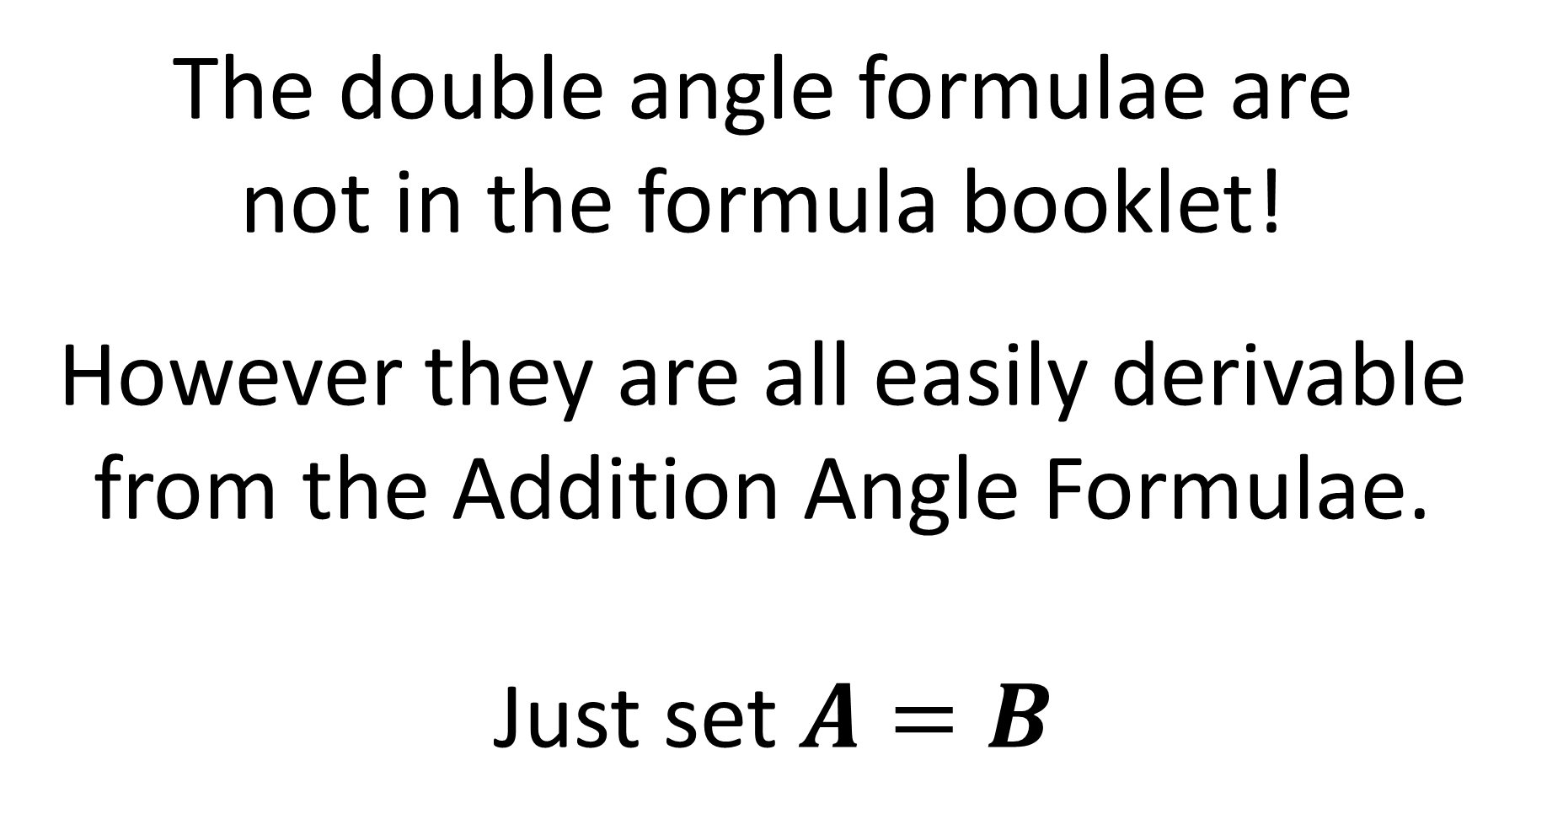
The double angle formulae are
not in the formula booklet!
However they are all easily derivable
from the Addition Angle Formulae.
Just set $A=B$

Slide 4


$\sin\left(A+B\right)=\sin{A}\cos{B}+\cos{A}\sin{B}$
Let $A=B$
$\sin\left(A+A\right)=\sin{A}\cos{A}+\cos{A}\sin{A}$
$\sin\left(2A\right)=2sin{A}\cos{A}$

Slide 5

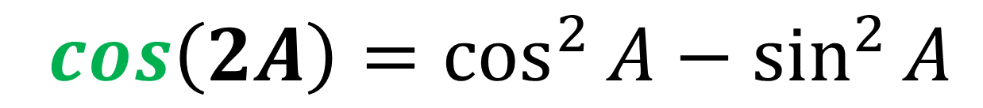
$\cos\left(A+B\right)=\cos{A}\cos{B}−\sin{A}\sin{B}$
Let $A=B$
$\cos\left(A+A\right)=\cos{A}\cos{A}−\sin{A}\sin{A}$
$\cos\left(2A\right)=\cos^{2}{A}−\sin^{2}{A}$

Slide 6
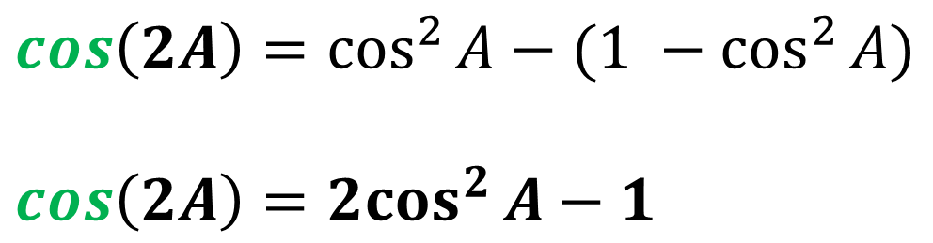
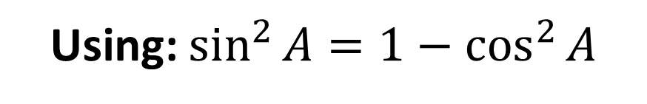
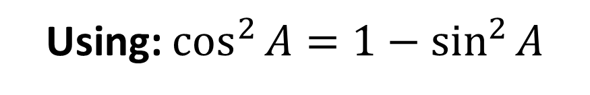

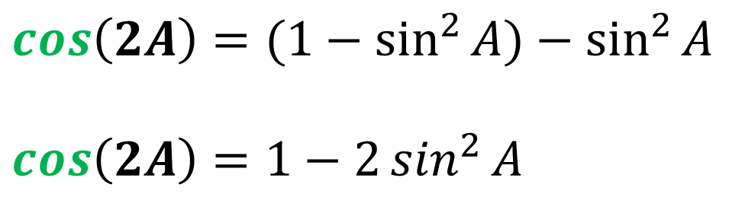
$\cos\left(2A\right)=\cos^{2}{A}−\sin^{2}{A}$
Using: $\sin^{2}{A}=1−\cos^{2}{A}$
Using: $\cos^{2}{A}=1−\sin^{2}{A}$
$$\cos\left(2A\right)=(1−\sin^{2}{A)}−\sin^{2}{A}$$
$$\cos\left(2A\right)=1−2\sin^{2}{A}$$
$$\cos\left(2A\right)=\cos^{2}{A}−{(1 −cos}^{2}{A})$$
$$\cos\left(2A\right)={2cos}^{2}{A}−1$$

Slide 7
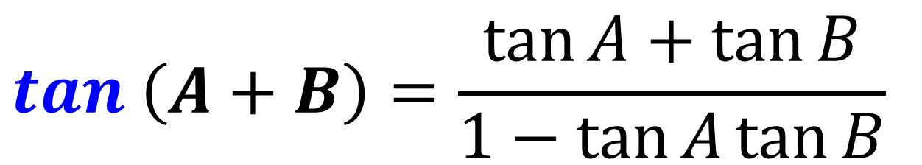
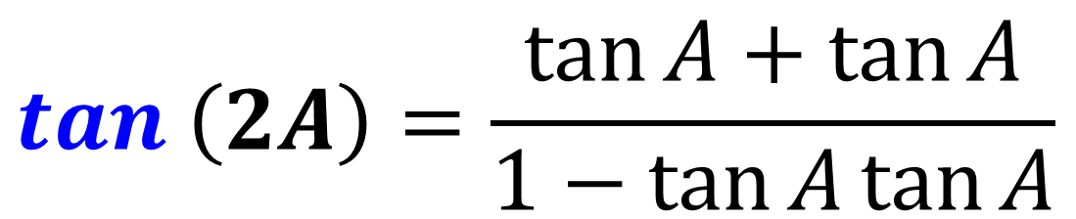

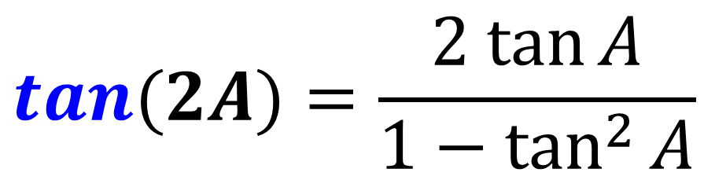
$$\tan\left(A+B\right)=\frac{\tan{A}+\tan{B}}{1−\tan{A}\tan{B}}$$
Let $A=B$
$$\tan\left(2A\right)=\frac{\tan{A}+\tan{A}}{1−\tan{A}\tan{A}}$$
$$tan⁡(2A)=\frac{2 tan{A}}{1−\tan^{2}{A}}$$

Slide 8



Double-Angle Formulae
$$\sin\left(2A\right)=2\sin{A}\cos{A}$$
$$\cos\left(2A\right) =\cos^{2}{A}−\sin^{2}{A}$$
$=2\cos^{2}{A}−1$
$=1−2\sin^{2}{A}$
$$\tan\left(2A\right)=\frac{2\tan{A}}{1−\tan^{2}{A}}$$

Slide 9

Show (sin A + cos A)² $≡$ 1 + sin 2A
(sin A + cos A)(sin A + cos A)
= sin² A + sin A cos A + cos A sin A + cos² A
= sin² A + 2 sin A cos A + cos² A
= sin² A + cos² A + 2 sin A cos A
= 1 + sin 2A

Slide 10
5 cos 2x + 3 sin x = 4
Rewrite as a quadratic that you could solve.
5 cos 2x + 3 sin x = 4
5 (1 – 2 sin² x) + 3 sin x = 4
5 – 10 sin² x + 3 sin x = 4
10 sin² x – 3 sin x – 1 = 0

Slide 11
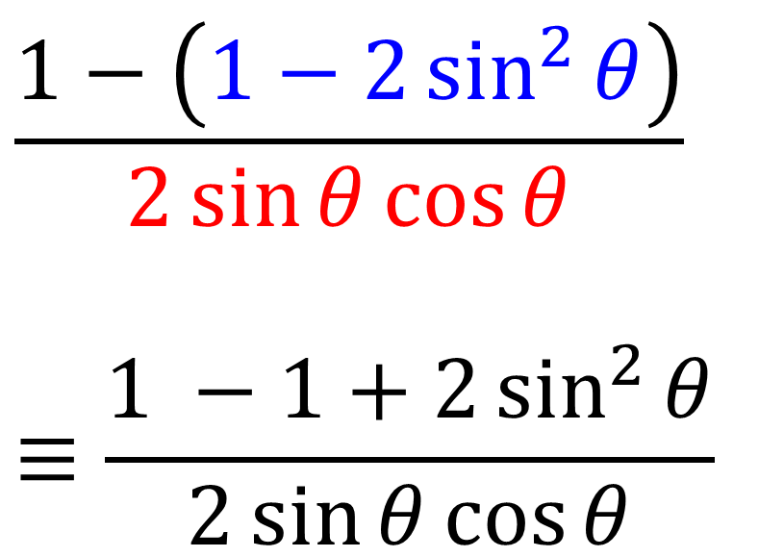

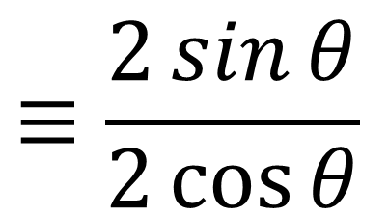
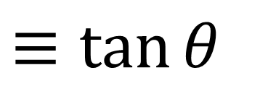
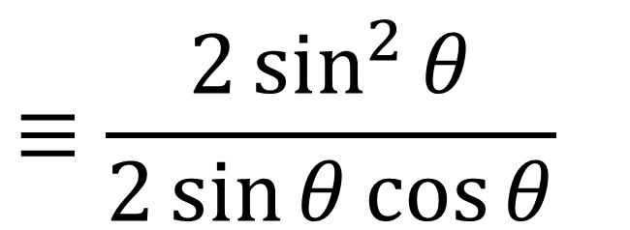
Prove that $\frac{1 −\cos{2θ}}{\sin{2θ}}≡\tan{θ}$
$$≡\frac{2\sin^{2}{θ}}{2\sin{θ}\cos{θ}}$$
$$\frac{1−\left(1−2\sin^{2}{θ}\right)}{2\sin{θ}\cos{θ}}$$
$$≡\frac{1 −1+2\sin^{2}{θ}}{2\sin{θ}\cos{θ}}$$
$$≡\frac{2\sin{θ}}{2\cos{θ}}$$
$$≡\tan{θ}$$

Slide 12
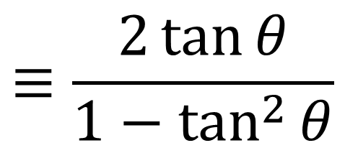
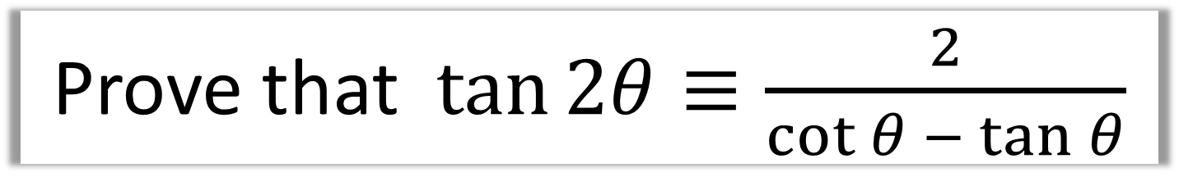
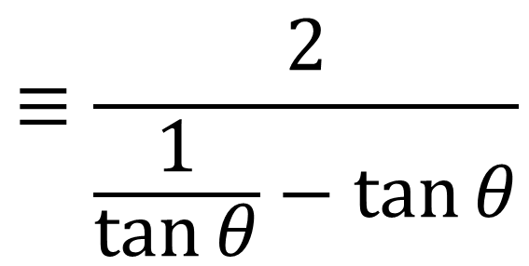
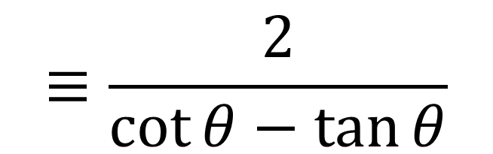
Prove that $\tan{2θ}≡\frac{2}{\cot{θ} − \tan{θ}}$
$$≡\frac{2\tan{θ}}{1−\tan^{2}{θ}}$$
$$≡\frac{2}{\frac{1}{\tan{θ}}−\tan{θ}}$$
$$≡\frac{2}{\cot{θ}−\tan{θ}}$$

Slide 13
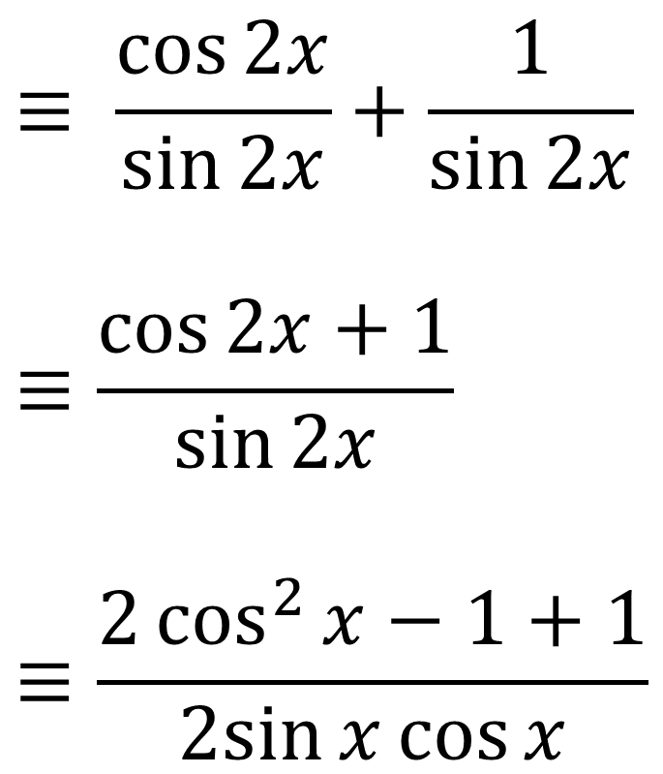

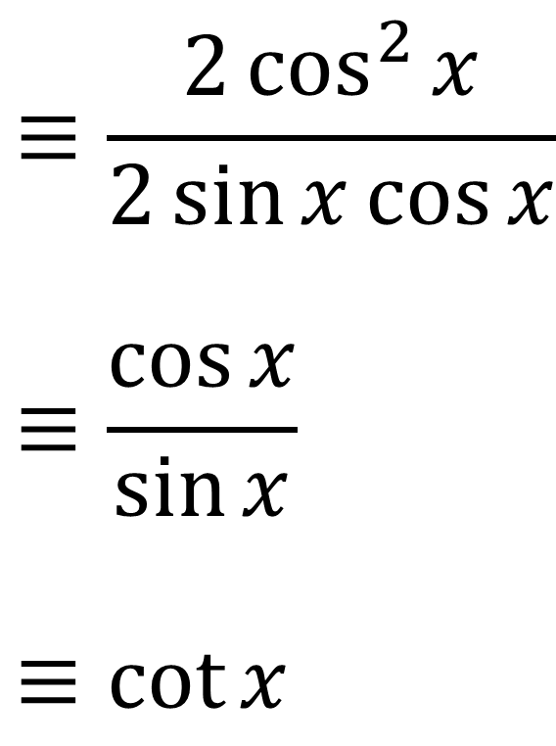
Prove that $\cot{2x}+cosec 2x≡\cot{x}$
$$≡ \frac{\cos{2x}}{\sin{2x}}+\frac{1}{\sin{2x}}$$
$$≡\frac{\cos{2x}+1}{\sin{2x}}$$
$$≡\frac{2\cos^{2}{x}−1+1}{2sin{x}\cos{x}}$$
$$≡\frac{2\cos^{2}{x}}{2\sin{x}\cos{x}}$$
$$≡\frac{\cos{x}}{\sin{x}}$$
$$≡\cot{x}$$

Slide 14
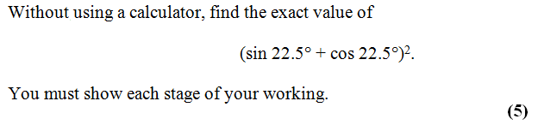
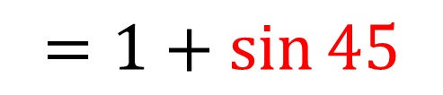


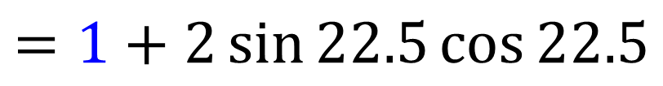
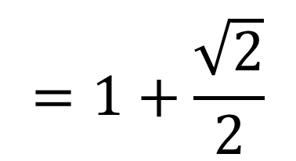
$$(sin{22.5}+\cos{22.5)}(\sin{22.5+\cos{22.5)}}$$
$=\sin^{2}{22.5}$ ${+ cos}^{2}{22.5}+2\sin{22.5\cos{22.5}}$
$\sin^{2}{x}$ ${+ cos}^{2}{x}=1$
$$=1+2\sin{22.5\cos{22.5}}$$
$$2\sin{x}cos x=\sin{2x}$$
$$=1+\frac{\sqrt{2}}{2}$$
$$=1+\sin{45}$$

