Slide 1
Normal Distribution
Inverse Normal Distribution
Chapter 3
(Part 3 of 7)

Slide 2
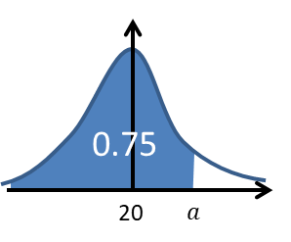
Given the probability (area)
find the boundary value.

Slide 3

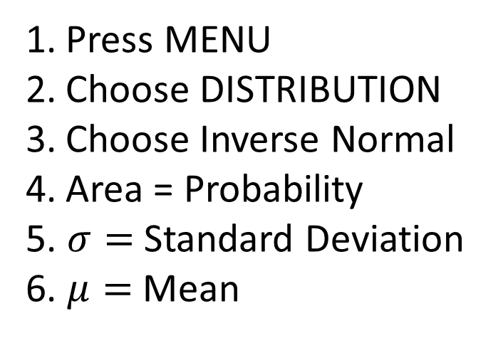
Inverse Normal Distribution
Press MENU
Choose DISTRIBUTION
Choose Inverse Normal
Area = Probability
5. $σ=$ Standard Deviation
6. $μ=$ Mean

Slide 4
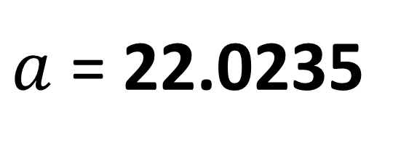
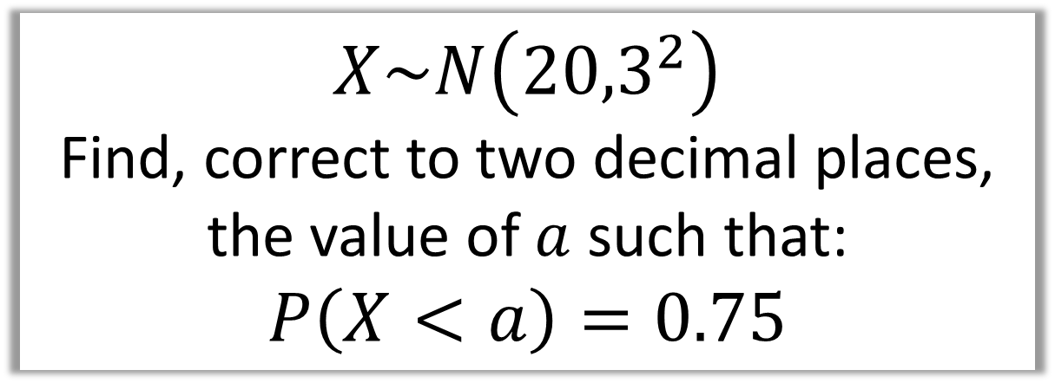
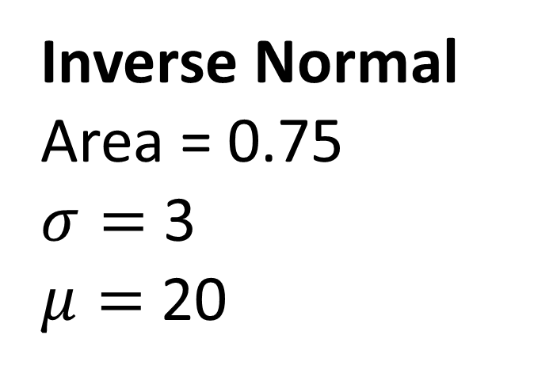
$$X\sim N\left({20,3}^{2}\right)$$
Find, correct to two decimal places,
the value of $a$ such that:
$$P\left(X<a\right)=0.75$$
Inverse Normal
Area = 0.75
$σ=$ 3
$μ=$ 20
$a$ = 22.0235

Slide 5
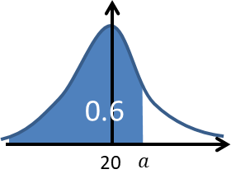
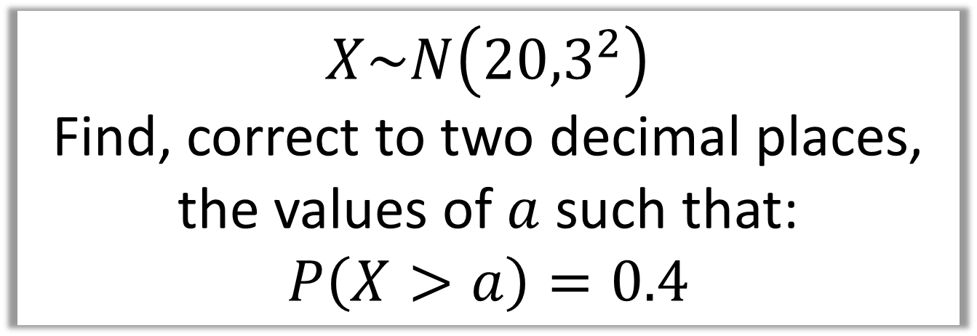
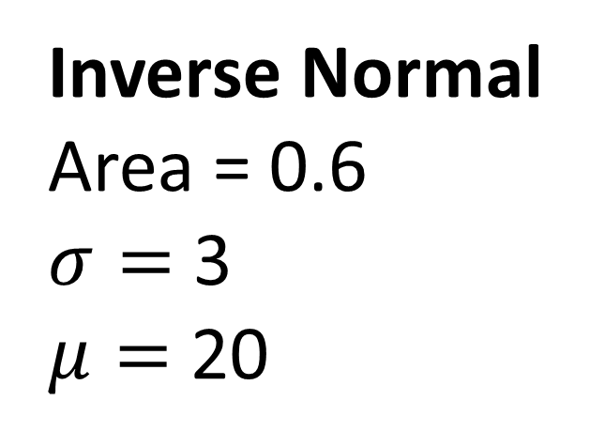
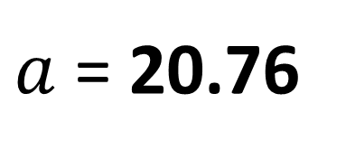
$$X\sim N\left({20,3}^{2}\right)$$
Find, correct to two decimal places,
the values of $a$ such that:
$$P\left(X>a\right)=0.4$$
Inverse Normal
Area = 0.6
$σ=$ 3
$μ=$ 20
$a$ = 20.76

Slide 6

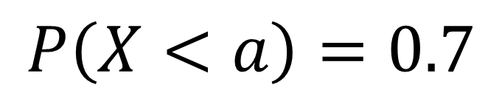
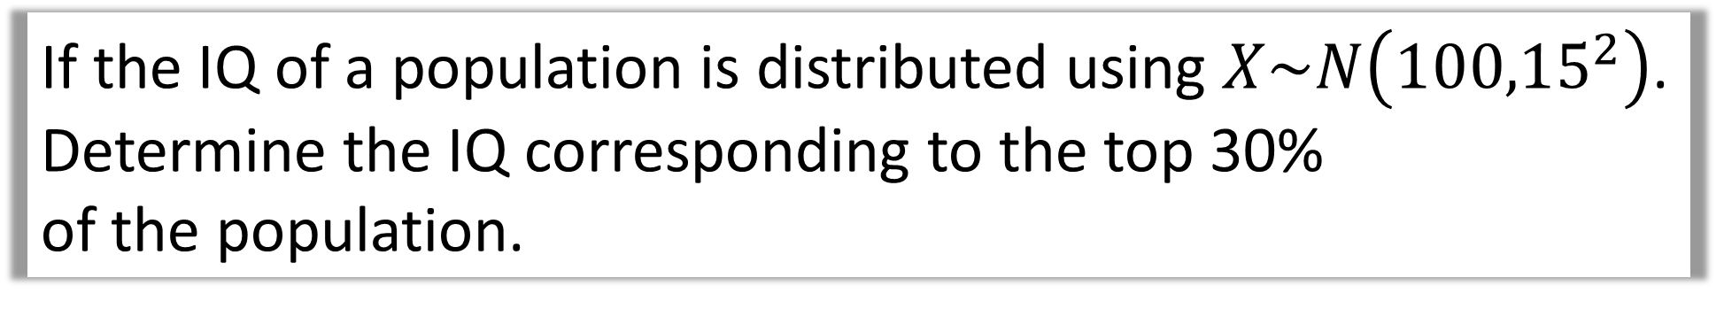
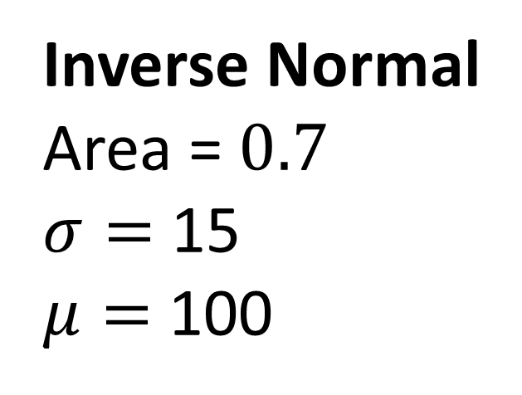
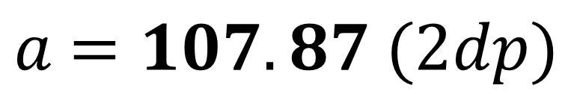
If the IQ of a population is distributed using $X\sim N\left({100,15}^{2}\right)$.
Determine the IQ corresponding to the top 30%
of the population.
Inverse Normal
Area = $0.7$
$σ=$ 15
$μ=$ 100
$a$ $=107.87 (2dp)$
$$P\left(X<a\right)=0.7$$

Slide 7
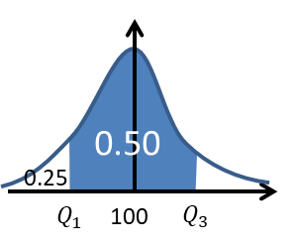
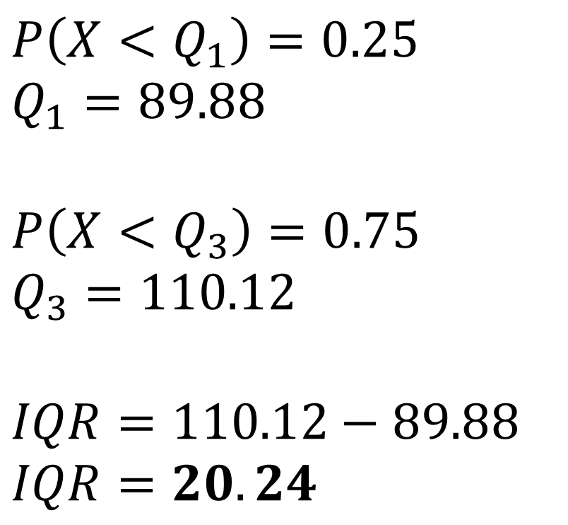
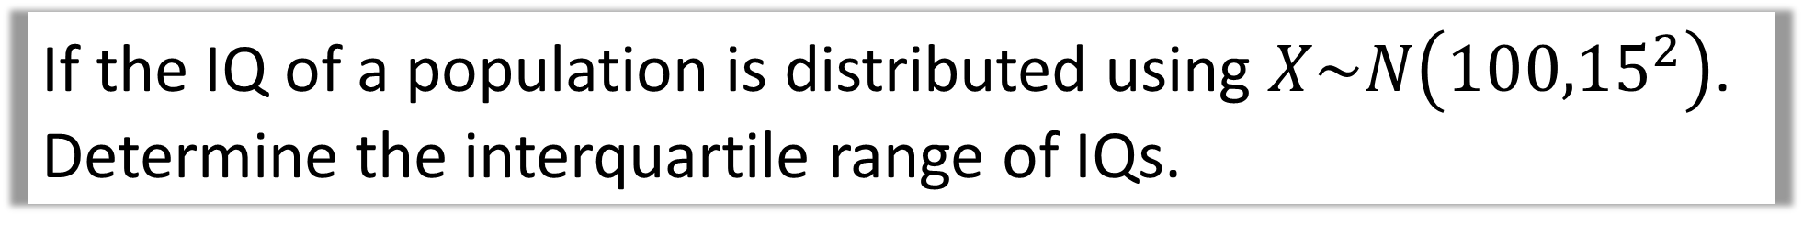
If the IQ of a population is distributed using $X\sim N\left({100,15}^{2}\right)$.
Determine the interquartile range of IQs.
$$P\left(X<Q_{1}\right)=0.25 \\ Q_{1}=89.88$$
$$P\left(X<Q_{3}\right)=0.75 \\ Q_{3}=110.12$$
$$IQR=110.12−89.88$$
$$IQR=20.24$$

Slide 8
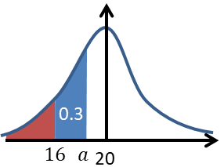

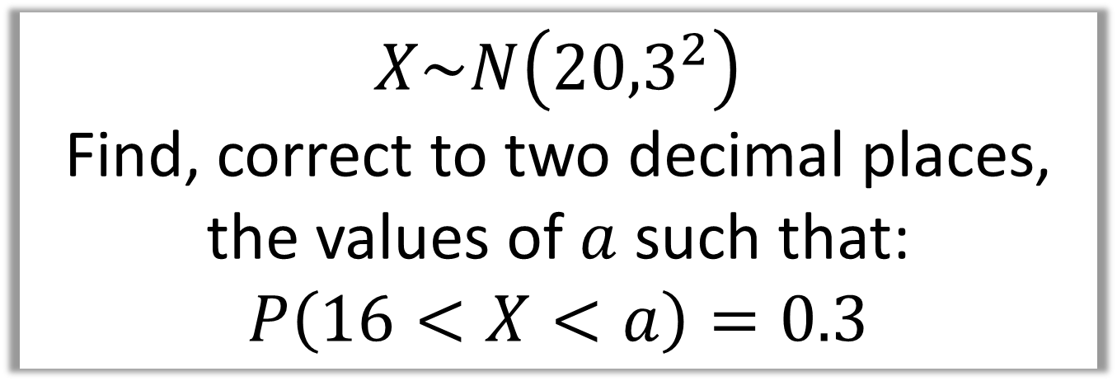
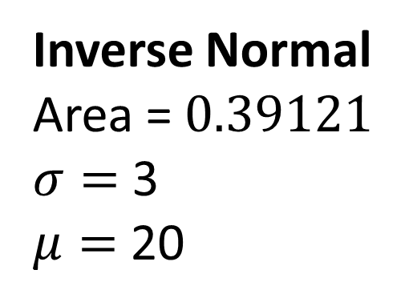
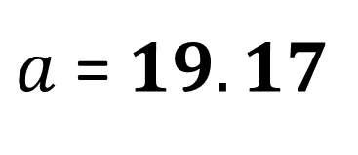
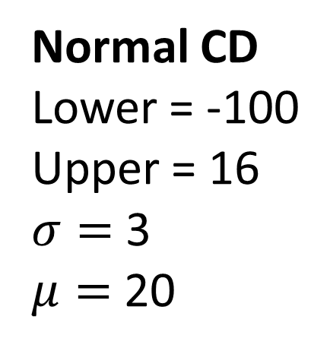
$$X\sim N\left({20,3}^{2}\right)$$
Find, correct to two decimal places,
the values of $a$ such that:
$$P\left(16<X<a\right)=0.3$$
Normal CD
Lower = -100
Upper = 16
$σ=$ 3
$μ=$ 20
Inverse Normal
Area = $0.39121$
$σ=$ 3
$μ=$ 20
$a$ = $19.17$
$$P\left(X<16\right)=0.09121$$

