Slide 1
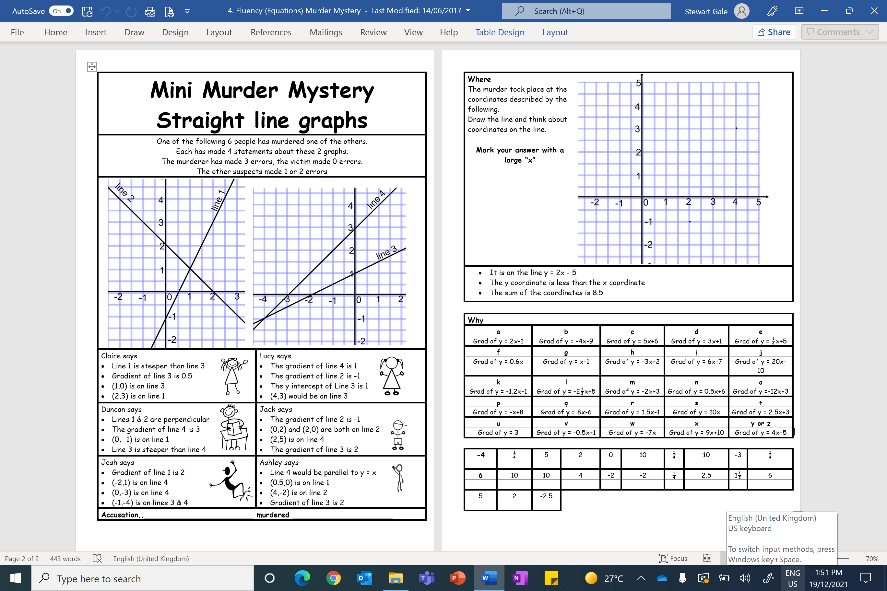

Slide 2
ANSWERS

Slide 3
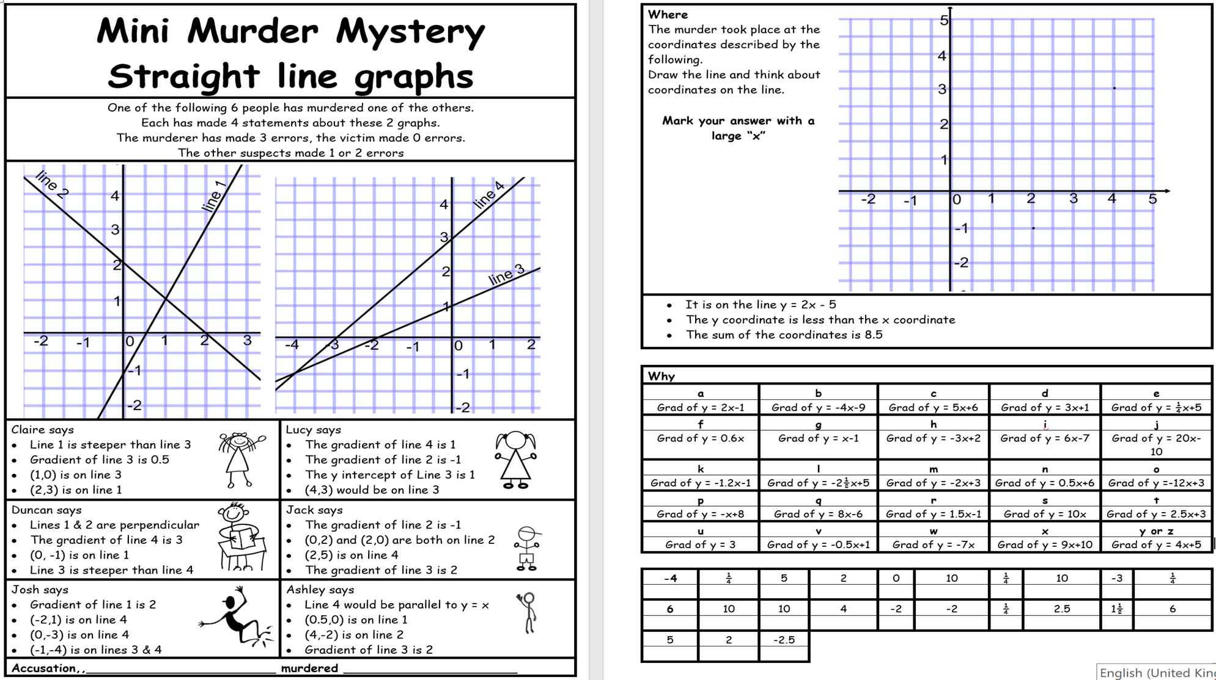
T
T
T
T
F
T
T
T
F
F
F
T
T
F
T
F
T
T
T
T
F
F
F
F

Slide 5
Because she is symmetrical

