Slide 1
LO: Sequences and Diagrams

Slide 2
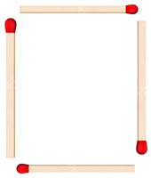
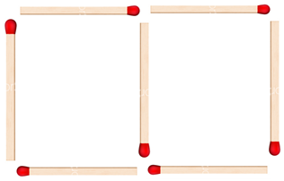
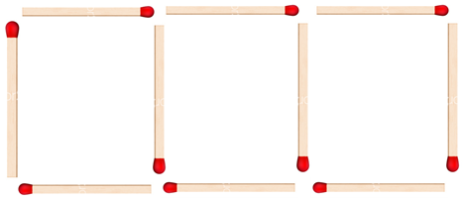
Diagram 1
Diagram 2
Diagram 3
How many matches do you need for diagram 4?
13

Slide 3
Diagram 1
Diagram 2
Diagram 3
How many matches do you need for diagram 20?
61

Slide 4
Diagram 1
Diagram 2
Diagram 3
How many matches do you need for diagram n?
3n + 1

Slide 5
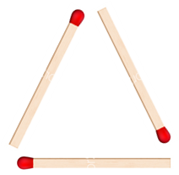
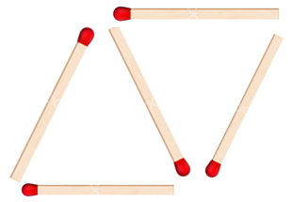
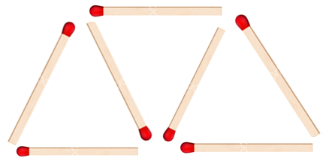
Diagram 1
Diagram 2
Diagram 3
How many matches do you need for diagram n?
2n + 1

Slide 6
Pattern 1
Pattern 2
Pattern 3
How many squares do you need for diagram n?
3n + 1

Slide 7
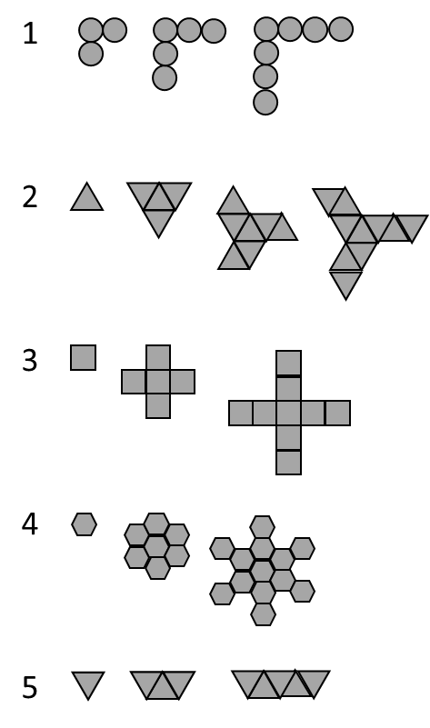
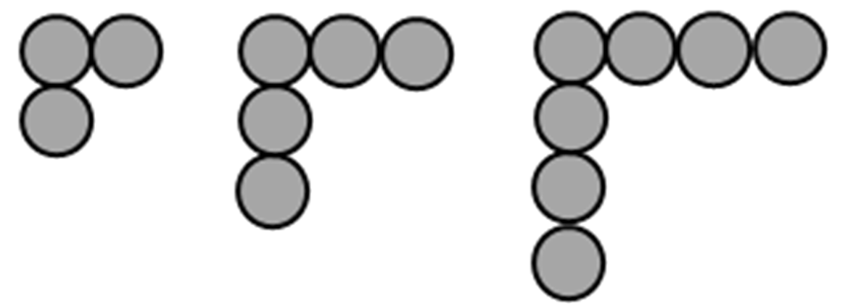
Pattern 1
Pattern 2
Pattern 3
How many circles do you need for diagram n?
2n + 1

Slide 8
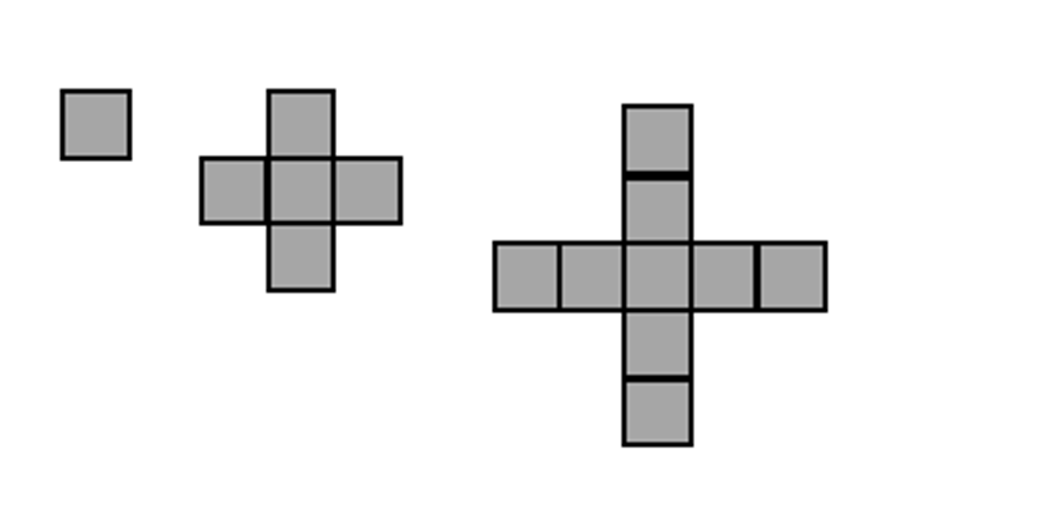
Pattern 1
Pattern 2
Pattern 3
How many squares do you need for diagram n?
4n – 3

Slide 9


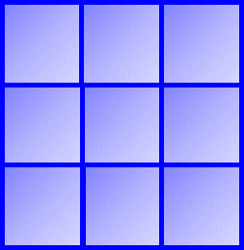
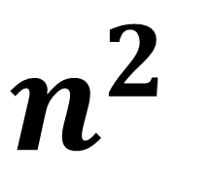
Pattern 1
Pattern 2
Pattern 3
How many squares do you need for diagram n?
$$n^{2}$$

Slide 10
1 | 2 | 3 | 4 | 5
2 | 4 | 6 | 8 | 10
Is the number 16 in the Sequence?
Yes
2, 4, 6, 8, 10, 12, 14, 16

Slide 11
1 | 2 | 3 | 4 | 5
3 | 5 | 7 | 9 | 11
Is the number 14 in the Sequence?
No
3, 5, 7, 9, 11, 13, 15,

Slide 12
1 | 2 | 3 | 4 | 5
3 | 5 | 7 | 9 | 11
Is the number 37 in the Sequence?
Yes
2n + 1 = 37
2n + 1 = 18

Slide 13
1 | 2 | 3 | 4 | 5
7 | 9 | 11 | 13 | 15
Is the number 123 in the Sequence?
Yes
2n + 5 = 123
2n + 1 = 59

Slide 14
1 | 2 | 3 | 4 | 5
2 | 5 | 8 | 11 | 14
Is the number 423 in the Sequence?
No
3n – 1 = 423
2n + 1 = 141.3333….

