Slide 1
Identities and Equations
Quadratics Equations
Chapter 10
(Part 4 of 4)

Slide 2
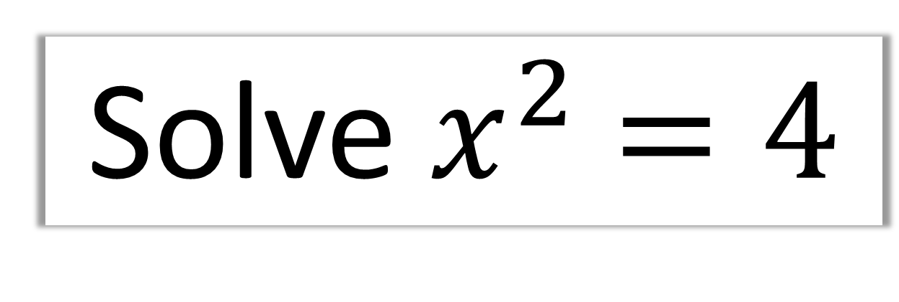
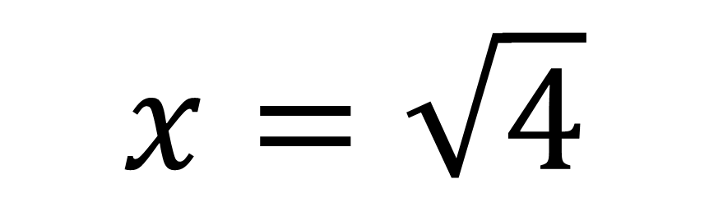
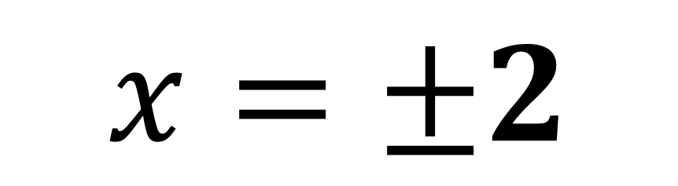
Solve${ x}^{2} =4$
$$x=\sqrt{4}$$
$$x=±2$$

Slide 3
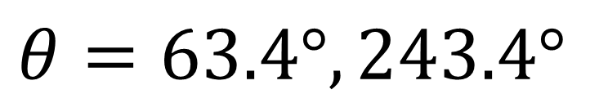
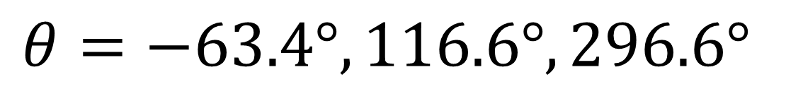
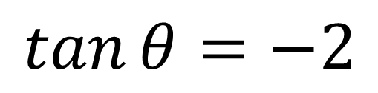
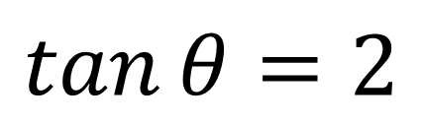
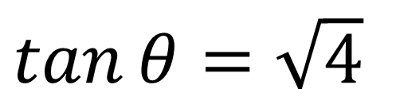
Solve $\tan^{2}{θ}=4$ in the interval $0≤θ≤360°$
$\tan{θ}=\sqrt{4}$
$$\tan{θ}=2$$
$$θ=63.4°, 243.4°$$
$$\tan{θ}=−2$$
$$θ=−63.4°, 116.6°,296.6°$$
$$θ=63.4°, 116.6°, 243.4°,296.6°$$

Slide 4
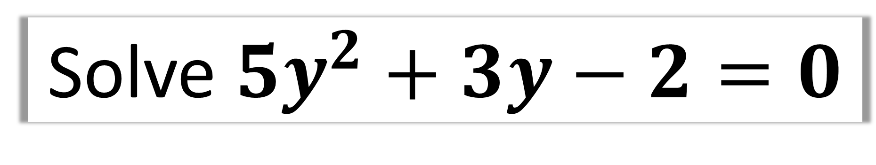
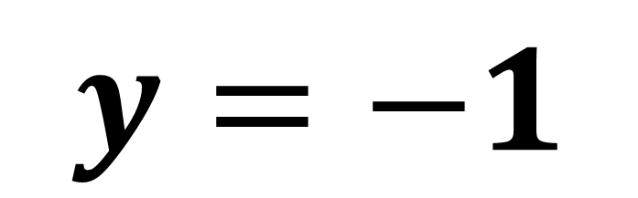
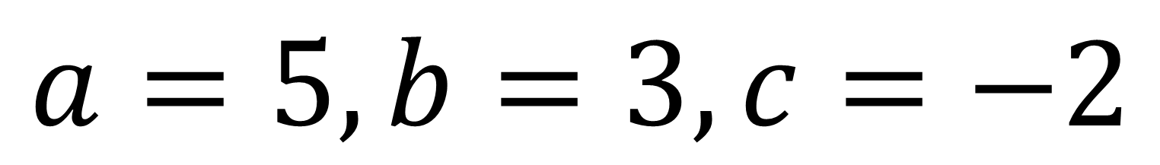
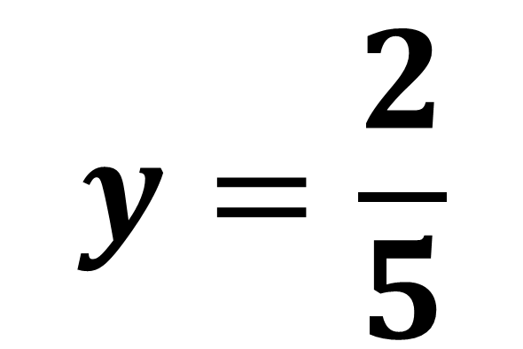
Solve $5y^{2}+3y−2=0$
$$a=5, b=3, c=−2$$
$$y=\frac{2}{5}$$
$$y=−1$$

Slide 5
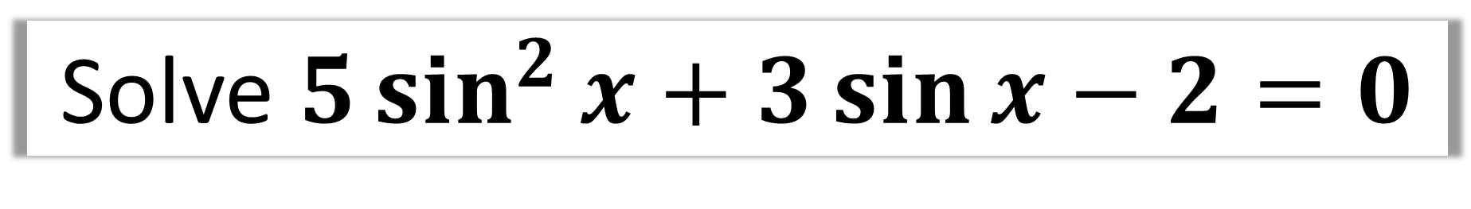
Solve $5\sin^{2}{x}+3\sin{x}−2=0$
What does the above trigonometric equation
remind you of?
A Quadratic Equation!

Slide 6
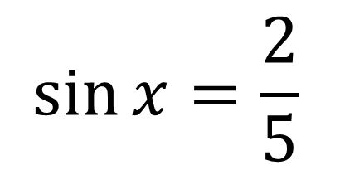
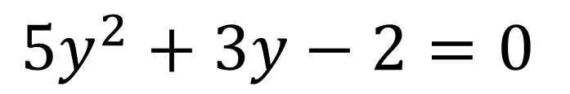
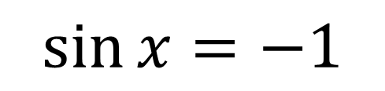
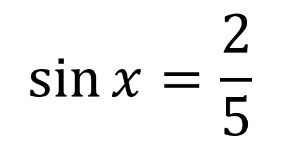
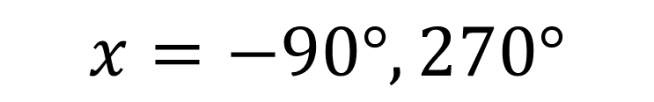
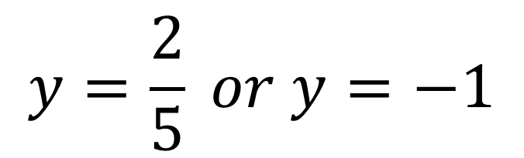
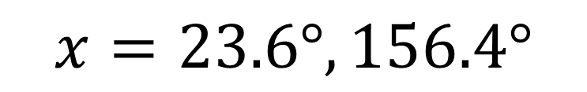
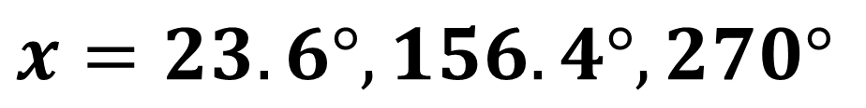
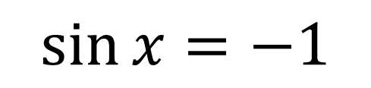
Solve $5\sin^{2}{x}+3\sin{x}−2=0$ in the interval $0≤x≤360°$
$$\sin{x}=\frac{2}{5}$$
$$5y^{2}+3y−2=0$$
$$y=\frac{2}{5} or y=−1$$
$$x=23.6°, 156.4°$$
$$\sin{x}=−1$$
$$\sin{x}=\frac{2}{5}$$
$$x=−90°, 270°$$
$$\sin{x}=−1$$
$$x=23.6°, 156.4°,270°$$

Slide 7

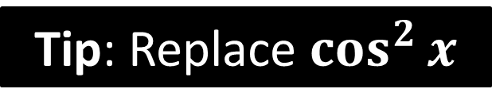
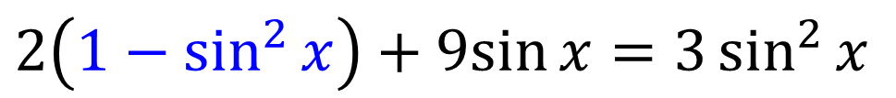
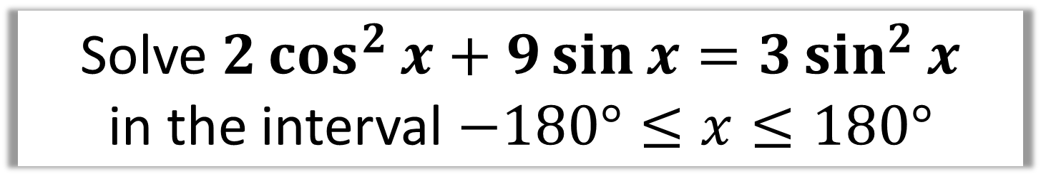

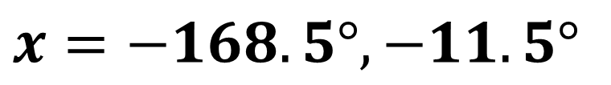

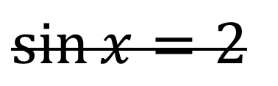
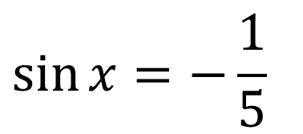
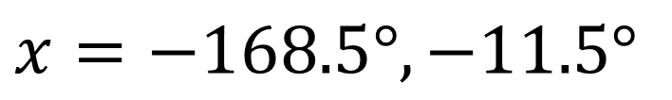
Solve $2\cos^{2}{x}+9\sin{x}=3\sin^{2}{x}$
in the interval $−180°≤x≤180°$
Tip: Replace $\cos^{2}{x}$
$$\sin{x}=−\frac{1}{5}$$
$$2\cos^{2}{x}+9\sin{x}=3\sin^{2}{x}$$
$$x=−168.5°, −11.5°$$
$$2\left(1−\sin^{2}{x}\right)+9sin{x}=3\sin^{2}{x}$$
$$\sin{x}=2$$
$$2−2\sin^{2}{x}+9sin{x}=3\sin^{2}{x}$$
No Solutions
$$5\sin^{2}{x}−9sin{x}−2=0$$
$$x=−168.5°, −11.5°$$

Slide 8
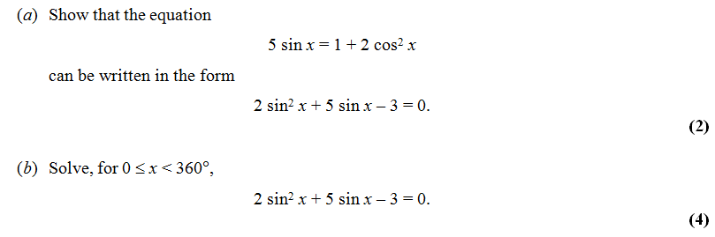
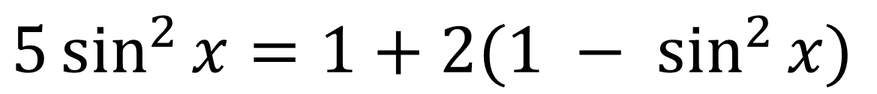
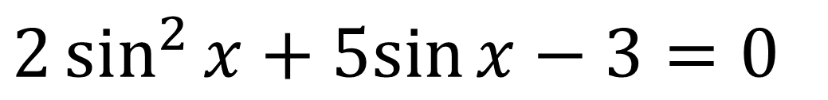
a)
$$5\sin^{2}{x}=1+2(1 − \sin^{2}{x)}$$
$$2\sin^{2}{x}+5sin{x}−3=0$$

Slide 9
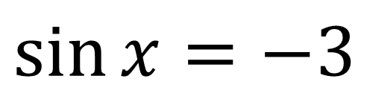
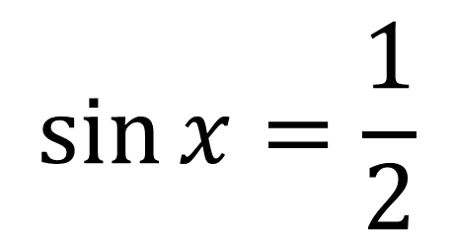
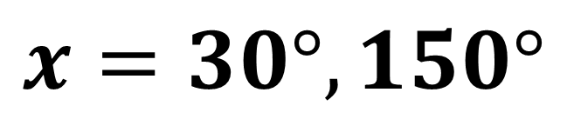
$$\sin{x}=\frac{1}{2}$$
b)
$$\sin{x}=−3$$
No Solutions
$$x=30°, 150°$$

