Slide 1
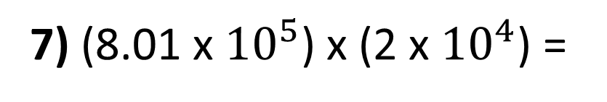
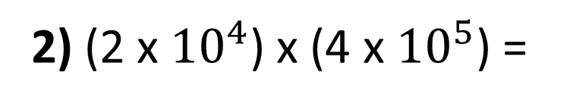
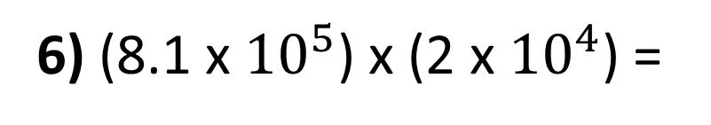
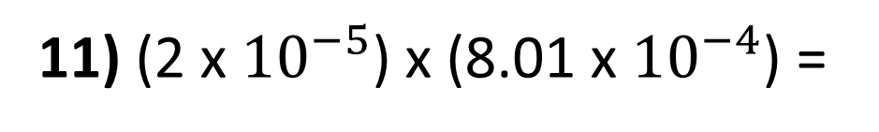
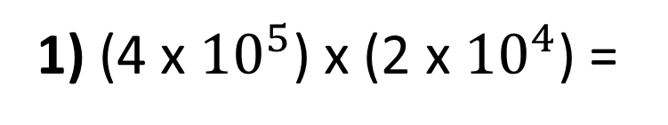
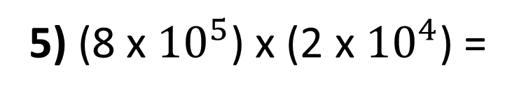
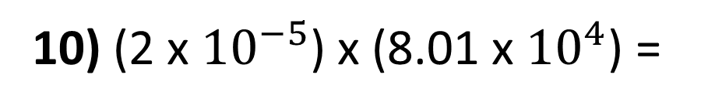
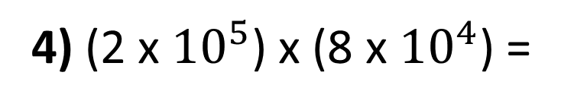
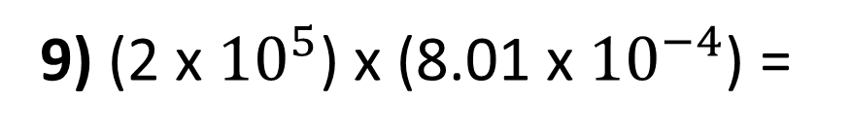
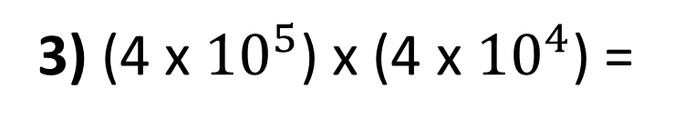
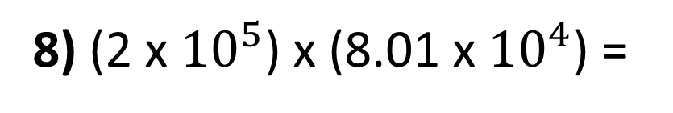
1) (4 x ${10}^{5}$) x (2 x ${10}^{4}$) =
7) (8.01 x ${10}^{5}$) x (2 x ${10}^{4}$) =
2) (2 x ${10}^{4}$) x (4 x ${10}^{5}$) =
8) (2 x ${10}^{5}$) x (8.01 x ${10}^{4}$) =
3) (4 x ${10}^{5}$) x (4 x ${10}^{4}$) =
9) (2 x ${10}^{5}$) x (8.01 x ${10}^{−4}$) =
4) (2 x ${10}^{5}$) x (8 x ${10}^{4}$) =
10) (2 x ${10}^{−5}$) x (8.01 x ${10}^{4}$) =
5) (8 x ${10}^{5}$) x (2 x ${10}^{4}$) =
11) (2 x ${10}^{−5}$) x (8.01 x ${10}^{−4}$) =
6) (8.1 x ${10}^{5}$) x (2 x ${10}^{4}$) =

Slide 2
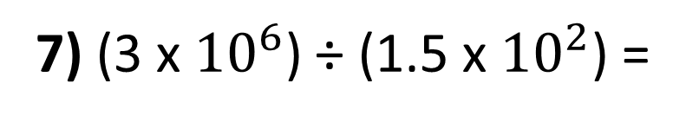
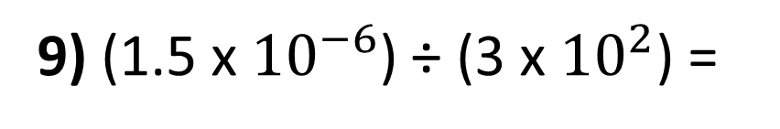
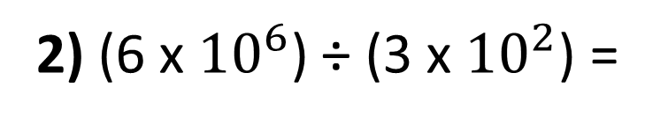
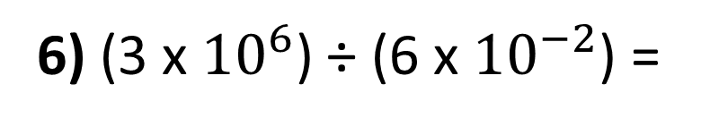
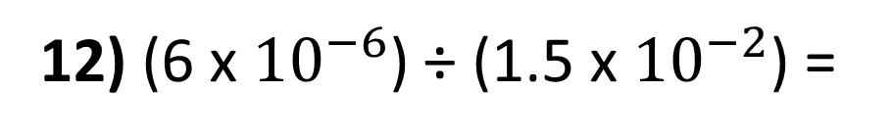
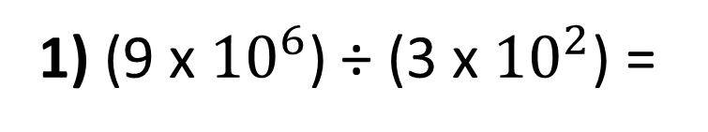
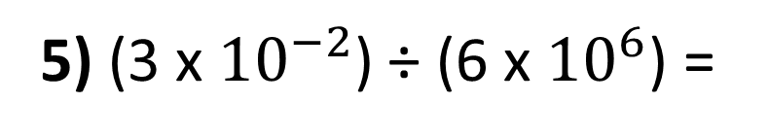
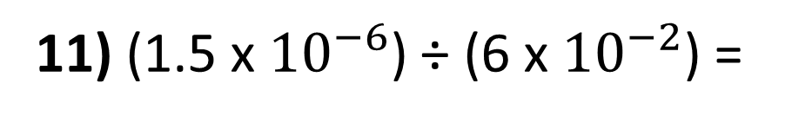
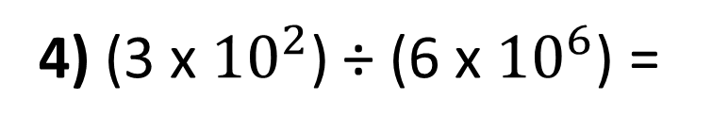
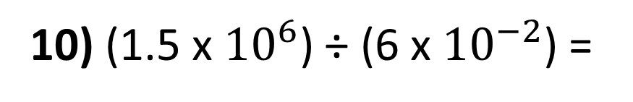
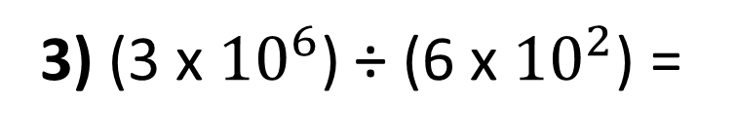
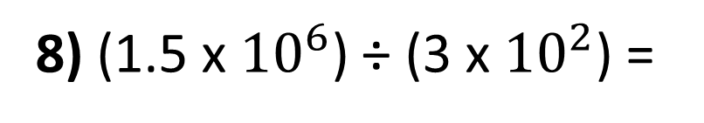
1) (9 x ${10}^{6}$) ÷ (3 x ${10}^{2}$) =
7) (3 x ${10}^{6}$) ÷ (1.5 x ${10}^{2}$) =
2) (6 x ${10}^{6}$) ÷ (3 x ${10}^{2}$) =
8) (1.5 x ${10}^{6}$) ÷ (3 x ${10}^{2}$) =
3) (3 x ${10}^{6}$) ÷ (6 x ${10}^{2}$) =
9) (1.5 x ${10}^{−6}$) ÷ (3 x ${10}^{2}$) =
4) (3 x ${10}^{2}$) ÷ (6 x ${10}^{6}$) =
10) (1.5 x ${10}^{6}$) ÷ (6 x ${10}^{−2}$) =
5) (3 x ${10}^{−2}$) ÷ (6 x ${10}^{6}$) =
11) (1.5 x ${10}^{−6}$) ÷ (6 x ${10}^{−2}$) =
6) (3 x ${10}^{6}$) ÷ (6 x ${10}^{−2}$) =
12) (6 x ${10}^{−6}$) ÷ (1.5 x ${10}^{−2}$) =

Slide 3
ANSWERS

Slide 4
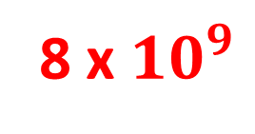
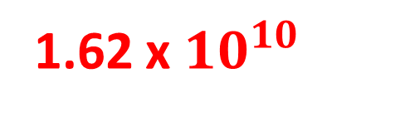
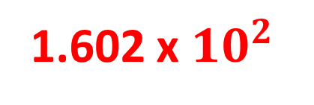
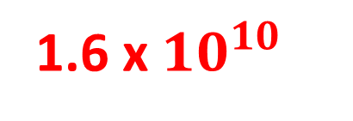

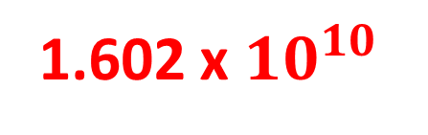
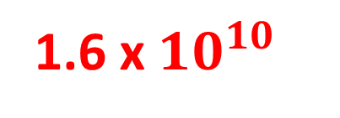
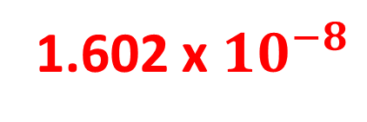
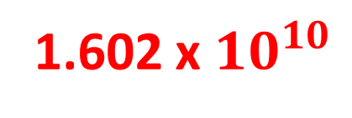
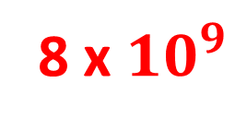
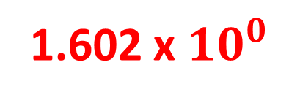
1) (4 x ${10}^{5}$) x (2 x ${10}^{4}$) =
7) (8.01 x ${10}^{5}$) x (2 x ${10}^{4}$) =
8 x ${10}^{9}$
1.602 x ${10}^{10}$
2) (2 x ${10}^{4}$) x (4 x ${10}^{5}$) =
8) (2 x ${10}^{5}$) x (8.01 x ${10}^{4}$) =
8 x ${10}^{9}$
1.602 x ${10}^{10}$
3) (4 x ${10}^{5}$) x (4 x ${10}^{4}$) =
9) (2 x ${10}^{5}$) x (8.01 x ${10}^{−4}$) =
1.6 x ${10}^{10}$
1.602 x ${10}^{2}$
4) (2 x ${10}^{5}$) x (8 x ${10}^{4}$) =
10) (2 x ${10}^{−5}$) x (8.01 x ${10}^{4}$) =
1.6 x ${10}^{10}$
1.602 x ${10}^{0}$
5) (8 x ${10}^{5}$) x (2 x ${10}^{4}$) =
11) (2 x ${10}^{−5}$) x (8.01 x ${10}^{−4}$) =
1.6 x ${10}^{10}$
1.602 x ${10}^{−8}$
6) (8.1 x ${10}^{5}$) x (2 x ${10}^{4}$) =
1.62 x ${10}^{10}$

Slide 5
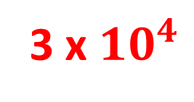
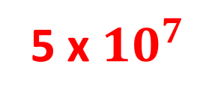
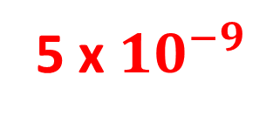
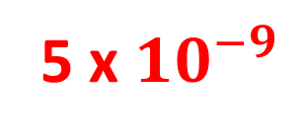
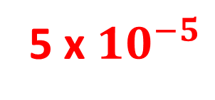
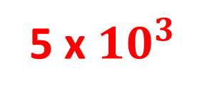
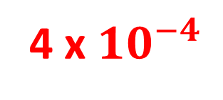
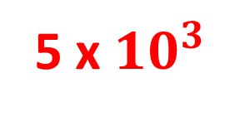
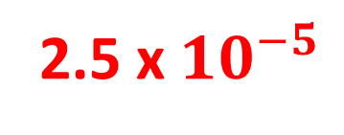

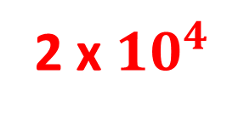
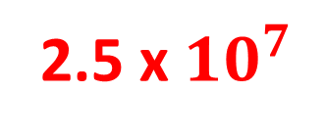
1) (9 x ${10}^{6}$) ÷ (3 x ${10}^{2}$) =
3 x ${10}^{4}$
7) (3 x ${10}^{6}$) ÷ (1.5 x ${10}^{2}$) =
2 x ${10}^{4}$
2) (6 x ${10}^{6}$) ÷ (3 x ${10}^{2}$) =
2 x ${10}^{4}$
8) (1.5 x ${10}^{6}$) ÷ (3 x ${10}^{2}$) =
5 x ${10}^{3}$
3) (3 x ${10}^{6}$) ÷ (6 x ${10}^{2}$) =
5 x ${10}^{3}$
9) (1.5 x ${10}^{−6}$) ÷ (3 x ${10}^{2}$) =
5 x ${10}^{−9}$
4) (3 x ${10}^{2}$) ÷ (6 x ${10}^{6}$) =
5 x ${10}^{−5}$
10) (1.5 x ${10}^{6}$) ÷ (6 x ${10}^{−2}$) =
2.5 x ${10}^{7}$
5) (3 x ${10}^{−2}$) ÷ (6 x ${10}^{6}$) =
5 x ${10}^{−9}$
11) (1.5 x ${10}^{−6}$) ÷ (6 x ${10}^{−2}$) =
2.5 x ${10}^{−5}$
6) (3 x ${10}^{6}$) ÷ (6 x ${10}^{−2}$) =
5 x ${10}^{7}$
12) (6 x ${10}^{−6}$) ÷ (1.5 x ${10}^{−2}$) =
4 x ${10}^{−4}$

